Slide 1
Investment Analysis
Lecture: 9
Course Code: MBF702

Slide 2
Outline
RECAP
  Net Present value – exmaples
  Lease or buy decisions
  Internal Rate of Return
  Risk Analysis in investment analysis

Slide 3
Quick Check ✓
Denny Associates has been offered a four-year contract to supply the computing requirements for a local bank.
The working capital is released at the end of the contract.
Denny Associates requires a 14% return.
Notes:
Assume the information provided for Denny Associates.

Slide 4
Quick Check ✓
What is the net present value of the contract with the local bank?
  a. $150,000
  b. $ 28,230
  c. $ 92,340
  d. $132,916
Notes:
What is the net present value of the contract with the local bank?

Slide 5
Quick Check ✓
What is the net present value of the contract with the local bank?
  a. $150,000
  b. $ 28,230
  c. $ 92,340
  d. $132,916
Notes:
The net present value of the contract is $28,230. Take a minute and review the solution presented.

Slide 6

Least Cost Decisions
In decisions where revenues are not directly involved, managers should choose the alternative that has the least total cost from a present value perspective.
Let’s look at the Home Furniture Company.
Notes:
In decisions where revenues are not directly involved, managers should choose the alternative that has the least total cost from a present value perspective.

Slide 7

Least Cost Decisions
Home Furniture Company is trying to decide whether to overhaul an old delivery truck now or purchase a new one.
The company uses a discount rate of 10%.
Notes:
Assume the following:
Home Furniture Company is trying to decide whether to overhaul an old delivery truck or purchase a new one.
The company uses a discount rate of 10 percent.

Slide 8
Least Cost Decisions
Here is information about the trucks . . .
Notes:
The information pertaining to the old and new trucks is as shown.

Slide 9
Least Cost Decisions
Notes:
The net present value of buying a new truck is negative $32,883. The net present value of overhauling the old truck is negative $42,255.
Notice that both NPV numbers are negative because there is no revenue involved – this is a least cost decision.

Slide 10
Least Cost Decisions
Home Furniture should purchase the new truck.
Notes:
The net present value in favor of purchasing the new truck is $9,372.

Slide 11
Quick Check ✓
Bay Architects is considering a drafting machine that would cost $100,000, last four years, and provide annual cash savings of $10,000 and considerable intangible benefits each year. How large (in cash terms) would the intangible benefits have to be per year to justify investing in the machine if the discount rate is 14%?
  a. $15,000
  b. $90,000
  c. $24,317
  d. $60,000
Notes:
Consider the information provided for Bay Architects. How large (in cash terms) would the intangible benefits have to be to justify investing in the machine if the discount rate is 14 percent?

Slide 12
Quick Check ✓
Bay Architects is considering a drafting machine that would cost $100,000, last four years, and provide annual cash savings of $10,000 and considerable intangible benefits each year. How large (in cash terms) would the intangible benefits have to be per year to justify investing in the machine if the discount rate is 14%?
  a. $15,000
  b. $90,000
  c. $24,317
  d. $60,000
$70,860/2.914 = $24,317
Notes:
The annual intangible benefits would have to be at least $24,317. Take a minute and review the detailed solution provided.

Slide 13
Lease or Buying Decision
1. Financing cash flows: A company faces two types of decisions
-i- Acquisition Decisions –Whether to acquire or not – (discounted using WACC)
-ii- Financing Decisions – Whether to Lease or Buy – (Post Tax Incremental Interest / Borrowing Rate)
While appraising an acquisition decision, the company uses the after tax cost of capital / required return to discount the cash flows. This cost of capital is in fact the IRR of the mode of financing being used. Hence the PV of all the cash flows would be zero & would not be considered in acquisition decisions.

Slide 14
Lease or Buying Decision
However, if cost of capital & IRR of loan are different, than the financing cash flows would need to be considered.
The only cash flows that are considered are those that are effected by the choice of decisions / method of financing.
2. In making lease / borrow decisions (lease’s point of view) the incremental borrowing rate shall be used for calculating the lease based NPV & IRR for lease shall not be used.

Slide 15
Lease or Buying Decision
3. When lease rentals are being paid in advance at start of the year, the than tax impact shall be taken form start of year 2. This is because of the fact that the tax benefit of the first rental paid at Year 0 would be materialized in year 1 & tax benefit shall be taken in year 2, iff tax is paid in arrears.
4. Tax saving on tax depreciation would be allowed in accordance with timing of tax payment. If tax is ignored, than no such tax benefit would be allowed.

Slide 16
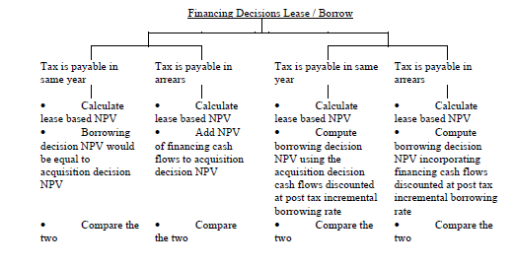
Lease or Buying Decision

Slide 17
Internal Rate of Return (IRR) Method
The IRR Method calculates the discount rate at which the present value of expected cash inflows from a project equals the present value of its expected cash outflows
A project is accepted only if the IRR equals or exceeds the RRR
Allows the risk associated with an investment project to be assessed
The IRR is the rate of interest (or discount rate) that makes the net present value = to zero
  Helps measure the worth of an investment
  Allows the firm to assess whether an investment in the machine, etc. would yield a better return based on internal standards of return
  Allows comparison of projects with different initial outlays
  Set the cash flows to different discount rates
  Software or simple graphing allows the IRR to be found

Slide 18
IRR Method
Analysts use a calculator or computer program to provide the IRR
Trial and Error Approach:
  Use a discount rate and calculate the project’s NPV. Goal: find the discount rate for which NPV = 0
    If the calculated NPV is greater than zero, use a higher discount rate
    If the calculated NPV is less than zero, use a lower discount rate
    Continue until NPV = 0

Slide 19
IRR Method
The IRR for a given stream of conventional cash flows is calculated as
Where;
a: smaller discount rate where NPV is positive
b: larger discount rate where NPV is negative
A: Positive NPV
B: Negative NPV
IRR ≈ 2/3 of ARR

Slide 20
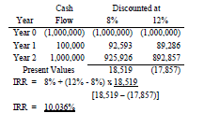
IRR Method
Conventional cash flow are those cash flows in which outflow occurs initially & inflow occurs subsequently throughout the project life
IRR technique assumes that if there is any surplus cash, it will be invested at the Project IRR; unlike NPV which assumes that surplus cash is invested at WACC. Modified IRR is calculated with the assumption that the re - investment of surplus cash would be made at the required rate of return

Slide 21
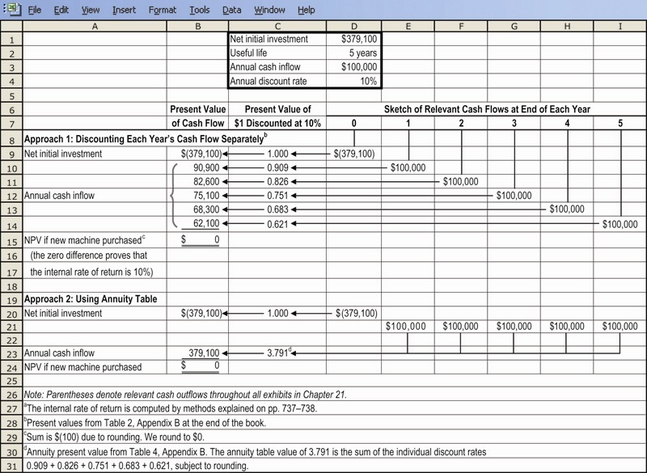
IRR Method Illustrated

Slide 22
Question
The Zero Machine Company is evaluating a capital expenditure proposal that requires an initial investment of $20,960 and has predicted cash inflows of $5,000 per year for 10 years. It will have no salvage value.
Required:
a. Using a required rate of return of 16%, determine the net present value of the investment proposal.
Answer:
 | Predicted Cash Flows | Year(s) | PV Factor | PV of Cash Flows
Initial investment | $(20,960) | 0 | 1.000 | $(20,960)
Annual operations | 5,000 | 10 | 4.833 | 24,165
Net present value |  |  |  | $ 3,205

Slide 23
Question
The Zero Machine Company is evaluating a capital expenditure proposal that requires an initial investment of $20,960 and has predicted cash inflows of $5,000 per year for 10 years. It will have no salvage value.
Required:
b. Determine the proposal's internal rate of return.
Answer: Present value factor of an annuity of $1.00 = $20,960/$5,000 = 4.192.
From the annuity table, the 4.192 factor is closest to the 10-year row at the 20% column. Therefore, the IRR is 20%.

Slide 24
Internal Rate of Return Method
When using the internal rate of return method to rank competing investment projects, the preference rule is:
The higher the internal rate of return, the more desirable the project.
Notes:
When using the internal rate of return method to rank competing investment projects, the preference rule is: the higher the internal rate of return, the more desirable the project.

Slide 25
Internal Rate of Return (IRR) Method
The IRR Method calculates the discount rate at which the present value of expected cash inflows from a project equals the present value of its expected cash outflows
A project is accepted only if the IRR equals or exceeds the RRR

Slide 26
Comparison NPV and IRR Methods
IRR is widely used
NPV can be used with varying RRR
NPV of projects may be combined for evaluation purposes, IRR cannot
Both may be used with sensitivity analysis (“what-if” analysis)

