Slide 1
Investment Analysis
Lecture: 8
Course Code: MBF702

Slide 2
Outline
  -RECAP
  - NPV – Considerations continued
  - IRR
  - Comparison of NPV and IRR
  - Comparing investment appraisals methods

Slide 3
RECAP
  NET PRESENT VALUE – Basic considerations
    Discounted cash flows
    CASH MONEY IN - CASH MONEY OUT
    Incremental cash flows
    Inflation effects
    Tax effect on cash flows
    Opportunity cash flows
    Working capital changes impact
    Inflation
    Entire life of investment
    Tax depreciation shield (tax effect)

Slide 4
Treat inflation consistently
Make sure that inflation is accounted for in a consistent manner. Either:
  State cash flows in terms of actual dollars, at the time the cash flows are received. These are nominal cash flows
Or
  2. State cash flows in terms of dollars, at the time the projections are made. These are real cash flows.
If cash flows are in nominal terms, use nominal discount rates to discount the cash flows.
If cash flows are in real terms use real discount rates to discount the cash flows.

Slide 5
Treat inflation consistently
Example: There is 3% anticipated inflation per year. The real price of Honda Accords is expected to remain constant into the foreseeable future at $20,000. What will the nominal price be after 5 years?
Nominal Price = (Real Price) (1.03)⁵
= $23,185.48

Slide 6
Treat inflation consistently
IN GENERAL TERMS:
CONVERTING NOMINAL CASH FLOWS TO REAL CASH FLOWS, AND NOMINAL INTEREST RATES TO REAL INTEREST RATES.
If Y(t) is the nominal cash flow in period t, in is the annual anticipated inflation rate, then the real cash flow, y(t) is:
y(t) = Y(t) and Y(t) = y(t)(1+in)^{t}
(1+in)^{t}

Slide 7
Treat inflation consistently
( 1 + i ) ( 1 + r ) = (1 + n )
where
i : inflation rate
r : real discount rate
n : nominal discount rate
Don't assume that all cash flows will be affected equally by inflation.
BEWARE OF THE APPROXIMATION:
R = r + in
This works only if r times in is small.

Slide 8
Different discount rates for different periods

Slide 9
Remember taxes
1. Calculate all cash flows after taxes
2. Include non-cash expenses (depreciation) for its effect on taxes, but not as a cash flow itself.
HOW TO HANDLE THE DEPRECIATION TAX SHIELD
We want the project's AFTER TAX CASH FLOW
Equals: Before Tax Cash Flow Less Corporate Taxes
Taxes = tc [Cash revenue - Cash Expenses - Depreciation]
Therefore, for each year:
After Tax Cash Flow =(Cash Revue - Cash Expenses)(1 - tc)+ tc Depr
Where: tc x Depr is the Depreciation Tax Shield)

Slide 10
Remember taxes on Capital Gains
3. Tax on gains/losses from sale of assets is an additional negative/positive cash flow
Tax on
Gains/Losses = tc x (Market Value - Book Value)
On sale
If Market Value > Book Value, then tax on gain is cash outflow.
If Market Value < Book Value, then we have a loss on sale, tax is negative, and there is a cash inflow.

Slide 11
Remember taxes and the effect of selling assets
However, you expect that you can sell the asset for $500,000 at the end of 5 years. Thus there is a taxable capital gain of: (MV-BV) = $200,000.
At a 35% Corporate Capital Gain Tax rate, that means that after tax cash flow from the disposal of P&E is
0.35 * $200,000 = $70,000
Thus the Cash flow from selling the asset is:
$500,000 -70,000 = $430,000
(Remember to add back Book Value)

Slide 12
Tax
Tax payments and tax gain/loss are always nominal cash flows (they have inflation element built in them because they are calculated from profit figure which are nominal) hence they are never inflated to account for the delay in payments. Similar for Tax depreciation. However, if all the figures are real figures & we are provided with the real discount rate, then we must deflate them to arrive at the real cash flows
If tax is payable in the same year than gross taxable cash flows shall be taken. Tax on taxable profits shall be calculated separately & shown in subsequent years. Impact of tax depreciation , tax gain / loss on disposal shall be added or deducted to reach actual cash flows.

Slide 13
Ignore the means of financing both as a direct cash flow and as its effect on taxes.
Interest payment is not a cash flow. Discounting already takes the value of time into account. To deduct interest would be double counting.
Example: Suppose that you borrow $500, and put in $500 of your money into the following project. (Bank charges 8% on loan)
0 1
Cash Flow -1000 1125
Interest -40
Net -1000 1085
To say that we reject the project since NPV (of net cash flow) is negative at 10% (NPV = -13) is double counting. We penalize the project twice, one by deducting interest, second by discounting.
The NPV of this project is:- 1,000 + (1,125) X (0.909) = 23

Slide 14
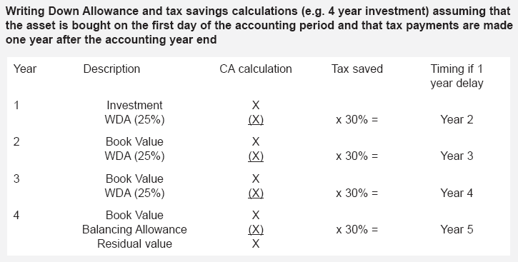
Writing down allowances

Slide 15
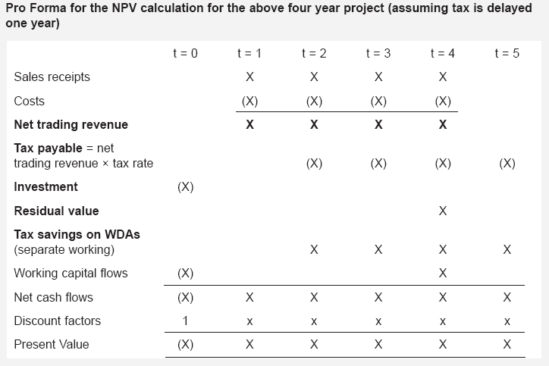
Pro Forma NPV calculation

Slide 16
STEPS IN PROJECT ANALYSIS
1. MAKE INITIAL PROJECTIONS
Made by operations manager
Generally in form of income statement
Clarify assumptions
2. ADJUST FOR INFLATION IF APPROPRIATE
3. REARRANGE IN CASH FLOW FORM
4. PERFORM NET PRESENT VALUE CALCULATIONS
5. PERFORM "WHAT IF" CALCULATIONS

Slide 17

The Net Present Value Method
Let’s look at how we use the net present value method to make business decisions.
Notes:
Let’s look at how we use the net present value method to make business decisions.

Slide 18

NPV Example
White Co. has two alternatives:
  (1) remodel an old car wash or,
  (2) remove it and install a new one.
The company uses a discount rate of 10%.
Notes:
Assume that White Co. has two alternatives – remodel an old car wash or remove the old car wash and replace it with a new one.
The company uses a discount rate of 10 percent.
The net annual cash inflows are Rs60,000 for the new car wash and Rs45,000 for the old car wash.

Slide 19
NPV Example
If White installs a new washer . . .
Let’s look at the net present value of this alternative.
Notes:
In addition, assume that the information, as shown, relates to the installation of a new washer.

Slide 20
NPV Example
If we install the new washer, the investment will yield a positive net present value of $83,202.
Notes:
The net present value of installing a new washer is $83,202.

Slide 21
NPV Example
If White remodels the existing washer . . .
Let’s look at the present value
of this second alternative.
Notes:
If White chooses to remodel the existing washer, the remodeling costs would be $175,000 and the cost to replace the brushes at the end of six years would be $80,000.

Slide 22
NPV Example
If we remodel the existing washer, we will produce a positive net present value of $56,405.
Notes:
The net present value of remodeling the old washer is $56,405.

Slide 23
NPV Example
Both projects yield a positive net present value.
However, investing in the new washer will produce a higher net present value than remodeling the old washer.
Notes:
While both projects yield a positive net present value, the net present value of the new washer alternative is $26,797 higher than the remodeling alternative.

