Slide 1
Investment Analysis
Lecture: 7
Course Code: MBF702

Slide 2
Outline
  RECAP
  NET PRESENT VALUE – Basic considerations
    DISCOUNTED CASH FLOWS
    CASH MONEY IN - CASH MONEY OUT
    INCREMENTAL CASH FLOWS
    INFLATION EFFECTS
    TAX EFFECT ON CASH FLOWS
    OPPORTUNITY CASH FLOWS
    WORKING CAPITAL CHANGES IMPACT
    INFLATION
    ENTIRE LIFE OF INVESTMENT
    TAX DEPRECIATION SHIELD (TAX EFFECT)

Slide 3
RECAP
  INVESTMENT
    Definition
    Capital or revenue
    Investment opportunities
    Evaluation methods of investments
  ACCOUNTING RATE OF RETURN (ROCE, ROI, SRR)
    (Estimated total or average profits/ estimated initial total or average investment) * 100
    Present value factor of rs 1 at i% (pv = 1 / (1+i)^n
  PAYBACK METHOD
  TIME VALUE OF MONEY (FV=PV (1+i)^n and PV = FV ( 1 / (1+i)^n)
  ANNUITY
  NET PRESENT VALUE - Introduction

Slide 4
Three Step NPV Method - RECAP
Draw a sketch of the RELEVANT cash inflows and outflows
2. Convert the inflows and outflows into present value figures using tables or a calculator (using given rate of return)
3. Sum the present value figures to determine the NPV. Positive or zero NPV signals acceptance, negative NPV signals rejection

Slide 5
NPV Method – Basic consideration
1. Net Present Value is the "Discounted value of incremental cash flow”
2. Cash flow is:
CASH MONEY IN - CASH MONEY OUT

Slide 6
NPV Method – Basic consideration
3. Consider only if it is an incremental cash flow, and consider all incremental cash flows:
(a) not historical, or averages;
(b) consider only cash flows that appear as a result of the project
(c) consider the impact of the project on cash flows from other projects
(d) exclude fixed or sunk costs
(e) exclude allocated overhead unless it will change as a result of the project.

Slide 7
NPV Method – Basic consideration
4. Treat inflation consistently:
Discount real cash flow by real discount rates
Discount nominal cash flows by nominal discount rates
Note: Revenues and costs will not necessarily react uniformly to inflation.
5. All Cash Flow should be on an After-Tax basis.
Use actual tax changes when paid!
Don't forget to allow for the tax on capital gains
Use future marginal tax rates applied to future taxable income

Slide 8
NPV Method – Basic consideration
6. Include the opportunity cost of the project, even if there is no explicit cash flow realized
  Account for assets sold and not sold as a result of adoption of a project.
7. Account for changes in working capital and only changes in working capital. Recognize that working capital will in general be re-couped at the end of the project.
8. Ignore financing including the tax shield on interest

Slide 9
NPV Method – Basic consideration
9. Include Asset's Entire Life
10. Include the depreciation tax shield, but not depreciation itself.

Slide 10
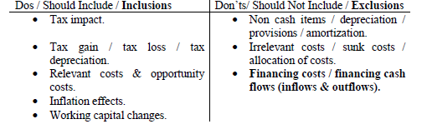
NPV – Basic considerations

Slide 11
NPV – working capital changes
Working capital changes are used to translate the profit figures into cash flows
Working capital is always recovered at the end of the project unless told otherwise

Slide 12
NPV
No matter how complicated the decision: What is important?
MAXIMIZE NPV
PLAN TO TAKE ALL PROJECTS WITH A POSITIVE NET PRESENT VALUE AND REJECT ALL PROJECTS WITH A NEGATIVE NET PRESENT VALUE

Slide 13
Application of the NPV Rule and Capital Budgeting
For now we are going to assume that the appropriate discount rate is known.
The problem we want to tackle is to forecast the relevant cash flows.

Slide 14
Incremental costs
Other Incremental Costs Are
Increases in overhead costs as a result of project.
Increases in working capital as a result of project.
Notice the reduction in working capital would be a cash inflow at that time.
Do not use allocated overhead, or allocated working capital.

Slide 15
Only Cash Flows Affect Wealth.
What is and is not Cash Flow
-Expenses are cash flow regardless of whether the accountant capitalizes and depreciates them or expenses them.
-Capital expenditures are cash outflows regardless of the fact that accountants depreciate them over a period.

Slide 16
Only Incremental cash flows are relevant
Not historical cash flows, not averages, not sunk costs!
Example 1: Consider a firm having made an investment one year in the past. The project required an initial investment of $10,000; with the expectation of $14,000 to be generated within two years. At a discount rate of 10% should the firm have made the investment?

Slide 17
Only Incremental cash flows are relevant
14,000
-1---------------0-----------------1
10,000

Slide 18
Only Incremental cash flows are relevant
14,000
-1---------------0-----------------1
10,000
Of course it should have. The NPV was: NPV = 1,564

Slide 19
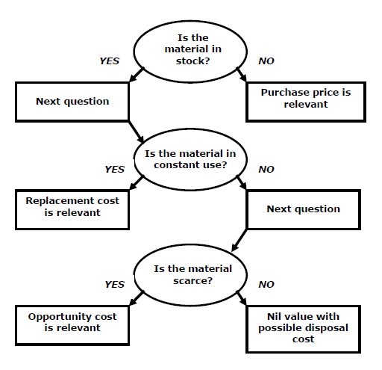
Material Cost decision

Slide 20
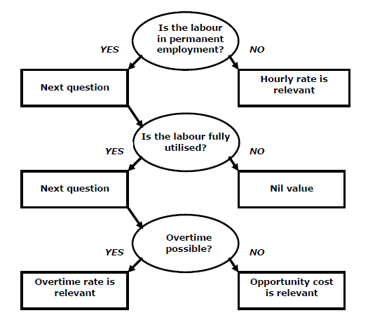
Labor cost decision

Slide 21
Inlfation
Inflation:
(Uninflated cash flows are real cash flows)
(Inflated / money cash flows are nominal cash flows)
Nominal cash flows are discounted at nominal rates and vice versa
If multiple inflation rates for cost components are given than all variables are inflated with the corresponding inflation rates & the general inflation rate is used to calculate the Inflation Adjusted Discount Rate

