Slide 1
Investment Analysis
Lecture: 6
Course Code: MBF702

Slide 2
Outline
Investment analysis - RECAP
Time value of money
Annuity
Cash flows
Net present value

Slide 3
Investment analysis - recap
”Investment analysis is the study of financial securities for the purpose of successful investing.”
This definition contains within it a number of important points.
Firstly, there are the facts about financial securities: how to trade and what assets there are to trade.
Secondly, there are issues involved in studying these securities: the calculation of risks, returns and the relationship between the two.
Then there is the question of what success means for an investor, and the investment strategies which ensure that choices are successful.
Finally, there are the theories that are necessary to try to understand how the markets work and how assets are priced

Slide 4
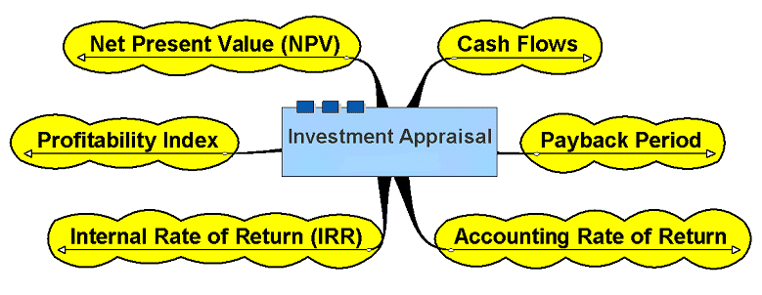
Investment Appraisal

Slide 5
Time Value of Money
A dollar today is worth more than a dollar a year from now. Therefore, investments that promise earlier returns are preferable to those that promise later returns.
The time value of money concept recognizes that a dollar today is worth more than a dollar a year from now. Therefore, projects that promise earlier returns are preferable to those that promise later returns.
Notes:
The time value of money concept recognizes that a dollar today is worth more than a dollar a year from now. Therefore, projects that promise earlier returns are preferable to those that promise later returns.

Slide 6

Time Value of Money
The investment analysis or capital budgeting techniques that best recognize the time value of money are those that involve discounted cash flows.

Slide 7
Time Value of Money
If someone offers you Rs 1,000 today or Rs 1,000 in one year, what would you do?
If someone offers you Rs 980 today or Rs 1,000 in one year, what would you do?
If someone offers you Rs 900 today or Rs 1,000 in one years, what would you do?

Slide 8
Time value of money
Future Value
 | Example | Example | Example
 | 1 | 2 | 3
Present Value | Rs1,000 | Rs1,000 | Rs1,000
Interest Rate | 10% | 10% | 10%
Number of Years | 1 | 2 | 10
Future Value | Rs1,100 | Rs1,210 | Rs2,593.74
Example 1: Invest Rs1,000 at 10% for 1 year, then the Future Value is Rs1,100
  Formula ➔ Rs1,000 * 1.10 = Rs 1,100 (Year 1)
Example 2: Invest Rs1,000 at 10% for 2 years, then the Future Value is Rs1,210
  Formula ➔ Rs1,000 * 1.10 = Rs1,100 (Year 1); Rs1,100 * 1.10 = Rs1,210 (Year 2)
Example 3: Invest Rs1,000 at 10% for 10 years, then the Future Value is Rs2,593.74
  Formula ➔ Rs1,000 * 1.10^10 = Rs2,593.74 (Year 10)

Slide 9
Time value of money
Present Value
 | Example | Example | Example
 | 1 | 2 | 3
Future Value | Rs1,100 | Rs1,210 | Rs2,593.74
Interest Rate | 10% | 10% | 10%
Number of Years | 1 | 2 | 10
Present Value | Rs1,000 | Rs1,000 | Rs1,000
Example 1: Desire Rs1,100 one year from now, then Present Value at 10% is Rs1,000
  Formula ➔ Rs1,100 / 1.10 = Rs1,000 (Year 0)
Example 2: Desire Rs1,210 two years from now, then Present Value at 10% is Rs1,000
  Formula ➔ Rs1,210 / 1.10 = Rs1,100 (Year 1); Rs1,100 / 1.10 = Rs1,000 (Year 0)
Example 3: Desire Rs2,593.74 ten years from now, then Present Value at 10% is Rs1,000
  Formula ➔ Rs2,593.74 / 1.10^10 = Rs1,000 (Year 0)

Slide 10
Time value of money
What is the future value of Rs10,000 (invested today) in 5 years at 10%?
    Answer: Rs10,000 * 1.611 = Rs16,110
What is the future value of Rs8,000 (invested today) in 20 years at 12%?
    Answer: Rs8,000 * 9.646 = Rs77,168
What is the future value of Rs5,000 (invested today) in 11 years at 8%?
    Answer: Rs5,000 * 2.332 = Rs11,660

Slide 11
Annuity
What is an annuity?
Answer: A series (or stream) of Identical Cash Flows
Example: A lotto winner who chooses to receive Rs200,000 a year for 20 years.
Example: A person who chooses to invest Rs1,000 a year for 5 years.

Slide 12
A Series of Cash Flows
Annuity
An investment that involves a series of identical cash flows at the end of each year is called an annuity.
Rs100
Rs100
Rs100
Rs100
Rs100
Rs100
1
2
3
4
5
6
Notes:
Although some investments involve a single sum to be received (or paid) at a single point in the future, other investments involve a series of identical cash flows known as an annuity.

Slide 13
Future Value of an Annuity
Example: What is the Future Value of investing Rs1,000 at the end of each year for the next five years, assuming the investment returns 10% per year?
 | End of Year | End of Year | End of Year | End of Year | End of Year
 | 1 | 2 | 3 | 4 | 5
Invest | Rs1,000 | Rs1,000 | Rs1,000 | Rs1,000 | Rs1,000
10% FV Factor | 1.464 | 1.331 | 1.210 | 1.100 | 1.000
Future Value | Rs1,464 | Rs1,331 | Rs1,210 | Rs1,100 | Rs1,000
 |  |  | Rs6,105

Slide 14
Future Value of an Annuity
Example: What is the Future Value of investing Rs1,000 at the end of each year for the next five years, assuming the investment returns 10% per year?
The below example calculates the future value of EACH payment:
 | End of Year | End of Year | End of Year | End of Year | End of Year |  | 5-Year
 | 1 | 2 | 3 | 4 | 5 |  | Annuity
Invest | Rs1,000 | Rs1,000 | Rs1,000 | Rs1,000 | Rs1,000 |  | Rs1,000
10% FV Factor (page 839) | 1.464 | 1.331 | 1.210 | 1.100 | 1.000 | = | 6.105
Future Value | Rs1,464 | Rs1,331 | Rs1,210 | Rs1,100 | Rs1,000 | = | Rs6,105
 |  |  | Rs6,105

Slide 15
Present Value of an Annuity
Example: What is the Present Value of receiving Rs1,000 at the end of each year for the next five years, assuming a 10% investment return?
The below example calculates the present value of EACH payment:
 | Year | Year | Year | Year | Year
 | 1 | 2 | 3 | 4 | 5
Future Value | Rs1,000 | Rs1,000 | Rs1,000 | Rs1,000 | Rs1,000
PV Factor (from page 840) | 0.909 | 0.826 | 0.751 | 0.683 | 0.621
Present Value | Rs909 | Rs826 | Rs751 | Rs683 | Rs621
 |  |  | Rs3,791

Slide 16
Present Value of an Annuity
Example: What is the Present Value of receiving Rs1,000 at the end of each year for the next five years, assuming a 10% investment return?
 | Year | Year | Year | Year | Year |  | 5-Year
 | 1 | 2 | 3 | 4 | 5 |  | Annuity
Future Value | Rs1,000 | Rs1,000 | Rs1,000 | Rs1,000 | Rs1,000 |  | Rs1,000
PV Factor (from page 840) | 0.909 | 0.826 | 0.751 | 0.683 | 0.621 | = | 3.791
Present Value | Rs909 | Rs826 | Rs751 | Rs683 | Rs621 | = | Rs3,791
 |  |  | Rs3,791

Slide 17
Evaluate the acceptability
of an investment project
using the net present
value method.
Notes:
Learning objective number 1 is to evaluate the acceptability of an investment project using the net present value method.

Slide 18

Choosing a Discount Rate
The cost of capital is the average rate of return the company must pay to its long-term creditors and stockholders for the use of their funds.
The firm’s cost of capital is usually regarded as the minimum required rate of return.
Notes:
A company’s cost of capital, which is defined as the average rate of return a company must pay to its long-term creditors and shareholders for the use of their funds, is usually regarded as the minimum required rate of return. When the cost of capital is used as the discount rate, it serves as a screening device in net present value analysis.

Slide 19
Discounted Cash Flows
DCF methods use the Required Rate of Return (RRR), which is the minimum acceptable annual rate of return on an investment.
RRR is the return that an organization could expect to receive elsewhere for an investment of comparable risk.
RRR is also called the “Discount Rate”, “Hurdle Rate”, “Cost of Capital” or “Opportunity Cost of Capital”.

Slide 20

Two Simplifying Assumptions
Two simplifying assumptions are usually made in net present value analysis:
All cash flows other than the initial investment occur at the end of periods.
All cash flows generated by an investment project are immediately reinvested at a rate of return equal to the discount rate.
Notes:
Two simplifying assumptions are usually made in net present value analysis:
The first assumption is that all cash flows other than the initial
investment occur at the end of periods.
The second assumption is that all cash flows generated by an
investment project are immediately reinvested at a rate of return
equal to the discount rate.

Slide 21

Typical Cash Outflows
Repairs and
maintenance
Working
capital
Initial
investment
Incremental
operating
costs
Notes:
Examples of typical cash outflows that are included in net present value calculations are as shown. Notice the term working capital, which is defined as current assets less current liabilities.
The initial investment in working capital is a cash outflow at the beginning of the project for items such as inventories. It is recaptured at the end of the project when working capital is no longer required. Thus, working capital is recognized as a cash outflow at the beginning of the project and a cash inflow at the end of the project.

Slide 22

Typical Cash Inflows
Salvage
value
Release of
working
capital
Reduction
of costs
Incremental
revenues
Notes:
Examples of typical cash inflows that are included in net present value calculations are as shown.

Slide 23
Cash Flows from Net Initial Investment
Three Components:
Initial Machine Investment
Initial Working Capital Investment
After-tax Cash Flow from Current Disposal of Old Machine

Slide 24
Cash Flows from Operations
Two Components:
Inflows (after-tax) from producing and selling additional goods or services, or from savings in operating costs. Excludes depreciation, handled below:
Income tax cash savings from annual depreciation deductions

Slide 25
Cash Flows from Terminal Disposal of Investment
Two Components:
After-tax cash flow from terminal disposal of asset (investment)
After-tax cash flow from recovery of working capital (liquidating receivables and inventory once needed to support the project)

Slide 26
The Net Present Value Method
To determine net present value we . . .
  Calculate the present value of cash inflows,
  Calculate the present value of cash outflows,
  Subtract the present value of the outflows from the present value of the inflows.
The net present value method compares the present value of a project’s cash inflows with the present value of its cash outflows. The difference between these two streams of cash flows is called the net present value.
Notes:
The net present value method compares the present value of a project’s cash inflows with the present value of its cash outflows. The difference between these two streams of cash flows is called the net present value.

Slide 27
The Net Present Value Method
General decision rule . . .
Notes:
The net present value is interpreted as follows:
If the net present value is positive, then the project is acceptable.
If the net present value is zero, then the project is acceptable.
If the net present value is negative, then the project is not acceptable.

Slide 28
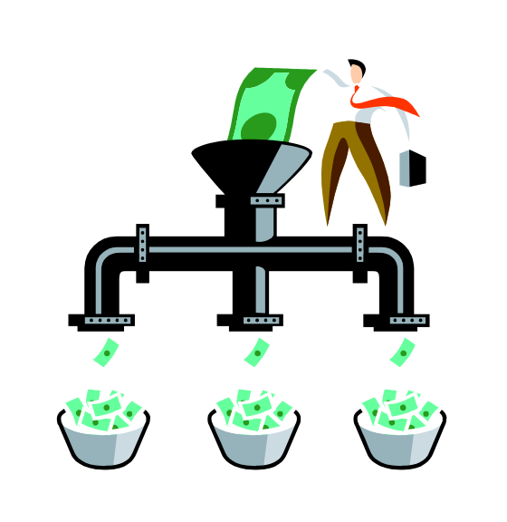
The Net Present Value Method
Net present value analysis emphasizes cash flows and not accounting net income.
The reason is that accounting net income is based on accruals that ignore the timing of cash flows into and out of an organization.
Notes:
Net present value analysis emphasizes cash flows and not accounting net income. The reason is that accounting net income is based on accruals that ignore the timing of cash flows into and out of an organization.

Slide 29
Net Present Value (NPV) Method
NPV method calculates the expected monetary gain or loss from a project by discounting all expected future cash inflows and outflows to the present, using the Required Rate of Return
Based on financial factors alone, only projects with a zero or positive NPV are acceptable

Slide 30
Three-Step NPV Method
Draw a sketch of the relevant cash inflows and outflows
Convert the inflows and outflows into present value figures using tables or a calculator
Sum the present value figures to determine the NPV. Positive or zero NPV signals acceptance, negative NPV signals rejection

Slide 31
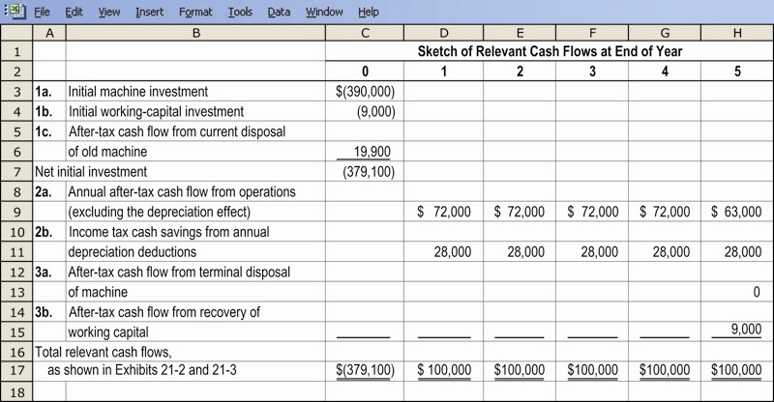
Cash Flow Effects From Investment Decisions, Illustrated

Slide 32
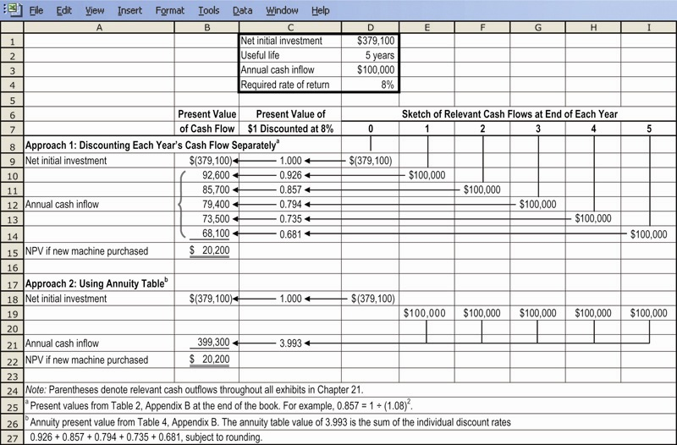
NPV Method Illustrated

