Slide 1
Investment Analysis
Lecture: 5
Course Code: MBF702

Slide 2
Recap
Our earlier lectures have introduced us about investment reasons for investments, investment objectives, real investment and financial investment, investment analysis, characteristics of investment, risk factors, securities, forms of securities, investment process and markets.

Slide 3
Outline
Investment analysis – recap
Investment analysis - methods
Accounting rate of return
Pay back period
Example

Slide 4
Investment analysis - recap
”Investment analysis is the study of financial securities for the purpose of successful investing.”
This definition contains within it a number of important points.
Firstly, there are the facts about financial securities: how to trade and what assets there are to trade.
Secondly, there are issues involved in studying these securities: the calculation of risks, returns and the relationship between the two.
Then there is the question of what success means for an investor, and the investment strategies which ensure that choices are successful.
Finally, there are the theories that are necessary to try to understand how the markets work and how assets are priced

Slide 5
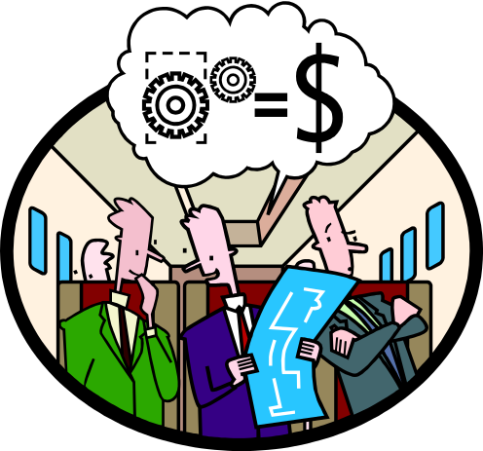
Typical Investment Analysis
Investment analysis can be used for any decision that involves an outlay now in order to obtain some future return (or cost savings). Typical decisions include:
Plant expansion
Equipment selection
Equipment replacement
Lease or buy
Cost reduction
Notes:
Capital budgeting analysis can be used for any decision that involves an outlay now in order to obtain some future return. Typical capital budgeting decisions include:
Cost reduction decisions. Should new equipment be purchased to reduce costs?
Expansion decisions. Should a new plant or warehouse be purchased to increase capacity and sales?
Equipment selection decisions. Which of several available machines should be purchased?
Lease or buy decisions. Should new equipment be leased or purchased?
Equipment replacement decisions. Should old equipment be replaced now or later?

Slide 6
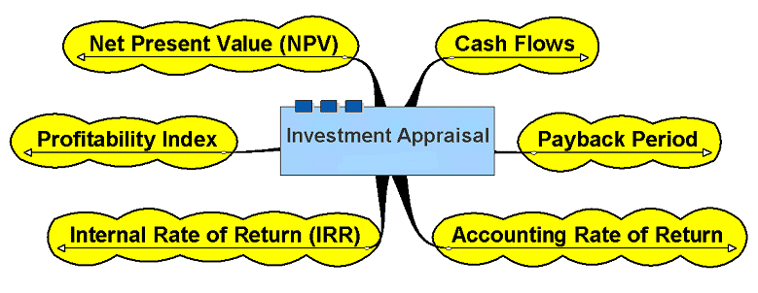
Investment Appraisal

Slide 7
Investment Analysis - Methods
  ACCOUNTING RATE OF RETURN
  PAYBACK METHOD
  Discounted cash flow methods:
  NET PRESENT VALUE
  INTERNAL RATE OF RETURN
  Profitability index

Slide 8
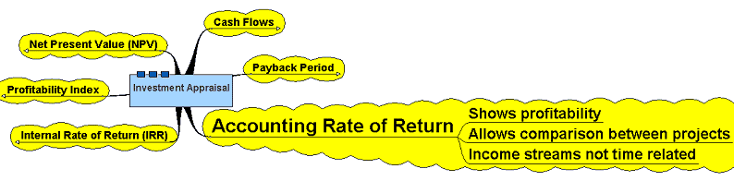
Accounting Rate of Return

Slide 9
ACCOUNTING RATE OF RETURN
Expresses the average annual net income as a percentage of the amount invested.
This may be in terms of the initial capital outlay or the average amount invested over the useful life of the investment.
Firms vary in how they calculate AARR
Easy to understand, and use numbers reported in financial statements
Does not track cash flows\
Ignores time value of money

Slide 10
Accounting Rate of Return Method
Does not focus on cash flows -- rather it focuses on accounting net operating income.
The following formula is used to calculate the simple rate of return:
Annual Incremental
Net Operating Income
ARR
=
Initial investment*
*Should be reduced by any salvage from the sale of the old equipment
Notes:
The simple rate of return method (also known as the accounting rate of return or the unadjusted rate of return) does not focus on cash flows, rather it focuses on accounting net operating income.
The equation for computing the simple rate of return is as shown.

Slide 11

Accounting Rate of Return Method
The Management of a company wants to install an espresso coffee machine in its restaurant.
The espresso espresso coffee machine :
  Cost Rs140,000 and has a 10-year life.
  Will generate incremental revenues of Rs100,000 and incremental expenses of Rs65,000, including depreciation.
What is the simple rate of return on the investment project?
Notes:
Assume the management of the Daily Grind wants to install an espresso bar in its restaurant.
The cost of the espresso bar is $140,000 and it has a ten-year life.
The espresso bar will generate incremental revenues of $100,000 and incremental expenses of $65,000, including depreciation.
What is the simple rate of return on this project?

Slide 12

Accounting Rate of Return Method
ARR
Rs100,000 - Rs65,000
Rs140,000
=
= 25%
Criticisms of the simple rate of return include that this method ignores the time value of money and it can fluctuate from year to year.
Notes:
The simple rate of return is 25 percent.
Criticisms of the simple rate of return include the following.
It does not consider the time value of money.
The simple rate of return fluctuates from year to year when used to evaluate projects that do not have constant annual incremental revenues and expenses. The same project may appear desirable in some years and undesirable in others.

Slide 13
Accounting Rate of Return - Example
An investment is expected to yield cash flows of Rs10,000 annually for the next 5 years
The initial cost of the investment is Rs 20,000
Total profit therefore is: Rs 30,000
Annual profit = Rs 30,000 / 5
= Rs 6,000
ARR = 6,000/20,000 x 100
= 30%
A worthwhile return?

Slide 14
ACCOUNTING RATE OF RETURN - Recap
Return as a percent of initial capital outlay
ARR = Y/I
WHERE:
ARR = ACCOUNTING RATE OF RETURN
Y = AVERAGE ANNUAL NET INCOME
(DEPRECIATION TAKEN INTO ACCOUNT)
I = INITIAL INVESTMENT OUTLAY

Slide 15
ACCOUNTING RATE OF RETURN - Recap
Y =(E – D)
WHERE:
Y = AVERAGE ANNUAL NET INCOME
E = TOTAL EXPECTED ANNUAL NET CASH RECEIPTS
D = TOTAL ANNUAL DEPRECIATION

Slide 16
Determine the
payback period
for an investment.
Notes:
Learning objective number 3 is to determine the payback period for an investment.

Slide 17
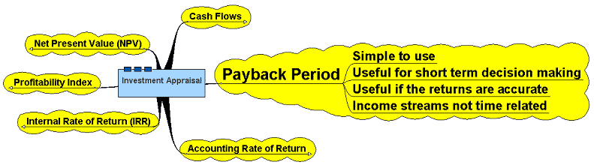
Payback Period

Slide 18
The Payback Method
The payback period is the length of time that it takes for a project to recover its initial cost out of the cash receipts that it generates.
When the net annual cash inflow is the same each year, this formula can be used to compute the payback period:
Investment required
Net annual cash inflow
Payback period =
Notes:
The payback method focuses on the payback period, which is the length of time that it takes for a project to recoup its initial cost out of the cash receipts that it generates.
When the net annual cash inflow is the same every year, the formula for computing the payback period is the investment required divided by the net annual cash inflow.

Slide 19

The Payback Method
The management of a company wants to install an espresso coffee machine in its restaurant.
The espresso coffee machine :
  Costs Rs140,000 and has a 10-year life.
  Will generate net annual cash inflows of Rs 35,000.
Management requires a payback period of 5 years or less on all investments.
What is the payback period for the espresso bar?

Slide 20
The Payback Method
Investment required
Net annual cash inflow
Payback period =
Rs140,000
Rs35,000
Payback period =
Payback period =
4.0 years
According to the company’s criterion, management would invest in the espresso bar because its payback period is less than 5 years.
Notes:
The payback period is 4.0 years. Therefore, management would choose to invest in the bar.

Slide 21
Quick Check ✓
Consider the following two investments:
Project X Project Y
Initial investment Rs100,000 Rs100,000
Year 1 cash inflow Rs60,000 Rs60,000
Year 2 cash inflow Rs40,000 Rs35,000
Year 3-10 cash inflows Rs0 Rs25,000
Which project has the shortest payback period?
  a. Project X
  b. Project Y
  c. Cannot be determined
Notes:
Consider the information provided for two investments. Which project has the shortest payback period?

Slide 22
Quick Check ✓
Consider the following two investments:
Project X Project Y
Initial investment Rs100,000 Rs100,000
Year 1 cash inflow Rs60,000 Rs60,000
Year 2 cash inflow Rs40,000 Rs35,000
Year 3-10 cash inflows Rs0 Rs25,000
Which project has the shortest payback period?
  a. Project X
  b. Project Y
  c. Cannot be determined
Project X has a payback period of 2 years.
Project Y has a payback period of slightly more than 2 years.
Which project do you think is better?
Notes:
Project X has the shortest payback period of two years. But, the real question is which project do you think is better? It looks like Project Y may be the better of the two investments because it has a much higher cash inflow over the ten-year period.

Slide 23
Evaluation of the Payback Method
Ignores the
time value
of money.
Criticisms
of the payback
period.
Ignores cash
flows after
the payback
period.
Notes:
Criticisms of the payback method include the following.
The payback method does not consider the time value of money.
A shorter payback period does not always mean that one investment is more desirable than another. This is because the payback method ignores cash flows after the payback period, thus, it has no inherent mechanism for highlighting differences in useful life between investments.

Slide 24
Evaluation of the Payback Method
Serves as screening tool.
Identifies investments that recoup cash investments quickly.
Strengths
of the payback
period.
Identifies products that recoup initial investment quickly.
Notes:
Strengths of the payback method include the following.
It can serve as a screening tool to help identify which investment proposals are in the “ballpark.”
It can aid companies that are “cash poor” in identifying investments that will recoup cash investments quickly.
It can help companies that compete in industries where products become obsolete rapidly to identify products that will recoup their initial investment quickly.

Slide 25
Payback and Uneven Cash Flows
When the cash flows associated with an investment project change from year to year, the payback formula introduced earlier cannot be used.
Instead, the un-recovered investment must be tracked year by year.
Rs1,000
Rs0
Rs2,000
Rs1,000
Rs500
1
2
3
4
5
Notes:
When the cash flows associated with an investment project change from year to year, the payback formula introduced earlier cannot be used. Instead, the un-recovered investment must be tracked year by year.

Slide 26
Payback and Uneven Cash Flows
For example, if a project requires an initial investment of Rs4,000 and provides uneven net cash inflows in years 1-5, as shown, the investment would be fully recovered in year 4.
Rs1,000
Rs0
Rs2,000
Rs1,000
Rs500
1
2
3
4
5
Notes:
For example, if a project requires an initial investment of $4,000 and provides uneven net cash inflows in years 1 to 5 as shown. The investment would be fully recovered in year 4.

Slide 27
Payback Method
Payback measures the time it will take to recoup, in the form of expected future cash flows, the net initial investment in a project
Shorter payback period are preferable
Organizations choose a project payback period. The greater the risk, the shorter the payback period
Easy to understand

Slide 28
Payback Method
With uniform cash flows:
With non-uniform cash flows: add cash flows period-by-period until the initial investment is recovered; count the number of periods included for payback period

Slide 29
PAYBACK METHOD
The payback method gives the number of years necessary to recover the initial investment.
Does not account for the timing of cash flows.

Slide 30
Payback Method
The length of time taken to repay the initial capital cost
Requires information on the returns the investment generates
e.g. A machine costs Rs 600,000
It produces items that generate a profit of Rs 5 each on a production run of 60,000 units per year
Payback period will be 2 years

Slide 31
Payback method
Payback could occur during a year
Can take account of this by reducing the cash inflows from the investment to days, weeks or years
Days/Weeks/Months x Initial Investment
Payback = ------------------------------------------
Total Cash Received

Slide 32
Payback Method
e.g.
  Cost of machine = Rs 600,000
  Annual income streams from investment = Rs 255,000 per year
Payback = 36 x 600,000/765,000
  = 28.23 months
  (2 yrs, 6¾ months)
 | Income
Year 1 | 255,000
Year 2 | 255,000
Year 3 | 255,000

Slide 33
PAYBACK METHOD
P = I / E
Where:
P = payback period in years
I = initial investment outlay
E = annual net cash flows
(cash receipts less cash expenses)

Slide 34
CASH FLOWS FOR THREE INVESTMENTS
YEAR | INV A | INV B | INV C
0 | -20,000 | - 20,000 | - 20,000
1 | 2,000 | 5,800 | 10,000
2 | 4,000 | 5,800 | 8,000
3 | 6,000 | 5,800 | 6,000
4 | 8,000 | 5,800 | 3,000
5 | 10,000 | 5,800 | 1,000
AVG | 6,000 | 5,800 | 5,600

Slide 35
PAYBACK PERIOD
A 20000/6000 = 3.33 YEARS
B 20000/5800 = 3.45 YEARS
C 20000/5600 = 3.57 YEARS

Slide 36
ACCOUNTING RATE OF RETURN
A (30000-20000)/5 = 2000
    2000/20000 = 0.10 10%
B (29000-20000)/5 = 1800
    1800/20000 = 0.09 9%
C (28000-20000)/5 = 1600
    1600/20000 = 0.08 8%
* Assume that the investment is fully depreciated in 5 years

