Slide 1
Investment Analysis and
Portfolio management
Lecture: 32
Course Code: MBF702

Slide 2
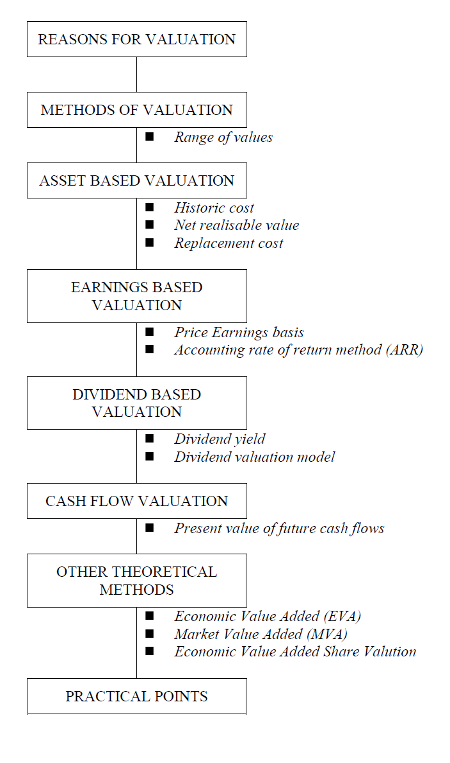
BUSINESS VALUATION
To estimate the potential value of another company.

Slide 3
REASONS FOR VALUATION OF A BUSINESS
To determine the price to be offered in a merger/takeover of a private company;
To aid in decisions regarding buying or selling shares of a private company;
To place a value on companies entering the stock market;
To value shares in a private company for tax/legal purposes;
To value subsidiaries/divisions for disposal, MBOs etc.

Slide 4
METHODS OF BUSINESS VALUATION
Range of values
When a business/company/division is valued it is not a precise exercise and there is no right answer to the question of what it is worth.
There are a variety of different methods of valuing businesses which will all produce different overall values. In any examination question it is likely that students would be expected to use a number of different valuation methods in order to determine a range of prices that could then be used in negotiations.
In the following paragraphs these methods of valuation will be considered:
􀂉 assets based valuation
􀂉 earnings based valuation
􀂉 dividend based valuation
􀂉 cash flow based valuation.

Slide 5


ASSET BASED VALUATION METHODS
Net assets = Assets – Liabilities.
Option 1 – Net assets based on book values
This option is not a very suitable basis since, it accounts for the historical cost of the assets and liabilities which are not relevant.
The value obtained is also called the Breakup Value of the company.
Option 2 – Net assets based on market values
A more preferred method since gives almost the fair value of the share.
This method is preferred when substantial acquisition is to be done. Moreover, it provides the Floor Value of the Business

Slide 6
ASSET BASED VALUATION METHODS
Historic cost
= balance sheet value (book value) of the net assets
Problems:
- meaningless total as the balance sheet does not attempt to give any indication of value;
- ignores unrecorded assets such as goodwill.
Net realisable value
= determine net realisable value of the net assets
- This can also be considered as effectively a scrap value of the business and therefore the minimum price that might be acceptable to owner of the business.

Slide 7
Problems:
- estimating the NRV of assets particularly specialised assets with no general market;
- ignores unrecorded assets such as goodwill;
only useful if a controlling interest is being purchased rather than a smaller interest.
Replacement cost = determine depreciated replacement cost of net assets
This can be viewed as the cost of setting up a similar business from scratch and therefore might be the maximum price a buyer might be prepared to pay.
Problems:
estimating depreciated replacement cost of assets particularly in the light of technological changes often difficult to find similar new asset;
ignores unrecorded assets such as goodwill;
- only useful if a controlling interest is being purchased.

Slide 8
EARNINGS BASED METHODS OF VALUATION
Price Earnings basis
P/E ratio = Share price / EPS
Therefore Share price/value = P/E ratio × EPS
This can be used for valuing the shares in an unquoted company.
Step 1 Select the P/E ratio of a similar quoted company.
Step 2 Adjust downwards to reflect the additional risk of an unquoted company and the non-marketability of unquoted shares. 2/3rds of Comparable P/E ratio of similar quoted company x EPS of the target company
Step 3 Determine the maintainable earnings to use for EPS.
The published P/E ratio of quoted companies takes account of expected growth rates of that company, it reflects the market’s expectations for the company. Therefore using a P/E ratio gives a type of market price for an unquoted company which might be an acceptable price to the seller of the shares.

Slide 9
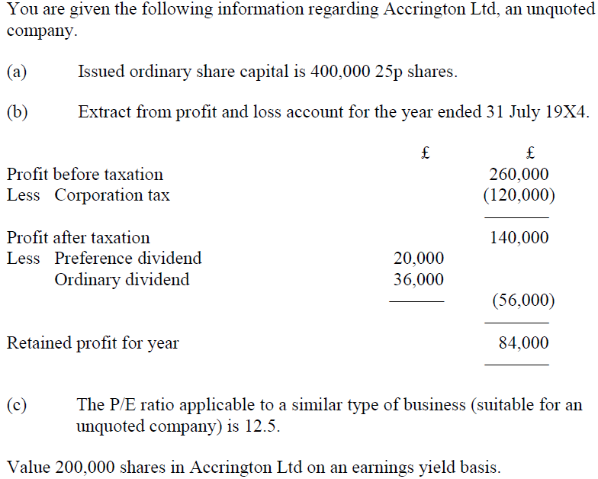
Example

Slide 10
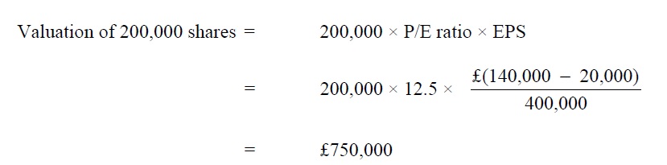
Solution

Slide 11

Accounting rate of return method (ARR)
Problems:
determining maintainable future earnings from target company;
estimating appropriate ROCE for performance of target company;
accounting policies can affect valuation.
This method gives an indication of what the target company might be worth to the buyer but it takes no account of growth prospects.

Slide 12
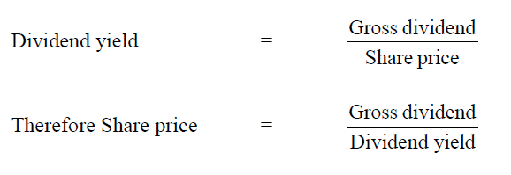
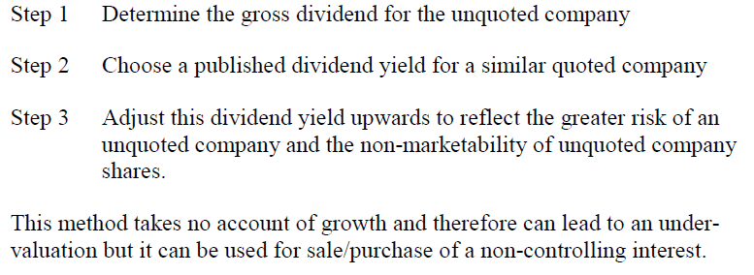
DIVIDEND BASED METHODS OF VALUATION
Dividend yield

Slide 13
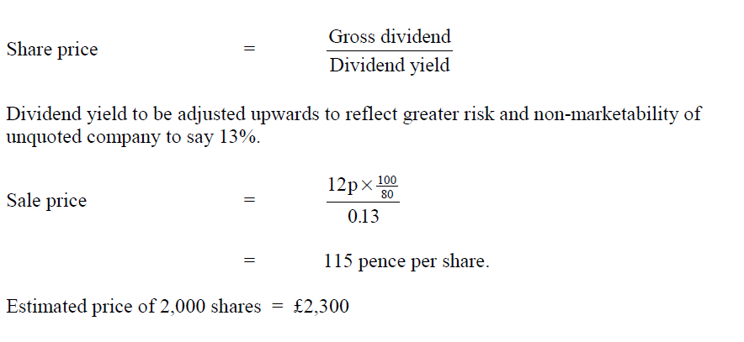
Example
An individual is considering the purchase of 2,000 shares in G Ltd.
G Ltd has 50,000 shares in issue and the latest dividend payments was 12 pence per share.
G Ltd is similar in type of business, size and gearing to H plc. H plc has a published dividend yield of 10%.
The BRIT rate is 20%.
Estimate a price that the individual might pay for the 2,000 shares in G Ltd.

Slide 14
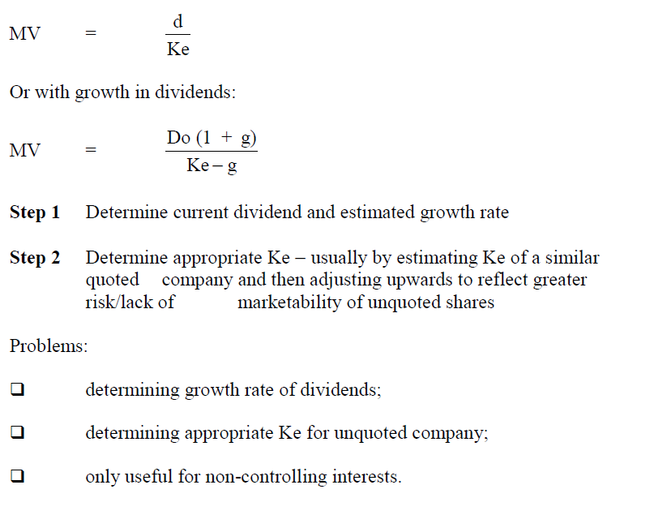
Dividend valuation model

Slide 15
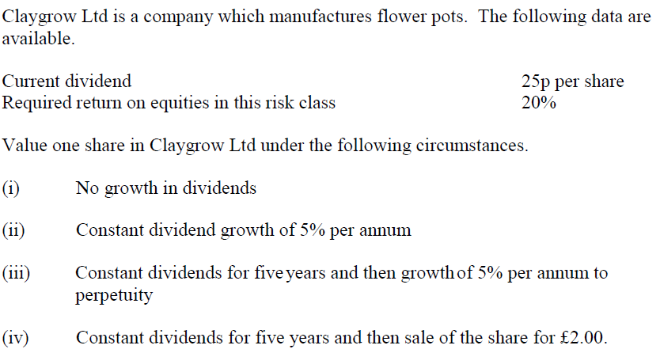
Example

Slide 16
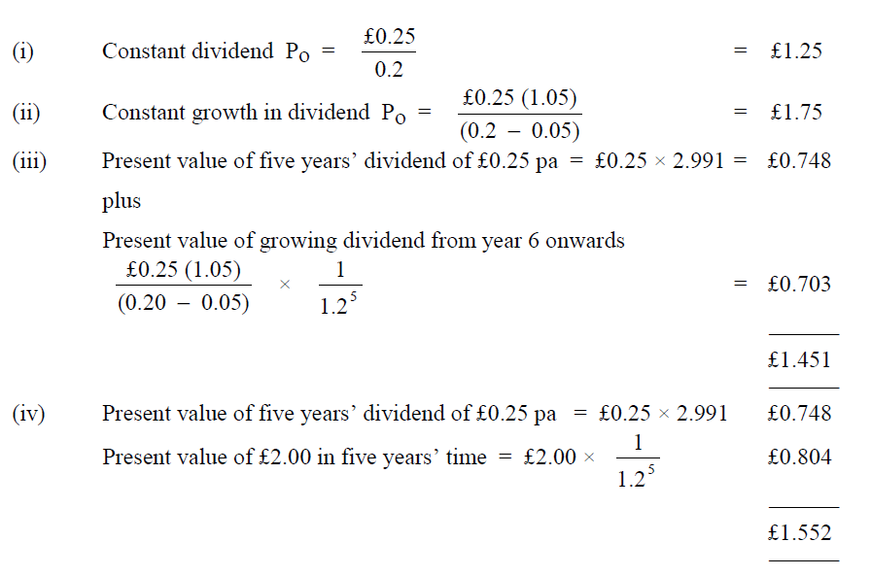
Solution

Slide 17
CASH FLOW BASED METHOD
Present value of future cash flows
Value of company to be acquired is the present value of the estimated future cash flows for that company − in theory the best method of valuation.
Problems:
estimating future cash flows (take account of synergy);
determining appropriate discount rate taking into account type of business and risk;
determining an appropriate time horizon for cash flows;
only useful for controlling interests.

Slide 18
DCF can be used to estimate a present value of the future profitability of a company. Management might want to know the present value of expected profits of a business in future years. One reason for wanting this information is to enable management to put a current value on the business, possibly in order to:
􀂄 decide how much to offer for a target company in a takeover bid, or
􀂄 decide whether to accept or reject a takeover offer from another company.
The value of a business can be estimated by discounting expected future cash flows from the business over a number of years into the future.
However, the cash flows that should be used for discounting are the expected free cash flows of the business.

Slide 19
Definition of free cash flow
Free cash flow is the amount of cash generated by a company or business during a specified period of time (say one year) minus the cash payments that the company or business is obliged to make. Essential payments include taxation payments and capital expenditure to replace ageing non-current assets (‘replacement’ capital expenditure). Free cash flow is therefore the amount of cash generated by the company that management are able to decide how to use.
However, there are differing specific definitions of free cash flow. The most appropriate definition to use might differ according to purpose.

Slide 20
Free cash flow for the firm
Free cash flow for the firm is the amount of free cash flow generated by the business as a whole, regardless of the source of finance. It is therefore calculated without deducting interest payments as an essential cash payment.
There are differing views about whether capital expenditure for expanding the business is an essential cash payment.
􀂄 One view is that only replacement capital expenditure should be deducted as essential cash payments.
􀂄 A different view is that replacement capital expenditure and capital expenditure to grow the business internally (organically) should both be deducted in calculating free cash flows, but that capital spending on acquisitions and cash received from business disposals should be excluded.
􀂄 A third view is that all capital expenditure (net of proceeds from disposals) should be included in the calculation of free cash flow.

Slide 21
There is no ‘correct’ answer. However, free cash flow is the amount of cash that management can decide how to use.
􀂄 If it is assumed that expanding the business is a free decision by management, only replacement capital expenditure should be deducted in calculating free cash flow.
􀂄 On the other hand, if it is assumed that capital expenditure to pay for expansion of the business is necessary to grow operating cash flows in future years, a better definition of free cash flow would be one where both replacement capital expenditure and capital expenditure to pay for growth and expansion are deducted.

Slide 22
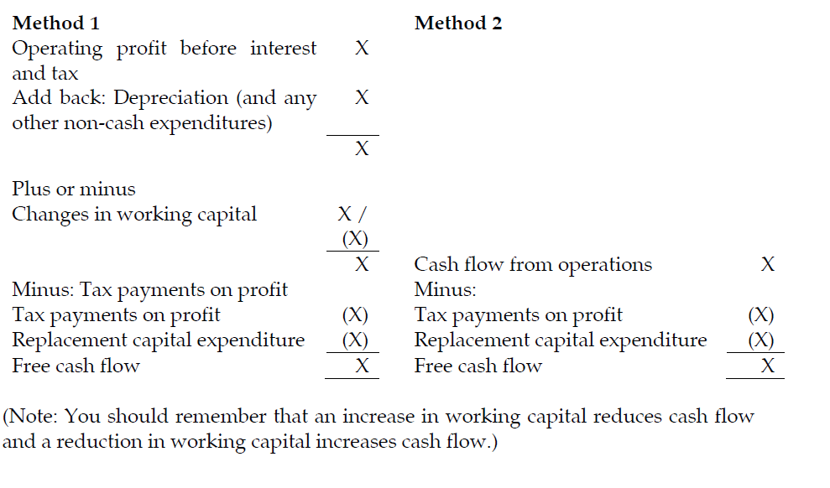
Calculating free cash flow for the firm
There are two methods of calculating free cash flow for the firm, although they are closely connected. One method starts with operating profit and the other starts with cash flow from operations (as given in the cash flow statement)

Slide 23
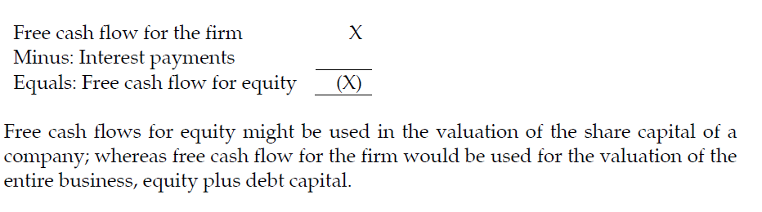
Free cash flow for equity is the amount of free cash flow after deduction of interest payments.

Slide 24
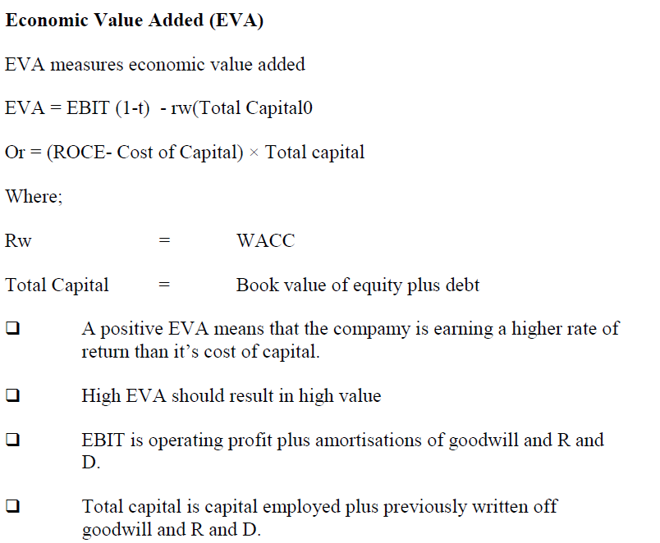
OTHER THEORETICAL METHODS

Slide 25
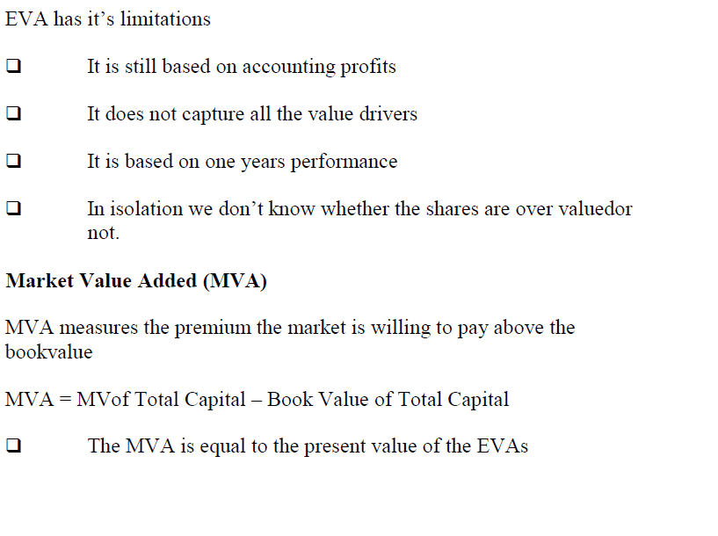

Slide 26
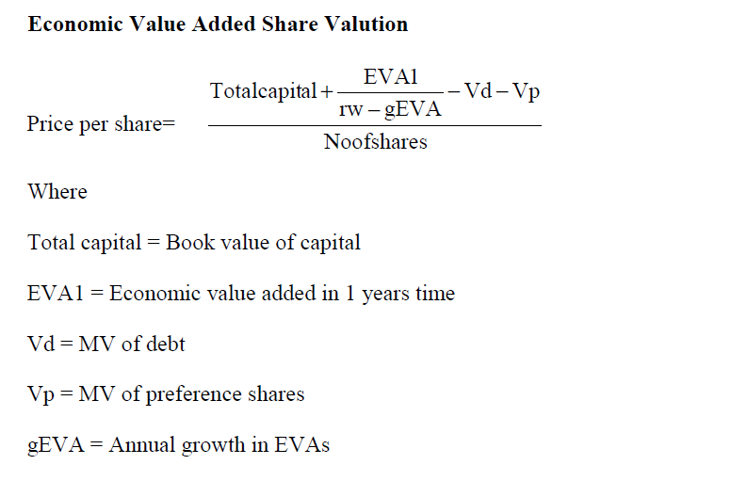

Slide 27
PRACTICAL POINTS
When valuing any business it is important not only to provide a range of theoretical values using any of the methods discussed above but also to take into account any other practical information in the question.
Points worth considering:
are all of the assets of the business recorded? − particularly in service industries where there are likely to be many human resource assets;
will key employees leave after the acquisition and what effect would this have on the value?
do key staff have long service contracts?
do surplus staff have long service contracts and termination penalties?
when forecasting future figures can these be based upon past figures or does the acquirer intend changes?
who is the value being estimated for? − the buyer, the seller or both;
are there any restrictive covenants in the target company’s debt agreements regarding takeovers?
are there other bidders who are likely to push up the price?

Slide 28
Focus
You should now be able to prepare and justify a range of prices for valuing a business in a variety of different circumstances.

Slide 29
Thank you

