Slide 1
Investment Analysis and
Portfolio management
Lecture: 31
Course Code: MBF702

Slide 2
Outline
RECAP
CHOSSING A DISCOUNT RATE
MERGERS AND ACQUISIITIONS
VENTURE CAPITAL

Slide 3
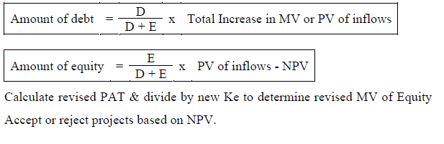
Discount Rate for Project Appraisal
No Changes in Financial or Business Risk.
Current WACC may be used as discount rate.
Questions are likely to be focused on how the project is to be financed to keep the WACC constant. Cost of project & increase in earning (equity) will be given. Calculate revised MV by dividing increased earning with WACC & compare with old MV to calculate NPV.

Slide 4
Business Risk changes / Financial Risk may or may not change
Adjusted Present Value (APV)
Risk adjusted WACC (WACC)
Financial Risk Changes & Business risk remains the same
Traditional Theory
Since traditional theory is not based on any formulae increase / decrease in Ke & Kd will be provided (due to gearing changes)

Slide 6
Objectives
MERGERS AND ACQUISITIONS
To appreciate alternative strategies for long-term growth;
To understand the arguments for and against mergers and acquisitions;
To describe alternative strategies and tactics of mergers and acquisitions;
To discuss the variety of methods of financing mergers and acquisitions;
To discuss various defences against takeovers;
To discuss other methods of financial restructuring.

Slide 7
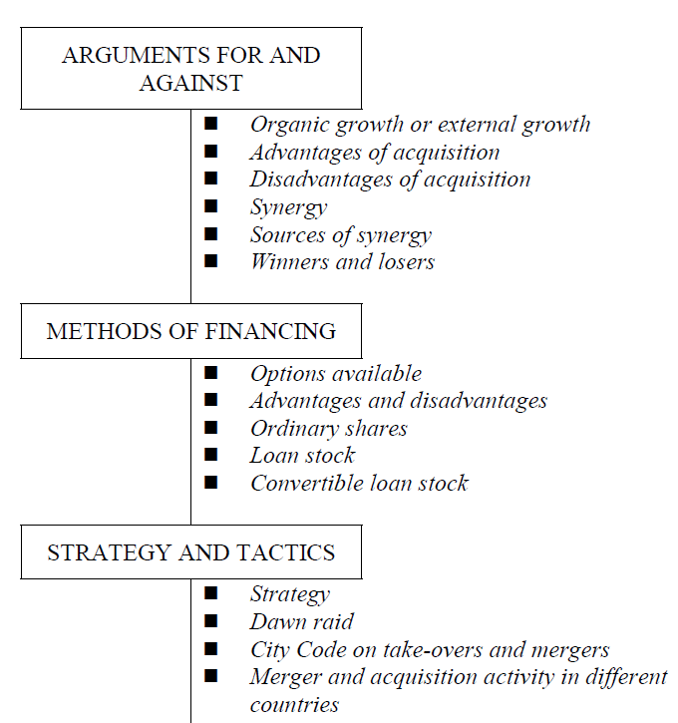

Slide 8
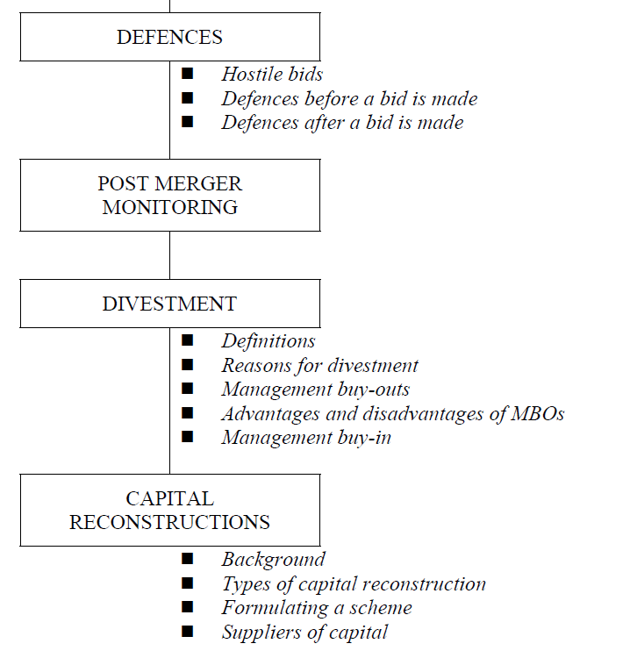

Slide 9
ARGUMENTS FOR AND AGAINST MERGERS AND
ACQUISITIONS
Organic growth or external growth
If the strategy of a company is for long-term growth then this can come from:
organic growth − development of new projects by the firm financed by retentions or new debt/equity; or
external growth − buying existing projects by acquiring another business.
Advantages of acquisition
Speed – often quicker/more immediate than organic growth;
Entry costs – if the cost of entering a new business is high it might be better to acquire such a business as a going concern;
Barriers to entry – this may mean that acquisition is the only method of entry to a new area of business;

Slide 10
Risk – organic growth may be riskier than acquiring an existing business;
Undervaluation – asset stripping is possible in an acquisition;
Synergy – see below.
Disadvantages of acquisition
Entry cost – frequently premiums paid over the existing market price are considerable;
Shareholder wealth – if the bidder pays too high a price for the victim this will reduce the bidding company's shareholders wealth.
Synergy
The most compelling argument for a merger or acquisition is normally the creation of synergy. The value of the two entities combined is greater than the value of the two entities separately.
Synergy: 2 + 2 = 5

Slide 11
Operating Synergy arises from
Improved productivity / cost cutting as a result of merger.
Increased market share.
Increased efficient use of resources / cash rich companies.
Financial Synergy arises from
Diversification reduces the risk of the company’s cash flows hence effecting the WACC of the company.
Reduced viability & return might improve the company’s credit rating increasing the debt capacity.
Uses of tax shields / losses previously unutilized.
Horizontal Merger→ Purchase of competitors
Vertical Merger→ Purchase of suppliers / customers
Note: Mergers are within the same industry, diversification is used to diversify outside the industry or to acquire a competitor

Slide 12
Sources of synergy
Economies of scale – bulk buying discount;
Economies of vertical integration – purchasing customer/supplier;
Economies of investment – use of common R&D, plant etc;
Economies of management – eradicating duplication of management skills;
Monopoly power – possible price increases;
Reduction in variability of cash flows – more stable cash flows might reduce borrowing costs and bankruptcy risk;
Surplus assets – sold off and proceeds invested in new projects;
Tax losses – reduce tax bills by acquiring company with tax losses;
Tax shield – acquiring company with low-gearing in order to gear up and gain the benefit of the tax shield on debt interest;
Cash cows – buying company with surplus cash to reinvest profitably.

Slide 13
Two arguments about creation of synergy are not valid:
Risk reduction – diversification by a company will only reduce unsystematic risk. If the shareholders are already well-diversified they have no unsystematic risk and are only concerned with systematic risk which cannot be diversified away.
Bootstrapping – sometimes argued that if a company with a high P/E ratio buys a company with a low P/E ratio then the higher ratio will be applied to the combined entity creating an immediate share price gain. In an efficient market however a weighted average P/E ratio would be applied.
Winners and losers
Empirical evidence indicates:
The only consistent parties to gain in merger activities are the victim shareholders;

Slide 14
Bidding company shareholders often lose out due to:
− Bid premiums too high;
− Bid costs too high;
− Potential synergy either not pursued or not great enough to cover costs.
Merger activity often undertaken for personal objectives of managers, eg empire building, rather than to increase wealth of shareholders.

Slide 15
METHODS OF FINANCING A MERGER
Options available
The main options available to a bidding company for buying the victims shares are:
􀂄 cash;
􀂄 ordinary shares;
􀂄 loan stock;
􀂄 hybrids such as convertible loan stock.
Commonly a mixture of these is offered.
Advantages and disadvantages
Advantages/disadvantages to bidder
− price certain
− liquidity problem

Slide 16
Advantages/disadvantages to victim
− price certain Capital Gains Tax
Ordinary shares
Advantages/disadvantages to bidder
− saves cash
− value uncertain dilution of EPS
Advantages/disadvantages to victim
− no Capital Gains Tax maintains ownership state value uncertain
Loan stock
Advantages/disadvantages to bidder
− saves cash reasonably certain value
− increases gearing
Advantages/disadvantages to victim
− no Capital Gains Tax reasonably certain value changes character of investment – no longer owners

Slide 17
Convertible loan stock
Advantages/disadvantages to bidder
− saves cash
− increases gearing uncertainty as to eventual outcome
Advantages/disadvantages to victim
− no Capital Gains Tax changes character of investment
BUT option to remain equity owners

Slide 18
STRATEGY AND TACTICS
Strategy
Identify likely target
Approach board of directors in confidence to gauge reaction
Determine price to offer (see next session)
Determine terms of the offer
Determine tactics of merger.
Possible tactics are:
dawn raid
offer via the City Code.
Dawn raid
Bidder buys share on the open market;
Once 30% of shares obtained formal offer must be made to the other shareholders.

Slide 19
City Code on take-overs and mergers
The City Code is an attempt to regulate the process of mergers and acquisitions although with no statutory backing. The general approach to an offer under the City Code is:
􀂉 bidder puts offer to the board of the victim;
􀂉 as soon as a firm offer is made shareholders must be informed by press notice;
􀂉 an announced offer cannot be withdrawn;
􀂉 directors must act in the interests of the shareholders;
􀂉 all documentation must be prepared with the same care as if they were a prospectus being prepared under the Companies Act;
􀂉 shareholders must be informed of all relevant facts;
􀂉 once 30% of shares acquired an offer must be made to the remaining shareholders. This offer must include a cash alternative.

Slide 20
DEFENCES AGAINST A BID
Hostile bids
􀂄 In some instances a merger will be agreed by both boards and the victim company directors will recommend the shareholders to accept the offer.
􀂄 However in many instances the bid will not be accepted initially normally either because the directors fear for their own futures or because they are holding out for a higher price.
Defences before a bid is made
􀂄 If a company wishes to avoid the attention of a bidder there are a number of actions that it can take to make it less attractive to a potential bidder:
􀂉 revalue fixed assets to improve balance sheet
􀂉 issue bonus shares to increase shares in issue
􀂉 dispose of surplus assets
􀂉 ensure dynamic, efficient management

Slide 21
􀂉 increase dividends
􀂉 minimise cash holdings
􀂉 hold strategic cross shareholdings
􀂉 “Poison pills” – build in a contract that will come into force when the business is taken over. The contract will have a detrimental effect on the business and thus will discourage predators. eg debenture that become instantly redeemable upon Takeover
􀂉“Golden parachutes” – really a type of poison pill. The directors have the right to leave with substantial pay-outs if the business is taken over
􀂉 “Crown jewels” – sell off assets that might make the company attractive to predators.

Slide 22
Defences after a bid is made
􀂄 If a bid is initially rejected the following defences are common:
􀂉 that the terms of the offer are unacceptable;
􀂉 that there is no logic/synergy to the merger;
􀂉 argue that victim's shares are undervalued and bidder's overvalued;
􀂉 disclosing favourable information about the future which makes the bid look unacceptable;
􀂉 appealing to the loyalty of the shareholders;
􀂉 seeking a bid from a friendly third party – a white knight;
􀂉 claiming that the bid is contrary to the City Code;
􀂉 appealing to the Competion Commission that the bid is against public policy.
􀂉 “Pacman defence” – bid for the predator

Slide 23
POST MERGER MONITORING
􀂄 Many mergers fail and therefore if a merger/acquisition is agreed it must be carefully monitored by management. The most common reasons given for failure of mergers are:
􀂉 over-optimistic assessment of potential economies of scale;
􀂉 inefficient amalgamation of the two parties;
􀂉 insufficient appreciation of the problems of the merger, in particular personnel problems;
􀂉 excessive concern with matters such as dominance of the boards of directors;
􀂉 problems of determining value (see next session) and terms of the offer;
􀂉 inaccurate assessment of future resource needs;
􀂉 incompatibility of systems/processes.

Slide 24
DIVESTMENT
Definitions
􀂄 Divestment is the withdrawal of investment in an activity.
􀂄 Unbundling is the process of selling off incidental businesses in order to concentrate resources on the core business.
􀂄 A demerger is the opposite of a merger – splitting a group into two or more comparable independent units.
Reasons for divestment
􀂄 Lack of fit
􀂄 Not a core activity
􀂄 Earning inadequate return
􀂄 Need for cash
􀂄 Risk too high.

Slide 25
Management buy-outs
􀂄 A management buy-out (MBO) is where a group of managers acquire the effective control of an operation to form an independent business.
􀂄 The most common features of an MBO are:
􀂉 usually managers can only provide a small proportion of the price required therefore specialist institutions will provide much of the finance;
􀂉 most institutional finance is in the form of loans and many MBOs are highly geared;
􀂉 most institutions will require board representation;
􀂉 managers must have well prepared business plans including future financing requirements and in particular exit routes for the institutional investors, ie, plans for eventual listing;
􀂉 use of mezzanine finance. This is finance that falls between senior debt and equity. Usually has little or no asset backing but carries high floating rate interest and potential for eventual equity participation.

Slide 26
Advantages and disadvantages of MBOs
Advantages include:
􀂉 often safer than starting up operating from scratch;
􀂉 management team know business, employees etc;
􀂉 fewer agency problems as owners and managers are the same parties;
􀂉 possibilities for cost cutting due to management plans to realise full potential.
disadvantages include:
􀂉 personal risk taken on by managers;
􀂉 loss of head office support;
􀂉 success dependent upon quality of management team;
􀂉 price paid might be pushed up by external bidding;
􀂉 usually highly geared with inherent financial risks.
Management buy-in
􀂄 This is where a business is acquired by an external group of managers.

Slide 27
CAPITAL RECONSTRUCTIONS
Background
􀂄 An enterprise is in financial difficulties (maybe cash flow problems which have culminated in the bank asking for a plan whereby the enterprises overdraft might be repaid).
􀂄 Often the enterprises balance sheet will be characterised by;
- a debit balance on retained earnings
- low NAPS (net assets per share)
􀂄 A scheme is suggested by the directors (or maybe another stakeholder). Under the scheme the balance sheet is restructured. Typically the scheme will involve;
- an injection of cash
- a reorganisation of the capital of the enterprise
- revaluation of assets

Slide 28
A capital reconstruction is occur when a company has experienced financial difficulties which have weakened its balance sheet and drained its resources.
The company may have good prospects in the future but is unable to exploit the opportunities available because of lack of cash.
􀂉 Shareholders may be unwilling to invest because there is a debit balance on retained earnings and
􀂉 The debt of the company may be inefficient eg the company may be using expensive overdraft facilities etc.

Slide 29
Formulating a scheme
Method:
􀂉 write off P&L debit balance
􀂉 write off fictitious assets, eg, goodwill, development expenditure;
􀂉 revalue other assets;
􀂉 reorganise capital structure;
􀂉 raise new capital;
􀂉 use capital reorganisation account for all double entry.

Slide 30
Suppliers of capital
In formulating a scheme consider the interests of the various suppliers of capital:
􀂉 secured creditors have power to apply for the company to be wound up therefore they should be given incentives not to do so such as offer of free equity or increased coupon rate;
􀂉 preference shareholders may have to forego arrears of preference dividend in return for promise of higher coupon rate in future;
􀂉 ordinary shareholders have most to lose in liquidation therefore it will not normally be necessary to be too generous to them in reorganisation

Slide 31
FOCUS
You should now be able to:
Discuss alternative methods of organisational growth;
Discuss the arguments for and against mergers, methods of financing mergers, strategies and tactics of mergers and defences against mergers;
Discuss divestment of businesses;
Discuss management buy-outs;
Deal with capital reconstructions.

Slide 32
VENTURE CAPITAL
The key areas to be aware of in venture capital deals (of which management buy outs are one form) are the following.
􀂉 Preparation of a business plan for a venture capitalist.
􀂉 Assessing whether a deal is worthwhile.
􀂉 Pricing a deal.
􀂉 Setting up an appropriate capital structure.
􀂉 Establishing an appropriate exit rout
What is venture capital?
A venture capitalist is typically someone who invests in a risk business to assist an entrepreneur with financial and business acumen. The reward for this is the potential to earn a large capital gain in the medium to long term.
There are a number of different forms of venture capital, ranging from very risky ‘seed capital’ (where a business has only just started and aims to develop an idea into a saleable product) to management buy outs (where the business is already well established and generating good cash flows).

Slide 33
CHARACTERISTICS OF VENTURE CAPITAL
Risk finance
Venture capital investment is very risky, as evidenced by the large number of companies which fail. As such, it is not viewed as an attractive lending option by traditional bankers for a number of reasons:
􀂉 little asset backing;
􀂉 personal guarantees of varying worth since the directors will already have invested much of their personal wealth in the business;
􀂉 little trading history;
􀂉 little evidence of management ability in the company;
􀂉 inability of the bank manager to assess equity style investment.
As a result, equity finance from investors who are used to dealing with risk and assessing the viability of investments from such a viewpoint is necessary.

Slide 34
Hands-on management
The venture capitalist will often have financial and organisational skills which will be of value to the company. In addition, the entrepreneur will have given up a sizeable stake of his company to the investor and may expect something more in return than just the initial cash finance. Active management participation and a seat on the board for the venture capitalist will often be attractive to both sides.
The risk of this is that the entrepreneur may feel that his company is being taken over and resent the intrusion represented by the venture capitalist. It is therefore important to establish the expectations of each side up front and ensure that they are compatible.
The level of management involvement will vary from organisational to organisation. 3I plc, for example, typically adopts a fairly hands off approach and will only seek a non executive seat on the board.

Slide 35
Capital gains
A young company is unlikely to have significant cash surpluses for distribution to investors. Any cash generated is likely to be reinvested in the business to achieve growth or to pay off debt. This means that a venture capital investor will need to achieve most of his return though selling his investment in the future and achieving a high capital gain. Only a small part of the overall return will be in the form of a running yield, through a preference dividend for example.
Exit routes
Given the investor’s need for a capital gain, a feasible exit route is vital from the very start. The exit is likely to be either a flotation, a trade sale to another company or a restructuring whereby the investor’s shares are repurchased by the company. The most likely of these is a trade sale since many companies will not be sufficiently large to be floated or may be unsuitable for floatation for some other reason. A share repurchase scheme may not realise a realistic sum unless the company gears up to an unacceptable extent.

Slide 36
Required rates of return
In order to compensate for the high risk levels, the return on the investment will need to be substantial. The actual return required will vary from investment to investment but a compound annual return of around 30% to 35% would not be unusual.

Slide 37
Thank you

