Slide 1
Investment Analysis and
Portfolio management
Lecture: 29
Course Code: MBF702

Slide 2
Outline
RECAP
SYSTEMATIC AND UNSYSTEMATIC RISK – CONTINUATION
CAPM FORMULA
USES OF CAPM
LIMITATIONS OF CAPM
TO APPLY THE ADJUSTED PRESENT VALUE APPROACH TO DECISION MAKING.

Slide 3
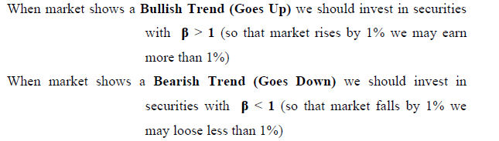
SYSTEMATIC RISK
Systematic risk is measured by a beta factor therefore the required return from an investment must be related to the beta factor of that investment.This is brought together in the Capital Asset Pricing Model which is a formula that relates required returns to beta factors, or measures of systematic risk.

Slide 4
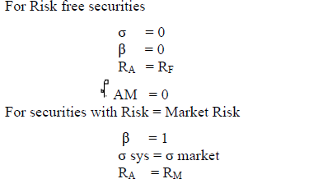
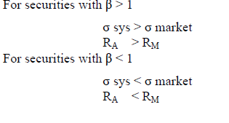

Slide 5
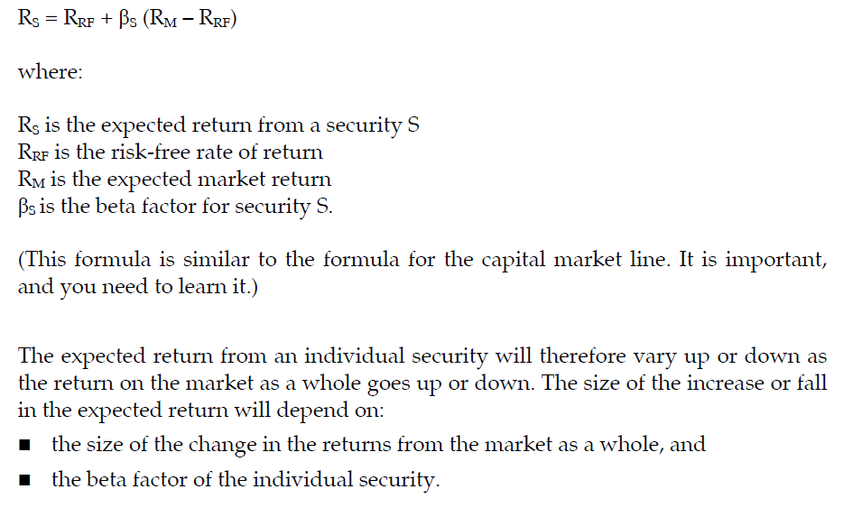
CAPM - formula

Slide 6
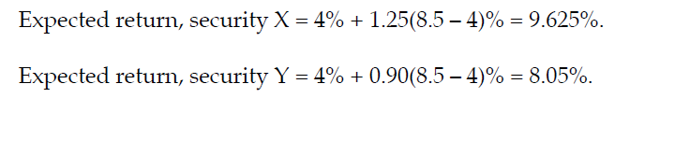
Example
The risk-free rate of return is 4% and the return on the market portfolio is 8.5%.
What is the expected return from shares in companies X and Y if:
the beta factor for company X shares is 1.25
the beta factor for company Y shares is 0.90?

Slide 7
Illustration
The following information is available:
Risk-free rate of return 4.0%
Expected market return 7.5%
Standard deviation of market return 1.4%
Standard deviation of return from shares in company ABC 2.5%
Correlation coefficient for returns from shares in Company ABC and returns from the market as a whole 0.90
Required
(a) Calculate the beta factor for Company ABC shares.
(b) Estimate the returns currently expected from Company ABC shares.

Slide 8
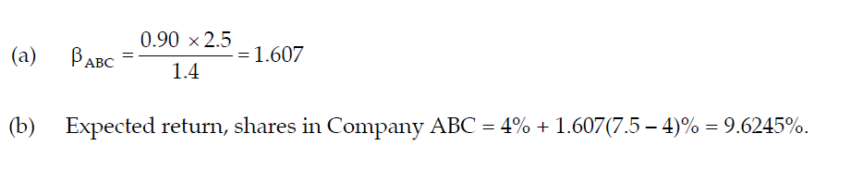
The beta factor of a small portfolio
A portfolio of investments containing just a few securities will not be fully representative of the market portfolio. Its systematic risk will therefore be different from the systematic risk for the market as a whole.
The relationship between the systematic risk of a small portfolio and the systematic risk of the market as a whole can be measured as a beta factor for the portfolio.

Slide 9
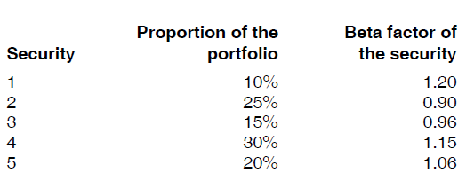
A beta factor for a portfolio is the weighted average value of the beta factors of all the individual securities in the portfolio. The weighting allows for the relative proportions of each security in the portfolio.
Example
A portfolio contains five securities. The proportions of each security in the portfolio and the beta factor of each security are as follows:

Slide 10
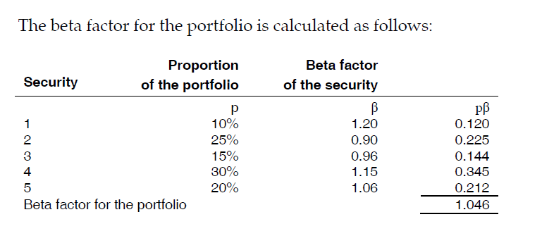

Slide 11
The required return of an investment with a beta of zero (risk free) will be the risk free return.
The required return of an investment with a beta of 1 will be the market return.
Consider investment A - it appears to be earning a higher return than the CAPM would predict given its beta. It is therefore temporarily underpriced.
Consider investment B - it appears to be earning a lower return than the CAPM and its beta would predict and therefore would appear to be temporarily over priced.
In the long run market forces should ensure that all investments do give the returns predicted by the Capita; or Security Market Line.

Slide 12
USES OF THE CAPM
Well-diversified investor
If an investor already holds a well-diversified portfolio then that investor will be concerned only with systematic risk. The CAPM is therefore relevant.
The investor will be concerned only if a potential investment gives a high enough return given its sensitivity to market risk as measured by its beta factor.
Companies
Companies should not diversify their activities simply to reduce the risk of their shareholders. Shareholders can diversify their shareholdings much more easily than a company can its activities.
If shareholders are well-diversified then the company should concern itself, on behalf of the shareholders, simply with the systematic risk of potential investments or projects.
Therefore the aim of a company, with well-diversified shareholders, should be to determine the required return from its investment projects using the CAPM and to then compare this to the expected return.

Slide 13
If the project is the same risk as that of the existing activities of the company then the existing WACC can be used.
However if the project is of a different risk type to the existing activities then the existing WACC will not be appropriate. In these instances a tailor made discount rate for that type of project must be determined using the CAPM.
Asset betas
Any company is made up of its assets or activities. These assets will have a certain amount of risk depending upon their nature. These assets will have a beta factor that recognises the sensitivity of such assets to systematic risk.
This beta factor is the asset beta and measures the systematic business risk of the company.
It is not affected by gearing.

Slide 14
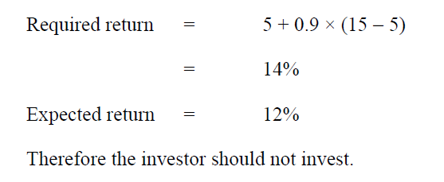
Example 2
An investment has an expected return over the next year of 12%. The beta of the investment is estimated at 0.9. The risk free rate is 5% and the market return is 15%.Should a well-diversified investor invest in this investment?

Slide 15
Equity betas
The equity beta measures the sensitivity to systematic risk of the returns of the equity shareholders in a company.
In an all-equity financed company, or ungeared company, the only risk that is incurred is business risk. Therefore in an ungeared company the asset beta and the equity beta are the same.
In a geared company however the equity shareholders bear not only business risk, measured by the asset beta, but also a degree of financial risk. The amount of financial risk is dependent upon the level of gearing but in general terms this means that the risk to the equity shareholders is not simply the business risk but some extra financial risk as well. Therefore in a geared company the equity beta > the asset beta.

Slide 16
Use of the equity beta
The equity beta in a geared company measures the sensitivity to market risks of the equity shareholders returns. If the equity beta is used in the CAPM this gives the required return for the equity shareholders. This required return is the return that the company must pay, which is the cost of equity (Keg).
The CAPM can be used as an alternative method to the dividend valuation model for estimating the cost of equity of a company.

Slide 17
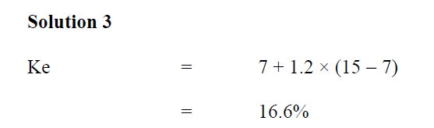
Example 3
The equity beta of a company is estimated to be 1.2. The risk free return is 7% and the return from the market is 15%. Estimate the cost of equity of the company?

Slide 18
GEARING AND UNGEARING BETAS
Project appraisal in a new industry
It has already been noted that a company’s existing WACC is only a relevant discount rate to use for project appraisal if the project is of the same type as the existing activities of the company.
If the project is in a new industry then a discount rate to reflect the business risk of that industry is required. However care must be taken here.
A company in a similar industry could be found and its beta discovered. However if that company is geared then the equity beta will contain both the business risk and finance risk elements. For an appropriate discount rate only the business risk element, the asset beta is required.

Slide 19
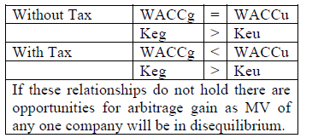
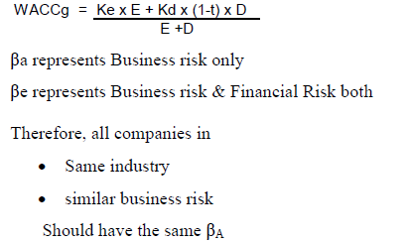

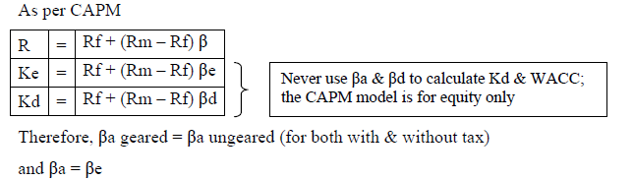

Slide 20
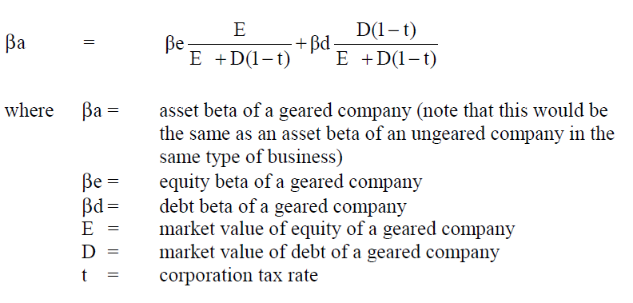

MM and betas
Modigliani and Miller applied their relationships between geared and ungeared companies to asset betas and equity betas resulting in the following relationship:
This formula means that if the equity beta of a company is known then its asset beta can be derived in order to use to determine a discount rate for the particular type of project of that company.

Slide 21
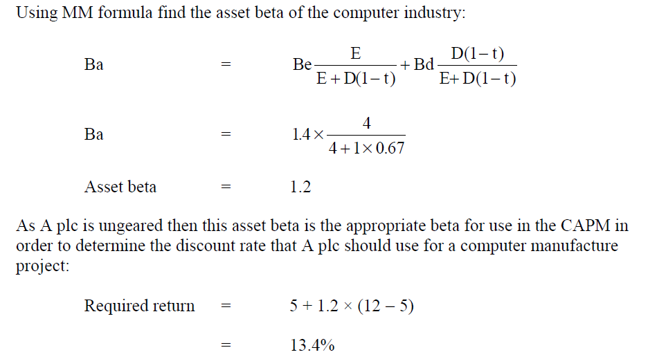
Example I
A plc produces electronic equipment but is considering venturing into the manufacture of computers. A plc is ungeared with an equity beta of 0.8. The average equity beta of computer manufacturers is 1.4 and the average gearing ratio is 1:4. The risk free return is 5%, the market return 12% and the rate of Corporation Tax 33%. If A plc is to remain an equity financed company what discount rate should it use to appraise a computer manufacture project?

Slide 22
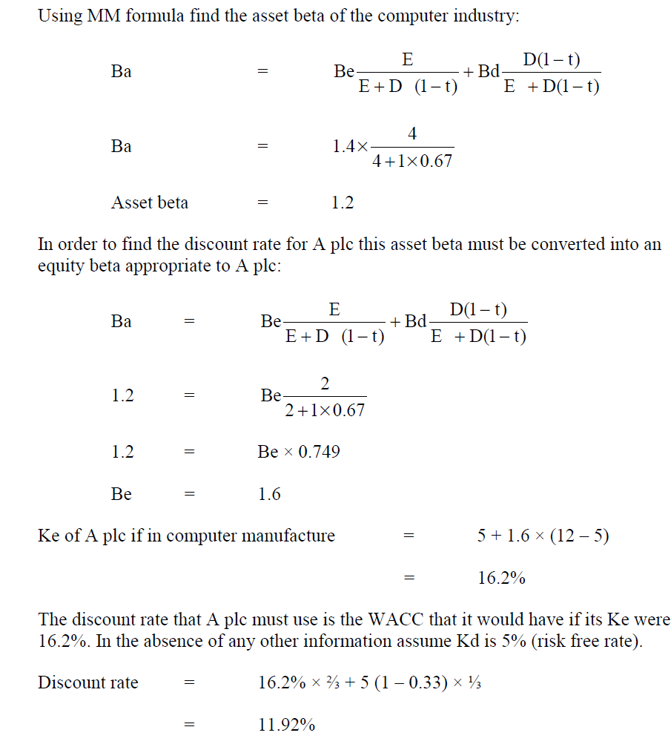
Example II
Suppose that A plc from the previous example has a gearing ratio of 1:2. It still wishes to enter into the same computer manufacturing project. What is the discount rate that should be used for A plc for a computer manufacturing project?

Slide 23
ASSUMPTIONS OF THE CAPM
The CAPM is a theoretical model that has a variety of uses for financial management.
As a theory however there are a number of inherent assumptions:
total risk can be split between systematic risk and unsystematic risk;
unsystematic risk can be completely diversified away;
a risk free security exists;
beta values remain constant throughout time;
it is a single period model;
perfect markets;
all of a company’s shareholders hold well-diversified portfolios

Slide 24
LIMITATIONS OF THE CAPM
Many of the limitations of the CAPM stem from the assumptions upon which the theory is based:
it is a single period model;
it ignores unsystematic risk as it assumes this has been
diversified away by the company’s shareholders;
how is the risk free rate determined?
how is a beta factor determined?
One final limitation of CAPM is that it does not provide a realistic estimate of returns on shares. If you compare returns predicted by CAPM and returns received in the real world they are markedly different. CAPM overstates returns on shares with high betas and understates returns on low beta shares. To overcome this theorists have added a further measure, α. A shares αvalue is the difference between returns actually received and returns predicted by CAPM.

Slide 25
Arbitrage Pricing Theory
It might be argued that one of the limitations of the CAPM is that it is a single index model in that the expected return is based solely upon the beta factor.
One alternative theory, which is less widely used, is the Arbitrage Pricing Theory (APT). This is a multi-index model where the required return is affected by a variety of factors such as return on the market, industry indices, interest rates etc.

Slide 26

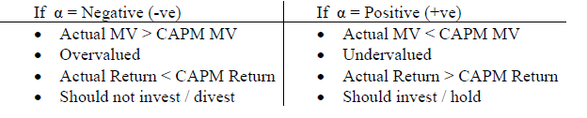
Alpha factor
When shares yield more or less than their expected return (based on the CAPM), the difference is an abnormal return. This abnormal return might be referred to as the alpha factor. The alpha factor for a security is simply the balancing figure in the following formula:
α values are temporary values as arbitrage gain opportunities / speculation will over a long period of time cause securities to offer the same return as that offered by a market portfolio (become inline with market).
For projects with similar investment requirements & expected returns than the project with lowest β should be selected

Slide 27
Thank you

