Slide 1
Portfolio Management
Lecture: 27
Course Code: MBF702

Slide 2
Outline
Portfolio Theory - continued
Two assets Portfolio
Portfolio Selection
Risky and risk-free assets
Implications for investment

Slide 3
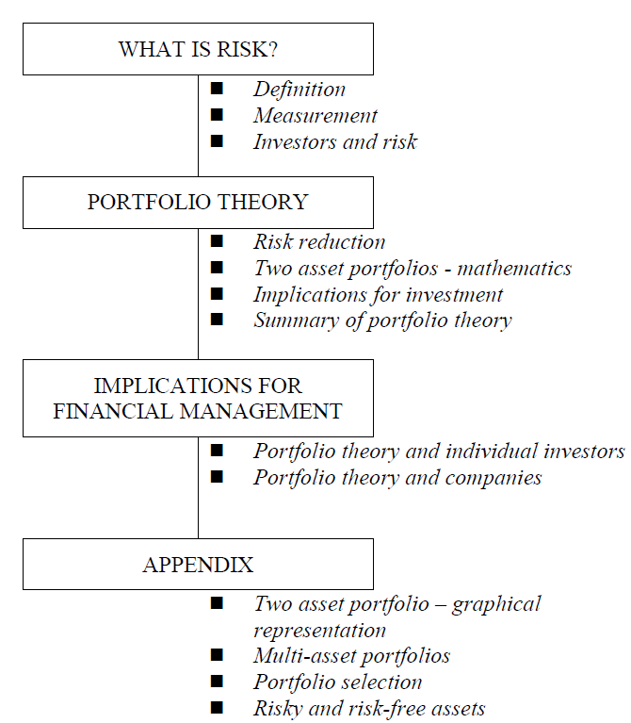
Portfolio
Theory

Slide 4
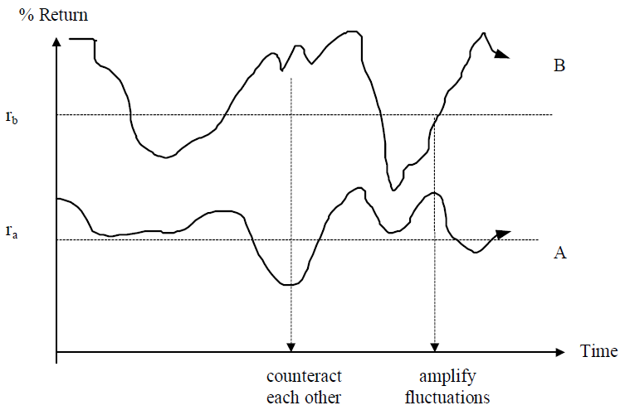
Two asset portfolios - mathematics
Investment Return Risk Proportion in
portfolio (by MV)
A ra σa x
B rb σb (1 – x)
What will be the return and risk of the portfolio?
The return will be a weighted average of the two average returns, but the risk will depend on how much the fluctuations in A and B counteract each other.
The extent to which this happens
will depend on the correlation between
the two investments returns.

Slide 5
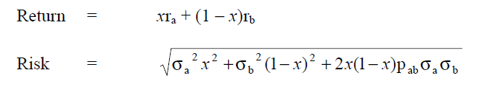

Formulae for risk and return of a two asset portfolio:
The final element of this two asset portfolio risk equation is the vital part:
It is this correlation coefficient which determines how much diversification is possible.

Slide 6
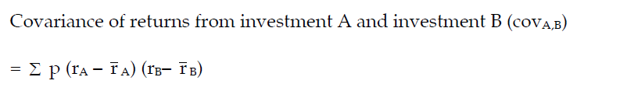
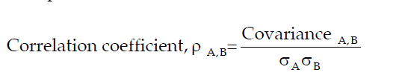
Covariance and Correlation coefficient - calculation
One way of calculating the correlation coefficient of returns between two investments in a two-asset portfolio is to begin by calculating the covariance of the returns from the two investments.
The correlation coefficient for the returns of two investments (A and B) in a two asset portfolio is calculated as:
This is the covariance of returns from investments A and B, divided by [the standard deviation of returns from investment A multiplied by the standard deviation of returns from investment B].

Slide 7
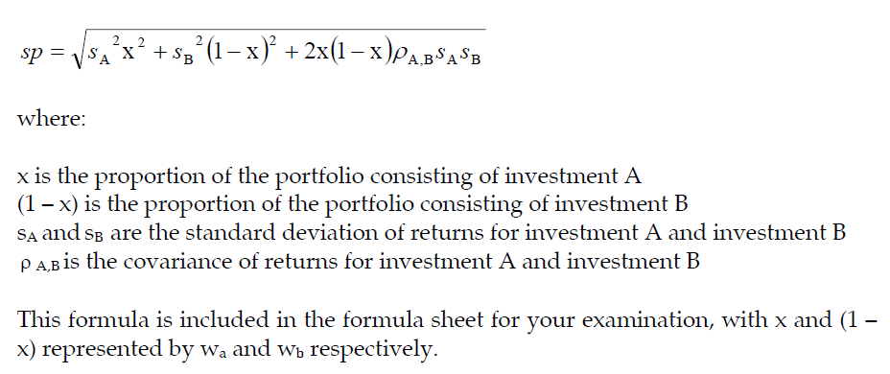
Standard deviation of return for a two-asset portfolio
The overall standard deviation of the return from a two-asset portfolio can be calculated using the following formula

Slide 8
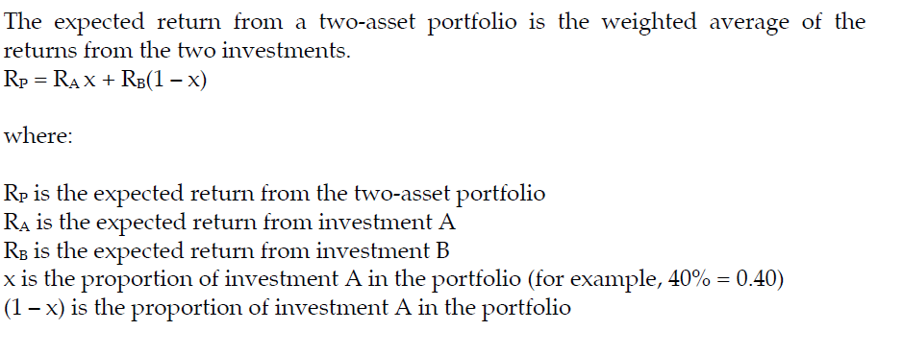
Expected return from a two-asset portfolio

Slide 9
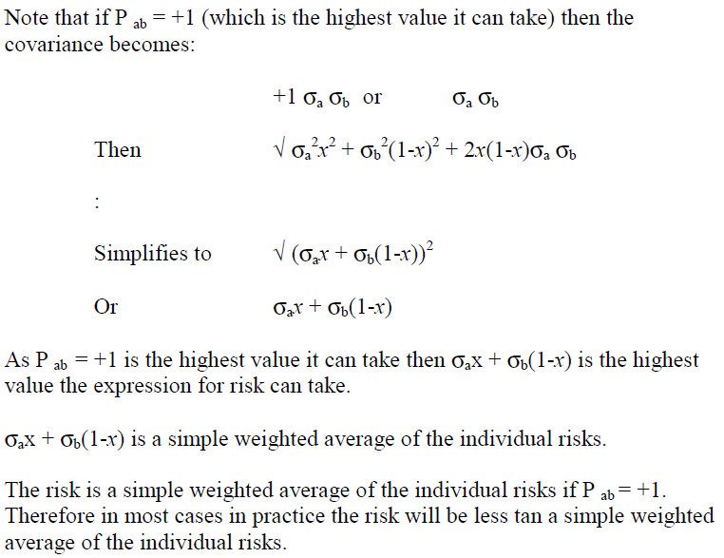
Illustration

Slide 10
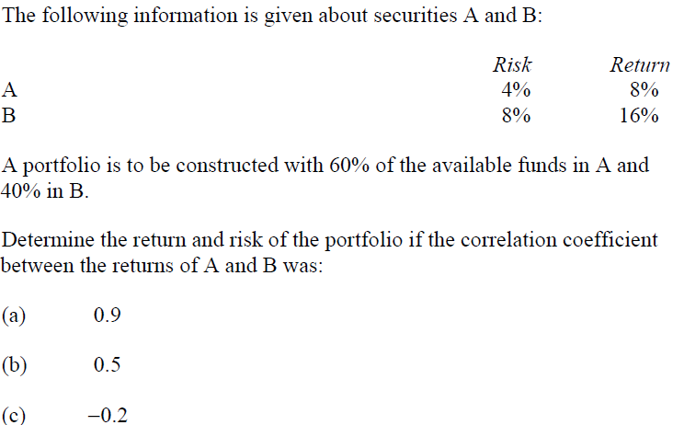
Example

Slide 11
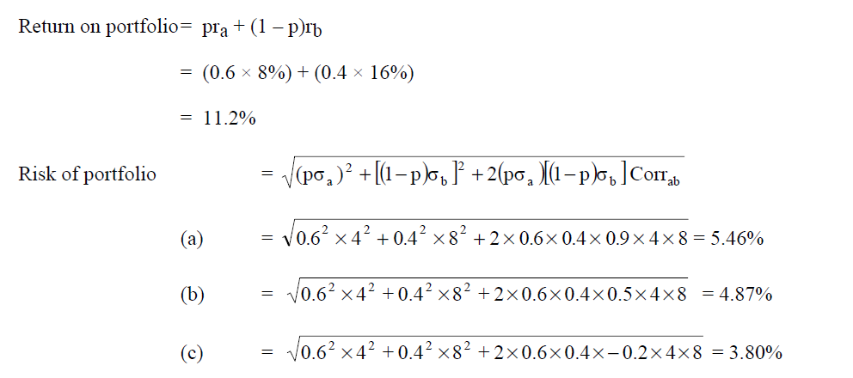
Solution

Slide 12
Implications for investment
The implications of this diversification process for investment are:
an investor should not consider an investment's risk and return characteristics in isolation but compare it to existing investments in order to identify any diversification opportunities;
it is therefore possible to reduce the risk of the investor’s portfolio without any reduction in return provided that investments that are to some degree less than perfectly positively correlated can be identified.

Slide 13
Summary of portfolio theory
It is possible for an investor to diversify away some risk by investing in more shares.
These shares must however be to some degree less than perfectly positively correlated with the returns on his existing portfolio.
A rational risk-averse investor will diversify away as much risk as is possible and will therefore hold the market portfolio of shares.
He may then decide to hold this portfolio in some combination with risk-free assets.

Slide 14
IMPLICATIONS FOR FINANCIAL MANAGEMENT
Portfolio theory and individual investors
To an individual investor portfolio theory and an understanding of diversification is important in order to reduce risk with no reduction in return. However even for a single individual investor there are practical problems:
assessing their own risk/return preferences;
determining forecast returns of current and potential investments;
determining correlation coefficients between current and potential investments;
carrying out the calculations required.

Slide 15
IMPLICATIONS FOR FINANCIAL MANAGEMENT
Portfolio theory and companies
Financial managers should understand the concepts and theory behind diversification.
This is perhaps particularly important in unquoted companies where the shareholders themselves may well not have diversified portfolios. Maybe a large proportion of the shareholders’ wealth is invested in this one unquoted company. In such circumstances it may benefit the shareholders if the company were to diversify its own investments with the aim of risk reduction.
However in larger quoted companies financial managers should not be aiming at diversification of the operations in order to reduce risk. This is because the shareholders in such companies can easily become diversified themselves by buying a portfolio of shares. Therefore they do not need the company to diversify for risk reduction purposes.

Slide 16
There is a direct mathematical link between portfolio theory and the capital asset pricing model. This section is given to provide a flavour of the link. Note that this information is given only as background. It is not important, of itself, for the examination

Slide 17
Two asset portfolio – graphical representation
The risks and return of different combinations of two assets can be represented on a graph.
The shape of the graph depends on the correlation coefficient between the returns of the two assets.
Perfect positive correlation (Corrab = +1)

Slide 18
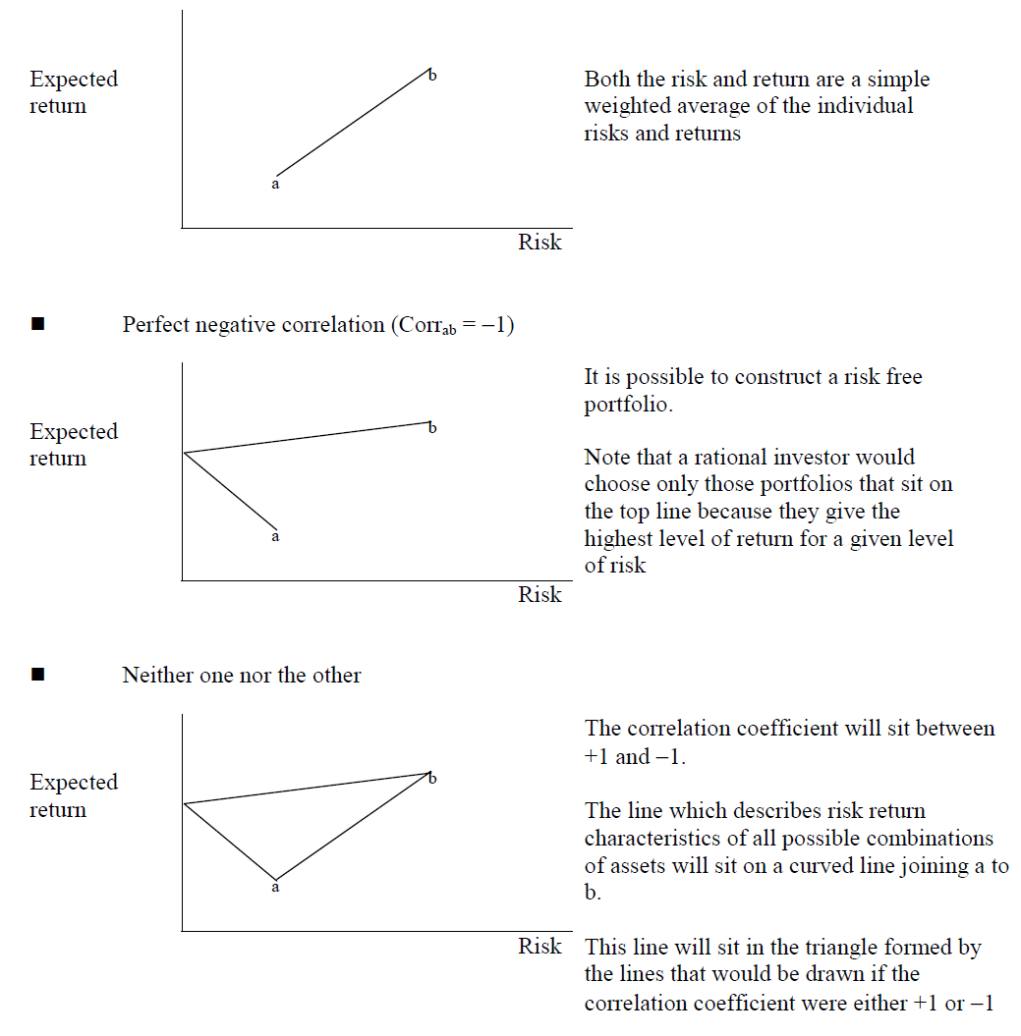

Slide 19
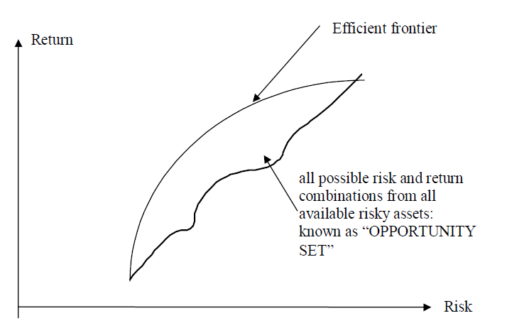
Multi-asset portfolios
With multiple risky assets available, the risk and return combinations possible are an area.

Slide 20
Only those portfolios lying along the “north west frontier” are mean-variance efficient.
A portfolio is mean-variance efficient if it offers
maximum return for a given level of risk
OR
minimum risk for a given level of return
This what a rational investor would choose from

Slide 21

Three asset portfolio

Slide 22
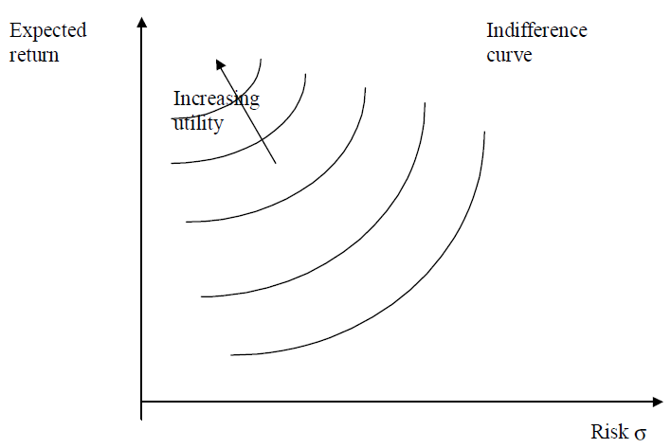
Portfolio selection
Which of the portfolios on the efficient frontier will the investor select?
This will depend upon the investor's attitude to risk. This can be represented by indifference curves which are unique to each investor. Where a curve cuts the vertical axis the risk is zero. The return at this point is risk free. As the line moves from the vertical axis the risk is increasing but so is the return. This increase in return exactly compensates the investor for the increse in risk. He is indifferent to each point on the curve.
An investor would like to be on the
highest curve possible as this
represents the greatest risk free equivalent
rate. (it cuts the vertical axis at a higher point).
Investors are assumed to each be trying
to maximise their own utility.
An investor will choose the portfolio
on the "efficient frontier" which cuts the
highest indifference curve on his graph.

Slide 23
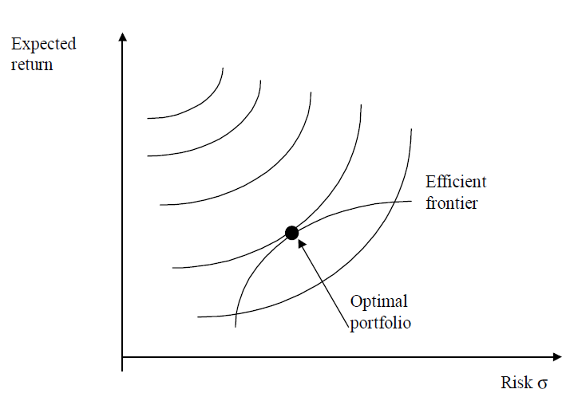
Portfolio selection
This will maximise his utility

Slide 24
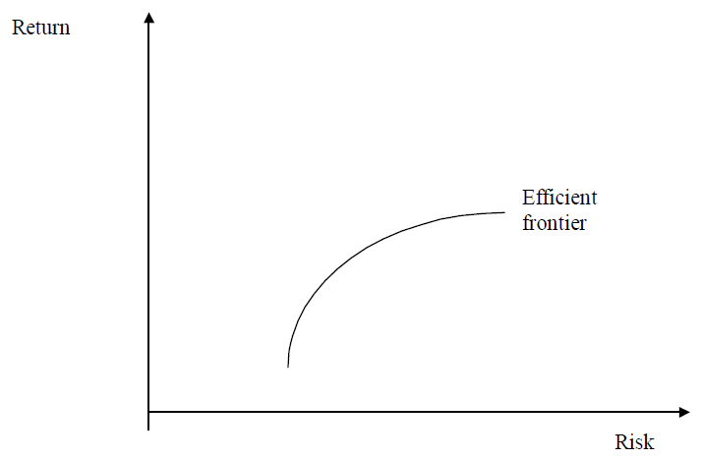
Risky and risk-free assets
If an investor buys a portfolio
of shares then these are all risky assets.
As we have seen by the judicial use
of the qualities of diversification a number
of efficient portfolios of shares have been
identified along the efficient frontier.
However an investor may also consider risk-free securities.
These are generally short-dated government stocks.

Slide 25
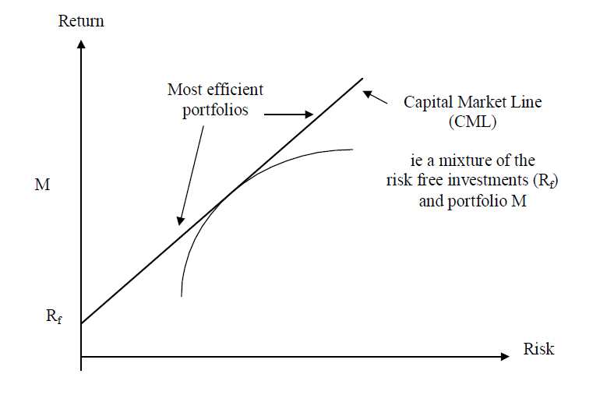
Risky and risk-free assets
In theory they have no risk, but due to risk and return trade offs, will also have a lower return than risky share investments.
An individual investor may decide on one of the following courses of action:
to invest only in risky shares;
to withdraw some of his investment
in shares and invest in risk-free
securities;
to increase his investment in shares
by borrowing at the risk-free rate.
The efficient frontier now changes to show the investors choice of efficient portfolios that are a mix of risky shares and risk-free securities. This new efficient frontier is known as the Capital Market Line.

Slide 26
Risky and risk-free assets
The most efficient portfolios lie along the line rf – M and beyond, ie these portfolios maximise return for a given level of risk.
Assuming that all shareholders are rational and risk averse and have access to the same information, they will all choose portfolios from along the capital market line.
Since M is therefore the only efficient risky portfolio of shares – it must be the market portfolio ie equivalent to owning shares in all companies trading on the Stock Exchange.
The equation of the capital market line can be transformed mathematically to a form which will give rise to the equation of the Capital Asset Pricing Model (CAPM)>

Slide 27
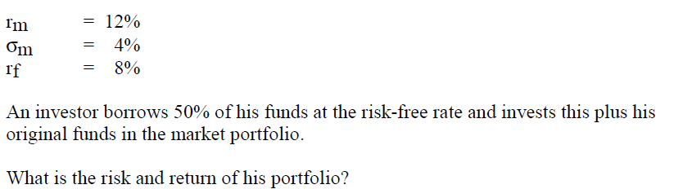
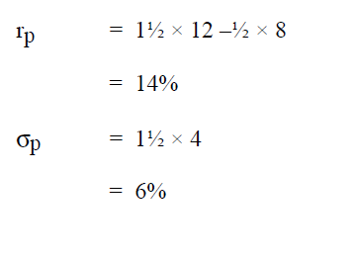
Example

Slide 28
Focus
You should now be able to:
understand the benefits of portfolio diversification;
carry out calculations of the return and risk of two asset portfolios;
understand the concept of utility and be able to explain portfolio selection when both risky and risk free assets are available;
understand the relevance and limitations of portfolio theory for financial management.

Slide 29
Thank you

