Slide 1
Portfolio Management
Lecture: 26
Course Code: MBF702

Slide 2
Outline
Risk
Portfolio Theory
Two assets Portfolio
Portfolio Selection
Risky and risk-free assets
Implications for investment

Slide 3
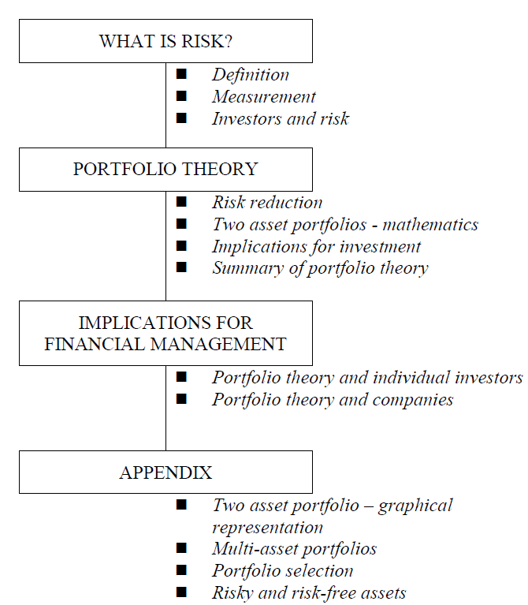
Portfolio
Theory

Slide 4
WHAT IS RISK?
An investment is defined as having a degree of risk if its returns are uncertain or variable. The amount of risk an investment has will depend upon the variability of the returns of the investment around the average return, σ
Measurement
Risk is measured by the standard deviation of the returns around the average return,
Investors and risk
Investors are on the whole “risk averse”. Investors seek to make as much gain as possible with as little risk as possible. In real life there will be a balance between risk and return, however investors in general will seek to maximise return in relation to risk- this is called mean –variance efficiency in portfolio theory.
Each investor is different and will have his own attitude to risk.

Slide 5
Risk and return in investments - Recap
Investors invest in shares and bonds in the expectation of making a return. The return that they want from any investment could be described as:
a return as reward for providing funds and keeping those funds invested, plus
a return to compensate the investor for the risk.
As a basic rule, an investor will expect a higher return when the investment risk is higher.

Slide 6
Investors in bonds, investors in shares and companies all face investment risk. In the case of bonds, the risks for the investor are as follows:
The bond issuer may default, and fail to pay the interest on the bonds, or fail to repay the principal at maturity.
There may be a change in market rates of interest, including interest yields on bonds. A change in yields will alter the market value of the bonds. If interest rates rise, the market value of bonds will fall, and the bond investor will suffer a loss in the value of his investment.
In the examination, you are often told to assume that debt capital is risk-free. (In practice, only government debt denominated in the domestic currency of the government is risk-free).

Slide 7
In the case of equity shares, the risks for the investor are that:
the company might go into liquidation, or
(much more significantly) the company’s profits might fluctuate, and dividends might also rise or fall from one year to the next.
For investors in equities, the biggest investment risk comes from uncertainty and change from one year to the next in annual profits and dividends. Changes in expected profits and dividends will affect the value of the shares.
When a company invests in a new project, there will be an investment risk. This is the risk that actual returns from the investment will not be the same as the expected returns but could be higher or lower. This investment risk for companies is similar to the investment risk facing equity investors.

Slide 8
Measuring risk as a variance or standard deviation of expected returns
The risk of variations in annual profits and dividends can be measured. When annual returns can differ by a large amount from normal or expected (average) returns, and there are considerable differences in returns from one year to the next, returns are volatile.
High volatility in returns is associated with high investment risk.
Risk can be measured statistically, either from an analysis of historical returns achieved in the past, or from probability estimates of returns in the future. The measurement of risk is a measurement of the volatility of possible returns.
This volatility can be measured as either the variance or standard deviation of expected returns over a given period of time, such as a variance or standard deviation of expected annual returns. For an investment, we can measure both:
an expected or average annual return for the time period, and
a variance or standard deviation of the returns.

Slide 9

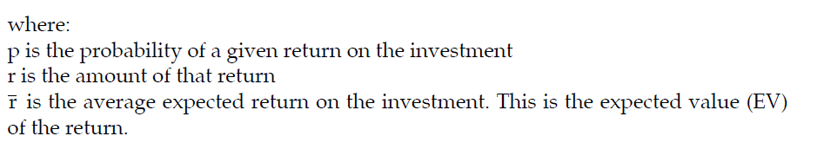
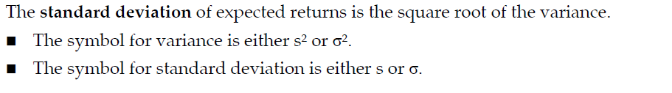
Calculating the variance or standard deviation of expected returns
The variance of expected returns is calculated as

Slide 10
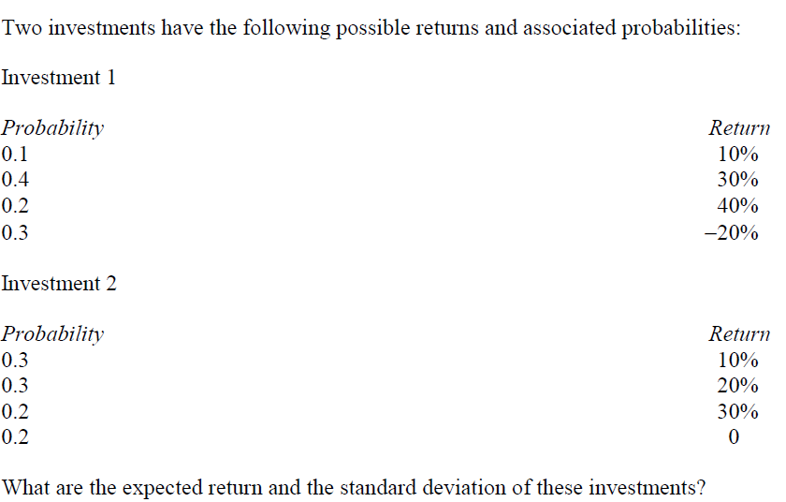
Example

Slide 11
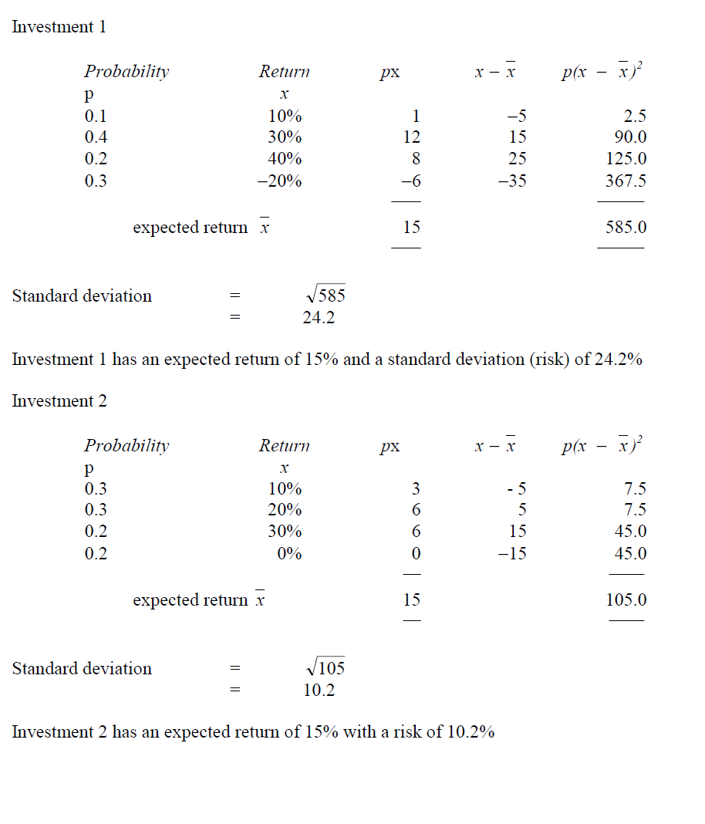
Solution

Slide 12
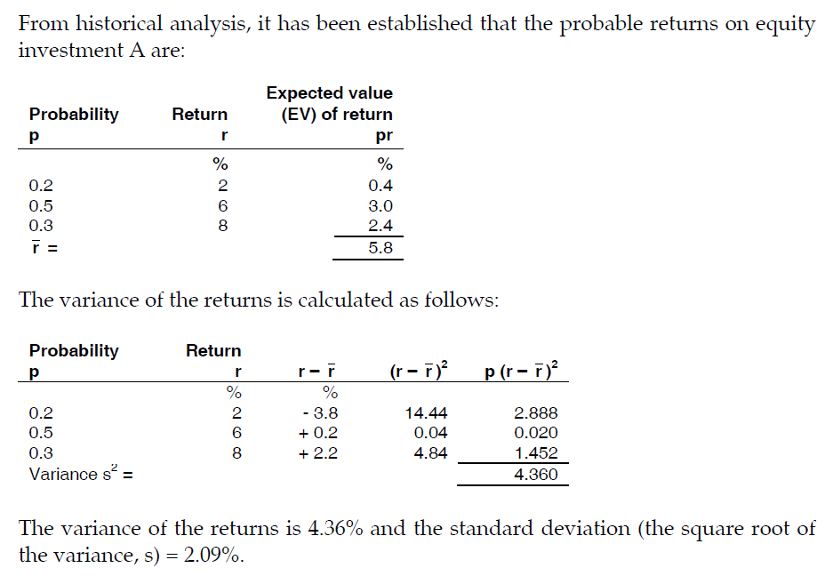
Example

Slide 13
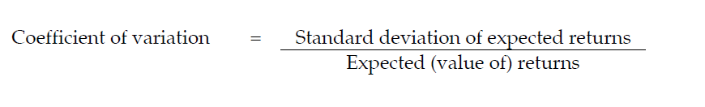
Assessing the investment risk: coefficient of variation
The expected return from the investment is therefore 5.8% with a standard deviation of 2.09%. The statistical significance of the standard deviation depends on whether the variability in possible returns has a recognisable statistical distribution, such as a standard normal distribution.
However, even when the standard deviation of returns is not normally distributed, the risk in an investment can be assessed by comparing the size of the risk (standard deviation of returns) with the expected return.
The coefficient of variation is the ratio of the standard deviation to the expected return.
A high coefficient of variation indicates high investment risk, because the risk is large in relation to the expected returns.

Slide 14
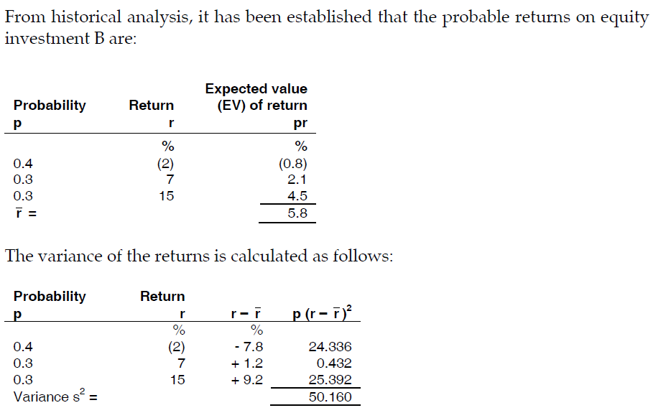
Example

Slide 15
The variance of the returns is 50.16% and the standard deviation (the square root of the variance, s) = 7.08%.
The coefficient of variation for Investment B is 7.08/5.8 = 1.22. This is higher than the coefficient of variation for Investment A in the previous example, which has the same expected return of 5.8% but a coefficient of variation of 2.09/5.8 = 0.36.
Clearly, the investment risk with Investment B is higher than the risk with Investment A.

Slide 16
PORTFOLIO
A portfolio is a collection of different securities such as stocks and bonds, that are combined and considered a single asset
The risk-return characteristics of the portfolio is demonstrably different than the characteristics of the assets that make up that portfolio, especially with regard to risk.
Combining different securities into portfolios is done to achieve diversification.

Slide 17
PORTFOLIO THEORY
Portfolio theory is concerned with how investors should build a portfolio of investments that gives them a suitable balance between return and investment risk. The theory may seem complex, but it is not often examined. However, portfolio theory provides a theoretical basis for the capital asset pricing model, which is an important model in financial management.

Slide 18
Diversification to reduce risk: building a portfolio
To a certain extent, an investor can reduce the investment risk – in other words, reduce the volatility of expected returns – by diversifying his investments, and holding a portfolio of different investments.
Creating a portfolio of different investments can reduce the variance and standard deviation of returns from the total portfolio, because if some investments provide a lower-than-expected return, others will provide a higher-than-expected return. Extremely high or low returns are therefore less likely to occur.
(Similarly, a company could reduce the investment risk in its business by diversifying, and building a portfolio of different investments. However, it can be argued that there is no reason for a company to diversify its investments, because an investor can achieve all the diversification he requires by selecting a diversified portfolio of equity investments.)

Slide 19
PORTFOLIO THEORY
Risk reduction
Risk averse investors will accept risk provided that they are compensated for it by an adequate return. However if they could reduce their risk without a reduction in return this would be even better.
This is possible by the process of diversification.
When an investment(a) is added to an existing portfolio (b) the risk of the new portfolio formed will usually be less than a simple weighted average of the individual risks of a and b alone.
This will almost always be the case

Slide 20
PORTFOLIO THEORY
Some investments might do even more than this. Some investments can be added to an existing portfolio to give a new portfolio of lower risk than the existing portfolio.
This is because of the way that the investments’ returns interact with each other in different sets of economic conditions – “states of the world”.
Whether such investments are acceptable will depend on the effect that they have on the return of the existing portfolio.
Portfolio theory appraises investments by looking at the effect that they have on the risk/return characteristics of the total investments
held. The approach involves
a comparison of the return of the existing portfolio to the return of the existing portfolio + the new investment
AND
a comparison of the risk of the existing portfolio to the risk of the existing portfolio + the new investment

Slide 21
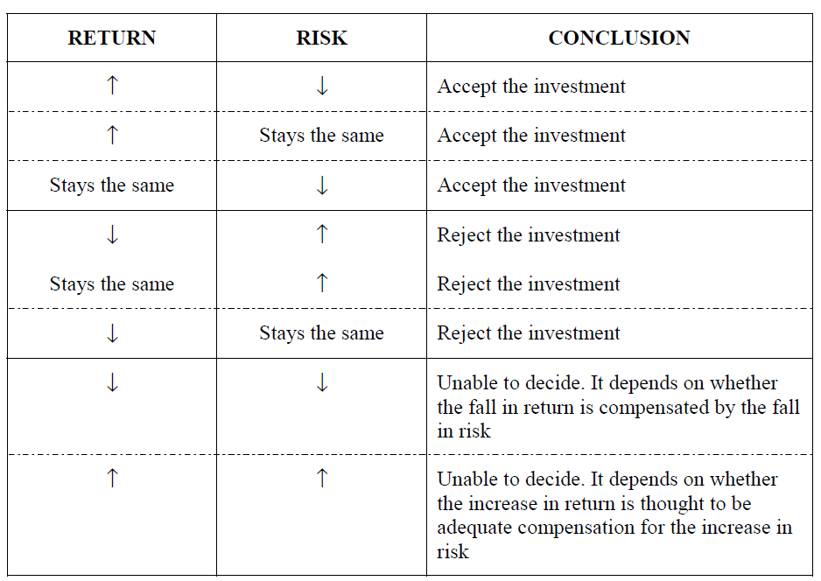
Possible outcomes

Slide 22
Possible outcomes
It is theoretically possible to apply this approach to any number of combinations of investments. In practical terms though an appraisal will always look at two assets only. These two assets are the existing portfolio (which may of course be made up of lots of investments) and a new investment.
It can be used to make decisions about including a new share in a portfolio of shares.
It can be used to make decisions about including a new project in a portfolio of projects (a company!).

Slide 23
Diversification to reduce risk: the correlation of investment returns
The extent to which investment risk can be reduced by building a portfolio of different investments depends on the correlation of the returns from the different investments in the portfolio.
When returns from different investments in a portfolio are positively correlated, this means that when the return from one of the investments is higher than expected, the returns from the other investments will also be higher than expected. Similarly, when returns from one investment are lower than expected, the returns from all the investments in the portfolio will be lower than expected.
When returns from two different investments in a portfolio are negatively correlated, this means that when the returns from one of the investments is higher than expected, the returns from the other investment will be lower than expected.

Slide 24
When returns from two investments are neither positively nor negatively correlated, this means that when the returns from one investment are higher than expected, the returns from the other investment might be either higher or lower than expected.
Investment risk is reduced by building up a portfolio of investments whose returns are negatively correlated, or where correlation is low.

Slide 25
Correlation coefficient of investment returns
The correlation of the returns from different investments can be measured statistically by a correlation coefficient, from an analysis of historical data about returns (or from probability estimates of future returns).
A correlation coefficient can range in value from +1 (perfect positive correlation) to – 1 (perfect negative correlation).
A correlation coefficient close to zero indicates very little correlation between investment returns.
Investment risk is reduced most effectively by having investments in a portfolio whose returns are negatively correlated, or where there is not much correlation.
You might be required to calculate the correlation coefficient of the returns from two investments in a portfolio (a two-investment portfolio). You will not be required to make any calculations of correlation for a portfolio of more than two investments, but the same principles apply to larger portfolios.

Slide 26
Thank you

