Slide 1
Investment Analysis and
Portfolio management
Lecture: 25
Course Code: MBF702

Slide 2
Outline
RECAP
  Expected returns
  Population variance
  Population covariance
  Choosing an investment portfolio

Slide 3
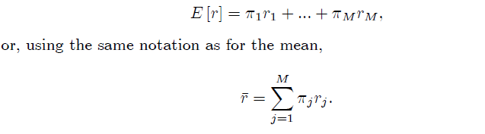
Expected return
The expectation can now be employed to evaluate the expected return on an asset and a portfolio. This is achieved by introducing the idea of states of the world. A state of the world summarizes all the information that is relevant for the future return of an asset, so the set of states describes all the possible different future financial environments that may arise. Of course, only one of these states will actually be realized. These states of the world are the analysts way of thinking about, and modelling, what generates the randomness in asset returns.
Let there be M states of the world. If the return on an asset in state j is rj and the probability of state j occurring is πj. then the expected return on asset i is

Slide 4

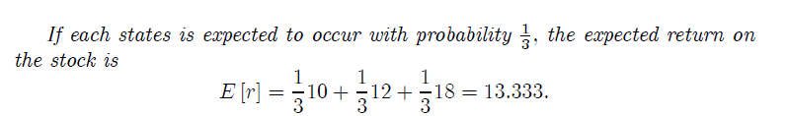
Example
The temperature next year may be hot, warm or cold. The returns to stock in a food production company in each of these states are given in the table.

Slide 5
Example
Consider a portfolio composed of two assets A and B. Asset A constitutes 20% of the portfolio and asset B 80%. The returns on the assets in the 5 possible states of the world and the probabilities of those states are given in the table.

Slide 6
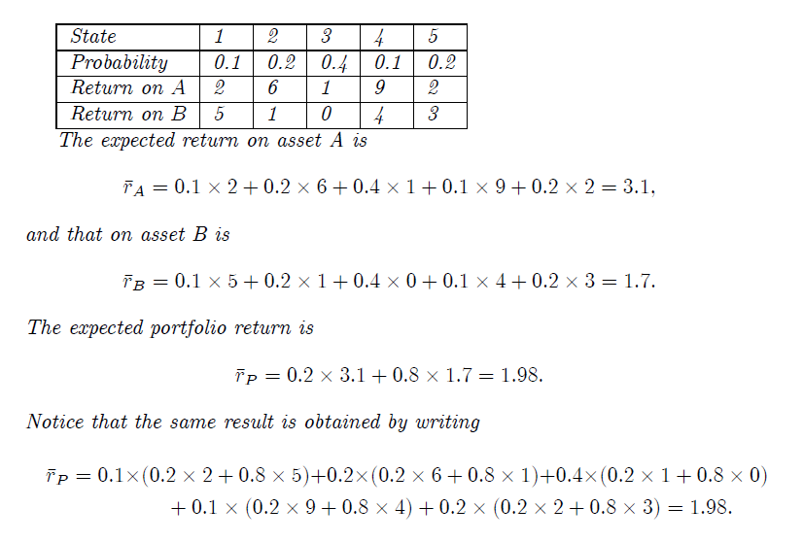

Slide 7

Population variance
The population variance mirrors the interpretation of the sample variance as being the average of the square of the deviation from the mean. But where the sample variance found the average by dividing by the number of observations (or one less than the number of observations), the population variance averages by weighting each squared deviation from the mean by the probability of its occurrence.
For a single asset the population variance is given by the expected value of the deviation from the mean squared, so

Slide 8
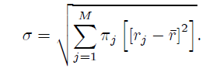
As for the sample variance, the population variance is always non-negative. The population standard deviation is given by

Slide 9
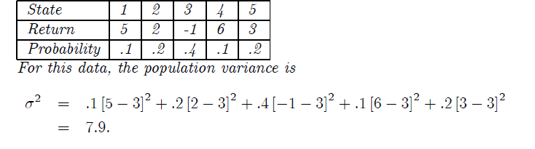
Population variance
Example
The table gives the returns on a stock in the five possible states of the world and the probabilities of those states.

Slide 10

Population Covariance
The population covariance mirrors the sample covariance in providing a measure of the relative movements of asset returns. It is defined as the expected value of the product of the deviation from the mean for two different assets.
For two assets A and B, the population covariance is

Slide 11
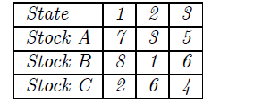
Example
Consider the returns on three stocks in the following table. Assume the probability of each state occurring is 1/3 .

Slide 12
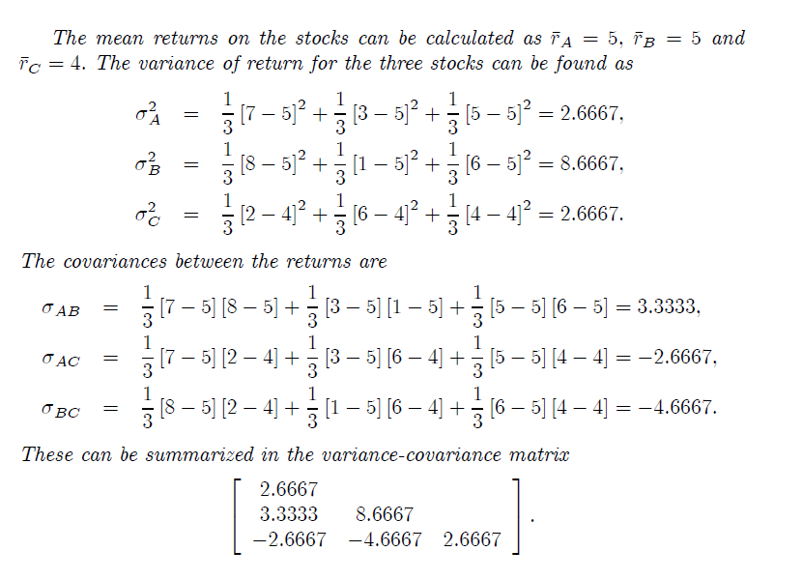

Slide 13
Choosing an investment portfolio
Investor preferences
Efficient portfolios and the efficient frontier
The market portfolio
Risk-free investments and choosing an investment portfolio
The market premium
The beta factor of a portfolio
Systematic and unsystematic risk

Slide 14
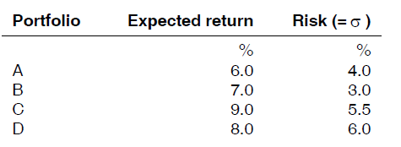
Investor preferences
Investors will usually avoid risk, in the sense that if they invest in a risky portfolio, they will expect a higher return than from investing in a less risky portfolio. A higher return is required to compensate the investor for the higher risk.
Suppose that an investor has a choice of selecting any of the following portfolios:

Slide 15
A normal (risk-averse) investor will not select Portfolio A, because Portfolio B offers a higher return than Portfolio A for less risk
Similarly, a risk-averse investor will not select Portfolio D, because Portfolio C offers a higher return than Portfolio D for less risk
It is not clear whether a risk-averse investor would select Portfolio B or Portfolio C, because Portfolio C offers a higher return for greater risk, and Portfolio B offers a lower return but less risk.

Slide 16
Efficient portfolios and the efficient frontier
Investors can assemble a wide variety of different portfolios, each consisting of different investments and in differing proportions. However, normal investors will always select a portfolio that offers a higher expected return or a lower risk than other portfolios that could be assembled.
An efficient portfolio is a portfolio that offers:
a higher expected return than any other portfolio, for a given level of risk, or
a lower amount of risk than any other portfolio, for a given size of expected return.
Rational, risk-averse investors will choose an efficient portfolio.

Slide 17
The efficient frontier of portfolios
In theory, it would be possible to prepare a graph showing every possible portfolio that investors might choose, with the expected return from the portfolio plotted on the y axis and the risk of the portfolio, measured as the standard deviation of its expected returns, on the x axis.
This graph of portfolios would be shown as an egg-shaped grouping of portfolios, with differing expected returns and differing risk.
The efficient portfolios all lie on the top edge. A line can be drawn through these efficient portfolios, to obtain the efficient frontier of investment portfolios. A riskaverse investor will always choose a portfolio on this efficient frontier.

Slide 18
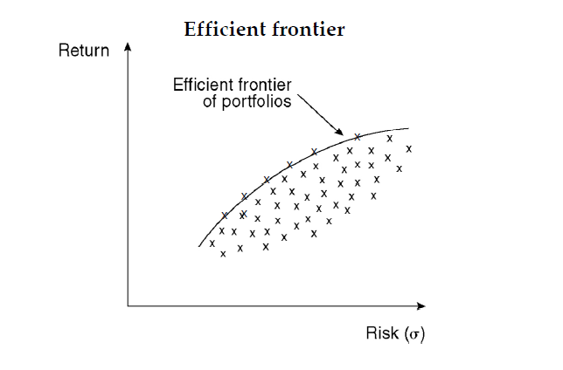

Slide 19
Investor preferences: indifference theory
The next question is whether investors might choose any investment portfolio on this efficient frontier, or whether there is any particular portfolio that will be preferred by all investors, above all the other portfolios.
In portfolio theory, this question is answered using the concept of indifference curves and investor preferences.
Risk-averse investors are prepared to accept higher risk for a higher investment return, but may also choose a lower expected return for lower risk. An investor’s preferences for higher returns or less risk can be illustrated in a graph of indifference curves.

Slide 20
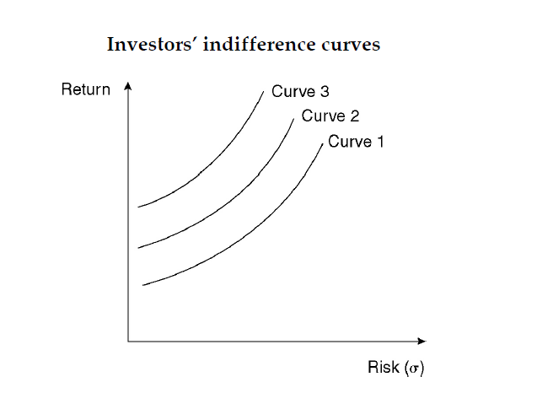

Slide 21
In this graph, there are three indifference curves, Curve 1, Curve 2 and Curve 3.
Curve 1 shows the combinations of risk and return that are of equal merit or attractiveness to the investor. The investor will be indifferent about choosing any portfolio that lies on this curve.
Similarly, Curve 2 shows the combinations of risk and return that are of equal merit or attractiveness to the investor. The investor will be indifferent about choosing any portfolio that lies on this curve. However, the investor will prefer a portfolio on Curve 2 rather than a portfolio on Curve 1, because portfolios on Curve 2 will offer a higher return for less risk than portfolios on Curve 1 (or lower risk for the same return).
Curve 3 also shows the combinations of risk and return that are of equal merit or attractiveness to the investor, and the investor will be indifferent about choosing any portfolio on this curve. However, the investor will prefer a portfolio on Curve 3 rather than a portfolio on Curve 2, because portfolios on Curve 3 will offer a higher return for less risk than portfolios on Curve 2 (or lower risk for the same return).

Slide 22
The conclusion is that investors will select a portfolio for investment that lies on an indifference curve as far to the left on the graph as possible.
The market portfolio
We can combine the efficient frontier of portfolios with investors’ indifference curves on the same graph. If we do, the graph will show that there is only one portfolio on the efficient frontier that will maximise the satisfaction of investors.
This is at point M on the graph below. This is the point where an indifference curve as far to the left as possible touches the efficient frontier.

Slide 23
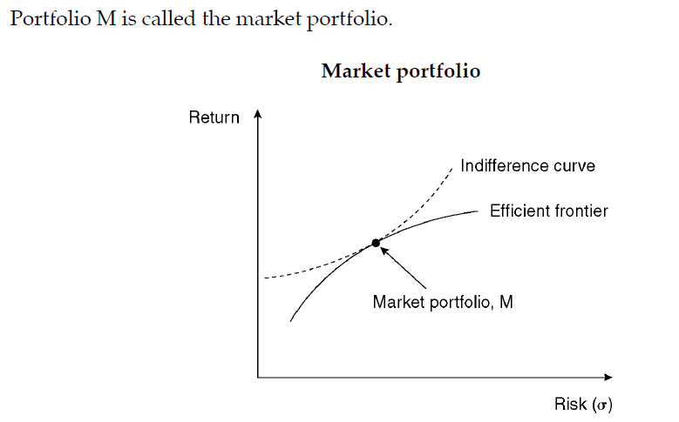

Slide 24
Thank you

