Slide 1
Investment Analysis
Lecture: 22
Course Code: MBF702

Slide 2
Outline
RECAP
MODIGLIANI AND MILLER’S THEORY

Slide 3
MM’s Theory with tax
Modigliani and Miller revised their arguments to allow for the fact that there is tax relief on interest. You do not need to know the arguments they used to reach their conclusions, but you must know what their conclusions were. You should also know and be able to apply the formulae described below.
Modigliani and Miller argued that allowing for corporate taxation and tax relief on interest, an increase in gearing will have the following effect:
As the level of gearing increases, there is a greater proportion of cheaper debt capital in the capital structure of the firm. However, the cost of equity rises as gearing increases.
As gearing increases, the net effect of the greater proportion of cheaper debt and the higher cost of equity is that the WACC becomes lower. Increases in gearing result in a reduction in the WACC.

Slide 4
MM’s Theory with tax
The WACC is therefore at its lowest at the highest practicable level of gearing. (There are practical limitations on gearing that stop it from reaching very high levels. For example, lenders will not provide more debt capital except at a much higher cost, due to the high credit risk).
The total value of the company is therefore higher for a geared company than for an identical all-equity company. The value of a company will rise, for a given level of annual cash profits before interest, as its gearing increases.
Modigliani and Miller therefore reached the conclusion that because of tax relief on interest, there is an optimum level of gearing that a company should be trying to achieve. A company should be trying to make its gearing as high as possible, to the maximum practicable level, in order to maximise its value.

Slide 5
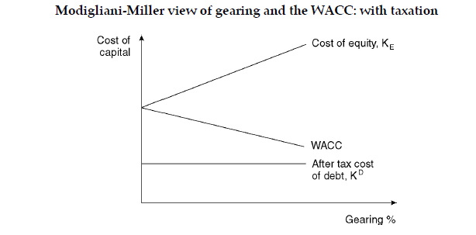
MM’s Theory with tax

Slide 6
MM’s Theory with tax
Modigliani and Miller’s arguments, allowing taxation, can be summarised as two propositions.
Proposition 1. The WACC falls continually as the level of gearing increases. In theory, the lowest cost of capital is where gearing is 100% and the company is financed entirely by debt. (Modigliani and Miller recognised, however, that ‘financial distress’ factors have an effect at high levels of gearing, increasing the cost of debt and the WACC.) For companies with identical annual profits and identical business risk characteristics, their total market value (equity plus debt) will be higher for a company with higher gearing.
Proposition 2. The cost of equity rises as the gearing increases. There is a positive correlation between the cost of equity and gearing (as measured by the debt/equity ratio).

Slide 7

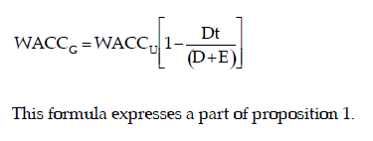
MM’s Theory with tax
There are three formulae for the Modigliani and Miller theory, allowing for corporate taxation. These are shown below. The letter ‘U’ refers to an ungeared company (all-equity company) and the letter ‘G’ refers to a geared company.
(1) WACC
The WACC in a geared company is lower than the WACC in an all-equity company, by a factor of

Slide 8
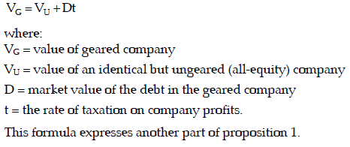
MM’s Theory with tax
(2) Value of a company
The total value of a geared company (equity + debt) is equal to the total value of an identical ungeared company plus the value of the ‘tax shield’. This is the market value of the debt in the geared company multiplied by the rate of taxation (Dt).
MVg= MVu + DT or

Slide 9
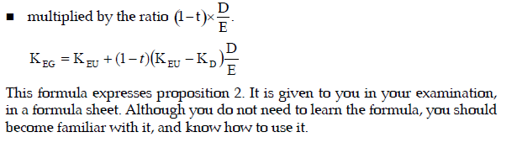
MM’s Theory with tax
(3) Cost of equity
The cost of equity in a geared company is higher than the cost of equity in an ungeared company, by a factor equal to:
the difference between the cost of equity in the ungeared company and the cost of debt, (KEU – KD)

Slide 10
MM’s Theory with tax
Debt related tax benefits : R x D x Kd x t
PV Factor : Kd
PV : D x t

Slide 11
Consider two companies, one ungeared, Co U, and one geared, Co G, both of the same size and level of business risk.
Illustration
 |  |  | Co U | Co G
(in Pounds) |  |  | m | m
PBIT |  |  | 100 | 100
Interest |  |  | - | 20
PBT |  |  | 100 | 80
Tax @ 35% |  |  | 35 | 28
Dividends |  |  | 65 | 52
Return to investors
Equity |  |  | 65 | 52
Debt |  |  | - | 20
 |  |  | 65 | 72

Slide 12
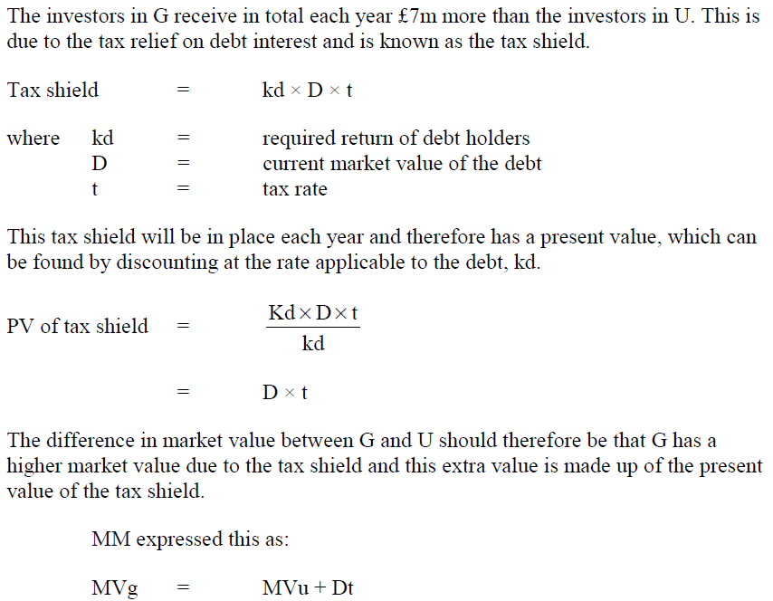

Slide 13
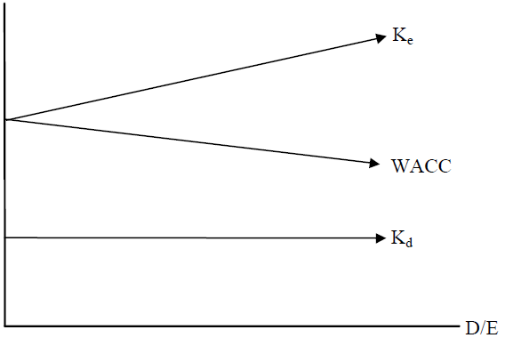
Changes in Costs of Capital
When Corporation Tax is introduced MM argue that the costs of capital change as follows:
Kd (the required return of the
debt holders) remains constant at
all levels of gearing
Ke increases as gearing levels
Increase to reflect additional
perceived financial risk
WACC falls as gearing increases
due to the additional tax relief on the debt interest.

Slide 14
WACC OF A GEARED CO
If the question asks to determine the MV of a geared company the same may be done by computing the MV of the company in its ungeared status then adding D x t to determine the MVg (Market value of the company in it’s geared status)
NOTE:
The MM theory is based on the assumption that Debt is available to all borrowers at the same rate.

Slide 15
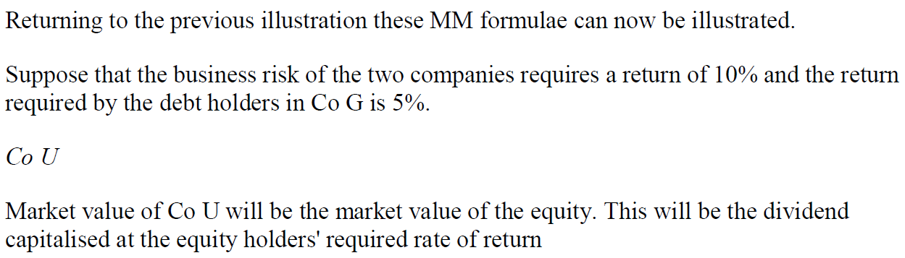
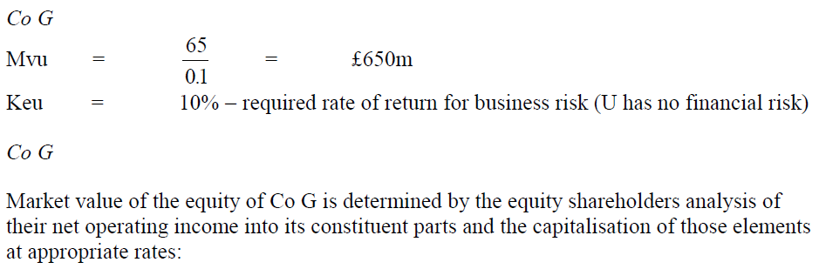
Illustration Contd

Slide 16
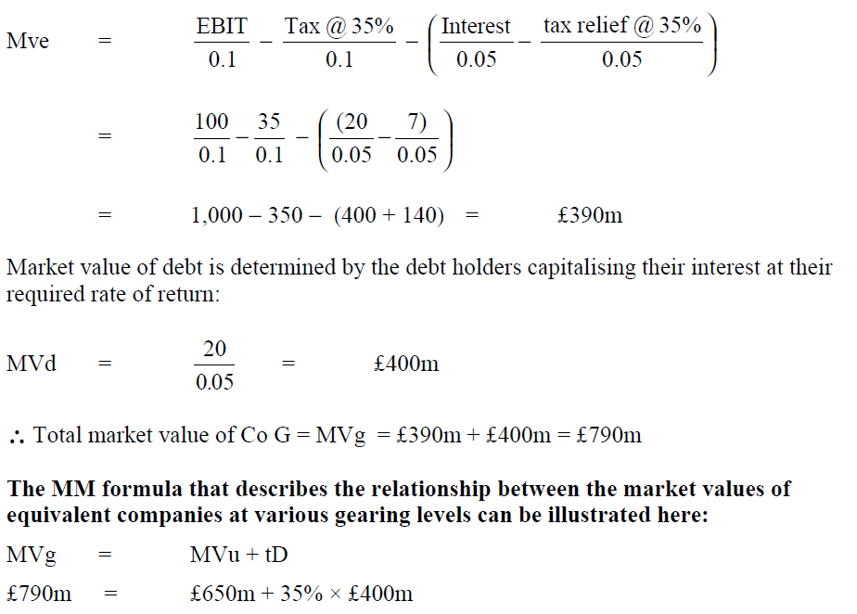

Slide 17
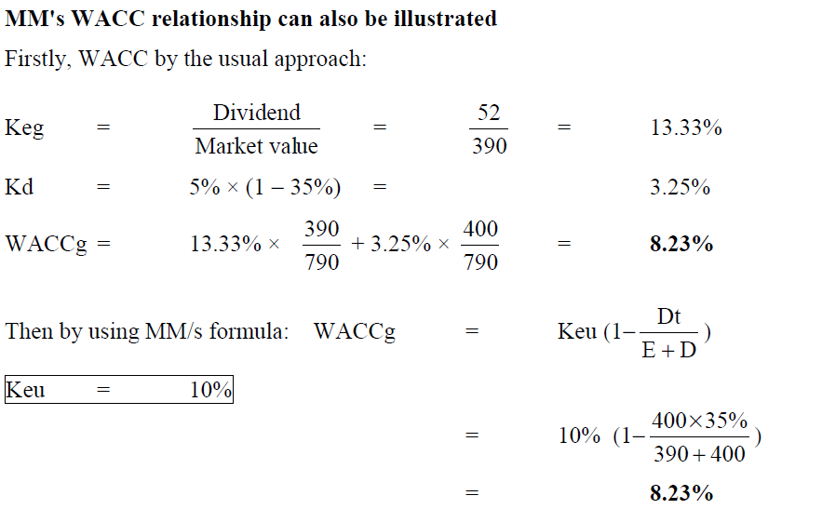

Slide 18
    Thank you

