Slide 1
Investment Analysis
Lecture: 21
Course Code: MBF702

Slide 2
Outline
RECAP
GEARING
FINANCIAL RISK AND THE COST OF CAPITAL
TRADITIONAL THEORY
MODIGLIANI AND MILLER’S THEORY

Slide 3
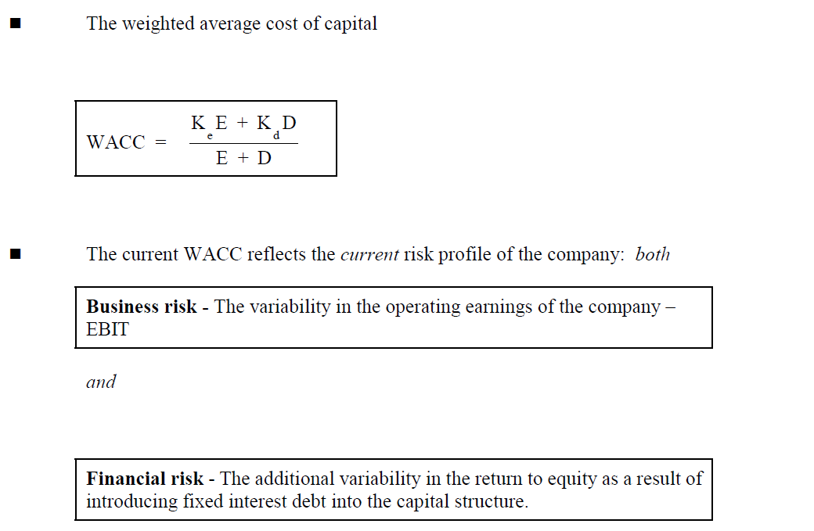
Gearing effect Recap

Slide 4
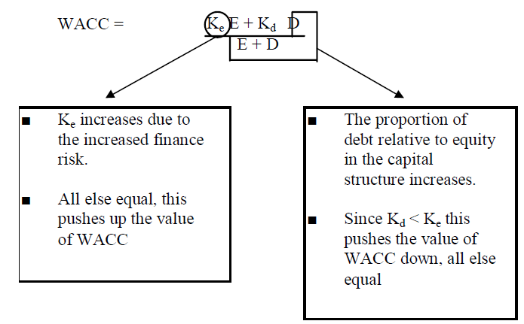
Gearing Effect - Recap

Slide 5
Gearing effect - Recap
There are two main schools of thought
Traditional view
Modigliani and Miller’s theory

Slide 6
TRADITIONAL THEORY
As per the traditional theory, till a certain point, if we keep on introducing debt,
Kd = fairly constant
Ke = increase marginally
WACC = keep on decreasing
Subsequently;
Ke = increase sharply
Kd = increases
WACC = starts increasing
Kd remains constant as gearing level rises upto a level after which it increases
Ke rises as gearing level

Slide 7
TRADITIONAL THEORY
Initially as the gearing level rises, WACC falls due to cheaper debt (KD is always lower than Ke). However if it continues to increase the increase in Ke would become insignificant & WACC should start increasing
Conclusion: with change in D/E ratio, WACC changes, therefore, WACC is not equal to the marginal cost of capital and consequently can’t be the required rate of return for any new project.
However, NPV can be calculated by incorporating DEBT cash flows in the normal cash flows and the discounting the net cash flows i.e. the residual cash flows available to the equity holder of the company, using Ke.

Slide 8
TRADITIONAL VIEW OF CAPITAL STRUCTURE - Reasoning
The traditional view has no theoretical foundation – often described as the “intuitive approach”.
It is believed that Ke rises only slowly at low levels of gearing and therefore the benefit of using lower cost debt finance outweighs the rising Ke.
At higher levels of gearing the increased financial risk outweighs this benefit and WACC rises.

Slide 9
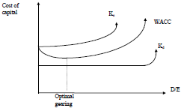
TRADITIONAL VIEW OF CAPITAL STRUCTURE - Reasoning
At higher levels of gearing the increased financial risk outweighs this benefit and WACC rises.

Slide 10
Conclusion
There is an optimal gearing level (minimum WACC).
No method of calculating Ke or WACC or indeed the optimal capital structure. The latter needs to be found by trial and error.
The traditional view of gearing is that there is an optimum level of gearing for a company. This is the level of gearing at which the WACC is minimised.
As gearing increases, the cost of equity rises. However, as gearing increases, there is a greater proportion of debt capital in the capital structure, and the cost of debt is cheaper than the cost of equity. Up to a certain level of gearing, the effect of having more debt capital has a bigger effect on the WACC than the rising cost of equity, so that the WACC falls as gearing increases.
However, when gearing rises still further, the increase in the cost of equity has a greater effect than the larger proportion of cheap debt capital, and the WACC starts to rise. The traditional view of gearing is therefore that an optimum level of gearing exists, where WACC is minimised and the value of the company is maximised.

Slide 11
Project finance - implications
If the company is optimally geared
Raise finance so as to maintain the existing gearing ratio
If the company is sub optimally geared
Raise debt finance so as to increase the gearing ratio towards the optimal
If the company is supra optimally geared
Raise equity finance so as to reduce the gearing ratio back to the optimal

Slide 12
Approach
Appraise the project at the existing WACC
If the NPV of the project is positive the project is worthwhile
Appraise the finance
If Marginal cost of the finance > WACC the finance is not appropriate and should be rejected.
If this were the case the company could raise finance in the existing gearing ratio. In this case the WACC will not deteriorate

Slide 13
MODIGLIANI AND MILLER’S THEORY
Modigliani and Miller (MM) constructed a mathematical model to attempt to provide a basis for financial managers to make finance decisions.
Mathematical models predict outcomes that would occur based on simplifying assumptions.
Comparison of the model’s conclusions to the real world observations then allows researchers to understand the impact of the simplifying assumptions. By relaxing these assumptions in turn the model can be moved towards real life.

Slide 14
MMs assumptions
MMs assumptions include:
Rational investors
Capital market perfection
No tax (either corporate or personal)
Investors are indifferent between personal and corporate borrowing
No risk of bankruptcy
There is a single risk free rate of borrowing
Corporate debt is irredeemable

Slide 15
MM Theory without tax
As the level of gearing increases, there is a greater proportion of cheaper debt capital in the capital structure of the firm.
However, the cost of equity rises as gearing increases.
As gearing increases, the net effect of the greater proportion of cheaper debt and the higher cost of equity is that the WACC remains unchanged.
The WACC is the same at all levels of financial gearing.
The total value of the company is therefore the same at all levels of financial gearing
Modigliani and Miller therefore reached the conclusion that the level of gearing is irrelevant for the value of a company. There is no optimum level of gearing that a company should be trying to achieve.

Slide 16
MM Theory without tax
MM considered two companies both the same size and in the same line of business therefore both having the same level of business risk. The letter ‘U’ refers to an ungeared company (all equity company) and the letter ‘G’ refers to a geared company.
One company was ungeared − Co U
One company was geared − Co G
MM expressed their theory as two propositions.
MM arguments, ignoring taxation, can be summarised as two propositions.
Proposition 1. The WACC is constant at all levels of gearing. For companies with identical annual profits and identical business risk characteristics, their total market value (equity plus debt) will be the same regardless of differences in gearing between the companies.

Slide 17

MM Theory without tax
Vg = Vu
WACCg = WACCu
Proposition 2. The cost of equity rises as the gearing increases. The cost of equity will rise to a level such that, given no change in the cost of debt, the WACC remains unchanged.

Slide 18
MM Theory without tax
There are three formulae for the Modigliani and Miller theory, ignoring corporate taxation. These are shown below.
(1) WACC
The WACC in a geared company and the WACC in an identical but ungeared (all-equity) company are the same:
WACCG = WACCU
This formula expresses a part of proposition 1.
(2) Total value of the company (equity plus debt capital)
The total value of an ungeared company is equal to the total value of an identical geared company (combined value of equity + debt capital):
VG = VU
This formula expresses another part of proposition 1.

Slide 19
MM Theory without tax
(3) Cost of equity
The cost of equity in a geared company is higher than the cost of equity in an ungeared company, by an amount equal to:
the difference between the cost of equity in the ungeared company and the cost of debt (KEU – KD)
multiplied by the ratio of the market value of debt to the market value of equity in the geared company (D/E).
KEG =KEU + D/ E (KEU −KD)
This formula expresses proposition 2.

Slide 20
Example
An all-equity company has a market value of $150 million and a cost of equity of 10%. It borrows $50 million of debt finance, costing 6%, and uses this to buy back and cancel $50 million of equity. Tax relief on debt interest is ignored.
Required
According to Modigliani and Miller, if taxation is ignored, what would be the effect of the higher gearing on (a) the WACC (b) the total market value of the company and (c) the cost of equity in the company?

Slide 21
Solution
According to Modigliani and Miller:
(a) WACC. The WACC in the company is unchanged, at 10%.
(b) Total value. The total market value of the company with gearing is identical to the market value of the company when it was all equity, at $150 million. This now consists of $50 million in debt and $100 million equity ($150 million – $50 million of debt)
(c) Cost of equity. The cost of equity in the geared company is
(10 6) % 12.0%

Slide 22
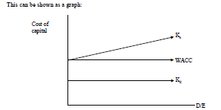
MM Theory without tax

Slide 23
Conclusion
There is no optimal gearing level;
The value of the company is independent of the finance decisions
Only investment decisions affect the value of the company.
This is not true in practice. Why not?
Because the assumptions are too simplistic. There are differences between the real world and the model
Note that MM never said gearing does not matter in the real world. They said that it would not matter in a world where their assumptions were correct. They were then in a position to relax the assumptions to see how the model predictions would change.
The first assumption they relaxed was the no corporate tax assumption.

Slide 24
Theory with tax
Modigliani and Miller revised their arguments to allow for the fact that there is tax relief on interest. You do not need to know the arguments they used to reach their conclusions, but you must know what their conclusions were. You should also know and be able to apply the formulae described below.
Modigliani and Miller argued that allowing for corporate taxation and tax relief on interest, an increase in gearing will have the following effect:
As the level of gearing increases, there is a greater proportion of cheaper debt capital in the capital structure of the firm. However, the cost of equity rises as gearing increases.
As gearing increases, the net effect of the greater proportion of cheaper debt and the higher cost of equity is that the WACC becomes lower. Increases in gearing result in a reduction in the WACC.

Slide 25
The WACC is therefore at its lowest at the highest practicable level of gearing. (There are practical limitations on gearing that stop it from reaching very high levels. For example, lenders will not provide more debt capital except at a much higher cost, due to the high credit risk).
The total value of the company is therefore higher for a geared company than for an identical all-equity company. The value of a company will rise, for a given level of annual cash profits before interest, as its gearing increases.
Modigliani and Miller therefore reached the conclusion that because of tax relief on interest, there is an optimum level of gearing that a company should be trying to achieve. A company should be trying to make its gearing as high as possible, to the maximum practicable level, in order to maximise its value.

Slide 26
    Thank you

