Slide 1
Investment Analysis
Lecture: 20
Course Code: MBF702

Slide 2
Outline
RECAP
GEARING
FINANCIAL RISK AND THE COST OF CAPITAL
TRADITIONAL THEORY
MODIGLIANI AND MILLER’S THEORY

Slide 3
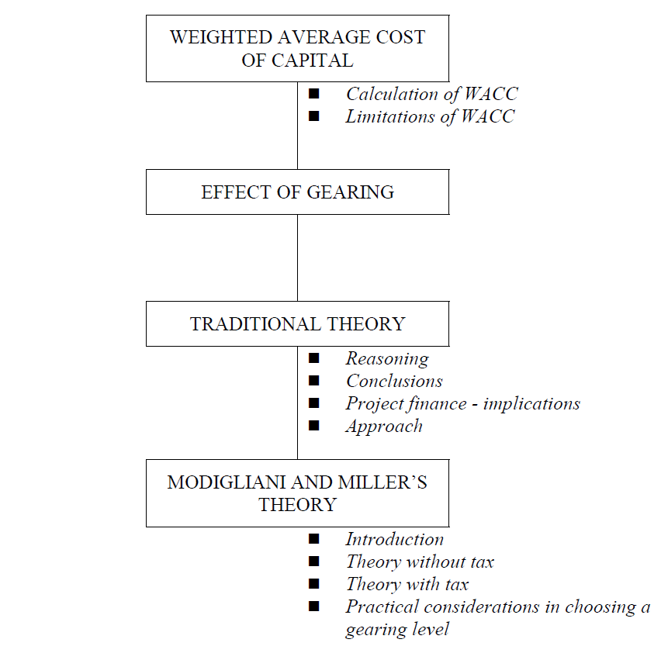
W
A
C
C
Recap

Slide 4
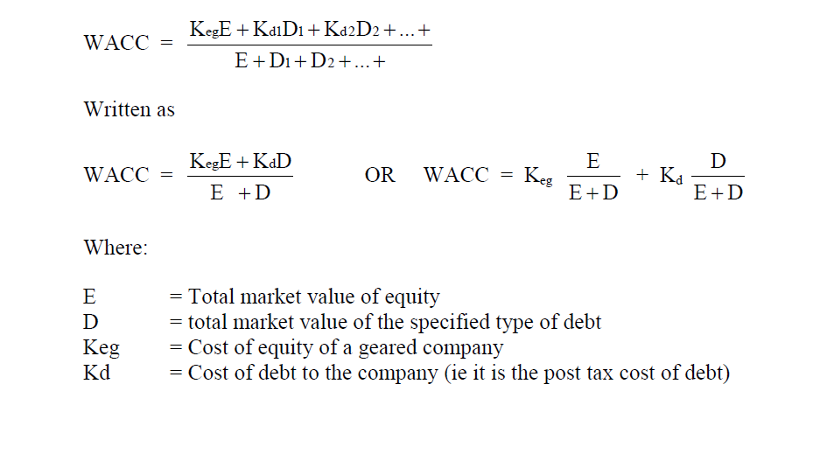
Calculation of WACC

Slide 5
WACC and capital investment appraisal
One approach to the evaluation of capital investments by companies is that all their investment projects should be expected to provide a return equal to or in excess of the WACC. If all their investment projects earn a return in excess of the WACC, the company will earn sufficient returns overall to meet the cost of its capital and provide its investors with the returns they require.
This principle is often applied in practice. The general rule is that when capital investment projects are evaluated using the NPV method, the cost of capital to be used is the WACC. This is on the assumption that the capital project will not alter the risk profile of the company’s investments and the risk with the new project is similar to the risks with the rest of the company’s business operations.

Slide 6
WACC and capital investment appraisal
The principle is often applied when the financing for a new capital investment changes the company’s WACC. On the assumption that the capital project will not alter the risk profile of the company’s investments, the NPV of the new project should be calculated using the new WACC that will exist after the project has been undertaken and financed.
An alternative approach to the evaluation of capital investment projects, which does not use these assumptions, is the adjusted present value method or APV method.

Slide 7
Example
E :40m Ke: 21%
D :20m Kd: 9%
WACC: 17%
The company wishes to invest in a project that would cost Rs 6m & would give NPV of Rs 3m at the existing WACC. The business risk of the project is similar to the existing operation of the company. Please compute how the project may be financed thorough debt & Equity?

Slide 8
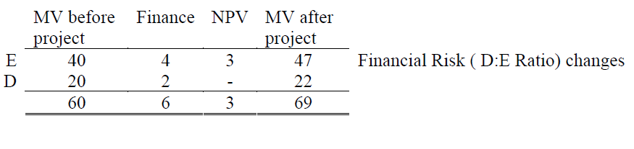
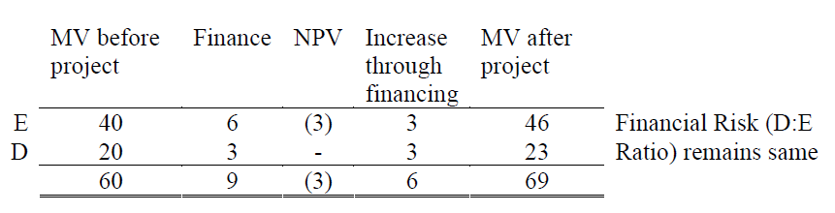
Example

Slide 9
Example
We distribute both the cost & NPV in D: E ratio.
It has been concluded that in order to keep the financial risk or gearing constant, the project must be financed in such a way so that revised gearing ratio (D:E) remains unchanged. The entire NPV belongs to the equity holders of the company as the debt holders usually get a fixed return

Slide 10
Cost of Capital
A return that the company must earn to satisfy the providers of funds & it reflects the riskiness of providing funds.
Elements of cost of capital:-
Risk Free Rate Of Return
Business Risk Premium
Financial Risk Premium

Slide 11
WACC used as a discount rate
If WACC = Marginal cost of the capital i.e. Existing WACC = Revised WACC, the WACC can be used as the discount rate
The above situation is only created if the Debt / Equity ratio or the financial risk and the business risk remain constant.
To keep the financial risk constant care should be taken when deciding the financing ratio of the new project.
The following procedure should be followed; (Required D/E ratio)
  Equity includes the effect of the NPV of the new project. The NPV would be calculated using the existing WACC since we are about to keep the financial risk constant and can use the WACC as the discounting rate for the new project.

Slide 12
WACC used as a discount rate
  Add the NPV of the project calculated above in the financing requirement of the new project
  Distribute the new figure calculated in step 2, in the D/E ratio.
  Deduct the amount of NPV from the share of Equity
  The resultant amount is the Debt and Equity portion of the financing required for the new project, and will keep the D/E ratio before and after the project constant.

Slide 13
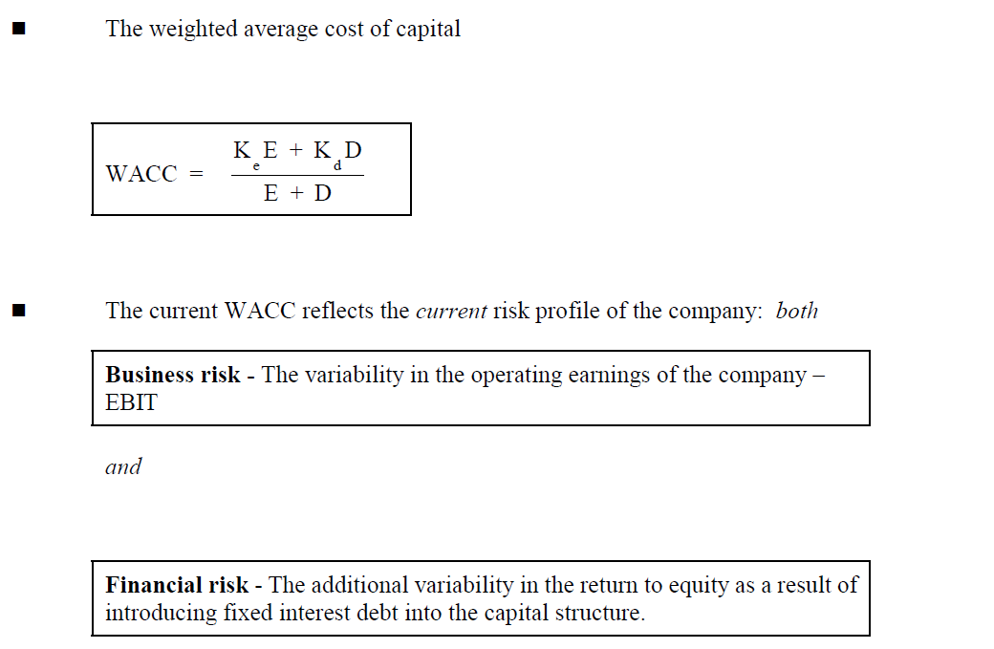
Gearing effect

Slide 14
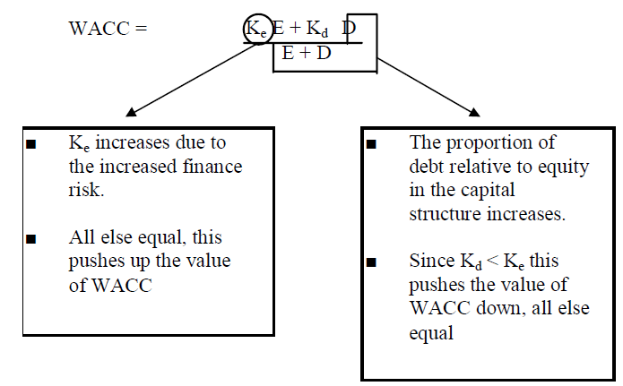
Gearing Effect

Slide 15
Gearing effect
There are two main schools of thought
Traditional view
Modigliani and Miller’s theory

Slide 16
    Thank you

