Slide 1
Investment Analysis
Lecture: 19
Course Code: MBF702

Slide 2
Outline
RECAP
WEIGHTED AVERAGE COST OF CAPITAL
GEARING
FINANCIAL RISK AND THE COST OF CAPITAL
TRADITIONAL THEORY
MODIGLIANI AND MILLER’S THEORY

Slide 3
Objective
To understand the weighted average cost of capital (WACC) of a company and how it is estimated.
To understand the effect of gearing on the WACC of a company.
To discuss the theories of Modigliani and Miller.

Slide 4
Weighted average cost of capital (WACC)
The cost of capital for a company is the return that it must make on its investments so that it can afford to pay its investors the returns that they require.
The cost of capital for investors and the cost of capital for companies should theoretically be the same. However, they are different because of the differing tax positions of investors and companies.

Slide 5
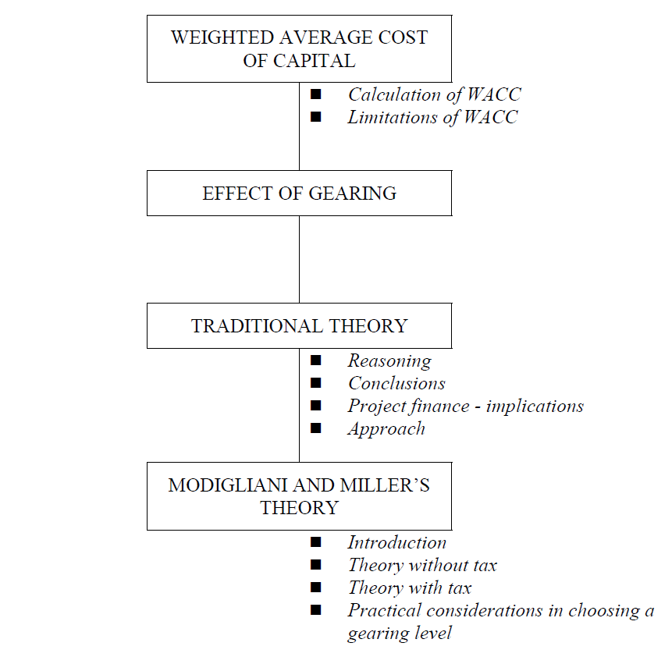
W
A
C
C

Slide 6
WACC
Companies are usually financed by both debt and equity, ie they are geared. We must therefore calculate a weighted average cost of capital.
This will give the overall cost of capital for the company as a potential discount rate.
We have already seen how to calculate the cost of equity and the costs of the individual elements of company debt.
We weight the various costs of debt and equity using their respective market values.

Slide 7
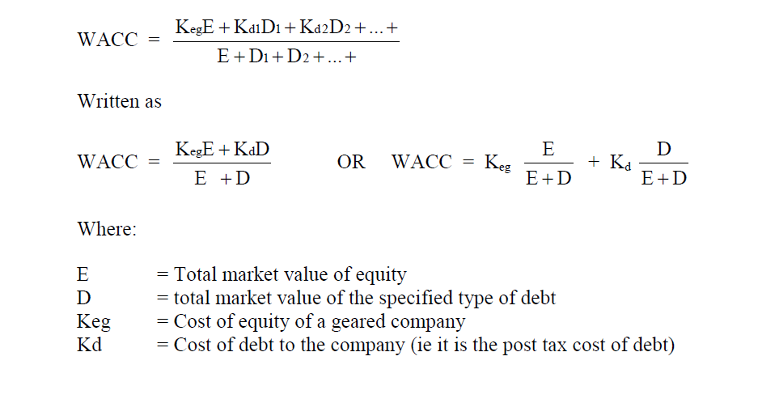
Calculation of WACC

Slide 8
Example
A company has in issue:
45 million £1 ordinary shares
10% loan stock with a book value of £55million
Share price £1.50
Dividend 15p (just paid)
Dividend growth 5% pa
Corporation tax 33%
Calculate the WACC.

Slide 9
Solution
Ke = Do(1+g) + g
Po
=0.15×1.05 + 0.05 = 15.5%
1.50
Kd = 10% × (1 − 0.33) = 6.67%
WACC = 15.5% × 45 × 1.50 + 6.67% × 55
45 × 1.50+ 55 45 × 1.50 +55
= 11.54%

Slide 10
Calculation of WACC – short cut
The following shortcuts may be used when:
Earnings are constant.
Debt is irredeemable / redeemable at Market value.
All earnings are paid out as dividend.
Tax is payable in same year.
Without tax
With tax

Slide 11
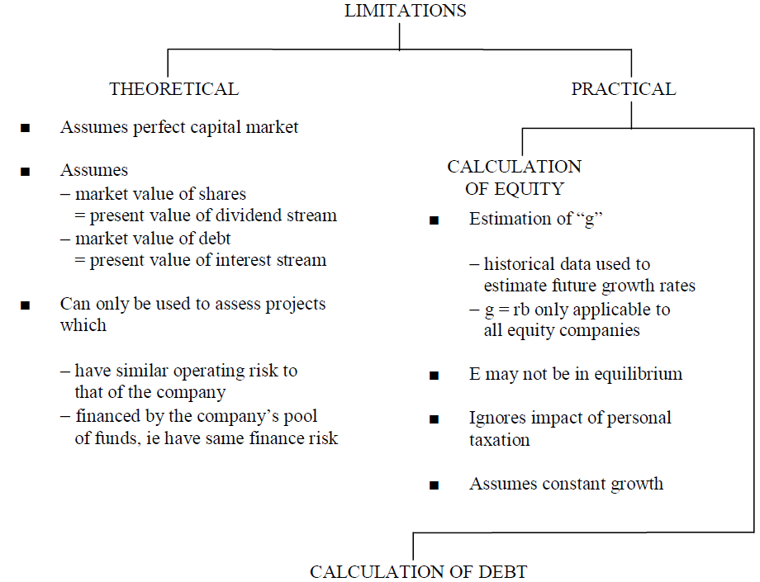
Limitations of WACC

Slide 12
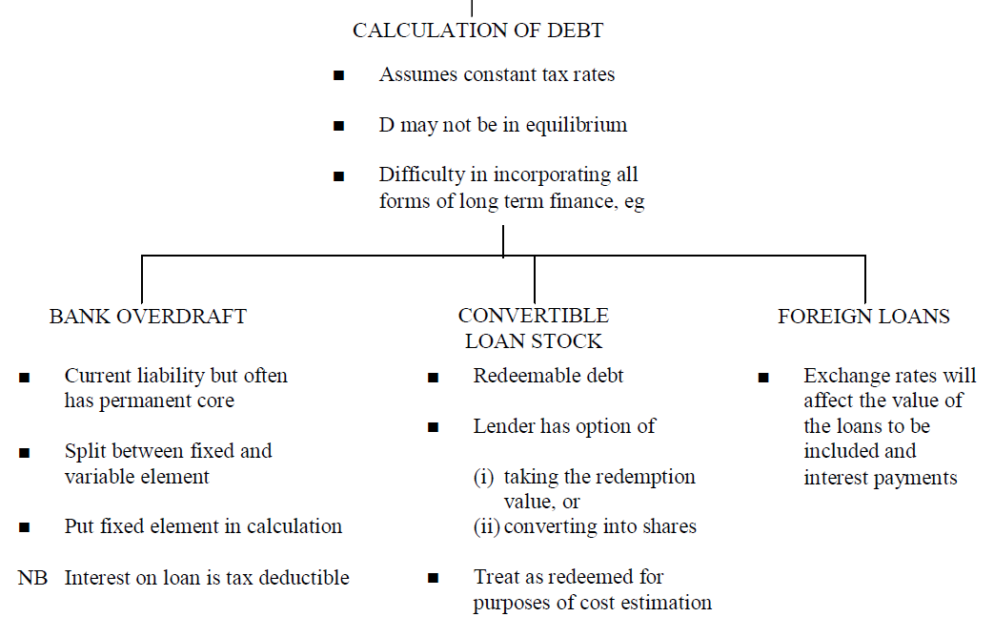
Limitations of WACC

Slide 13
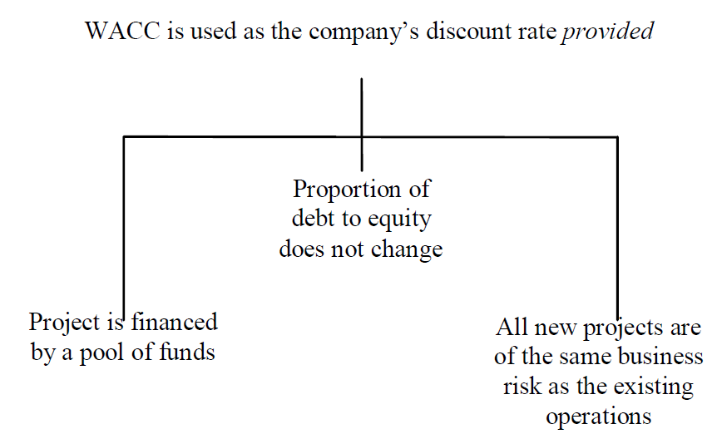
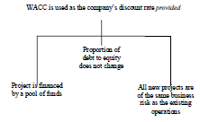
Calculation of WACC

Slide 14
WACC and capital investment appraisal
One approach to the evaluation of capital investments by companies is that all their investment projects should be expected to provide a return equal to or in excess of the WACC. If all their investment projects earn a return in excess of the WACC, the company will earn sufficient returns overall to meet the cost of its capital and provide its investors with the returns they require.
This principle is often applied in practice. The general rule is that when capital investment projects are evaluated using the NPV method, the cost of capital to be used is the WACC. This is on the assumption that the capital project will not alter the risk profile of the company’s investments and the risk with the new project is similar to the risks with the rest of the company’s business operations.

Slide 15
    Thank you

