Slide 1
Investment Analysis
Lecture: 18
Course Code: MBF702

Slide 2
Outline
RECAP
Effective / equivalent periodic rate of return
Convertible debt
EFFICIENT MARKET HYPOTHESIS

Slide 3
Effective / equivalent periodic rate of return for non-annual cash flows
Rate = p.a., therefore, if the cash flows are made on a periodic basis other than annual, an effective rate is needed which is calculated by the following formula:
(1+a) = (1+e)^{en}
Where,
a – annual rate
e – effective periodic rate
en – number of periods in one year (e.g. quarterly =4)

Slide 4
Convertible debentures
Convertible debentures or loan stock allow the investor to choose between redeeming the debentures at some future date or converting them into a pre-determined number of ordinary shares in the company.
In order to find the cost of debt of convertibles it is necessary to be able to determine which option the investor will exercise and at what
date.
This will normally involve the following stages:

Slide 5
Convertible debentures – calculation method
This will normally involve the following stages:
Calculate all cash flows from all options at the time of the decision making and opt for the option with maximum value.
In case where conversion option is with the debt holder, with respect to WACC, redemption would be taken the higher cost to the company, i.e. the redemption of debt or the conversion into shares, whichever results in higher cost to the company.
Possible options:

Slide 6
Convertible debentures – calculation method
Option | Calculations to perform
Immediate selling of debt | Discount future cash flows @ market rate of debt
Immediate conversion of debt | Number of shares x current market price
Holding the debt till redemption | All future cash flows discounted @ required rate of return of investor

Slide 7
Convertible debentures – calculation method
All comparisons should be made at the same point in time i.e. all options should be at any one point in time level
Question may ask for a
  possible growth rate in share price or
  share price at the end of debt period i.e. at redemption year which if prevailing give the required rate of return.
In such situations calculate / inflate / discount the cash flows at that time at the required rate of return (i.e. calculate NTV) and the
Balancing amount ÷ Number of shares = Share price

Slide 8
Example
A company has in issue some 8% convertible loan stock currently quoted at £85 ex interest. The loan stock is redeemable at a 5% premium in five years time, or can be converted into 40 ordinary shares at that date. The current ex div market value of the shares is £2 per share and dividend growth is expected at 7% per annum.
Corporation tax is 33%.
What is the cost to the company of the convertible loan stock?

Slide 9
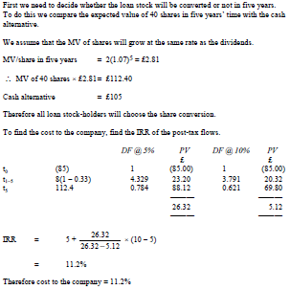
Solution

Slide 10

Elements of cost of capital - revision

Slide 11
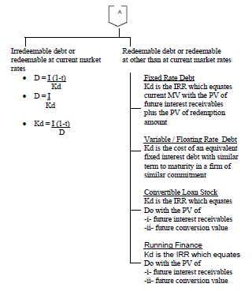
Cost of debt - revision

Slide 12
Comparing the cost of equity and the cost of debt - revision
For investors and for companies, the cost of their equity is always higher than the cost of their debt capital. This is because equity investment in a company is always more risky than investment in the debt capital of the same company.
In addition, from a company’s perspective, the cost of debt is also reduced by the tax relief on interest payments. This makes debt finance even lower than the cost of equity.
The effect of more debt capital, and higher financial gearing, on the WACC is considered in more detail later.

Slide 13
EFFICIENT MARKET HYPOTHESIS
Practical factors affecting share prices
The dividend valuation model gives a theoretical value, given the assumptions inherent in the model, for shares and debentures.
In practice there will be many factors other than the present value of cash flows from a security that play a part in its valuation. These are likely to include:

Slide 14
EFFICIENT MARKET HYPOTHESIS
interest rates
market sentiment
expectation of future events
Inflation
press comment
speculation and rumour
currency movements
takeover and merger activity
political issues.
The dividend valuation model helps us to understand how a change in these variables (or, to be more accurate, an expected change) should effect the market value of the security.

Slide 15
Efficient markets
The value of a share or of the equity shareholders funds is based upon expectations of future cash flows either in the form of dividends or NPVs of investment projects. The strength of the link between the performance of the company and the share price will depend upon the efficiency of the capital markets.
How much does the market know about a company? In other words, how good is it at incorporating information into the share price?

Slide 16
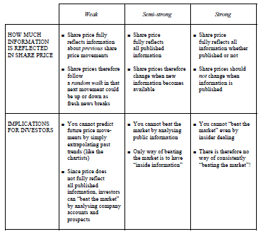
The three degrees of market efficiency

Slide 17
Term structure of interest rates - Definition
The term structure of interest rates refers to the way in which the yield of a security (interest and redemption value) varies according to the term of the security.
The normal picture is that the longer the term of a security, the length of time to redemption, the higher will be its gross redemption yield.
Gross redemption yield is interest yield plus capital gain or loss to maturity.

Slide 18
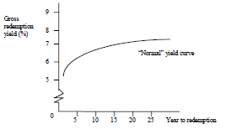
Yield curve
The yield curve is a graph that shows at any point in time the redemption yields of gilts (government stocks) plotted against the term of the gilt. A typical yield curve would be:
The yield curve above shows us that people like to get their money as fast as possible, this is called liquidity preference theory.

Slide 19
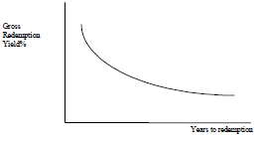
Yield curve
The graph shows that holders of long dated gilts are receiving a lower yield than holders of short dated gilts. This occurs in the situation when we expect interest rates to fall, falling interest rates increase bond prices.

Slide 20
Yield curve
Students should note that the graph plots maturity against redemption yield (also called yield to maturity). In the exam the examiner may also give you interest yield, this is simply annual interest divided by market value of the bond and is not part of the above graph.

Slide 21
Focus points
You should now be able to:
understand and use the dividend valuation model;
estimate the cost of equity and cost of debt for a company;
understand the practical factors that affect share prices including the
efficiency of capital markets;
understand the meaning of the term structure of interest rates.

Slide 22
Thank you

