Slide 1
Investment Analysis
Lecture: 17
Course Code: MBF702

Slide 2
Outline
RECAP
Redeemable debt
Convertible debt
EFFICIENT MARKET HYPOTHESIS

Slide 3
Redeemable debentures
This is no longer a perpetuity. However from the dividend valuation model we can derive the following rule:
The cost of any source of funds is the IRR of the cash flows associated with that source.
If we are looking at this from an investor’s point of view, interest payments are included gross. If we are looking at the cost to the company, we take the interest payments net of corporation tax.
The final redemption payment does not have any tax effects.
To find the cost of debt for a company find the IRR of the following cash flows:

Slide 4
Imp tips for calculations
Calculate / plot cash flows for Face value of Rs. 100 for easy calculations
Cash flows are made with respect to the company from the investor’s perspective to keep calculation simple i.e. outflow first and then inflow at the end.

Slide 5

Redeemable debentures

Slide 6
Example
A company has in issue £200,000 7% debentures redeemable at a premium of 5% on 31 December 19X6. Interest is paid annually on the debentures on 31 December. It is currently 1 January 19X3 and the debentures are trading at £98 ex interest. Corporation tax is 33%.
What is the cost of debt for this company?

Slide 7
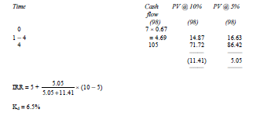
Solution

Slide 8

Redeemable debentures
Care should be taken not to confuse the required return of the debenture holders with the cost of debt of the company.
The required return of the debenture holders is used to determine the ex interest market value of the debentures using the dividend valuation model.
The cost of debt of the company is then determined by finding the IRR of the market value, net of tax interest payments and redemption value.

Slide 9
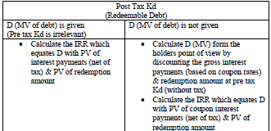
Cost of debt - revision
It has been agreed that if interest accrued on a debt would not be paid for some time, then such accrued interest would form part of MV of debt. There is no tax benefit of interest payment on preference shares hence gross interest payments are calculated & Kd is automatically post tax

Slide 10
Calculation of ‘D’
Irredeemable debt | Redeemable debt
Calculation of ‘D’ The only cash flow in irredeemable debt is the interest payments (Coupon rate x Face value of the debt). D can be calculated by discounting pre-tax interest cash flows at a pre tax Kd or discounting post tax interest cash flows with a post tax Kd (Kd x (1-t) would suffice the need). | Calculation of ‘D’ The value of D can be calculated by plotting the cash flows (Interest – Coupon rate x Face value of the deb) of the debt, including the redemption of the debt. The cashflows should however, be from the investors perspective to keep calculation simple. These cashflows should be pre-tax, or if investor’s tax rate is given then post tax by the rate of tax of the investor. Discount these cash flows at the pre tax market rate (kd). The present value of these cash flows will be the market value of the debt.

Slide 11
Calculation of ‘Kd’
Irredeemable debt | Redeemable debt
Calculation of ‘Kd’ Since interest (Coupon rate x Face value of the debt) is the only cash flow and D is given, the IRR of the cash flows is Kd. In other words, if the interest cash flow is divided by the market value of the debt, the Kd is obtained, pre tax or post tax would depend on the status of the cash flow. | Calculation of ‘Kd’ (for the company) Kd for the company is always post tax (using the tax rate of the company). However, it cannot be made post tax by Kd x (1-t). For determining the Kd, plot the debt cash flows from the investor’s perspective, including the redemption of the debt. Put the market value of the Debt as determined above. The IRR of these cash flows will be the post tax Kd of the debt for the company. Present value of all cash flows (other than initial Year ‘0’ one) @ ‘Kd’ Kd is determined by calculating the IRR of the cash flows with initial cash flow in year ‘0’ equal to the Market value of Debt ‘D’ – Also see the concept of ‘Simple Annualized Return’ below for the starting point of calculating the IRR.

Slide 12
Example
A company has 8% debentures redeemable at a 5% premium in ten years.
Debenture-holders require a return of 10%.
What is the cost to the company? Corporation tax is 33%.

Slide 13
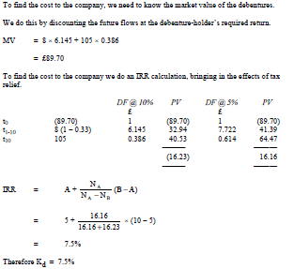
Solution

Slide 14
COST OF DEBT – half yearly interest payments
In practice debenture interest will tend to be paid every six months rather than annually. This practical aspect can be built into our calculations for cost of debt.
If interest payments are being made every 6 months then when the IRR of the debenture cash flows is calculated it should be done on the basis of a single time period being 6 months.
The IRR, or cost of debt, will then be a 6 monthly cost of debt and must be adjusted to determine the annual cost of debt.

Slide 15
Example
A company has in issue 6% debentures the interest on which is paid on 30 June and 31 December each year. The debentures are redeemable at par on 31 December 19X9. It is now 1 January 19X7 and the debentures are quoted at 96% ex interest.
What is the annual cost of debt for the company? Ignore corporation tax.

Slide 16
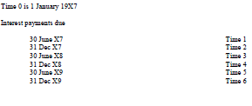
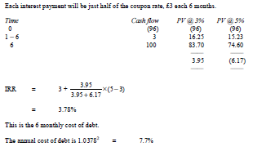
Solution

Slide 17
Thank you

