Slide 1
Investment Analysis
Lecture: 16
Course Code: MBF702

Slide 2
Outline
RECAP
COST OF DEBT – terminology
Tax on interest
Irredeemable debt
Redeemable debt
Convertible debt
EFFICIENT MARKET HYPOTHESIS

Slide 3
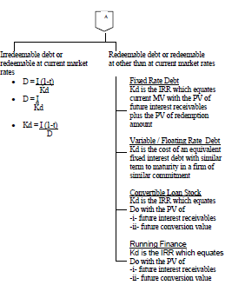

Elements of cost of capital and cost of debt

Slide 4
Cost of Debt
When companies borrow funds from outside or take debt from financial institutions or other resources the interest paid on that amount is called cost of debt. The cost of debt is computed by taking the rate on a risk free bond whose duration matches the term structure of the corporate debt, then adding a default premium. This default premium will rise as the amount of debt increases (since, all other things being equal, the risk rises as the amount of debt rises).
Since in most cases debt expense is a deductible expense, the cost of debt is computed as an after tax cost to make it comparable with the cost of equity (earnings are after-tax as well). Thus, for profitable firms, debt is discounted by the tax rate. The formula can be written as (Rf + credit risk rate)(1-T), where T is the corporate tax rate and Rf is the risk free rate.
The yield to maturity can be used as an approximation of the cost of debt.

Slide 5
Determination of ‘Kd’ and ‘D’
Important terms
Face value = nominal value of the debt
Coupon rate = rate at which the interest is paid on the debt
Redemption at Means
Face value At par
> face value At premium
< face value At discount
D fluctuates with respect to Kd as D is present value of debt cash flows discounted at Kd (always pre-tax) since the tax rate w.r.t. the company and the investor will not be same. Therefore, in order to compute a market value (same for both the parties) a pre-tax Kd is used. The only exception to using pre tax Kd is determining D for an irredeemable debt.

Slide 6
COST OF DEBT - Terminology
COUPON RATE:
The coupon rate gives the gross rate of interest received by debenture holders. The coupon rate is based on the nominal value of the debentures.
Face Value / Nominal Value: Reference value used for calculation of coupon interest rate.
Issue Value: Value at which debt / security is initially issued to the borrower.
MV is normally quoted as the MV of a block of £100 nominal value.
e.g. 10% debentures quoted at £95 means that a £100 block is selling for £95 and annual interest is £10 per £100 block.

Slide 7
COST OF DEBT - Terminology
Redemption Value: Value / amount to be paid by the borrower to the holder. on maturity / redemption of the debt security.
Redemption value > face value: redemption at premium
Redemption value < face value: discount at premium
Redemption value = face value: redemption at par
Market Value: Value at which the security can be actively traded in the market currently.
Purchase Yield: Rate at which when all future cash flows are discounted at the time of purchase of security their PV equals the purchase price; IRR when all cash flows are plotted against purchase value; does not change.

Slide 8
COST OF DEBT - Terminology
Market Yield: Rate at which when all future cash flows are discounted their PV equals the market value of debt; IRR when all cash flows are plotted against market value. It changes when securities are redeemed at par
Return > market rate ; traded at premium
Return < market rate ; traded at discount
Return = market rate ; traded at par
WACC is based on Ex dividend & Ex Interest Market Values of equity & debt components respectively.

Slide 9
Cost of debt - Tax on interest
The cost of capital for companies recognises that interest costs are an allowable expense for tax purposes, and the cost of debt capital to a company should allow for the tax relief that companies receive on interest payments, reducing their tax payments. The cost of debt capital for companies is measured as an after-tax cost.

Slide 10
Example: pre-tax and after-tax cost of debt
A company has a bank loan of $100,000 on which it pays interest at 8%. The rate of tax on company profits is 25%.
Gross interest on the loan each year is $8,000 and the pre-tax cost of the debt is 8%. This means that the company needs to make a profit of $8,000 each year before tax and interest in order to cover the interest cost of the debt. Tax relief on the interest is $2,000, which means that the tax charge for the company is reduced by $2,000 each year. The company therefore needs to make a profit after tax of $6,000 to cover the cost of the debt interest, and the after-tax cost of the debt is just 6%. The $6,000 after tax profit plus the reduction in the tax charge of $2,000 together provide the return of $8,000 that is needed to cover the cost of the debt interest.

Slide 11
Example: pre-tax and after-tax cost of debt
The after tax cost of debt is simply:
the pre-tax cost of debt
multiplied by a factor (1 – t) where t is the rate of tax on profits.
The after tax Kd of an irredeemable debt can be computed by multiplying the Pre tax Kd with (1-t).

Slide 12
Irredeemable debt
Using the same logic as for dividends and looking at the cash flows from the investor’s point of view.
MV (ex interest) = present value of future interest payments discounted at the debenture-holder’s required rate of return.
For irredeemable debentures interest is a constant perpetuity.
MV (ex int) = I / r
where I = annual interest rate
    r = return required by debenture holder
r = I / MV (ex int) = Interest yield
The company gets tax relief on the debenture interest it pays, which reduces the cost of debentures to the company

Slide 13
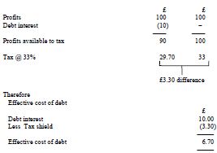
Irredeemable debt

Slide 14
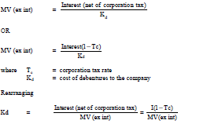
Irredeemable debt
Unless told otherwise, we assume that tax relief is instant (in practice, there will be a minimum time lag of nine months). The expression for market value then becomes:

Slide 15
Irredeemable debt
Note that if debt is irredeemable then:

Slide 16
Example
12% debentures with a nominal value of £100 are quoted at £92 cum interest.
The rate of corporation tax is 33%.
Find
(a) the return required by the debenture-holders
(b) the cost to the company.

Slide 17
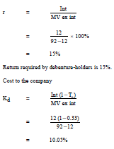
Solution

Slide 18
Thank you

