Slide 1
Investment Analysis
Lecture: 15
Course Code: MBF702

Slide 2
Outline
RECAP
Cost of equity - Dividend with constant growth (example)
Cost of preference shares
COST OF DEBT – terminology
Tax on interest
Irredeemable debt
Redeemable debt
Convertible debt
EFFICIENT MARKET HYPOTHESIS

Slide 3

Cost of equity
Dividend with constant growth - Recap
This constant growth rate of dividends can be estimated using either of two methods.

Slide 4
Example
A company has 300,000 ordinary shares in issue with an ex-div market value of £2.70 per share. A dividend of £40,000 has just been paid out of post-tax profits of £100,000.
Net assets at the year end were valued at £1.06m.
Estimate the cost of equity.

Slide 5
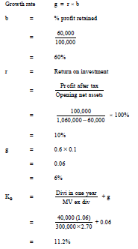
Solution

Slide 6
Cost of equity
Illustration
A plc is all equity financed and has 1m shares quoted at £2 each ex div. It pays constant annual dividends of 30p per share.
It is considering adopting a project which will cost £500,000 and which is of the same risk as its existing activities. The cost will be met by a rights issue. The project will produce inflows of £90,000 pa in perpetuity. All inflows will be distributed as dividends.
What is the new value of the equity in A plc and what is the gain to the shareholders?
Ignore tax.

Slide 7

Cost of equity
Illustration

Slide 8
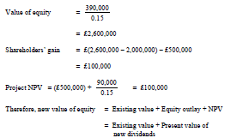
Cost of equity
Illustration
The NPV of the project serves to increase the value of the equity shareholders’ shares.

Slide 9
Imp Aspects
Limitations of the model
Method is not applicable for companies paying no or very low cash dividend.
If g > Ke, the method fails
Retained profits may not earn enough profit to maintain the dividend stream
Important MISTAKE to note
If formula applies at later than Yr ‘0’, discount the value of ‘E’ here and dividends in interim years at the required rate of return of shareholder, i.e. Ke to obtain ‘E’

Slide 10

Cost of preference shares
By definition preference shares have a constant dividend
If you have cumulative preference shares, the MV is increased by the
outstanding amount to be paid.
Preference dividends are normally quoted as a percentage, e.g. 10% preference shares. This means that the annual dividend will be 10% of
the nominal value, not the market value.
Share prices change, often dramatically, on a daily basis. The dividend valuation model will not predict this, but will give an estimate of the underlying value of the shares.

Slide 11
Example
A company has 100,000 12% preference shares in issue (nominal value £1).
The current ex-div market value is £1.15 per share.
What is the cost of the preference shares?

Slide 12
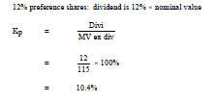
Solution

Slide 13
Thank you

