Slide 1
Investment Analysis
Lecture: 11
Course Code: MBF702

Slide 2
Outline
RECAP
  Profitability index
  Annuities and perpetuity
  Net terminal value
  Capital Rationing

Slide 3
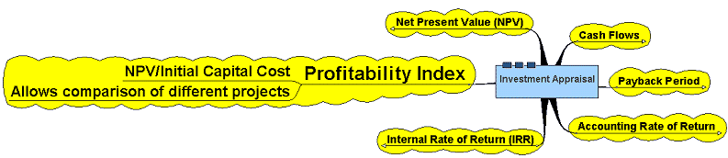
Profitability Index

Slide 4
Profitability Index
Allows a comparison of the costs and benefits of different projects to be assessed and thus allow decision making to be carried out
Net Present Value of future net cash flows
Profitability Index = --------------------------- -------------------------------
Initial Capital Cost

Slide 5
Profitability Index
Accept/Reject Decision:
  if PI > 1, accept the project
  if PI < 1, reject the project

Slide 6
PI Strengths and Weaknesses
Strengths:
  Same as NPV
  Allows comparison of different scale projects
Weaknesses:
  Same as NPV
  Provides only relative profitability
  Potential Ranking Problems

Slide 7
Annuities and Perpetuities
Annuity – finite series of equal payments that occur at regular intervals
  If the first payment occurs at the end of the period, it is called an ordinary annuity
  If the first payment occurs at the beginning of the period, it is called an annuity due
Perpetuity – infinite series of equal payments
Perpetuity : PV = CF / r

Slide 8
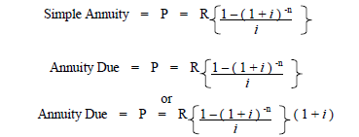

Annuities– Basic Formulas
Present value
Future value

Slide 9
Net terminal value
Net Terminal Value is the cash surplus remaining at the end of the project after taking into account repayment of capital / initial cost & return of capital at the required rate.
NTV when discounted at the required rate would give the NPV of the project with the underlying assumption that any surplus (arising at the end of each year) would earn interest at the required rate /same rate.
Only because of the aforesaid assumption the relationship between NPV & NTV remains true.

Slide 10
Capital Rationing
A situation in which the company has a limited amount of capital to invest in potential projects such as the different possible investments need to be compared with one another in order to allocate the limited capital available
Soft Capital Rationing : Due to internal factors
Hard Capital Rationing : Due to external / environmental factors

Slide 11
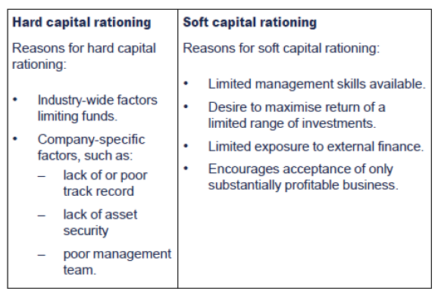
Capital Rationing

Slide 12
Capital Rationing
Occurs when a limit is set on the amount of funds available to a firm for investment.
Firm must rank investments based on their NPVs
Those with positive NPVs greater than the cost of capital are accepted until all funds are exhausted

Slide 13
Other Project Relationships
Dependent – A project whose acceptance depends on the acceptance of one or more other projects.
Mutually Exclusive – A project whose acceptance preclude (exclude) the acceptance of one or more alternative projects.

Slide 14
Mutually Exclusive versus Independent Project
Mutually Exclusive Projects: only ONE of several potential projects can be chosen, e.g. acquiring an accounting system.
  RANK all alternatives and select the best one.
Independent Projects: accepting or rejecting one project does not affect the decision of the other projects.
  Must exceed a MINIMUM acceptance criteria.

Slide 15
Capital rationing calculation
Calculate the PI for each project
Rank all projects in term of their PIs, from highest to lowest
Starting with the project having the highest PI, go down the list and select all projects having PI>1 until the capital budget is exhausted

Slide 16
Capital rationing - Special situations
When projects are independent and the firm has few constraints on capital, then we check to ensure that projects at least meet a minimum criteria – if they do, they are accepted.
  NPV≥0; IRR≥ discount rate; PI≥1
Sometimes a firm will have plenty of funds to invest, but it must choose between projects that are mutually exclusive. This means that the acceptance of one project precludes the acceptance of any others. In this case, we seek to choose the one highest ranked of the acceptable projects.
If the firm has capital rationing, then its funds are limited and not all independent projects may be accepted. In this case, we seek to choose those projects that best use the firm’s available funds. PI is especially useful here.

Slide 17
Capital Rationing
Recall: If the firm has capital rationing, then its funds are limited and not all independent projects may be accepted. In this case, we seek to choose those projects that best use the firm’s available funds. PI is especially useful here.
Note: capital rationing is a different problem than mutually exclusive investments because if the capital constraint is removed, then all projects can be accepted together.
Analyze the projects on the next page with NPV, IRR, and PI assuming the opportunity cost of capital is 10% and the firm is constrained to only invest $50,000 now (and no constraint is expected in future years).

Slide 18
Capital Rationing – Example
(All $ numbers are in thousands)
Year | Proj. A | Proj. B | Proj. C | Proj. D | Proj. E
0 | -$50 | -$20 | -$20 | -$20 | -$10
1 | $60 | $24.2 | -$10 | $25 | $12.6
2 | $0 | $0 | $37.862 | $0 | $0
NPV | $4.545 | $2.0 | $2.2 | $2.727 | $1.4545
IRR | 20% | 21% | 14.84% | 25% | 26%
PI | 1.0909 | 1.1 | 1.11 | 1.136 | 1.145

Slide 19
Capital Rationing Example: Comparison of Rankings
NPV rankings (best to worst)
  A, D, C, B, E
    A uses up the available capital
    Overall NPV = $4,545.45
IRR rankings (best to worst)
  E, D, B, A, C
    E, D, B use up the available capital
    Overall NPV = NPV_{E+D+B}=$6,181.82
PI rankings (best to worst)
  E, D, C, B, A
    E, D, C use up the available capital
    Overall NPV = NPV_{E+D+C}=$6,381.82
The PI rankings produce the best set of investments to accept given the capital rationing constraint.

Slide 20
Capital Rationing Conclusions
PI is best for initial ranking of independent projects under capital rationing.
Comparing NPV’s of feasible combinations of projects would also work.
IRR may be useful if the capital rationing constraint extends over multiple periods (see project C).

Slide 21
Summary and Conclusions
Discounted Cash Flow (DCF) techniques are the best of the methods we have presented.
In some cases, the DCF techniques need to be modified in order to obtain a correct decision. It is important to completely understand these cases and have an appreciation of which technique is best given the situation.

Slide 22
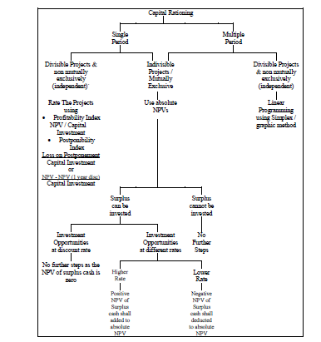

Slide 23
Linear programming
The aim of decision making is to maximise profit, assuming that the fixed cost does not change, this would mean that we must maximise contribution. Alternatively the aim may be minimise cost to subsequently maximise profit.
Steps to perform linear programming
1. Define the problem
2. Objective function
3. Constraints
4. Graph
5. Optimal solution
6. Shadow prices

Slide 24
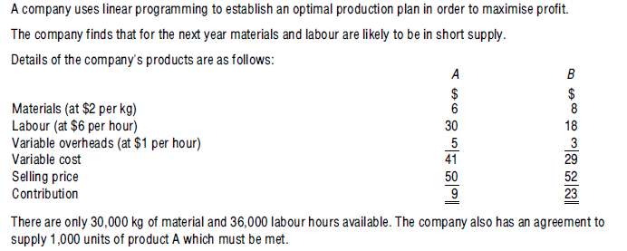
Illustration

Slide 25
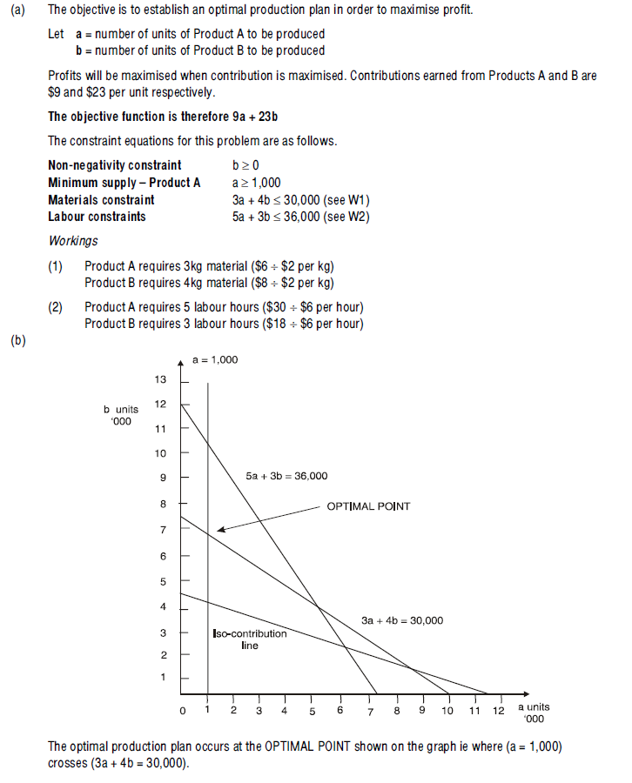
Solution

Slide 26
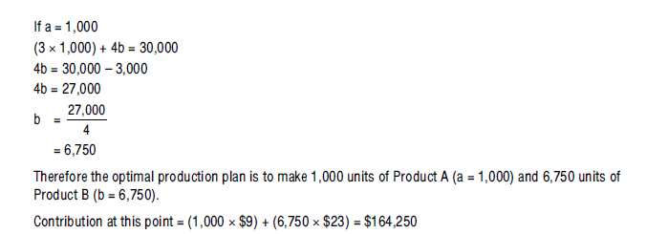
Solution

Slide 27
Thank you

