Slide 1
Revise lecture 19

Slide 2
Contingent liabilities and contingent assets

Slide 3
Contingent liabilities
A contingent liability is:
1. A possible obligation that arises from past events and whose existence will be confirmed only by the occurrence or non-occurrence of one or more uncertain future events not wholly within the control of the enterprise OR

Slide 4
Contingent liabilities
2. A present obligation that arises from past events but is not recognised because:
It is not probable that an outflow of resources embodying economic benefits will be required to settle the obligation; or
The amount of the obligation cannot be measured with sufficient reliability.

Slide 5
Contingent assets
A contingent assets is:
A contingent assets is a possible asset that arises from past events and whose existence will be confirmed only by the occurrence or non-occurrence of one or more uncertain future events not wholly within the control of the enterprise.

Slide 6
Accounting for contingent liabilities
Contingent liabilities:
Should not be recognised in the statement of financial position itself.
Should be disclosed in a note unless the possibility of a transfer of economic benefits is remote.

Slide 7
Accounting for contingent assets
Contingent assets:
Should not generally be recognised, but if the possibility of inflows of economic benefits is probable, they should be disclosed.
If a gain is virtually certain, it falls within the definition of an asset and should be recognised as such, not as a contingent assets.

Slide 8
Accounting for contingent liabilities and assets
The requirements of IAS 37 as regards contingent liabilities and assets are summarised in the following table:

Slide 9
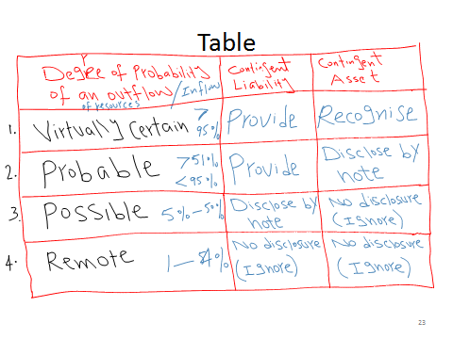
Table

Slide 10
Accounting for contingent liabilities and assets
Note that the standard gives no guidance as the meaning of the terms in the left-hand column (probable, possible, remote). One possible interpretation is as follows:
Virtually certain > 95%
Probable 51% - 95%
Possible 5% - 50%
Remote < 5%

Slide 11
Events after the reporting period date IAS 10

Slide 12
Events after the reporting period date IAS 10
Events after the reporting period are those events, both favourable and unfavourable, which occur between the reporting date and the date on which the financial statements are approved for issue by the board of directors

Slide 13
Events after the reporting period date IAS 10
What are adjusting events and non-adjusting events?

Slide 14
Events after the reporting period date IAS 10
Adjusting events
Adjusting events are events after the reporting date which provide additional evidence of conditions existing at the reporting date.

Slide 15
Adjusting events
These events provide additional evidence of conditions existing at the reporting date. For example, irrecoverable debts arising one or two months after the reporting date may help to quantify the allowance for receivables as at the reporting date.
Adjusting events may, therefore, affect the amount at which items are stated in the reporting.

Slide 16
Adjusting events
Examples of adjusting events
The settlement after the reporting date of a court case which confirms a year end obligation.
The receipt of information after the reporting date that indicates that as asset was impaired at the reporting date.

Slide 17
Adjusting events
Examples of adjusting events
The bankruptcy of a customer after the reporting date that confirms that a year-end debt is irrecoverable.
The sale of inventories after the reporting period at a price lower than cost.

Slide 18
Adjusting events
Examples of adjusting events
The determination after the reporting date of the cost of assets purchased or proceeds from assets sold before the reporting date.
The discovery of fraud or errors showing that the financial statements are incorrect

Slide 19
Non-adjusting events
These are events arising after the reporting date but which do not concern conditions existing at the reporting date. Such events will not, therefore, have any effect on items in the reporting or income statement.

Slide 20
Non-adjusting events
However, in order to prevent the financial statements from presenting a misleading position, some form of additional disclosure is required if the events are material, by way of a note to the financial statements giving details of the event.

Slide 21
Non-adjusting events
Examples of non-adjusting events:
Announcing a plan to discontinue an operation.
Major purchases of assets.
The destruction of assets after the reporting date by fire or flood

Slide 22
Non-adjusting events
Examples of non-adjusting events:
4. Entering into significant commitments or contingent liabilities
5. Commencing a court case arising out of events after the reporting date.

Slide 23
Non-adjusting events
Proposed dividends:
It is not acceptable to include dividends declared after the reporting date as liabilities at the year end.
If dividends are declared before the year end, they must be shown in the statement of changes in equity and accrued for in the reporting period update.

Slide 24
Non-adjusting events
Dislosure:
Where there are material non-adjusting events, a note to the financial statements should explain:
The nature of the event
An estimate of the financial effect or a statement that such an estimate cannot be made.

Slide 25
Non-adjusting events
Disclosure:
The date on which the financial statements were authorised for issue, and who gave the authorisation, should be disclosed in the financial statements.
If the owners or others have the power to amend the financial statements after issue, that fact should be disclosed.

