Slide 1

Negotiable Instruments
Contracts of a Company
(Companies ordinance 1984)

Slide 2
Record the term of loan
If you lend money to a friend or family member, you may feel that his or her word, or a handshake, is enough to seal the deal. Unfortunately, memories fade and disagreements do arise. Protect yourself by creating and signing a document in order to detail and record the terms of the loan agreement.

Slide 3
Negotiable instrument
A negotiable instrument is a document guaranteeing the payment of a specific amount of money, either on demand, or at a set time, with the payer named on the document.
More specifically, it is a document contemplated by or consisting of a contract, which promises the payment of money , which may be paid either on demand or at a future date.
The term can have different meanings, depending on what law is being applied and what country it is used in and what context it is used in.

Slide 4
PROMISSORY NOTES
What is Promissory notes?
A written, signed, unconditional promise to pay a certain amount of money on demand at a specified time. A written promise to pay money that is often used as a means to borrow funds or take out a loan.
The individual who promises to pay is the maker, and the person to whom payment is promised is called the payee or holder. If signed by the maker, a promissory note is a negotiable instrument. It contains an unconditional promise to pay a certain sum to the order of a specifically named person or to bearer—that is, to any individual presenting the note. A promissory note can be either payable on demand or at a specific time.

Slide 5
PROMISSORY NOTES
A financial instrument that contains a written promise by one party to pay another party a definite sum of money either on demand or at a specified future date. A promissory note typically contains all the terms pertaining to the indebtedness by the issuer or maker to the payee, such as the amount, interest rate, maturity date, date and place of issuance, and issuer's signature.

Slide 6
PROMISSORY NOTES
Promissory notes that are unconditional and saleable become negotiable instruments that are extensively used in business transactions in numerous countries.
A promissory note is usually held by the payee. Once the debt has been discharged, it must be canceled by the payee and returned to the issuer.

Slide 7
'Bill Of Exchange'
A non-interest-bearing written order used primarily in international trade that binds one party to pay a fixed sum of money to another party at a predetermined future date.
There are three parties to a bill of exchange, namely drawer, drawee and payee. The maker of the bill is called the drawer, the person who is ordered to pay is called the drawee and the person to whom or to whose order the money is directed to be paid is called the payee. In some cases drawer and payee may be one person. The payee, or if, it is endorsed; endorsee is called the holder of the bill. The drawee of a bill of exchange who has signified his assent to the order of the drawer is called the acceptor. The acceptor becomes liable to the holder only when he has communicated his assent but not before.

Slide 8
Promissory Note V Bill of Exchange
1 . It is promise to pay It is an order to pay
2. There are only two parties the drawer, and the payee in p note whereas in B/E there are three parties, the drawer, the drawee, and the payee.
3 . There is no necessity of acceptance but the B/E must be accepted
4 . The maker is primarily liable whereas in B/E the drawer is not primarily liable.
5. P Note is never drawn in sets .Foreign bills are specially drawn in sets.
6 . Protesting is not necessary after dishonor of promissory note.
A foreign bill must be protested upon dishonor.

Slide 9
Letter paper:
Letter paper:
writing paper for use in writing correspondence
paper cut to an appropriate size for writing letters; usually with matching envelopes
paper material made into thin sheets that are sized to take ink

Slide 10
Endorsement:
A legal term that refers to the signing of a document which allows for the legal transfer of a negotiable from one party to another.
An attachment to a document that amends or adds to it. Typically, it is an added provision to an insurance policy. Also referred to as a "rider".
An endorsement is a form of public support or approval. Endorsements are given to politicians and products.

Slide 11
Endorsement:
If you give something an endorsement, you're basically saying "I approve of this person or product.“
Celebrities give politicians an endorsement if they think you should vote for them. When celebrities do commercials for products, those are also endorsements.
If someone puts their fame or name behind something, they're endorsing it and giving their approval. That goes for checks, too: when you sign one you've just written, you've endorsed it.

Slide 12
Invoice:
Invoice:
A commercial document that itemizes a transaction between a buyer and a seller. An invoice will usually include the quantity of purchase, price of goods and/or services, date, parties involved, unique invoice number, and tax information. If goods or services were purchased on credit, the invoice will usually specify the terms of the deal, and provide information on the available methods of payment. Also known as a "bill", "statement" or "sales invoice".

Slide 13
Letter of credit:
Letter of credit:
A letter from a bank guaranteeing that a buyer's payment to a seller will be received on time and for the correct amount. In the event that the buyer is unable to make payment on the purchase, the bank will be required to cover the full or remaining amount of the purchase.

Slide 14
Letter of credit:
Letters of credit are often used in international transactions to ensure that payment will be received. Due to the nature of international dealings including factors such as distance, differing laws in each country and difficulty in knowing each party personally, the use of letters of credit has become a very important aspect of international trade. The bank also acts on behalf of the buyer (holder of letter of credit) by ensuring that the supplier will not be paid until the bank receives a confirmation that the goods have been shipped.

Slide 15
Why use a letter of credit?
Letters of credit are most commonly used when a buyer in one country purchases goods from a seller in another country. The seller may ask the buyer to provide a letter of credit to guarantee payment for the goods.
The main advantage of using a letter of credit is that it can give security to both the seller and the buyer.
Advantages for sellers
By asking for an appropriate letter of credit a seller is reassured that they will receive their money in full and on time. A letter of credit is one of the most secure methods of payment for exporters as long as they meet all the terms and conditions. The risk of non-payment is transferred from the seller to the bank (or banks).

Slide 16
HUNDI
A hundi is a financial instrument that developed on the Indian sub-continent for use in trade and credit transactions.
Hundis are used as a form of remittance instrument to transfer money from place to place, as a form of credit instrument to borrow money and as a bill of exchange in trade transactions.
  The Reserve Bank of India describes the Hundi as "an unconditional order in writing made by a person directing another to pay a certain sum of money to a person named in the order.

Slide 17
Bills of parcel:
What is BILL OF PARCELS?
A statement sent to the buyer of goods, along with the goods, exhibiting in detail the items composing the parcel and their several prices, to enable him to detect if there is any mistake or omission.
an account given by the seller to the buyer of the several articles purchased, with the price of each containing the details and the names of the items which compose a parcel or package of goods;
it is usually transmitted with the goods to the purchaser, in order that if any mistake have been made, it may be corrected.

Slide 18
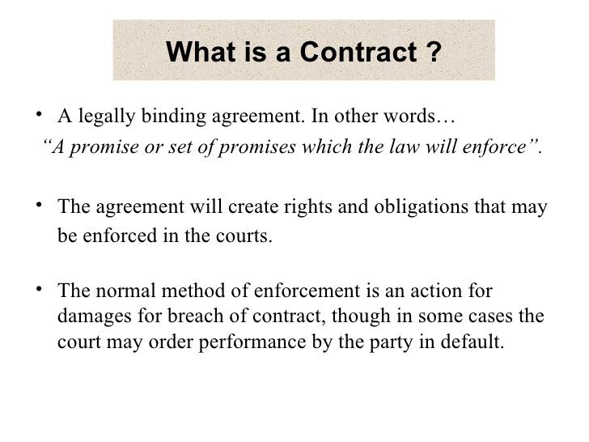

Slide 19
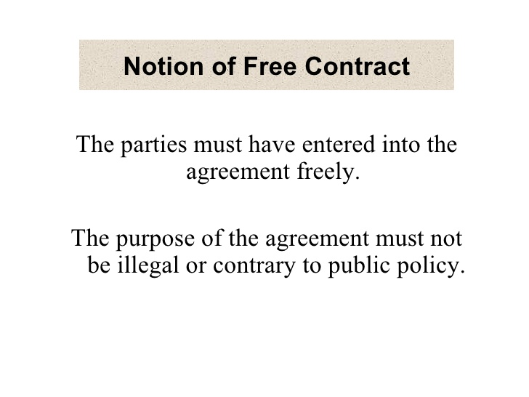

Slide 20
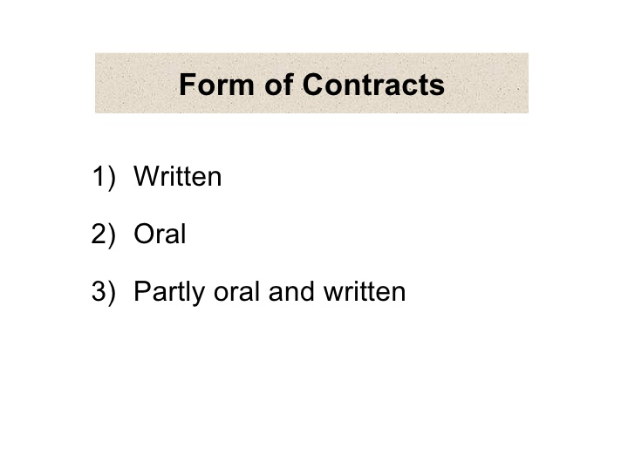

Slide 21
Form of Contracts
[Section 210]
Contracts on behalf of the company may be made by:
The contracts made between private persons must be in writing signed by the parties to be charged with,
Such contracts by the company must also be in writing signed by any person acting under its authority, express or implied.
such contracts may be varied or discharged in same manner.

Slide 22
Continue…..
In case of private company,
a contract may be entered into by parole( means oral) only and need not be reduced to writing
Company must also enter into such contracts by parole through any person acting under the authority ( whether expressed or implied.)

Slide 23
Continue….
All such contracts shall be binding on the company and its successors and all other parties , their heirs or legal representative as the case may be.

Slide 24
Bills of exchange and promissory notes [Section 211]
Bills of exchange, hundi or promissory note shall be deemed to have been made, drawn, accepted or endorsed on behalf of a company, if made, drawn, accepted or endorsed by a person acting under the company’s authority, express or implied.

Slide 25
Execution of deeds
A company may empower any person to act as its attorney, either generally or in any specified matter.
Such appointment shall be in writing and shall be for the purpose of execution of any deeds in or outside Pakistan.
Every deed signed by such person on behalf of the company under his seal shall bind the company and shall have the same effect as if it were under its common seal.

Slide 26
Continue…..
Companies, if so authorised by its articles, are empowered to keep an official seal outside Pakistan if its business is transacted outside Pakistan.
such seal shall bear in addition to the name of the country, the name of the territory where the seal is to be used.
the company may in writing authorise any person appointed for the purpose in that territory to affix that seal on any deed, or document to which the company is partly in that territory.
The official seal should have the effect of common seal of the company. [Section 213]

Slide 27
Contracts by agents of company in which company is undisclosed principal
[Section 225]
where any officer or agent of a company, enters into a contract for or on behalf of the company in which contract, the company is an undisclosed principal shall, at the time of entering into a contract make a memorandum in writing of the terms of contract, and specify the name of the person with whom it has been made.

Slide 28
Continue….
Such memorandum shall be delivered by that person to the company.
copies of memorandum shall also be sent to the directors and the memorandum shall be laid before the directors in their next meeting.

Slide 29
Continue….
if default is made in complying with these conditions, the contract shall be at the option of the company, void as against the company and defaulting officer or other agent shall be liable to a fine not exceeding two thousand rupees.

Slide 30
Sole purchase and sales agent [Section 206]
A company, incorporated and carrying on business in Pakistan, can appoint any sole purchase, sales or distribution agent only with the prior approval of the SECP.
A company incorporated outside Pakistan and any person residing outside Pakistan and carrying on the major portion of its business within Pakistan,

Slide 31
Continue….
can appoint any sole purchase, sales, or distribution agent with the approval of SECP
but such permission shall not be accorded, if major portion of its business is carried on in Pakistan.

Slide 32
Punishment…. In case of contravenes with section 206
Imprisonment of two years, or
a fine of Rs. 100,000; or
both

Slide 33
Exemption to certain agreements and contracts
The Federal government may, by notification on the official gazette, exempt any of the following classes of agreements or contracts from the operation of provision relating to prohibition of managing agents.
Continue….

Slide 34
Continue….
An agreement or contract with an investment adviser in relation to an investment company registered under the rules made under the Securities and Exchange Ordinance, 1969 (XVII of 1969);
An agreement or contract, approved by the Federal government, with a Foreign Collaborator in relation to the company which owns n hotel in Pakistan.

Slide 35
Continue….
An agreement or contract approved by the Federal government in relation to a company formed for setting up, in collaboration with one or more public sector financial institution, an industrial undertaking which, in the opinion of the said government, is likely to contribute to the economic development of Pakistan;

Slide 36
Continue….
An agreement or contract with an NBFC licensed to undertake asset management services in relation to an investment company registered with the Commission; and
An agreement or contract with an NBFC licensed as a venture capital company in relation to a fund registered with the Commission.

