Slide 1
RECAP
Directors and the manners a person become a director
First and subsequent director
Election of director
Removal of director
Loans to director
Ineligibility to become a director
Liabilities of a director
Disclosure of interest by the director

Slide 2
CHIEF EXECUTIVE

Slide 3
Chief Executive(Additional work)
"Definition"
The definition of "chief executive officer" almost always depends on whether a business is a corporation or not, that is, whether it usually has a board of directors or not. In an organization that has a board of directors, the "chief executive officer" is usually the singular organizational position that is primarily responsible to carry out the strategic plans and policies as established by the board of directors. In this case, the chief executive reports to the board of directors.

Slide 4
Chief Executive(Additional work)
Definition contd..
In a form of business that is usually without a board of directors (sole proprietorship, partnership, etc.), the "chief executive officer" is (usually) the singular organizational position (other than partnerships, etc.) that sets the direction and oversees the operations of an organization.

Slide 5
SECP CLARIFICATION
Following is the text of SECP clarification:
“Under the existing set of laws under SECP purview, no insurance company is required to seek prior approval of the SECP while appointing the chairman, the chief executive officer and the directors of that company. The appointment of the chief executive officer is governed by Section 199 and Section 200 of the Companies Ordinance, 1984, which empower the directors and/or the shareholders of a particular company to appoint the chief executive officer of that company.

Slide 6
SECP CLARIFICATION
Following is the text of SECP clarification:
The appointment of the directors is governed under Section 178 of the Companies Ordinance, 1984, which are appointed by the shareholders of that company through a general meeting. Sections 11 and 12 of the Insurance Ordinance, 2000, places the onus of appointment of a sound and prudent management on the insurer on itself.

Slide 7
Chief Executive
Means an individual who
    subject to the control
    subject to the directions of the directors
Is entrusted with the whole of the powers of the management
whether under a contract of service or otherwise.

Slide 8
Who shall have a chief executive?
A company other then a company managed by a managing agent, shall have a chief executive

Slide 9
Appointment of first chief executive:
Will be appointed by the directors of the company.
Shall be appointed as from the date of the commencement of the business or within 15 days of incorporation of the company whichever is earlier.

Slide 10
Appointment of subsequent Chief Executive:
Shall be appointed by directors within 14 days of elections of directors.
In case if a casual vacancy arises, shall be filled by the directors within 14 days of occurrence.
An elected director or retiring chief Executive is also eligible for the appointment
Chief Executive retiring under section 198 or 199 shall continue to perform his function till his successor is appointed.

Slide 11
Terms of appointment:
The directors and the members in General meeting shall determine the terms and conditions of chief Executive.
Chief Executive will be deemed to be a director if not already a director and shall be entitled to all the rights and privileges and subject to all the liabilities of a director.

Slide 12
Ineligibility to become chief Executive:
Person shall not be appointed if he’s subjected to any of following disqualifications for becoming a director of the company, if he:
Is a minor;
Is of unsound mind;
Has applied to be declared as insolvent;
As an un discharged insolvent;
Has been convicted for an offense involving moral turpitude

Slide 13
Ineligibility to become chief Executive:
Person shall not be appointed if he’s subjected to any of following disqualifications for becoming a director of the company, if he:
Has been debarred from holding office under any provision of the company ordinance 1984
Has betrayed lack of fiduciary behavior
Is a member of stock exchange in case of listed companies; or
Is a spouse of a member of a stock exchange or is a sponsor, director or officer of an corporate brokerage house

Slide 14
Removal of Chief Executive:
Chief Executive can be removed by;
Directors by passing a resolution by at least ¾ of the total number of directors for the time being; Or
Company by passing a special resolution

Slide 15
Restriction on Business of the chief Executive:
Chief executive of a public company cannot engage himself in any business directly or indirectly with the business of the same nature carried out by the company
Every person appointed as Chief Executive of a public company shall forthwith on such appointment disclosing to the company the nature of the business and his interest therein

Slide 16
Penalty:
whoever contravenes any of the above provisions shall be liable to
A fine up to Rs. 10,000/-
And may be debarred by the commission from becoming a director or chief executive of a company for a period not exceeding three years

Slide 17
MANAGING AGENT
The concept was adopted from companies act 1913.
It is a person who has exclusive supervision and control of some department of a company’s business.
The management requires him to exercise his independent judgment and discretion.
Managing agent shall not be appointed by any incorporated company in or outside the Pakistan by virtue of any agreement or contract with the company.

Slide 18
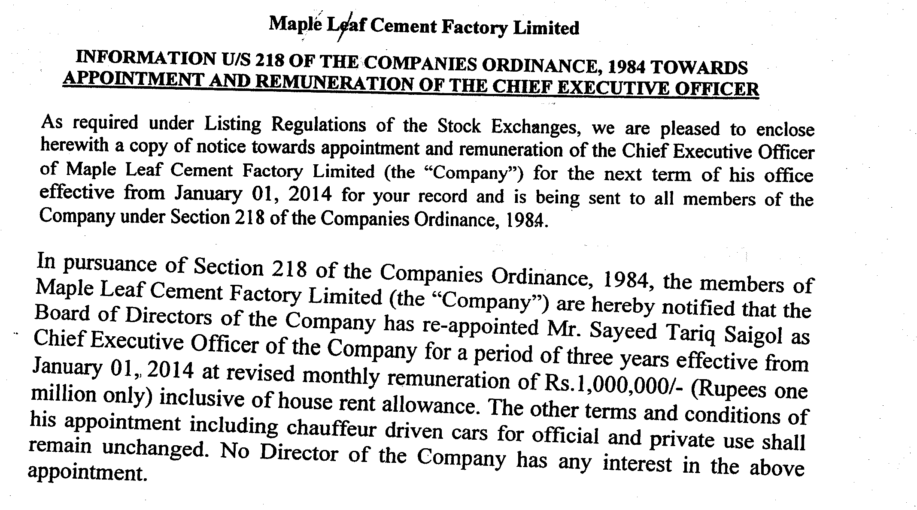
Islamabad stock Exchange Notice

Slide 19
COMPANY SECRETARY

Slide 20
SALIENT FEATURES
Company Secretary
A company secretary is recognizes as one of the principal officers of the company.
The company secretary is the person who checks the compliance of the corporate laws.
He is also responsible for managing the various statutory meetings of the company.
The code of Corporate Governance which is now a part of the listing regulations of all Stock Exchanges sets various responsibilities of a company secretary in relation to compliance of corporate laws and code of Corporate Governances.

Slide 21
SALIENT FEATURES
Company Secretary
The qualification of a company secretary was not previously defined under the Companies Ordinance, 1984 however, the code of Corporate Governance prescribes the qualification of a company secretary of a listed company.
The knowledge and training makes a company secretary versatile to carry out various functions in finance, accounts, legal, administrative and personnel areas in addition to his own secretarial duties and responsibilities. In fact his role starts from the very moment when the idea of formation of a Company is conceived.

Slide 22
Company Secretary
EMPLOYMENT PROSPECTS
Almost every kind of organization whose affairs are controlled whether by boards, councils or otherwise needs to appoint a secretary, by virtue of law, to manage the legal affairs independently.
The position of company secretary is the key management position in a company. After the implementation of Code of Corporate Governance the employment prospects have very much enlarged.
All listed companies have to appoint a company secretary who fulfills the qualification prescribed in the Code of Corporate Governance.
A qualified member of the Institute of Corporate Secretaries of Pakistan may, therefore, find an opening as a company secretary, assistant company secretary or an intermediate level administrative position depending upon the size of the organization.

Slide 23
Company Secretary
EMPLOYMENT PROSPECTS
However after the attaining the position of a company secretary, he does not necessarily reach the zenith of his career but by virtue of his academic background, professional expertise he may aptly suited to become a member of the board or the governing body of an organization.
Bureau of public enterprises, State Bank of Pakistan Government of Pakistan , Stock Exchanges, Nationalized Banks recommends the names of senior company secretaries on their panel for appointment as directors in public sector companies or as members of advisory committees. Many senior members have become chairman, managing directors and whole-time directors in many companies.

Slide 24
Company Secretary
SELF-EMPLOYMENT (PRACTICE)
A member of the Institute of Corporate Secretaries of Pakistan may also practice as a practicing company secretary.
However, the concept of a practicing company secretary is in initial stage of development but in the developed countries the practicing company secretaries are working successfully.
A company secretary in practice may be called upon by the promoters to incorporate a new company or amalgamation, merger, reorganization or winding up of the company.

Slide 25
Company Secretary
SELF-EMPLOYMENT (PRACTICE)
He may act as an authorized representative of a company in respect of filing, registration, presentation, attestation, verification of documents (including forms, application and returns) by or on behalf of the company.
He may also offer the serves as share registrar, issue house, stock broker, a secretarial auditor, a consultant or an adviser to a company on management affairs including any legal or procedural matter falling under the Companies Ordinance 1984.
He may give consultancy on issues in respect of the rules or bye-laws of stock exchange, the monopoly control authority or under any other law for the time being in force.

Slide 26
Company Secretary
Job description
Company secretaries are responsible for ensuring that an organization complies with standard financial and legal practice and maintains standards of corporate governance. Although they are not strictly required to provide legal advice, company secretaries must have a thorough understanding of the laws that affect their areas of work.
They act as a point of communication between the board of directors and company shareholders, reporting in a timely and accurate manner on company procedures and developments.
Public limited companies are legally required to employ a company secretary and many private companies also have the role. Positions can be found across all sectors and in the public sector this role often has the title chartered secretary or simply secretary.

Slide 27
Company Secretary
Typical work activities
A company secretary's role covers a wide variety of functions and these depend, in part, on the company for which they work. Typical tasks include:
organizing, preparing agendas for and taking minutes of board meetings and annual general meetings (AGMs);
maintaining statutory books, including registers of members, directors and secretaries;
dealing with correspondence, collating information and writing reports, ensuring decisions made are communicated to the relevant company stakeholders;
contributing to meeting discussions as and when required, and advising members of the legal, governance, accounting and tax implications of proposed policies;

Slide 28
Company Secretary
Typical work activities
monitoring changes in relevant legislation and the regulatory environment and taking appropriate action;
liaising with external regulators and advisers, such as lawyers and auditors;
taking responsibility for the health and safety of employees and managing matters related to insurance and property;
developing and overseeing the systems that ensure the company complies with all applicable codes, in addition to its legal and statutory requirements.
The work of a company secretary in a registered company may be more specialized than in a smaller private company. For example, the liaison role with shareholders and compliance responsibilities may make up a major part of the work and may include:

Slide 29
Company Secretary
Typical work activities
maintaining the register of shareholders and monitoring changes in share ownership of the company;
paying dividends and managing share option schemes;
taking a role in share issues, mergers and takeovers.
In small businesses, other duties commonly undertaken by company secretaries may include:
monitoring the administration of the company's pension scheme;
overseeing and renewing insurance cover for employees, equipment and premises;

Slide 30
Company Secretary
Typical work activities
managing office space and property as well as dealing with personnel administration;
overseeing public relations and aspects of financial management.

Slide 31
SECRETARY [SEC2(1)(33)]
Individual appointed to perform:
Secretarial duties
Administrative duties
Other duties of a company
Notes:
Secretarial: of or relating to a secretary or to a secretary's work.

Slide 32
QUALIFICATION OF A COMPANY SECRETARY
Qualification of company secretary for listed company:
Member of recognized body of professional accountants
Member of a recognized body of corporate/ chartered secretaries

Slide 33
CONTD
Holding degree in any one of following from a university recognized by HEC:
Masters in Business Administration
Masters in Commerce
Law Graduate
Should have 2 years experience in relevant field

Slide 34
CONTD
Single member company shall have secretary holding BACHELOR degree from a university recognized by HEC

Slide 35
LEGAL PROVISIONS
Following should have a whole time secretary possessing such qualifications mentioned in previous slides:
A listed company
Single member company
Secretary should provide his particulars to the company within 10 DAYS of his appointment

Slide 36
CONTD
Particulars of the secretary shall be recorded in the following:
Registers of directors
Officers of the company
Company shall file a return of all particulars of the secretary with the registrar within 14 DAYS of his appointment

Slide 37
CONTD
Prospectus of the company shall state following things in respect of the secretary:
Name
Address
Occupation
Contract relating to appointment

Slide 38
CONTD
Remuneration and compensation for loss of office
Date, parties and general nature of a contract fixing the remuneration of secretary
Notes:
Remuneration: money paid for work or a service.
Compensation: something, typically money, awarded to someone in recognition of loss, suffering, or injury.

Slide 39
DUTIES OF A SECRETARY
Duties of a company secretary have not been described by the companies Ordinance, 1984.
General duties performed by a secretary are as follow:
To ensure that the statutory requirements of a company are fulfilled
To ensure that the various forms required to be filed by the company are duly filled
Notes:
Statutory: required, permitted, or enacted by statute.

Slide 40
CONTD
To have knowledge about contents of:
Memorandum of association
Articles of association
To prepare and issue notices for following:
General meetings
Directors’ meetings
To ensure that all the statutory books are properly maintained

Slide 41
CONTD
To keep the seal of the company in his safe custody and ensure that it is properly used
To send registrar the copy of special resolution
To supply the copy of accounts to every member
To send audited accounts at least 21 DAYS before the meeting

Slide 42
CONTD
To arrange inspection of all the company’s books and records to the people entitled to do so
To arrange for the allotment letters and issue of share certificates

Slide 43
UPCOMING
Who is a share holder and member
How to become a member
Number of members
Rights and duties of members
A person may cease to become a member

