Slide 1
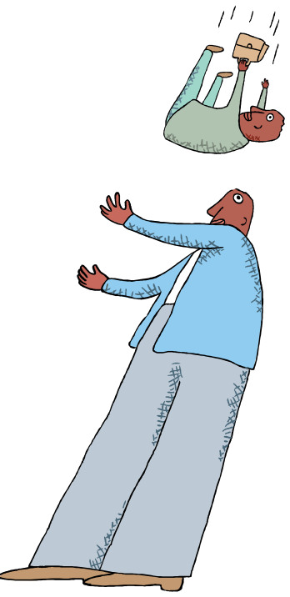
Altruism
Presented by
Dr Sadaf Sajjad

Slide 2
Why do people help?
Prosocial Behavior
Any act performed with the goal of benefiting another person.
Altruism
The desire to help another person even if it involves a cost to the helper.

Slide 3
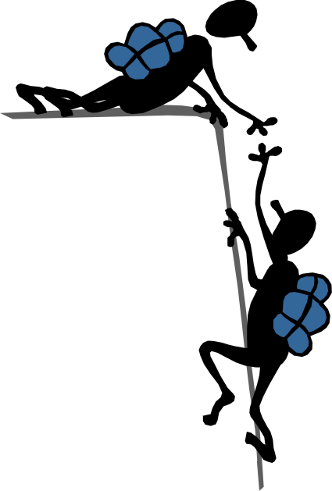
Altruism
Rooted in the Latin word alter – meaning other
Altruism – means “living for others”
Key component – selflessness – an unselfish regard for the welfare of others

Slide 4
Altruism
Altruism refers to an individual acting in a way that will decrease its own survival chances, but improve the survival chances of another individual.
The Darwinian perspective emphasising ‘survival of the fittest’ gave the impression that selfishness was the norm.
Pioneering work involving the study of animals living in social groups in fact revealed that co-operation and altruism are just as ‘natural’ as selfishness.

Slide 5
History of Altruism
The French philosopher named August Comte coined the word altruism in 1851 and it was added to the English dictionary two years later.
However, all human kind has been demonstrating altruism since the world’s beginning.
Altruism is studied today by psychologists, biologists, theologians, anthropologists, political scientists, economists, sociologists, mathematicians and more.

Slide 6
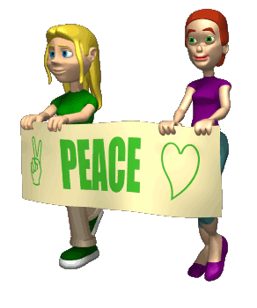
Yesterday and Today
Most societies acknowledge the importance of altruism in that it benefits a community as a whole.
Societies also understand that it is imperative to cooperate with one another rather than strive on conflict. Thus, it helps avoid war and instead, instills peace.

Slide 7
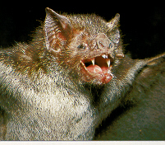
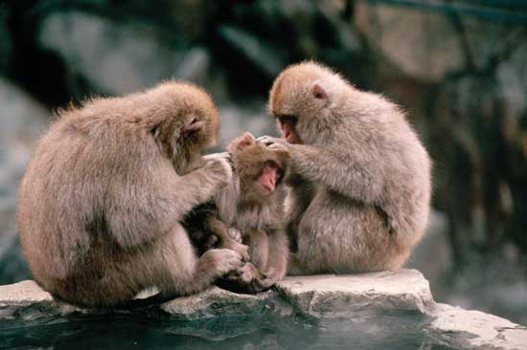
Examples of Animal Altruism.
Vampire bats will regurgitate and feed blood that they have collected from their prey to a hungry conspecific.
Ground squirrels will warn others of the presence of a predator, even though making such a call may draw the attention of the predator to itself

Slide 8
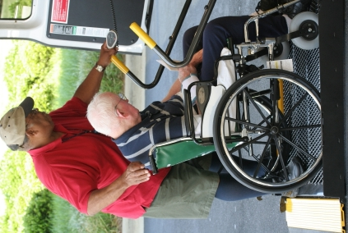
Three Characteristics of Altruistic Behavior
Perceiving the need of another person
Being motivated by empathy to help the other person
Addressing the need by taking action without expecting a reward or recognition in return

Slide 9

Example of Altruism
Video 1

Slide 10
Theories of Altruism
Psychologists believe there are two types of altruism:
  Biological altruism (with its roots in evolutionary psychology)
  Psychological altruism (based more on cognitive psychology)

Slide 11
Theories of Altruism
Altruism
Biological altruism
Kin selection theory
Reciprocal altruism theory
Psychological altruism
Negative state relief model
Empathy-altruism model

Slide 12
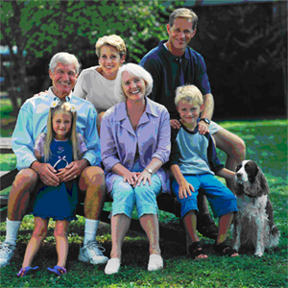
Biological Altruism
Based in Instinct and Genes
Evolutionary Psychology is the attempt to explain social behavior in terms of genetic factors that evolved over time, according to the principles of natural selection.
Darwin recognized that altruistic behavior posed a problem for his theory: if an organism acts altruistically, it may decrease its own reproductive fitness.

Slide 13
Kin Selection Theory
Kin selection theory predicts that the extent of altruism depends on genetic relatedness.
By helping relatives to reproduce (even at the cost to your own reproductive success) then your shared genes can spread. Assisting a close relative thereby increases one’s ‘Inclusive Fitness’.
Using mathematical modelling, Hamilton showed that an altruistic gene can spread through the population if it causes an individual to help a relative, whenever the cost to the individual is offset by the reproductive benefit gained by the receiver.
            ‘Hamilton’s Rule’ = r B>c
    where r=coefficient of relatedness, B = benefit to the recipient, c = cost to the giver.

Slide 14
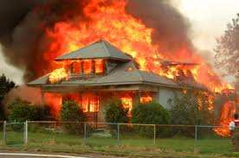
Kin Selection Theory
In a house fire, who would you save first, your brother/sister or your neighbor?

Slide 15
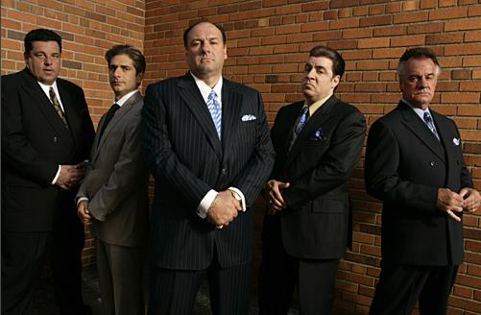
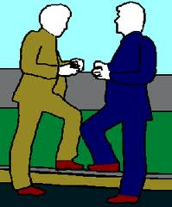
Kin Selection in Humans
Food sharing is more common amongst close relatives.
Political alliances between kin are more stable than those formed between distantly related, or unrelated individuals and involve less preconditions.
The passing on of wealth to lineal descendants (excluding spouses) is far more common than giving to less closely related or unrelated individuals.
Close relatives are preferentially sought out in times of need and such help is less likely to be reciprocal.
Relatives typically receive more expensive presents.

Slide 16
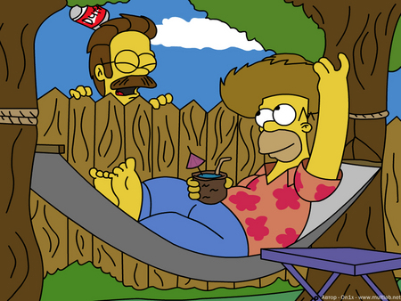
Reciprocal Altruism Theory
Norm of Reciprocity
The expectation that helping others will increase the likelihood that they will help us in the future.
One reason we help people is that we assume it will make them more likely to help us in the future.
This is so strong it may have become genetically based.

Slide 17
Reciprocal Altruism Theory
Proposed by Trivers (1971).
Natural Selection may create psychological mechanisms designed to deliver benefits even to non-relatives, provided that such actions lead to reciprocal beneficial actions in the future.
This is not necessarily limited to the same species e.g. cleaner fish.
If the benefit received is larger than the cost incurred, then individuals who engage in such behaviour will out-reproduce those who do not.
E.g, in vampire bats, an individual will share food with a conspecific (whether related or not) if the other has shared food with that individual in the past

Slide 18
Conditions Under Which
Reciprocation Flourishes
Individuals must associate for long-enough periods of time to develop reciprocal interactions.
The likelihood of one individual performing some social exchange with another should be predicted on the basis of their past associations.
The roles of giver and receiver should reverse at least once.
The short-term benefits to the recipient are greater than the costs to the donor.
Givers should be able to recognise and expel cheaters from the system.

Slide 19
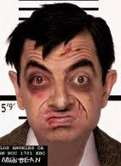
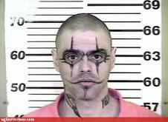
Reciprocal Altruism: Prisoner’s Dilemma
Criminals A and B commit a crime together
They are caught by the police and are interviewed separately
They both know that without the testimony of the other, there is not enough evidence to imprison them for more than a year.
However, they also know that if they collaborate with the police and blame the other one, the other would go to prison for 20 years, but they would go free.

Slide 20
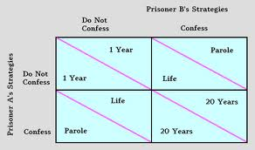
Reciprocal Altruism: Prisoner’s Dilemma

Slide 21
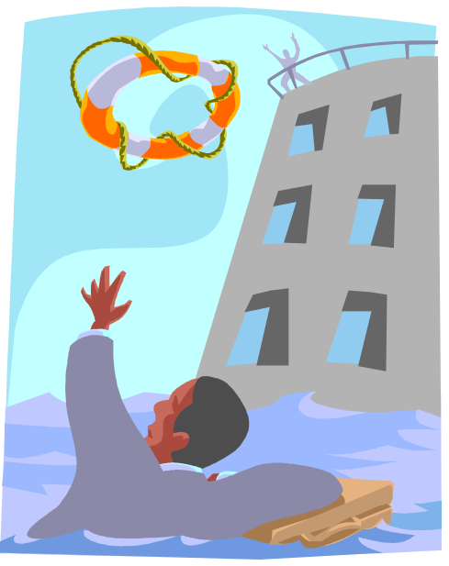
Psychological Altruism
Where biological explanations of altruism can be seen in many animals, psychological explanations of altruism are witnessed only in higher-level mammals.
While biological explanations of altruism occur almost automatically, psychological explanations of altruism arise as a result of cognition. That is, this type of altruism relies on the ‘helper’ understanding the situation. This kind of altruism is not innate.

Slide 22
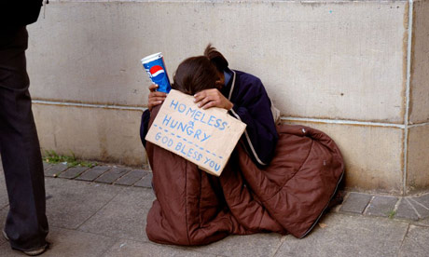
Negative-state relief model
When encountering a homeless person asking for money, we can either:
    Give them some money or
    Walk away

Slide 23

Negative-state relief model
Schaller and Cialdini (1988) proposed the negative-state relief model.
Pro-social behavior results from egoism rather than altruism.
We help others in order to relieve the stress we feel when encountering a bad situation.
This model also explains why people walk away. Walking away also alleviates distress.

Slide 24

Empathy-altruism model
Batson disagrees with the notion that we only help to relieve negative feelings.
Batson et al (1981) suggests that people experience two kinds of emotion when they see suffering.

Slide 25
Empathy-altruism model
Personal distress (e.g. anxiety, fear)
Empathic concern (e.g. sympathy, compassion, tenderness)

Slide 26
Empathy-altruism model
According to Batson, if you feel empathy towards a person, you will help, regardless of what you may gain from it.
Relieving suffering becomes the most important thing.
If a person feels no empathy, then they would consider the costs and benefits before making the decision to help

Slide 27
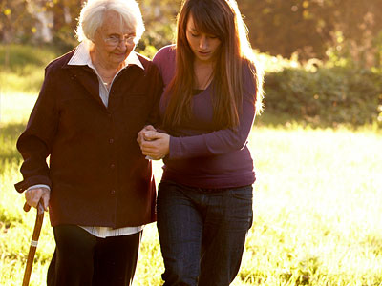
Empathy-altruism model
The empathy-altruism hypothesis has been tested empirically many times, in order to distinguish it from egoist hypotheses (e.g. Schaller and Cialdini’s ‘negative-state relief’ model).
It is, however, very difficult to determine from observed behavior, whether someone is acting out of empathy or to relieve distress.

Slide 28
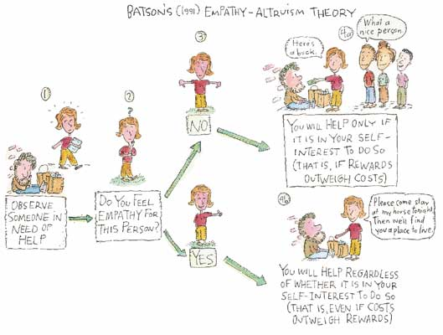
Empathy-altruism model

Slide 29
Empathy-altruism model
Video 2

Slide 30
Process of Helping
Has something happened?
Is it an emergency?
Is this something for which I should take personal responsibility?
What form of assistance should I give?
I’ll help.

Slide 31
Process of Helping
Video 3

Slide 32
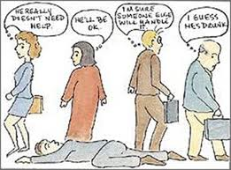
Factors that Influence Helping
Number of bystanders
  How does a large crowd influence noticing an emergency, interpreting something as an emergency, and assuming responsibility?
  Leads to the bystander effect.
Factors exist that reduce bystander effect.
  Clear emergencies vs. ambiguous.
  Cohesive groups vs. strangers.

Slide 33
Bystander Effect
Video 4

Slide 34
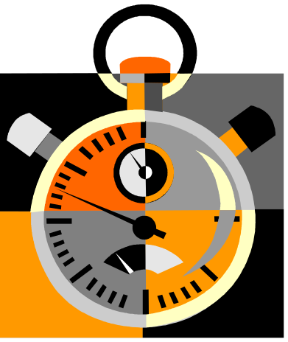
Additional Factors
Presence of Prosocial models.
  Salvation Army contributions increase if person has just seen someone else give.
Time pressure
  You are less likely to receive aid from someone in a hurry
  They are less likely to notice an emergency and less likely to interpret a situation correctly.

Slide 35

Emotions
Guilt
  Increases helping behavior.
  In one study, those who had not lied volunteered to help an experimenter for an average of 2 minutes, those who had lied helped for approximately 63 minutes!
  More likely to help if our guilt is public knowledge.

Slide 36

Emotions
Negative mood
  For adults, not children, a bad mood increases the likelihood of helping behavior.
  It appears that adults have learned that helping is a self-gratifying behavior.
  Exceptions to this tendency include feelings of anger and grief.
Positive mood
  Happy people are helpful people.
  Parking ticket study: fear turning to relief increases helping behavior significantly.

Slide 37
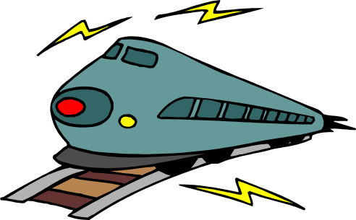
Personality Traits
No one trait predicts altruism
However,
  There are individual differences in helpfulness over time.
  Network of traits (emotionality, empathy, self-efficacy) are linked to helping.
  High self-monitors help if they believe it will be socially rewarded (interaction of personality and situation).
  Men more likely to help in dangerous situations; women in safer situations.

Slide 38
PROMOTIVE TENSION APPROACH
HELPING AS A NORM
GUILT
EMPATHY
SOCIAL LEARNING

Slide 39
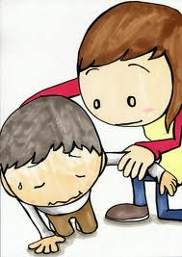
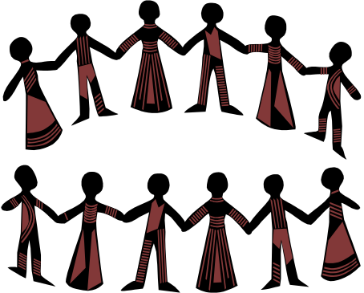
How do we teach altruism?
Teach moral inclusion
  If we are more likely to help those who are like us, expand that group.
Model altruism
  Even television can be helpful here!
Attributing behavior to altruistic motives
  Avoid over justification effect. That is, don’t coerce people into altruism, don’t reward them too much, etc.

Slide 40
THANKYOU

