Slide 1
Socialization
Liking and Friendship
Presented by
Dr. Sadaf Sajjad

Slide 2

Social Psychology
Study of how others influence our thoughts, feelings, and actions

Slide 3

What Are Social Psychology’s Big Lessons?
We construct our social reality
Our social intuitions are often powerful but sometimes perilous
Social influences shape our behavior
Personal attitudes and dispositions also shape behavior
Social behavior is biologically rooted
Social psychology’s principles are applicable to everyday life and other disciplines

Slide 4

Social Psychology Concept
Video 1
Notes:
Video is a psychology project of students explaining the social psychology concepts.

Slide 5
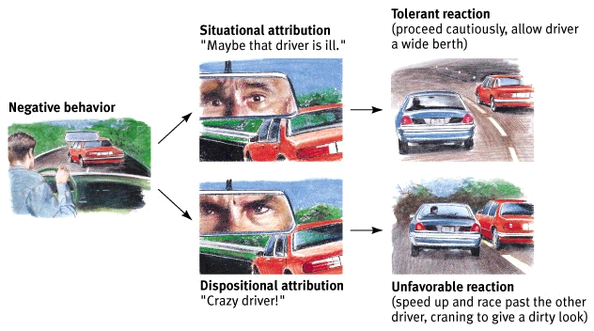
Attribution Theory
  Tendency to give a causal explanation for someone’s behavior, often by crediting either the situation or the person’s disposition

Slide 6
Social Thinking
Our behavior is affected by our inner attitudes as well as by external social influences
Internal
attitudes
External
influences
Behavior

Slide 7

Social Relations- Liking and Attraction
The Need to Belong
  The need to belong is a basic human motive
  We care deeply about what others think of us
  Those with a network of close social ties tend to be happier, healthier, and more satisfied with life than those who are more isolated

Slide 8
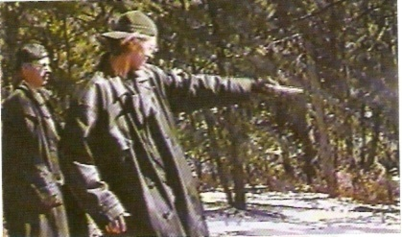
Social Relations- Liking and Attraction
Ostracism
  Acts of excluding or ignoring.
  Often used as social punishment.
  Leads to multiple negative outcomes including self-defeating behaviors, an inability to regulate behaviors, and aggression.

Slide 9
Social Relations- Liking and Attraction
Need for Affiliation
  The desire to establish social contact with others.
  We are motivated to establish and maintain an optimum balance of social contact.
Benefits of Affiliation
  Sense of attachment
  Social integration
  Reassurance of worth
  Sense of reliable alliance
  Guidance

Slide 10
Factors Involved in Interpersonal Attraction
Familiarity: Being There
  Who are we most likely to become attracted to?
  Two basic and necessary factors in the attraction process:
    Proximity
    Exposure

Slide 11
Factors Involved in Interpersonal Attraction
Proximity
  The physical closeness of two people is the single best predictor of the development of a social relationship
    more likely to know our neighbors than people 10 blocks away.
    what about recent technological advancements?

Slide 12
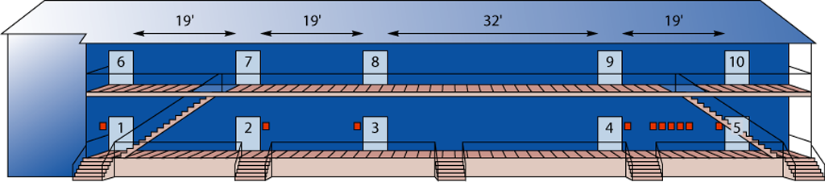
Proximity: The Person Next Door
Festinger, Schachter, and Back (1950) tracked friendship formation among the couples in various apartment buildings.
Residents had been assigned to their apartments at random. Most were strangers when they moved in.
The researchers asked the residents to name their three closest friends in the entire housing project.
Just as the proximity effect would predict, 65% of the friends mentioned lived in the same building, even though the other buildings were not far away.

Slide 13
Proximity: The Person Next Door
Even more striking was the pattern of friendships within a building:
41% of the next-door neighbors indicated they were close friends.
22% of those who lived two doors apart said so.
Only 10% of those who lived on opposite ends of the hall indicated they were close friends.

Slide 14
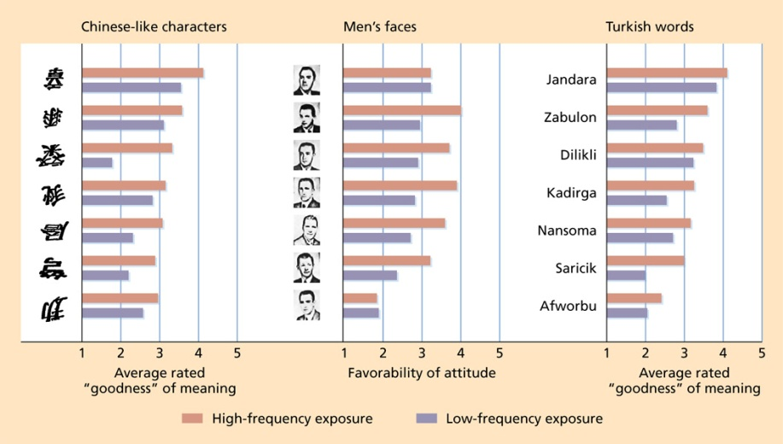
Factors Involved in Interpersonal Attraction
Mere Exposure
  Contrary to folk wisdom, familiarity does not breed contempt
  The more often we are exposed to a stimulus, the more we come to like that stimulus
  Familiarity can influence our self-evaluations
Notes:
Figure 11-2: The Mere-Exposure Effect. Students rated stimuli—a sample of which is shown here—more positively after being shown them repeatedly.
-We prefer things we are familiar with, whether these things are new foods, Chinese characters, or songs.
-This exposure can even have occurred subliminally.
-Has an evolutionary basis, if we are familiar with something, we must have already survived an interaction with it.
-If people are asked which photo they prefer, one of themselves normally, or one that is a mirror image, people prefer the mirror image since it is the image they are used to seeing in the mirror every morning.

Slide 15



Mere Exposure
If we simply recognize a brand, we will judge it more positively.
  Researchers asked people to pick which of two airlines to fly on, one familiar, one unfamiliar.
    People overwhelmingly chose the familiar.
    Even after adding three troubling pieces of information, such as accidents, 67% still chose the familiar company.
One goal of advertising is to blitz us with a name so many times that it unconsciously triggers the recognition heuristic.
  Children definitely preferred the taste of food in McDonalds wrappers over the same food in plain wrappers.

Slide 16

Mere Exposure Effect
Video 2

Slide 17
Factors Involved in Interpersonal Attraction
Physical Attractiveness
  We react more favorably to others who are physically attractive than to those who are not
  Bias for beauty is pervasive

Slide 18
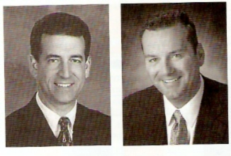
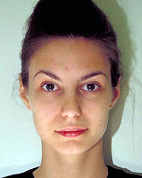
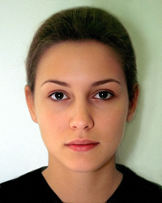
Is Beauty an Objective Quality?
Some argue that certain faces are inherently more attractive than others
  High levels of agreement for facial ratings across ages and cultures
  Physical features of the face are reliably associated with judgments of attractiveness
  Babies prefer faces considered attractive by adults

Slide 19
Is Beauty a Subjective Quality?
People from different cultures enhance their beauty in very different ways
Ideal body shapes vary across cultures, as well as among racial groups within a culture
Standards of beauty change over time
Situational factors can influence judgments of beauty

Slide 20
Why Are We Blinded by Beauty?
Inherently rewarding to be in the company of people who are aesthetically appealing
  Possible intrinsic and extrinsic rewards
Tendency to associate physical attractiveness with other desirable qualities
  What-is-beautiful-is-good stereotype

Slide 21

Physical Attraction Stereotype
People within a culture, assume that attractive people have the traits that are valued by that culture
Adults and children are biased toward attractive people
Even infants stare at attractive people longer than unattractive people!
Lessons begin early – how many ugly heroes are there in children’s tales vs. the number of ugly villians?

Slide 22
Principle of Liking-Example
Video 3
Notes:
Example of presentations. Dress well and communicate with audience. They will like you more and accept your opinion.

Slide 23
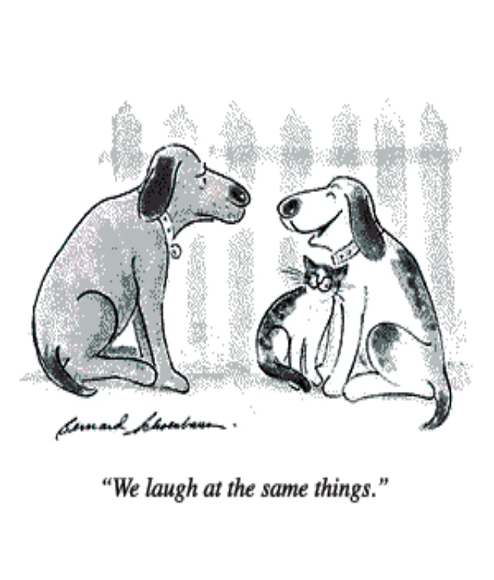
Factors Involved in Interpersonal Attraction
Similarity
    Proximity increases familiarity, which leads to liking, but something more is needed to fuel a growing friendship.
    That “fuel” is similarity—a match between our interests, attitudes, values, background, or personality and those of another person.

Slide 24
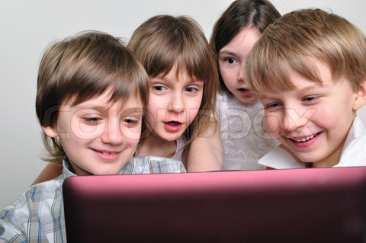
Similarity
Three Areas of Similarity that Increase Liking
  Demographic Similarity
  Attitudes and Values
  Personality
    Similar cognitive complexities
    Similar emotional styles
    Attachment styles

Slide 25
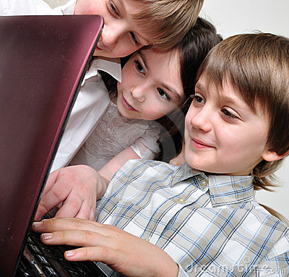
Similarity
  The more similar to ourselves we find someone to be, the more we tend to like them.
  Friends more likely to share opinions, attitudes, beliefs, and values.
  Dissimilarity breeds dislike in an even stronger fashion that similarity breeds liking.

Slide 26
Factors Involved in Interpersonal Attraction
Reciprocal Liking
  One of the most potent determinants of our liking someone is if we believe that that person likes us—reciprocal liking.
  Reciprocal liking effects can only occur if we like ourselves. People with negative self-concepts tend to be skeptical that others actually do like them and therefore may not reciprocate liking.
  Reciprocal liking can come about because of a self-fulfilling prophecy.

Slide 27
Reciprocal Liking
People with a negative self-concept respond quite differently:
Such people indicate that they’d prefer to meet and talk to a person they know has criticized them earlier than meet and talk to a person they know has praised them earlier.
Thus if people think of themselves as unlikable, another person’s friendly behavior toward them will seem unwarranted, and they may not respond, setting in motion another self-fulfilling prophecy.

Slide 28
Attraction- An Example
Video 4

Slide 29
Theories of Liking and Attraction
Exchange Theory
Equity Theory
Gain-Loss Theory

Slide 30

Exchange Theory
The main idea behind social exchange is everyone tries to maximise the rewards they obtain form a relationship and try to minimise the costs. If the a relationship is to be successful then both parties are expected to give and take in equal proportions.
In exchange theory, there are 4 basic steps:
  Reward
  Cost
  Outcome
  Comparison level

Slide 31
Exchange Theory
Rewards are the positive, gratifying aspects of the relationship that make it worthwhile and reinforcing, including:
The kinds of personal characteristics and behaviors of our relationship partner that we have already discussed, and
Our ability to acquire external resources by virtue of knowing this person (e.g., gaining access to money, status, activities, or other interesting people).

Slide 32
Exchange Theory
Costs are, obviously, the other side of the coin, and all friendships and romantic relationships have some costs attached to them. (Such as putting up with someone’s annoying habits and characteristics)

Slide 33
Exchange Theory
Outcome If the cost is more than reward we have a negative outcome. If on the other hand there is a profit left over after we have subtracted the cost we have a positive outcome,
      Reward – cost = outcome

Slide 34
Exchange Theory
Comparison Level People’s expectations about the level of rewards and punishments they are likely to receive in a particular relationship.

Slide 35
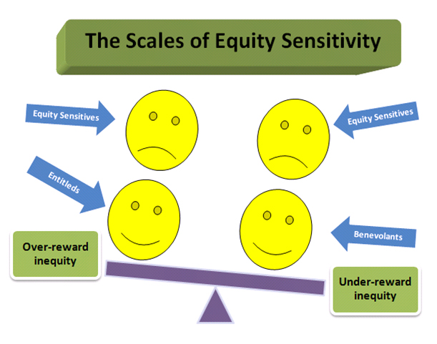
Equity Theory
Proponents of equity theory describe equitable relationships as the happiest and most stable.
In comparison, inequitable relationships result in one person feeling:
  Over-benefited (getting a lot of rewards, incurring few costs, having to devote little time or energy to the relationship), or
  Under-benefited (getting few rewards, incurring a lot of costs, having to devote a lot of time and energy to the relationship).

Slide 36
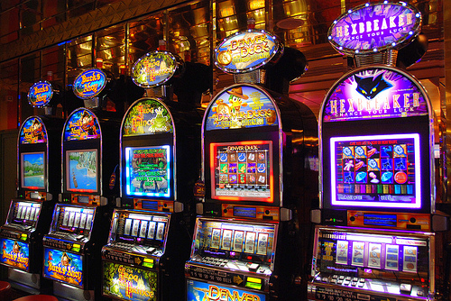
Gain- loss Theory
This deals with the area of liking and feedback.
According to this theory changes in another person evaluation of us will have more impact on our liking for him/ her then if the evaluation were constant.
Thus we like a person who is esteemed for us increases overtime better than someone, who has always liked us. (a gain situation)
Similarly, we dislike a person whose evaluation of us become negative over time. More than some one who has always disliked us. (a loss situation)

Slide 37
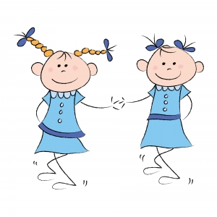
Social Relations- Friendship
Definition: Reciprocal relationship with positive affect
  Distinct from popularity
Importance
  Source of social support
  Conflict resolution skills
  Preparation for adulthood
  Can have bad consequences as well: Quality of friendships

Slide 38

Stages of Friendship
There are 4 stages of friendship.
  Formative stage.
  Exploratory research.
  Negotiation (Bargaining) State.
  Commitment.

Slide 39
Formative Stage
Analysis focuses upon the sequence of events and stages that led to the development of friendship.
The sequence may be examined as we described the process of an imaginary group
A group of students lets say from various universities are strangers to each other who are brought together for a weekend conference.

Slide 40
Exploratory Research
At the first meeting of the imaginary group, the students who are attending the conference, look each other and engage in a process term as sampling and estimation.
Each person explores a varying degree of cost to him or herself and the rewards available in potential relations with other persons around the room.

Slide 41
Negotiating / Bargaining
The process is not conscious or rational.
Each person makes evaluations and attempts to negotiate a definition of the situation and of the resultant relationship that will maximize the outputs.
In parts such attempts take the form of strategies.

Slide 42
Commitment
Members of pair progressively reduce their sampling and bargaining with other person.
They stop looking around the room, stop thinking about other possibilities and commit themselves to a particular other person.
Thus, find a stage called institutionalization.

Slide 43
