Slide 1
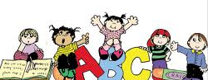
Theories of Human development
Dr. Sadaf Sajjad

Slide 2

Definition
Theories of development is the study of the psychological processes of children and, specifically, how these processes differ from those of adults, how they develop from birth to the end of adolescence, and how and why they differ from one child to the next.
It is sometimes grouped with infancy, adulthood, and aging under the category of developmental processes of a human being

Slide 3

Background
Historically, children were often viewed simply as smaller versions of adults.
When Jean Piaget suggested that children actually think differently than adults, Albert Einstein proclaimed that the discovery was "so simple that only a genius could have thought of it."
Today, it has been recognize that child development is unique and complex, but many differ in terms of the unique perspective they take when approaching development.
Experts also differ in their responses to some of the bigger questions in development, such as whether early experiences matter more than later ones or whether nature or nurture plays a greater role in certain aspects of development.

Slide 4
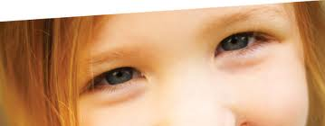
Contexts of Developmental theories
Some of the major contexts that we need to consider in our analysis of developmental theories:
The Social Context: Relationships with peers and adults have an effect on how children think, learn and develop. Families, schools and peer groups all make up an important part of the social context.
The Cultural Context: The culture a child lives in contributes a set of values, customs, shared assumptions and ways of living that influence development throughout the lifespan. Culture may play a role in how children relate to their parents, the type of education they receive and the type of child care that is provided.

Slide 5

Contexts of Developmental theories Conti…
The Socioeconomic Context: Social class can also play a major role in child development. Socioeconomic status (often abbreviated as SES), is based upon a number of different factors including how much education people have, how much money they earn, the job they hold and where they live.
Children raised in households with a high socioeconomic status tend to have greater access to opportunities, while those from households with lower socioeconomic status may have less access to such things as health care, quality nutrition and education. Such factors can have a major impact on child psychology.

Slide 6
Importance of Developmental theories
To understand the child better.
To know that some problems have a psychological origin.
To establish effective communication between the child and the parent.
To gain confidence of the child and of the parent.
To teach parents and children the importance of primary and preventive care.
To have better treatment planning and interaction with other medical disciplines.

Slide 7
Psychoanalytic Child Development Theories

Slide 8
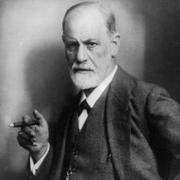
Sigmund Freud Theory
The theories proposed by Sigmund Freud stressed the importance of childhood events and experiences, but almost exclusively focused on Problem behaviors rather that normal functioning.
According to Freud, child development is described as a series of 'psychological stages.' In "Three Essays on " (1915), Freud outlined these stages as oral, anal, phallic, latency and genital. Each stage involves the satisfaction of a libidinal desire and can later play a role in adult personality.

Slide 9
Freud definition of mind
Topographic mind Model
Human Mind
Conscious Mind
Preconcious Mind
Subconcious
Mind

Slide 10
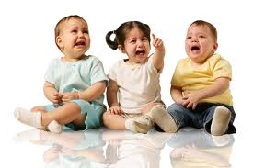
Stages of Development
Oral Stage: During the oral stage, the infant's primary source of interaction occurs through the mouth. The primary conflict at this stage is the weaning process--the child must become less dependent upon caretakers. If fixation occurs at this stage, Freud believed the individual would have issues with dependency or aggression. Oral fixation can result in problems with drinking, eating, smoking or nail biting.
Birth to 18 months

Slide 11
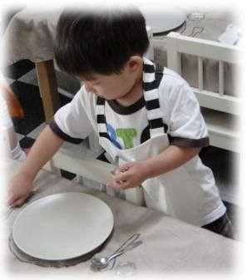
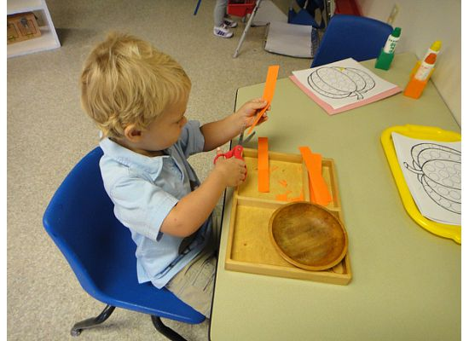
Anal Stage: According to Freud, success at this stage is dependent upon the way in which parents approach toilet training. Parents who utilize praise and rewards for using the toilet at the appropriate time encourage positive outcomes and help children feel capable and productive. Freud believed that positive experiences during this stage served as the basis for people to become competent, productive and creative adults.
18 months to three years

Slide 12


The Phallic Stage: (ages three to six) Freud also believed that boys begin to view their fathers as a rival for the mother’s affections.
The Latent Period: (age six to puberty) The development of the ego andsuperego contribute to this period of calm. The stage begins around the time that children enter into school and become more concerned with peer relationships, hobbies and other interests.
The Genital Stage: (puberty on) The focus was solely on individual needs, interest in the welfare of others grows during this stage. If the other stages have been completed successfully, the individual should now be well-balanced, warm and caring. The goal of this stage is to establish a balance between the various life areas.

Slide 13

Video 2

Slide 14
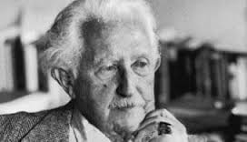
Erik Erikson Theory
Proposed a stage theory of development, but his theory encompassed human growth throughout the entire human lifespan.
Erikson believed that each stage of development was focused on overcoming a conflict.
For example, the primary conflict during the adolescent period involves establishing a sense of personal identity.
Success or failure in dealing with the conflicts at each stage can impact overall functioning. During the adolescent stage, for example, failure to develop an identity results in role confusion.

Slide 15
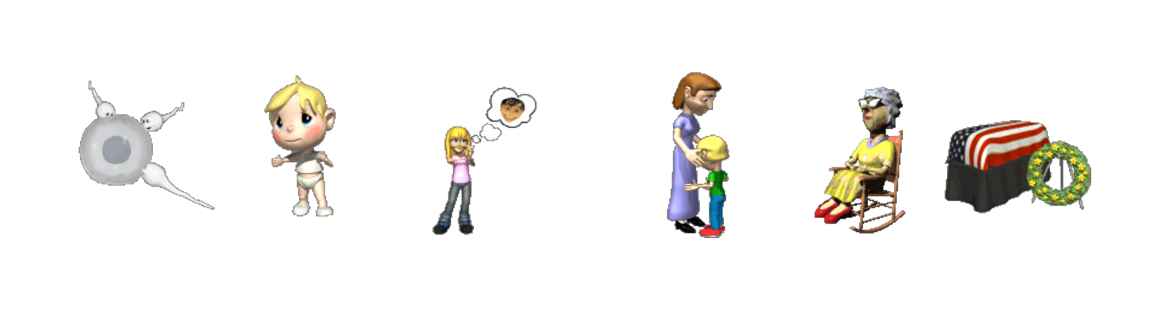
Stages of development
Trust vs. Mistrust (this is the stage and the conflict) occurs from birth to 1 year. To resolve this conflict, the child must develop a sense of security
Autonomy vs. Shame and Doubt occurs from age 1 - 2. To resolve the conflict, the child must a achieve a sense of independence
Initiative vs. Guilt occurs from age 3 - 5. To resolve this conflict, the child must find a balance between restraint and being spontaneous (can't just do everything want whenever they want)

Slide 16

Stages of development Conti…
Industry vs. Inferiority occurs from age 6 through puberty. To resolve this conflict, the child must develop a sense of self-confidence
Identity vs. Role Confusion occurs through adolescence. To resolve the conflict, the adolescent experiences a unified sense of self
Intimacy vs. Isolation occurs from puberty to young adulthood . To resolve the conflict, the young adult must form close personal relationships with others.

Slide 17

Stages of development Conti…
Generativity vs. Stagnation occurs through middle adulthood. To resolve the conflict, the adult must learn to promote the well-being of others and not be focused completely on themselves.
Integrity vs. Despair occurs through late adulthood. At this stage, the adult enjoys a sense of satisfaction with themselves and life by reflecting on a well-lived life.

Slide 18

Video 1

Slide 19
Cognitive Child Development Theories

Slide 20
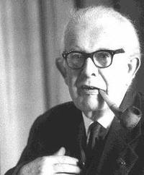
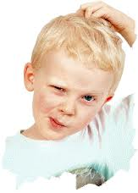

Jean Piaget Theory
Suggested that children think differently than adults and proposed a stage theory of cognitive development.
He was the first to note that children play an active role in gaining knowledge of the world.
According to his theory, children can be thought of as "little scientists" who actively construct their knowledge and understanding of the world.

Slide 21
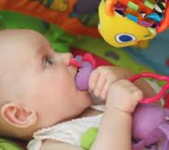

Sensory Motor Stage (Birth - 2yrs)
Piaget's ideas surrounding the Sensory Motor Stage are centred on the basis of a 'schema'. Schemas are mental representations or ideas about what things are and how we deal with them.
A few weeks after birth, the baby begins to understand some of the information it is receiving from it's senses, and learns to use some muscles and limbs for movement.
Babies are unable to consider anyone else's needs, wants or interests.
Babies act as though the object has ceased to exist.

Slide 22

Pre-Operations Stage (2yrs-7yrs)
During this stage, children's thought processes are developing, although they are still considered to be far from 'logical thought‘.
Pre-operational children are usually 'ego centric', meaning that they are only able to consider things from their own point of view, and imagine that everyone shares this view, because it is the only one possible.
Animism' is also a characteristic of the Pre-operational stage. This is when a person has the belief that everything that exists has some kind of consciousness.
Another aspect of the Pre-operational stage in a child, is that of 'symbolism'.

Slide 23

Concrete Operations Stage (7yrs-11yrs)
During this stage, the thought process becomes more rational, mature and 'adult like', or more 'operational', Although this process most often continues well into the teenage years.
The process is divided by Piaget into two stages, the Concrete Operations, and the Formal Operations stage, which is normally undergone by adolescents.
Concrete Operational stage, the child has the ability to develop logical thought about an object, if they are able to manipulate it.
Formal Operations stage, the thoughts are able to be manipulated and the presence of the object is not necessary for the thought to take place.

Slide 24

Concrete Operations Stage (7yrs-11yrs) Conti…
Piaget claims that before the beginning of this stage, children's ideas about different objects, are formed and dominated by the appearance of the object. For example, there appears to be more blocks when they are spread out, than when they are in a small pile.
Once children have learnt to conserve, they learn about 'reversibility'. This means that they learn that if things are changed, they will still be the same as they used to be. For example, they learn that if they spread out the pile of blocks

Slide 25

Formal Operations Stage (11yrs-16yrs)
There are 2 major characteristics of formal operational thought.
The first is 'hypothetic-deductive reasoning'. When faced with a problem, adolescents come up with a general theory of all possible factors that might affect the outcome.
The second important characteristic of this stage is that it is 'propositional' in nature. Adolescents can focus on verbal assertions and evaluate their logical validity without making refence to real-world circumstances.

Slide 26

Video 3

Slide 27
Behavioral Child Development Theories

Slide 28


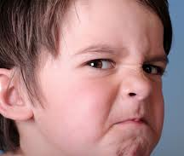
Behavioral theories
Behavioral theories of child development focus on how environmental interaction influences behavior and are based upon the theories of theorists such as John B. Watson, Ivan Pavlov and B. F. Skinner.
These theories deal only with observable behaviors. Development is considered a reaction to rewards, punishments, stimuli and reinforcement.
This theory differs considerably from other child development theories because it gives no consideration to internal thoughts or feelings.

Slide 29
Social Child Development Theories

Slide 30
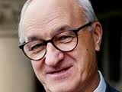

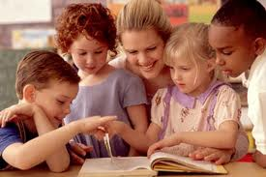
Albert Bandura
Proposed what is known as social learning theory.
According to this theory of child development, children learn new behaviors from observing other people.
Bandura believed that external reinforcement was not the only way that people learned new things.
Intrinsic reinforcements such as a sense of pride, satisfaction and accomplishment could also lead to learning.
By observing the actions of others, including parents and peers, children develop new skills and acquire new information.

Slide 31
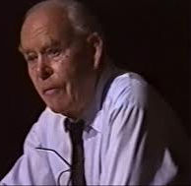

John Bowlby
Proposed one of the earliest theories of social development. Bowlby believed that early relationships with caregivers play a major role in child development and continue to influence social relationships throughout life.

Slide 32

Parenting Styles
Developmental psychologists have long been interested in how parents impact child development.
Finding actual cause-and-effect links between specific actions of parents and later behavior of children is very difficult.
Some children raised in dramatically different environments can later grow up to have remarkably similar personalities.
Children who share a home and are raised in the same environment can grow up to have astonishingly different personalities than one another.

Slide 33
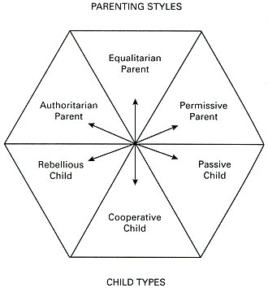
Parenting Styles Conti..

Slide 34

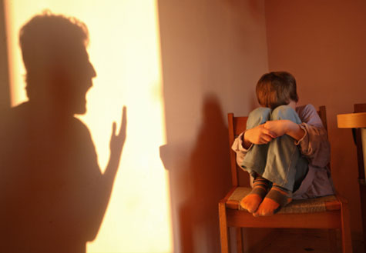
Authoritarian Parenting
Children are expected to follow the strict rules established by the parents.
Failure to follow such rules usually results in punishment. Authoritarian parents fail to explain the reasoning behind these rules. If asked to explain, the parent might simply reply, "Because I said so." These parents have high demands, but are not responsive to their children.
According to Baumrind, these parents "are obedience- and status-oriented, and expect their orders to be obeyed without explanation“.

Slide 35
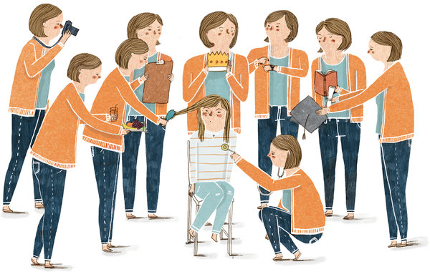
Equalitarian Parenting
This parenting style is much more democratic.
parents are responsive to their children and willing to listen to questions. When children fail to meet the expectations, these parents are more nurturing and forgiving rather than punishing.
Baumrind suggests that these parents monitor and impart clear standards for their children’s conduct.

Slide 36

Permissive Parenting
Permissive parents, sometimes referred to as indulgent parents, have very few demands to make of their children.
These parents rarely discipline their children because they have relatively low expectations of maturity and self-control.
According to Baumrind, permissive parents are more responsive than they are demanding.
Permissive parents are generally nurturing and communicative with their children, often taking on the status of a friend more than that of a parent.

Slide 37

Uninvolved Parenting
An uninvolved parenting style is characterized by few demands, low responsiveness and little communication.
While these parents fulfill the child's basic needs, they are generally detached from their child's life.
In extreme cases, these parents may even reject or neglect the needs of their children.

Slide 38
Video 4

Slide 39
The Impact of Parenting Styles
Authoritarian parenting styles generally lead to children who are obedient and proficient, but they rank lower in happiness, social competence and self-esteem.
Equalitarian parenting styles tend to result in children who are happy, capable and successful.
Permissive parenting often results in children who rank low in happiness and self-regulation. These children are more likely to experience problems with authority and tend to perform poorly in school.
Uninvolved parenting styles rank lowest across all life domains. These children tend to lack self-control, have low self-esteem and are less competent than their peers.

Slide 40
Resocialization
Resocialization is a process of Learning a new and different set of attitudes, values and behaviors from those in ones background and previous experience.
It could be voluntary or Involuntary
Sociologist Erving Goffman studied resocialization in mental institutions. He characterized the mental institution as a total institution—one in which virtually every aspect of the inmates’ lives was controlled by the institution and calculated to serve the institution's goals. For example, the institution requires that patients comply with certain regulations, even when compliance is not necessarily in the best interest of the individual.

Slide 41
There are two types of resocialization:
Voluntary and Involuntary
Voluntary resocialization occurs when we enter a new status of our own free will (e.g., medical or psychological treatment or religious conversion).

Slide 42
Involuntary resocialization occurs against a person's wishes and generally takes place within a total institution - a place where people are isolated from the rest of society for a set period of time and come under the control of the officials who run the institution (e.g., military boot camps, prisons, concentration camps, some mental hospitals and residential schools).

Slide 43
THANKYOU

