Slide 1
SUMMARY PART 5 : SOCIAL CHANGE
Dr. Sadaf Sajjad

Slide 2
What is Social Change?
Social change refers to changes in the way society is organized, the beliefs, and/or practices of the people who live in that society.
Alterations in basic structures of a social group or society.
Change in the social institutions, the rules of social behavior, value systems or the social relations of a society or community

Slide 3
Social Change
Definition: may refer to the notion of social progress or sociocultural evolution or paradigmatic change or social revolution or social movements.
  Sociocultural evolution: The idea that society moves forward by looking from different perspectives and arguing a certain point of view.
  Paradigmatic: When society shifts from one point of view or way of thinking to another (eg. Feudalism to capitalism).
  Social revolution: In order to change the foundation of a society, a large uprising must occur.
  Social movement: When the “people” within a society begin to advocate change.

Slide 4
Sociology and Change
Focus of Studies:
  massive shifts in behaviour and attitudes of groups or whole societies
The Process:
  Change is inevitable
  Should be predictable - patterned

Slide 5
Sociology Theories for Explaining Change
Decay – (Taken from Adam & Eve Genesis story)
  all societies began in an ideal state and as societies inevitably become more materialistic and less spiritual, they become less able to provide for and protect its citizens
Cycles of Growth and Decay –
  societies are not always headed for destruction, but they have ups and downs
Progress –
  change as the result of continual progress (build on the experience of past societies)

Slide 6
Sociology Theories cont’d
There is a debate whether change is the result of one factor or many
Reductionist/Determinist Theories: ­ Believe that social change was caused (determined) by a single factor (i.e., Marx – struggle for economic power – led to feminist theory)
Interactionist Theories: Believe that social change is caused by many factors

Slide 7
Sociology: Characteristics of Change
Direction of Change – positive or negative?
Rate of Change – slow, moderate, or fast? What factors are affecting rate?
Sources – what factors are behind change? Exogenous (from another society) or Endogenous (from within the society)
Controllability – look at the degree to which social change can be controlled or engineered (e.g. eliminating racism and discrimination)

Slide 8
Sociology Theories of Social Change
Tension (Adaptation Theory):
  When a part of society diverges from the rest and causes a disturbance.
Accumulation:
  Humans gathering increasing amounts of knowledge and technology – this leads to change
Diffusion of innovation:
  an innovation is developed and becomes mainstream (integrated into society)

Slide 9
Anthropology and Change
Focus of Studies: Culture
The Process:
  Constantly changing (continuous)
  Gradual process (slow)
Change process is gradual unless a culture is destroyed by another culture

Slide 10
Culture is Made Up of 4 Interrelated Parts:
Physical Environment –
  (e.g. length of seasons)
Level of Technology – depends on the need of that society and its existing culture
  (e.g. light-rail transit seen as solution to overcrowded highways but not in culture where foot transportation still common)
Social Organization
  (e.g. kinship system, division of labor, etc.)
Systems of Symbols
  (e.g. clothing & physical objects, gestures, writing, etc.)
Key Term: Enculturation:
  The process by which members of a culture learn and internalize shared ideas, values, and beliefs.

Slide 11
Anthropology
According to an anthropologist, social change happens because of…
  Invention: new innovations that change the way cultures function
  Discovery: finding information that changes a culture that was previously unknown
  Diffusion: distribution of ideas and information between cultures
  Acculturation: blending of certain beliefs and customs between 2 cultures after close interaction over time

Slide 12
    Acculturation can occur in 3 ways:
Incorporation:
  It can be freely borrowed
Directed change:
  It can be unavoidable; when one culture overtakes another and suppresses its people
Cultural evolution:
  View that cultures develop due to common patterns in ways that are predictable

Slide 13
Psychology and Change
Focus of Studies:
  Behaviours and attitudes of individuals
Major Focus:
  Link between people’s attitudes and behaviours – is it necessary to change attitudes before behaviours can change?

Slide 14
Psychological Theories of Attitude Change
Cognitive Consistency Theory:
  People desire consistency in their beliefs.
  Most people want to avoid attitudes that conflict with each other – makes people happier
Cognitive Dissonance Theory:
  People try to avoid conflicts between what people think and what they do (i.e., if you smoke you may not smoke in front of a friend who is strongly against it)
  Can motivate change in behaviour to match actions and beliefs

Slide 15
For example, suppose you smoke, but you also believe that smoking causes lung cancer. You are experiencing dissonance because what you do (behaviour – smoking) conflicts with what you think (attitude – causing cancer).
You may avoid smoking in front of family because they oppose smoking. If a friend who is a smoker gets lung cancer, your dissonance will increase. Your inner conflict between your attitude and behaviour will mount – can cause anxiety, depression etc...
Psychologists suggest that there are only two things that can be done to lower dissonance. One is that you change your behaviour so it is consistent with your attitude (you stop smoking), and the other is that you reinforce your attitude (you tell yourself cancer will never happen to you).

Slide 16
Collective Behavior and Social Movements

Slide 17
Characteristics of Collective Behavior
Represent the actions of groups of people, not individuals.
Involve relationships that arise in unusual circumstances.
Capture the changing elements of society more than other forms of social action.

Slide 18
Characteristics of Collective Behavior
May mark the beginnings of more organized social behavior.
Exhibit patterned behavior, not the irrational behavior of crazed individuals.
Usually appear to be highly emotional, even volatile.

Slide 19
Characteristics of Collective Behavior
Involve people communicating extensively through rumors.
Are often associated with efforts to achieve social change.

Slide 20
Crowds
Crowds are one form of collective behavior.
Crowds share several characteristics:
  Crowds involve groups of people coming together in face-to-face or visual space with one another.
  Crowds are transitory.
  Crowds are volatile.
  Crowds usually have a sense of urgency.

Slide 21
Emergent Norm Theory
Postulates that people faced with an unusual situation can create meanings that define and direct the situation.
Group norms govern collective behavior, but the norms that are obeyed are newly created as the group responds to its new situation.
Members of the group follow norms—they just may be created on the spot.

Slide 22
Panic
A panic is behavior that occurs when people in a group suddenly become concerned for their safety.
People tend to flee in groups, often stopping to look out for one another.
We know, for example, that in the World Trade Center on 9/11, people for the most part tried to leave in an orderly fashion.

Slide 23
Riots
Sociologists see riots as a multitude of small crowd actions spread over a particular geographic area, where the crowd is directed at a particular target.
Riots occur when groups of people band together to express a collective grievance or when groups are provoked by anger or excitement.

Slide 24
Fads
Fads may be products (scooters, hula hoops, yo-yos), activities (streaking, raves), words or phrases (yo!, whatever, cool), or popular heroes (Harry Potter, Barbie).
Fads provide a sense of unity among their participants and a sense of differentiation between participants and nonparticipants.
Crazes are similar to fads except that they tend to represent more intense involvement for participants.

Slide 25
Hysterical Contagions
Involves the spread of symptoms of an illness among a group when there is no physiological disease present.
Most likely to occur when it provides a way of coping with a situation that cannot be handled in the usual ways.

Slide 26
Scapegoating
Occurs when a group collectively identifies another group as a threat to the perceived social order and incorrectly blames the other group for problems they have not caused.
The group so identified becomes the target of negative actions that can range from ridicule to imprisonment, extreme violence, and even death.

Slide 27
Social Movements
A social movement is an organized social group that acts with continuity and coordination to promote or resist change in society or other social units.
Social movements are the most organized form of collective behavior, and they tend to be the most sustained.
They often have a connection to the past, and they tend to become organized in coherent social organizations.

Slide 28
Type of Social Movements
Personal transformation movements - hippie, new age
Social change movements - environmental and animal rights movements
Reactionary movements -
Aryan Nation, Right-to-Life

Slide 29
Elements Necessary for Social Movements
Pre-existing communication network.
Pre-existing grievance.
Precipitating incident.
Ability to mobilize.

Slide 30
Modern Social Movements

Slide 31
Attempts in defining social movements
Social movements (sm) are any broad social alliances of people who are connected through their shared interests in blocking or affecting social change. Social movements do not have to be formally organized. Multiple alliances may work separately for common causes and still be considered as a social movement.

Slide 32
Sm are conscious, concerted and sustained efforts by ordinary people to change some aspects of their society by using extra-institutional means. They are more conscious and organized than fads and fashions. They last longer than a single protest or riot. There is more to them than formal organizations, although such organizations usually play a part. They are composed mainly of ordinary people as opposed to army officers, politicians or economic elites. They need not be explicitly political, but many are.

Slide 33
Social movements are one of the principal social forms through which colectivities give voice to their grievance, concerns about rights, welfare, well-being of themselves and others by engaging in various types of collective action, such as protesting in the streets, riots. Sm have long functioned as an important vehicle for articulating and pressing a collectivity’s interests and claims.

Slide 34
Sm is a collective, organized, sustained and noninstitutional challenge to authorities, powerholders, or cultural beliefs and practices.

Slide 35
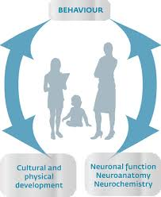

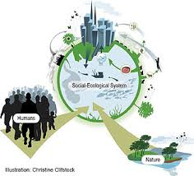
Human Behavior, Social Ecology and Social Environment

Slide 36

HUMAN BEHAVIOUR
Human behavior refers to the range of behaviors exhibited by humans and which are influenced by multiple factors such as environment which includes the surrounding of the human being . The capacity of mental, physical, emotional, and social activities experienced during the five stages of a human being's life - prenatal, infancy, childhood, adolescence, and adulthood. Includes the behaviors as dictated by culture, society, values, morals, ethics, and genetics.

Slide 37
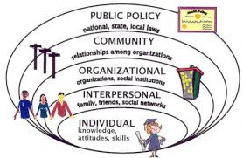
Social Ecology
man's collective interaction with his environment. Influenced by the work ofbiologists on the interaction of organisms within their environments, socialscientists undertook to study human groups in a similar way. Thus, ecologyin the social sciences is the study of the ways in which the social structure adapts to the quality of natural resources and to the existence of otherhuman groups. When this study is limited to the development and variationof cultural properties, it is called cultural ecology.

Slide 38

Social Environment
How we behave, our relationships, our gender and ethnic group, our education and work, the conditions and communities in which we live, and how we feel about ourselves are all elements of the social environment. These elements overlap and interact with elements of the physical environment to influence our health and impact on how long we live.

Slide 39
What is Environmental Ecology
Environmental Ecology: The study on the impacts of pollution and other stresses on ecosystem structure and function.

Slide 40
The Formation of Boundaries in Ecological Systems
Boundaries are maintained to determine who is the in-group and who is the out group
Two types of boundaries
  permeable
  impenetrable
Two types of systems
  open
  closed

Slide 41
The Formation of Boundaries
Open systems have permeable boundaries that allow easy movement in and out of the group
Closed systems have impenetrable boundaries that prevent movement in or out of the group

Slide 42
The Formation of Boundaries
Boundaries expand and contract as an individual develops over a lifetime
Initially there is expansion as one grows from childhood to adulthood
But as one develops the skills and experience at boundary maintenance, they can also contract

Slide 43
The Human Ecology Model / Family Systems Model
The Human Ecological Model seeks to capture the numerous relationships connecting children, families and their communities.

Slide 44
Bronfenbrenner’s Approach
Focuses on the developing child
Pays attention to the social environment
Recognizes the individual as an active player
Sees the social environment as dynamic

Slide 45
Environment
Environmental forces along with individual characteristics play a role in shaping the individual.
Mutually shaping systems that change overtime.
This interaction between individuals and their environment forms the basis of an ecological approach to human development.

Slide 46
BIOLOGICAL INFLUENCES
Common biological factors:
  Physical appearance; sex; race; age; abilities or disabilities; family history of inheritable conditions such as cancer, alcoholism, schizophrenia, depression, etc.
Do we start with a clean slate?
  No. At birth our slate is already written on by by heredity
  But environmental factors influence the unfolding of biological development. Einstein would not have become Einstein if he had been born into a family that could not feed him or who failed to provide him with intellectual stimulation.
Is biology destiny?
  The nature-nurture, heredity v. environment debate
  Can we modify biological inheritance? Genetic engineering, mapping of the human genome, genetic selection

Slide 47
PSYCHOLOGICAL INFLUENCES
Intelligence Personality Self-image
Where does your psychological make-up come from?
  Inheritance (biology)
  Experiences (sociology)
Cooley’s looking glass self – we learn who we are from how others treat us
Useful theory? One person may be strengthened by growing up with an alcoholic parent; another destroyed. What makes the difference?
Important issue – application of theory to practice:
  If behavior learned (a response to environment) it can be unlearned
  If behavior inherited, change may be more problematic.
    Can the leopard change its spots?

Slide 48
SOCIAL INFLUENCES
People: Family and family relationships; relationships with key individuals (parent, grandparent, spouse, significant other)
  Influence can be positive or negative; nurturing and supportive or destructive
  Clearly people are an important part of the factors which make us who we are.
Social environment: community, neighborhood
Economics: economic status influences resources and opportunities available to the individual
Religion
Moral: bio-psycho-social factors interact to make us who we are.

Slide 49

THE FAMILY AS A SOCIAL SYSTEM
THE FAMILY
FATHER Son MOTHER daughter

Slide 50
SYSTEM LEVELS
Microsystems – The smallest unit of analysis – typically the individual.
Mezzo systems – Typically small groups in which individuals are involved – family, friendship groups, work groups.
Macro systems – The largest units of analysis – society, culture, social institutions, communities, organizations
Exosystems – Systems outside the immediate area of analysis which may have an impact on it

Slide 51


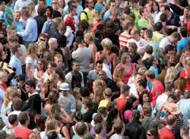
SOCIOLOGY OF Population, Demography AND Urbanization

Slide 52
POPULATION
A population is a summation of all the organisms of the same group, which live in the same geographical area, and have the capability of interbreeding.

Slide 53
Demography and the Census
Demography is the scientific study of the current state and changes over time in the size, composition, and distribution of populations.
A census is a head count of the entire population of a country, usually done at regular intervals.
Vital statistics include information about births, marriages, deaths, migrations in and out of the country, and other fundamental quantities related to population.

Slide 54
Malthusian Theory
The idea that a population tends to grow faster than the subsistence needed to sustain it.
Malthus noted that populations grow not by arithmetic increase but by exponential increase.
  The number of individuals added each year increases, with the larger population generating an even larger number of births with each passing year.

Slide 55
Malthusian Theory
Malthus failed to foresee three revolutionary developments that derailed his cycle of growth and catastrophe.
  In agriculture, technological advances permitted farmers to work larger plots of land and grow more food per acre.
  In medicine, science fought off diseases that Malthus expected to wipe out entire nations.
  The development of contraceptives kept the birthrate at a level lower than Malthus thought possible.

Slide 56
Demographic Transition Theory
Proposes that countries pass through a predictable and consistent sequence of population patterns linked to the degree of technological development in the society, ending with a situation in which the birthrates and death rates are both relatively low.
The population level is predicted to eventually stabilize, with little subsequent increase or decrease over the long term.

Slide 57
Demographic Transition Theory
Population change involves 3 main stages:
  Stage 1 is characterized by a high birthrate and high death rate.
  Stage 2 is characterized by a high birthrate but a declining death rate, increasing the overall level of the population.
  Stage 3 is characterized by a low birthrate and low death rate.
The overall level of the population tends to stabilize in Stage 3.

Slide 58
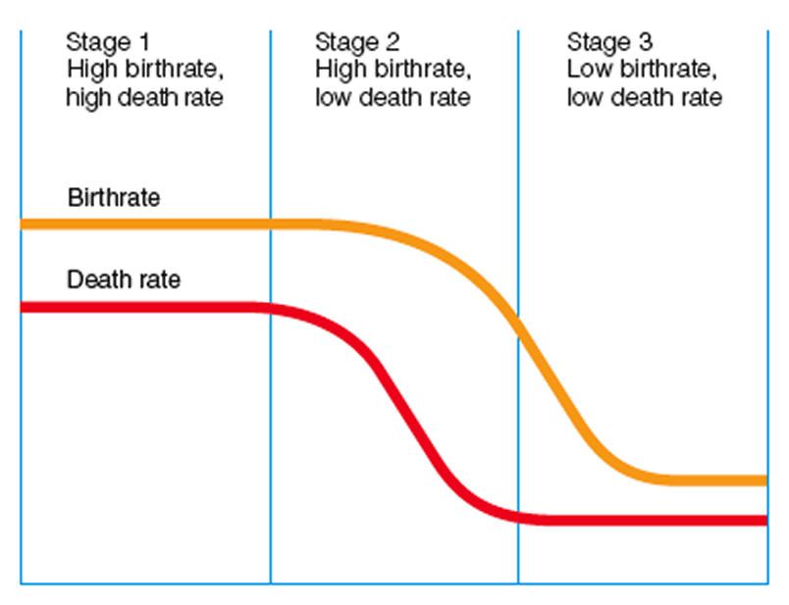
Demographic Transition Theory

Slide 59
Zero Population Growth
Achievement of zero population growth solves the problem of unchecked population growth.
Zero population growth has been achieved in the United States and other countries.

Slide 60
Urbanization
Scholars locate the development of the first city at around 3500 B.C.
The study of the urban, the rural, and the suburban is the task of urban sociology, a subfield of sociology that examines the social structure and cultural aspects of the city in comparison to rural and suburban centers.
Urbanization is the process by which a community has the characteristics of city life and the “urban” end of the rural–urban continuum.

Slide 61
Human Ecology and the Environment
Any society is an ecosystem with interdependent forces:
human populations
natural resources
the environment

Slide 62
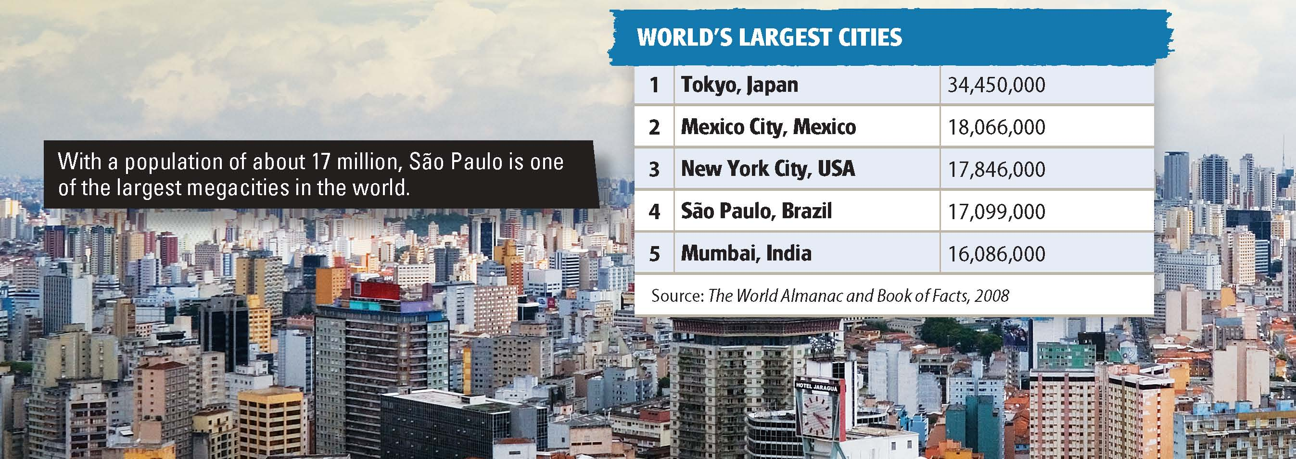

Slide 63
The Evolution of the City
Urbanization is the concentration of the population into cities. A city is a permanent concentration of a relatively large number of people who are engaged mainly in nonfarming activities.
The Preindustrial City
The Industrial City
The first cities arose about 6,000 years ago and grew because of advances in agriculture.
Life in early cities was crowded and dirty.
The Industrial Revolution changed life in the cities.
Mechanization of agriculture led people to move to cities.
Commerce and society became the focal point of life instead of the family.
Notes:
–

Slide 64
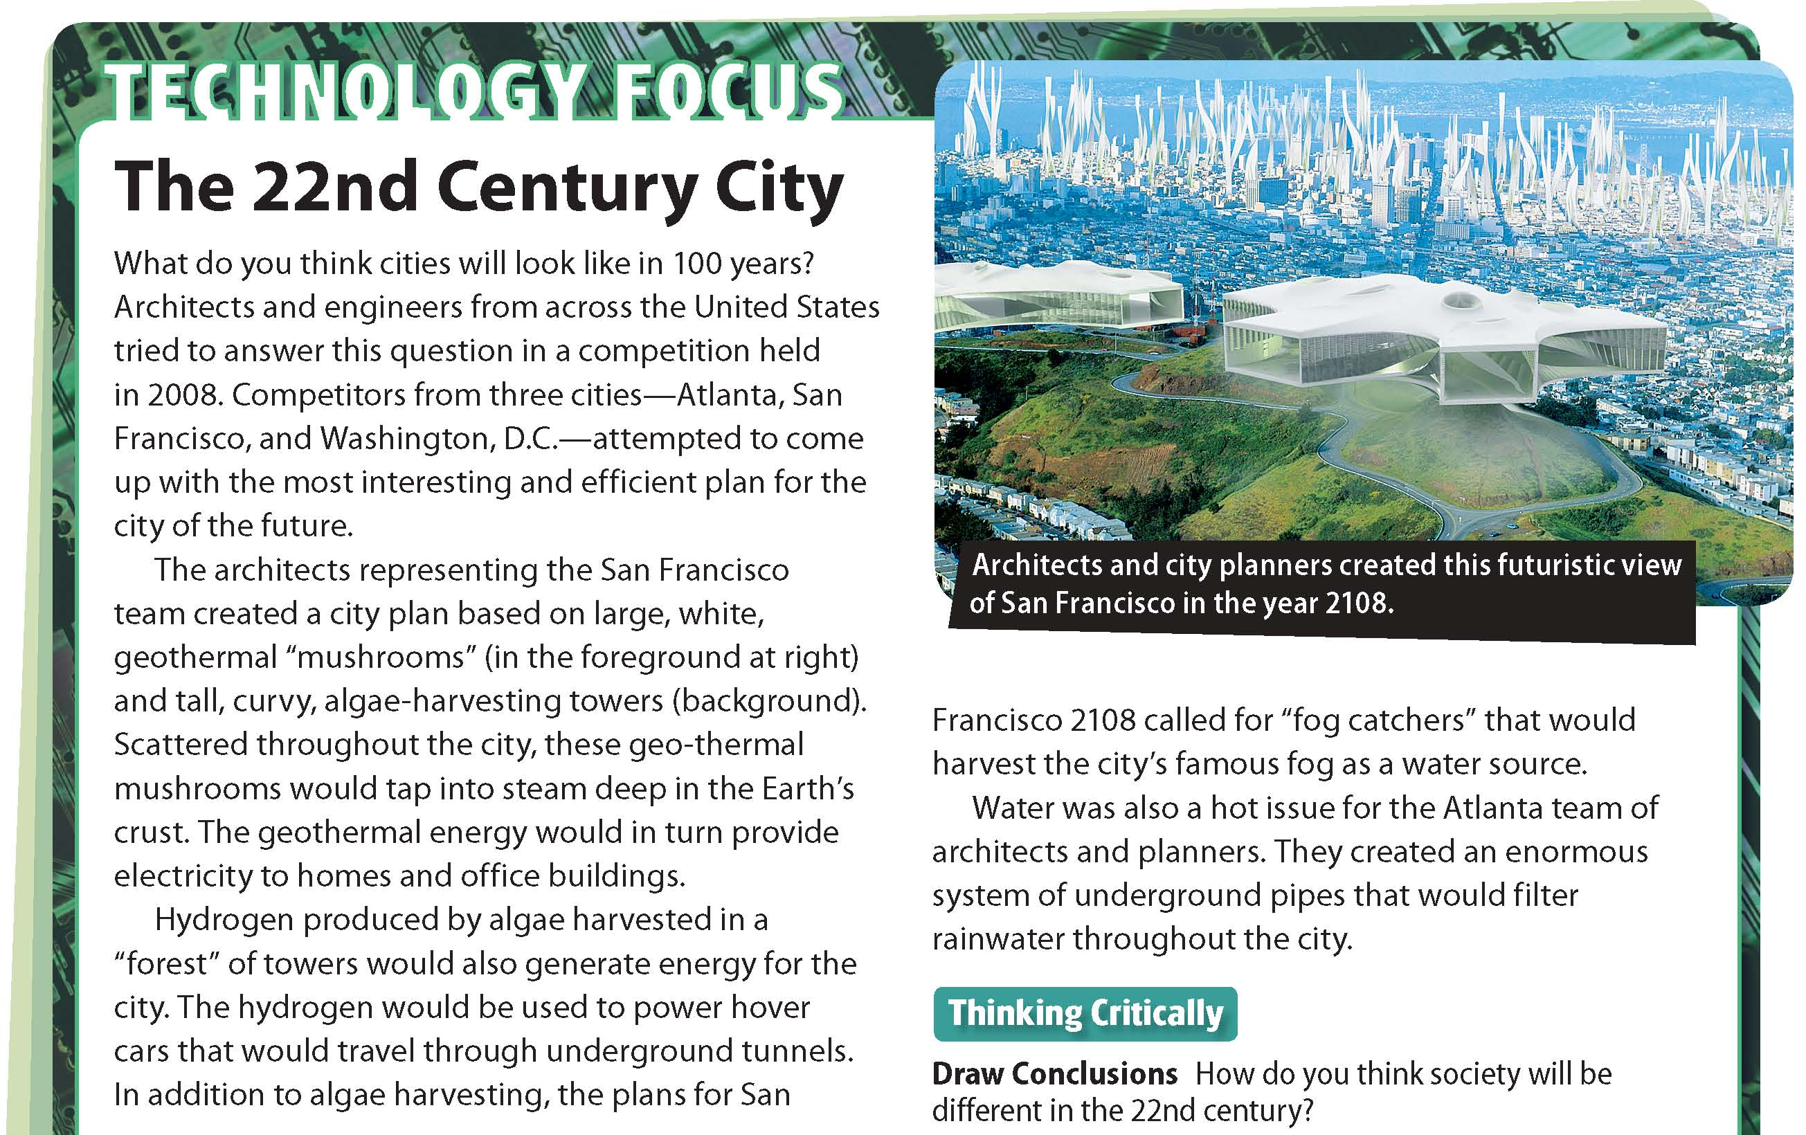

Slide 65
TEXT BOOKS PROPOSED and Lectures prepared by
1.The Real World: An Introduction to Sociology, 2nd Edition
By Kerry Ferris and Jill Stein.
2. Introduction to Sociology 10th edition
by Henry L. Tischler
3. Kendall, Diana: Sociology in our Times. Wadsworth
4. Henslin, James M. Sociology. Allyn & Bacon
5. Brgjar, George J. & Soroka, Michael P. Sociology. Allyn & Baco
6. Sociology in our Times, The Essentials 6th Edition, by Diana Kendall.

Slide 66
THANKYOU

