Slide 1
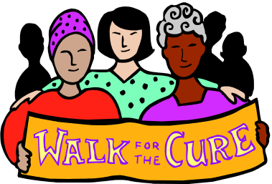
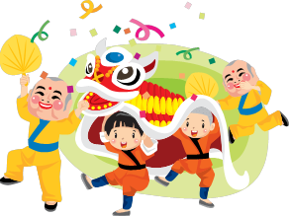


SUMMARY Part 2: The Individual In Society
Dr Sadaf Sajjad

Slide 2

The Individual…
…and Society

Slide 3

What rights do we have as citizens?

Slide 4
Key Ideas
No-one can be deprived of their possessions, except in the public interest or to secure payment of taxes or any other penalties in society.
All citizens have the right and are entitled to education, whilst respecting parents rights to ensure their children are taught in conformity with their own religious convictions.
Freedom of assembly: the freedom from retrospective criminal law and no punishment without law.
Freedom of expression: The right to marriage and family.
The right to a fair trial: the freedom from discrimination.
The right to vote once you have reached the age of 18.

Slide 5
Examples
What rights do we have as consumers?
The sales of goods act came about in 1979;
Goods we buy must:-
· Be of satisfactory quality.
· Be free from defects (except when marked “shop soiled”)
· Be fit for purpose.
· Fit the description used in any advert, label or packaging.
The retailer has a legal obligation to sort out your problem if the goods do not meet these requirements.
There is also the Consumer Protection Act 1987. Anyone who sells you goods that are not safe is breaking the law.
The Act also makes it an offence to mislead customers about the price of goods.

Slide 6
Examples
The right to vote:
Nearly everyone in the United Kingdom aged 18 and over has the right to vote for their local Member of Parliament. But the situation 200 years ago was very different.
Although MPs have been chosen by elections for over 400 years, it was only in the 20th Century that the right to vote was extended to all adults. At the start of the 19th Century only around three adults in every 100, all men, were allowed to vote. Over the following years there were a number of Acts of Parliament, starting with the Great Reform Act 1832 , which gradually extended the right to vote to greater numbers of men.
In the late 19th and early 20th centuries, women began to demand the right to vote as well. These protesters were known as Suffragettes. The Representation of the People Act 1918 allowed most women aged 30 and over to vote for the first time and the Representation of the People Act of 1969 lowered the voting age from 21 years and then to 18.

Slide 7
Examples
What rights do we have as an employee;
Any business has a responsibility to provide it's employees with a safe working environment, and must respect employees rights;
Important laws governing employment are:-
· The Health and Safety at Work Act 1974, ensures safe and healthy working
conditions.
· The Employment Protection (Consolidation) Act 1978, protects individuals from being unfairly dismissed.
· The Disability Discrimination Act 1995, the Race Relations Act 1976 and the Sex Discrimination Acts 1975 and 1986 make it unlawful to discriminate against individuals on the grounds of disability, sex, marital status, race, colour or ethnic or national origin.
· The Working Time Regulation Act 1998, covers areas such as maximum working hours, rest breaks and paid annual leave.
· The National Minimum Wage Act 1999, provides employees with basic protection from exploitation.
· The amount of paid and unpaid maternity leave was increased. Fathers were also given the right to two weeks unpaid paternity leave.

Slide 8

Examples
Freedom of Religion
The First Amendment guarantee of freedom of religion was established because many of the colonists who founded the United States came to America to escape religious persecution and government oppression. This country's founders wanted to prevent any one religion from dominating the government or imposing its will or beliefs on society as a whole.
Two clauses in the First Amendment guarantee freedom of religion.; The first part of this provision is known as the Establishment Clause, and the second part is known as the Free Exercise Clause. The establishment clause prohibits the government from passing laws that will establish an official religion or preferring one religion over another. The free exercise clause prohibits the government from interfering with a persons practice of their religion.

Slide 9
Examples
The Right to Assemble
Freedom of assembly is the right of people to gather peacefully to exchange ideas or to peacefully protest social, economic, or political conditions and demand reform.
The Million Mom March is a recent example of assembly. People gathered around the country on Mother's Day 2000 to educate children and adults about the dangers of guns. Most public gatherings in the United States proceed without active interference by police or other officials. But sometimes police officers may make arrests when demonstrations threaten to turn violent.
The right to assemble, however is not an absolute right. Most towns and cities can legally regulate the time, place, and manner of assembling. For example, a city may restrict a large demonstration to a particular area or time of day.

Slide 10
Discussion Time:
Do you feel that we as citizens have enough rights in Pakistan?
What rights do you think that we should be entitled to ,if we are not already?
What new laws do feel should be introduced in today's society?

Slide 11

What duties does society have a right to expect us to perform?

Slide 12
Society
Definition of society
A society is a grouping of individuals characterized by patterns of relationships between these individuals that may have distinctive culture and institutions, or, more broadly, an economic, social and industrial infrastructure in which a varied multitude of people or peoples are a part.
Key terms on society
Distinctive culture
Institutions
Culture
Religion
Politics
Social inequality

Slide 13
Human Rights
the right to life
freedom from torture and degraded treatment
freedom from slavery and forced labour
the right to liberty
the right to a fair trial
the right not to be punished for something that wasn't a crime when you did it
the right to respect for private and family life
freedom of thought, conscience and religion
freedom of expression
freedom of assembly and association

Slide 14
Human Rights
the right to marry or form a civil partnership and start a family
the right not to be discriminated against in respect of these rights and freedoms
the right to own property
the right to an education
the right to participate in free elections
If any of these rights and freedoms are abused you have a right to an effective solution in law, even if the abuse was by someone in authority, for example, a policeman.

Slide 15
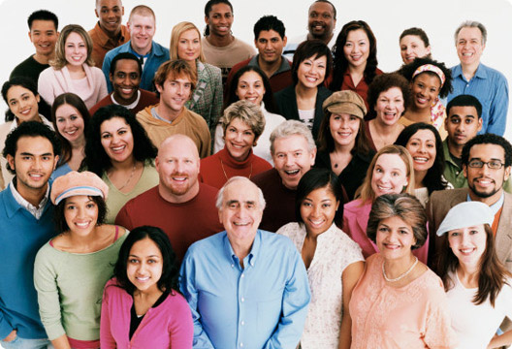
Do the interests of society override those of the individual?

Slide 16
Key Ideas
Although an individual is part of a society, it is possible for an individual to have interests that conflict with the interests of society.
So, whose interests are more important? Society’s or the individuals?
Society could not exist without individuals, so obviously it is important for the interests of society to match the interests of the individual.
However, when an individual’s interests do not match the interests of society (a conflict of interest). It is important to find a healthy balance between what the individual’s interests are, and public interest.

Slide 17
Key Definitions
Interest: A concern held by an individual or a society, concerning the welfare of the individual or society.
Individual interest: The concerns held by an individual. E.g. it is in the individual’s interests for pay rates to rise.
Public Interest: The public interest refers to the ‘common good’ of society. E.g. it is in the public interest for the government to uphold a good, working law system.
Conflict of interest: A situation in which the interests of the individual differs from the general interests of society. This can refer to when the personal interests of a person with a responsibility to the government differs from the interests of society. This could result in a poor governmental decision on the person’s behalf.
Welfare state: a government system to ensure economic security for those individuals most in need; e.g. unemployed or ill

Slide 18
Examples
Taxation; As we live in a welfare state, taxation benefits the public, but may not benefit the individual. Taxes are required to pay for many public services, such as the fire service, the NHS and police. However, this means that a large percentage of an individual's wages are taken from them without their personal permission. Whether the individual uses the public services provided for them is entirely up to them, but taxes are still taken for them. These taxes are taken in the public interest, but not necessarily in the interest of the individual. In this case, the interests of society override the interests of the individual.
Biometric passports; From 2008, it is planned for all passports to incorporate an iris scan and fingerprints. This is intended to prevent identity fraud. However, does it infringe on our right to privacy?

Slide 19
Discussion:
Do you think society’s needs outweigh your own?
Is there anything you feel the government has done in the public interest that is not in the interest of you as an individual?
Is there anything the government could do in order to meet both the needs of the individual and the needs of society?

Slide 20

Ought the privacy of public figures to be intruded upon?

Slide 21
What is privacy?
Privacy is the ability of an individual or group to seclude themselves or information about themselves and thereby reveal themselves selectively.
The boundaries and content of what is considered private differ among cultures and individuals, but share basic common themes.
Privacy is sometimes related to anonymity; the wish to remain unnoticed or unidentified in the public realm.

Slide 22

Theories of Self & Society

Slide 23
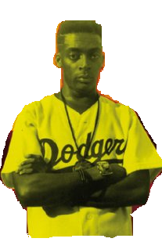
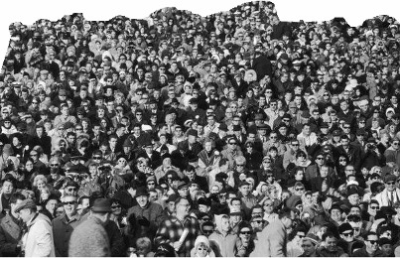
Is society the action of individuals or the collective conscience of a society?
Or something in between?
Social Action
Social Structure
the
“Self”
What are the bases of social interaction that make up society and the individuals within it?

Slide 24
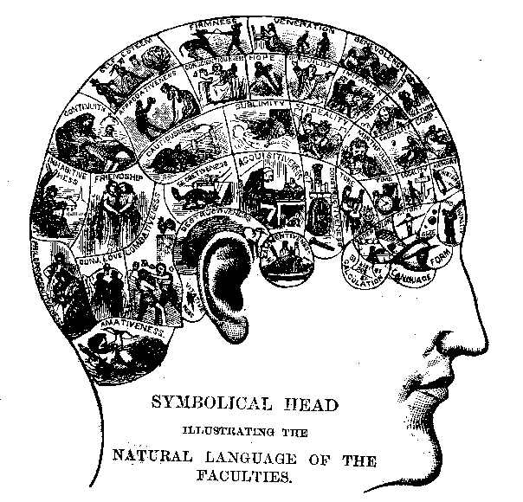
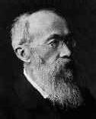
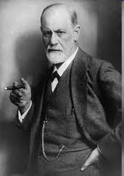
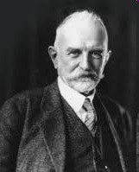
Mind and Self: The Study of the “Individual”
Phrenology – early science of the mind
Late 1800s – William Wundt’s science of psychology
Sigmund Freud – psychoanalytic theory
Mead – social psychology; symbolic interactionism
Individual = product of mental structure
Individual = product of social interaction

Slide 25
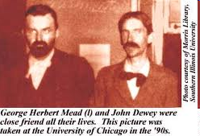
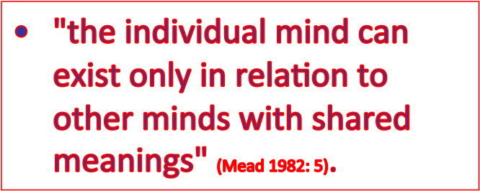
Mead and the Philosophy of Pragmatism
Pragmatism – John Dewey, William James
Theory of knowledge that holds that the truth of an idea is to be found in its practical application in everyday life—rejects the idea of universal truths.
Individuals improvise their actions and behaviors to respond to the actions and reactions of others, in order to solve the problems of existence.
(Social) reality is being constantly negotiated.

Slide 26
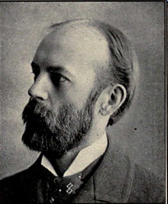
Charles Horton Cooley (1864 – 1929) Pragmatic Sociology
People are active communicators. As we negotiate our worlds, we are constantly concerned about others’ perceptions.
“Looking glass self” – Famous sociological concept
  We imagine how we look to other people.
  We imagine how other people judge our presentation.
  This produces “self-feelings” like pride, embarrassment, or praise that shape our self conception.

Slide 27
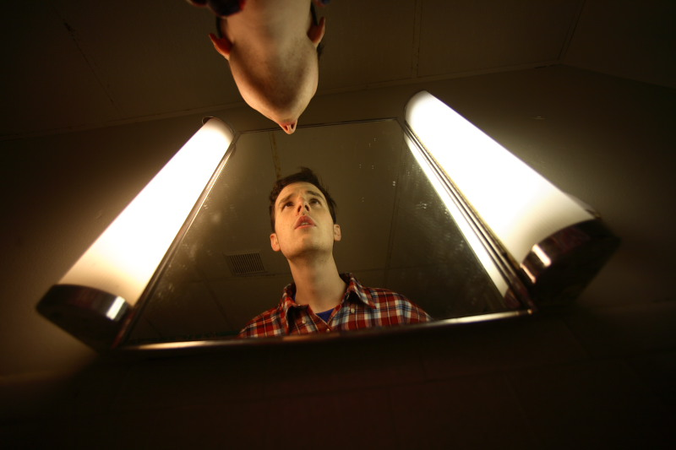
The Looking Glass Self: I am who I think you think I am.

Slide 28
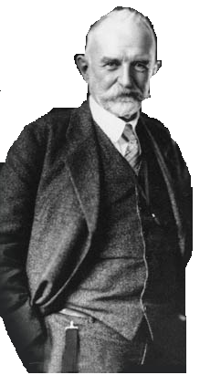
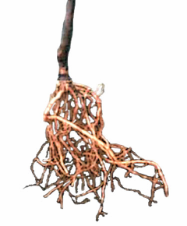
Mead
George Herbert
(1863-1931)
“the self…arises in the process of social experience”
Born in South Hadley, Massachusetts
Studied philosophy at Harvard, Leipzig, and Berlin
Taught at Univ. of Michigan & Univ. of Chicago
Stellar lecturer and social reformer
Intellectual Roots
Pragmatism
Behavioral Psychology

Slide 29










the importance of…
unlike animals, humans can delay their responses to stimuli…
We interpret through the use of significant gestures, or actions that arouse the same response in the self as in others.
How do gestures become significant? Through interaction…

Slide 30

?
What is the
Not innate, but emerges when we can take on the role of others.
“The self is something which has a development; it is not initially there, at birth, but arises in the process of social experience and activity…it is an object to itself, and that characteristic distinguishes it from other objects and the body.” (p. 282-83)
Gestures and symbols become significant through interaction with others.
Reflexivity—put ourselves in the place of others and act as they do.

Slide 31
Emergence of The Self
The self is developed from three inter-subjective forms of interaction:
  Language
  Play
  Game
The key to this process is “taking the role of the generalized other” in order to gain essential self-realization.

Slide 32
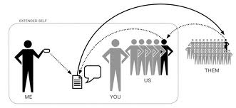
Self as “I” and “Me”
“Me” reflects the attitude of the generalized other.
“I” responds to the attitude of the generalized other.
_________________________
“both aspects of the ‘me’ and the ‘I’ are essential to the self in its full expression” (Mind, Self and Society 199).
The individual takes the attitude of the “me” or of the “I” according to situations.
Both the community and individual are necessary to identity.
Google image
There are 2 parts of the self:
“ I ”- is the initial self
“ Me ” - is the developed social self
Notes:
32

Slide 33
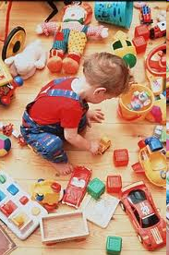
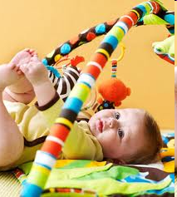
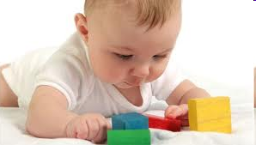
“Pure Play” or the Unsocialized “I”
Video 1

Slide 34
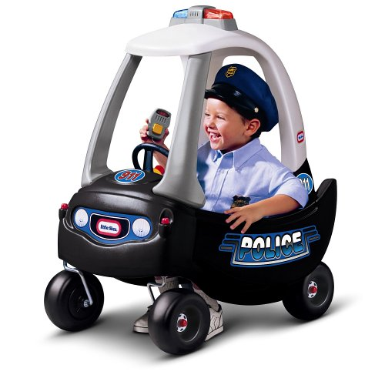
The Play:
—1st in childhood development—
“Me” starts to develop: point of view from others
    Children play games to develop adult roles
    Cops and Robbers, “playing house,” etc.
“A child plays at being a mother, at being a teacher… at playing different roles” (287).
Subject and Object
    Self becomes an object
Notes:
34

Slide 35
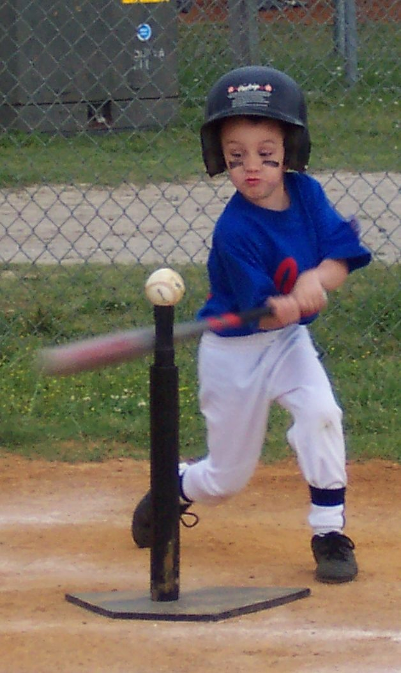
The Game:
—2nd stage in developing self—
Forms through experience and interaction
Taking the role of those all involved in the game, or situation
The organization of roles are based on rules
    Which helps →
Symbolically unify the personalities of all participants
    And leads to →
  “The Generalized Other”

Slide 36
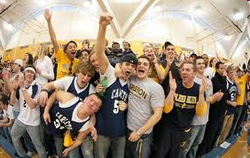
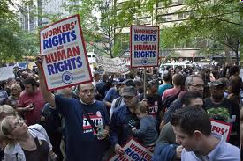
This unity is called- “The Generalized Other”
Defined as- An organized and generalized attitude to which the individual defines their own conduct
  What is expected
  How the group looks at you
Final separation of “I” and “Me”
  One becomes a socially competent self
Retaining self-consciousness
(Mind, Self and Society 195)

Slide 37











Attitudes of others generalized into a single view of the self
Take on the role of many significant others
Act out the role of significant others
STAGES OF ROLE-TAKING
Learn to interpret and rehearse
(socialized)
(spontaneous)

Slide 38
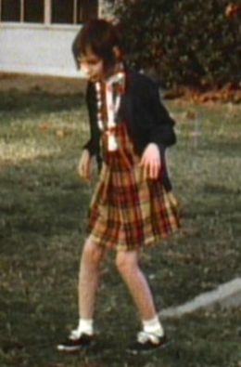
Would you be “you” if you were isolated from birth?
Video 2“Genie”

Slide 39
Self = Product of Social Interaction
“There are all sorts of different selves answering to all sorts of different social reactions” (286). Out of these interactions and the “selves” they produce emerge a number of social groups (290).
Taking the form of the “generalized other” is “how the community exercises control over the conduct of its individual members” (290). Social order/control maintained.
Mead pioneered study of social-psychology.
Basis for symbolic-interactionism: study of symbolic exchange in everyday life which takes the place of direct interaction.

Slide 40
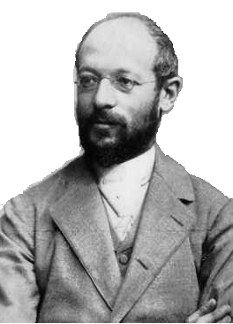
Simmel
Georg
(1858-1918)
Studied at the University of Berlin
Popular lecturer and prolific writer
Never received a full academic position despite efforts of friend Max Weber
The self is shaped by the size of one’s social circles.
Individuality increases as one’s social circles expand.
(Because it is less likely that anyone else will have the same memberships.)

Slide 41
CULTURE

Slide 42
What is culture?
Culture refers to the total lifestyle of a people, including all of their ideas, values, knowledge, behaviors, and material objects that they share
Culture shapes and guides people’s perception of reality

Slide 43
Culture determines…
Food we eat
Clothing
Music
Games we play
How to express emotions
What is good or bad
What is high or low culture (if any)

Slide 44
Culture is a way of life
Ideas
Attitudes
Values
Material
Objects
Behavior
Patterns
“Everything that people have, think, and do as members of a society” (Ferraro, 2008)
Culture is Relative

Slide 45

Theories of Human development

Slide 46
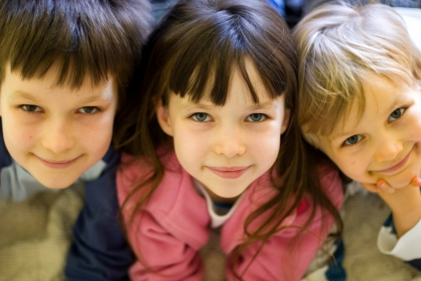
Definition
Theories of development is the study of the psychological processes of children and, specifically, how these processes differ from those of adults, how they develop from birth to the end of adolescence, and how and why they differ from one child to the next.
It is sometimes grouped with infancy, adulthood, and aging under the category of developmental processes of a human being

Slide 47
Importance of Developmental theories
To understand the child better.
To know that some problems have a psychological origin.
To establish effective communication between the child and the parent.
To gain confidence of the child and of the parent.
To teach parents and children the importance of primary and preventive care.
To have better treatment planning and interaction with other medical disciplines.

Slide 48
Psychoanalytic Child Development Theories

Slide 49
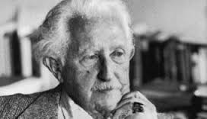
Erik Erikson Theory
Proposed a stage theory of development, but his theory encompassed human growth throughout the entire human lifespan.
Erikson believed that each stage of development was focused on overcoming a conflict.
For example, the primary conflict during the adolescent period involves establishing a sense of personal identity.
Success or failure in dealing with the conflicts at each stage can impact overall functioning. During the adolescent stage, for example, failure to develop an identity results in role confusion.

Slide 50
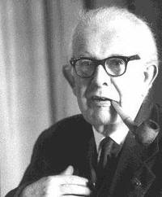
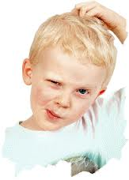
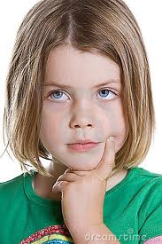
Jean Piaget Theory
Suggested that children think differently than adults and proposed a stage theory of cognitive development.
He was the first to note that children play an active role in gaining knowledge of the world.
According to his theory, children can be thought of as "little scientists" who actively construct their knowledge and understanding of the world.

Slide 51
Behavioral Child Development Theories

Slide 52

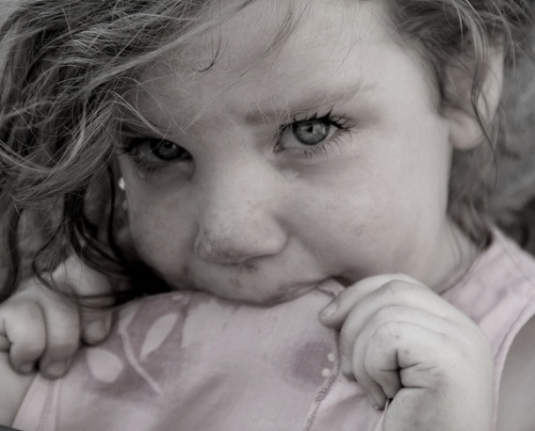
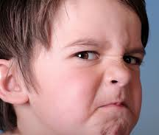
Behavioral theories
Behavioral theories of child development focus on how environmental interaction influences behavior and are based upon the theories of theorists such as John B. Watson, Ivan Pavlov and B. F. Skinner.
These theories deal only with observable behaviors. Development is considered a reaction to rewards, punishments, stimuli and reinforcement.
This theory differs considerably from other child development theories because it gives no consideration to internal thoughts or feelings.

Slide 53
Social Child Development Theories

Slide 54

SOCIALIZATION

Slide 55
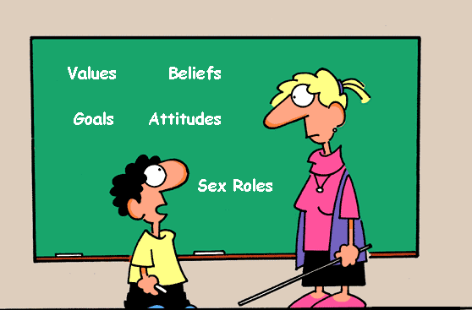
THE SOCIALIZATION PROCESS
An all encompassing educational process from which values, goals, beliefs, attitudes, and gender-roles are acquired.

Slide 56
Agents or Sources of Socialization
FAMILY
  HAS THE GREATEST IMPACT ON SOCIALIZATION
  THE FIRST TO TEACH SKILLS, VALUES, & BELIEFS
  EVEN TEENS CONTINUE TO PLACE THEIR GREATEST TRUST IN THEIR PARENTS

Slide 57
THE FAMILY
RESEARCH SUGGESTS THAT NOTHING IS MORE LIKELY TO PRODUCE A HAPPY, WELL-ADJUSTED CHILD THAN BEING IN A LOVING FAMILY.
RESEARCH ALSO SHOWS THAT THE CLASS POSITION OF PARENTS AFFECTS HOW THEY RAISE THEIR CHILDREN.

Slide 58
THE SCHOOL
SCHOOLING ENLARGES CHILDREN’S SOCIAL WORLDS TO INCLUDE PEOPLE WITH BACKGROUNDS VERY DIFFERENT FROM THEIR OWN.

Slide 59
SCHOOLS
TEACH A WIDE RANGE OF KNOWLEDGE & SKILLS…
“THE HIDDEN CURRICULUM” HONORING COMPETITION, ACADEMIC SUCCESS, SOCIETAL VALUES, ETC.

Slide 60
PEER GROUPS
BY THE TIME THEY ENTER SCHOOL, KIDS HAVE DISCOVERED THE PEER GROUP: A SOCIAL GROUP WHOSE MEMBERS HAVE INTERESTS, SOCIAL POSITION, AND AGE IN COMMON.

Slide 61
MASS MEDIA
IMPERSONAL COMMUNICATIONS AIMED AT A VAST AUDIENCE
SPREAD INFORMATION ON A VAST SCALE
NEWSPAPERS = > RADIO => TV
IN THE U.S., IT HAS AN ENORMOUS EFFECT ON OUR ATTITUDES AND BEHAVIOR.
  HIGHEST RATE OF TV OWNERSHIP IN THE WORLD
  THE AVG. HOUSEHOLD HAS THE TV ON FOR 7 HRS. A DAY
  PEOPLE SPEND ALMOST ½ OF THEIR FREE TIME WATCHING

Slide 62
SOCIAL INTERACTION

Slide 63
Social Interaction
Includes the socialization aspect of sociology
Is easily studied using approaches at the micro level of investigation

Slide 64
Elements of Social Interaction
We as human beings do not interact with one another as anonymous beings. We come together in specific environments with specific purposes. Our behaviors therefore, are determined by defined statuses and particular roles.

Slide 65
Statuses
are socially defined positions that people occupy.
They exist independent of the people who occupy them
-common statuses may pertain to religion, education, ethnicity, occupation: such as Protestant, college graduate, Asian American, teacher.

Slide 66
Ascribed v. Achieved
Statuses conferred upon us by virtue of birth or other significant factors not controlled by our own actions or decisions; people occupy them regardless of their intentions
-son/daughter, one’s gender, ethnicity, race etc.
Statuses occupied as a result of an individual's actions
-student, professor, mechanic, prisoner, husband, mother,

Slide 67
Roles
The culturally defined rules for proper behavior that are associated with every status (think of them as a collection of rights and obligations)
-the rights of an employee are to be paid and trained to do their job, in return they are obligated to be at work on time and do their job to the best of their ability

Slide 68
Role Sets
All the roles attached to a single status are known collectively as a role set.
-not every role is used all the time
-an individual’s role is dependent on the situation
As a student you behave one way with:
-other students
-another with teachers.
-another with parents
-another with a boss
-another with siblings and so on

Slide 69
Role: Strain, Conflict, Playing
Role Strain: Role strain occurs when a person has difficulty meeting the responsibilities of a particular role in his or her life. If you're reading this right now at a time when you are having trouble keeping up with the expectations on you as a student, learning all you need to learn, keeping on top of the work involved, this means you are experiencing strain on your role as a student.

Slide 70
Role Conflict: when an individual who is occupying more than one status at a time…
Role Playing: the roles we play can feel natural, awkward, could make us feel likes we’re actors, or feel quite natural. (Some) Sociologists feel that the roles a person plays are the person’s only true self.

Slide 71

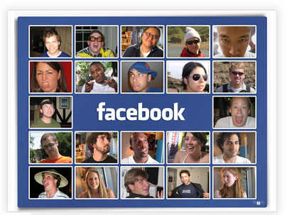

Networks
…a web of weak social ties
Includes people we know of – or who know of us-but with whom we interact rarely, if at all.

Slide 72
Other Topics Summarize
Altruism
Liking and Friendship
Leadership
Conformity
Technology and Society etc etc.

Slide 73
THANKYOU

