Slide 1

LEADERSHIP
Presented by
Dr.SADAF SAJJAD

Slide 2

Social Context
Sociology is about understanding individual behavior in a social context.
“The scientific field that seeks to understand the nature and causes of individual behavior in social situations”
Sociologists therefore deal with the factors that lead us to behave in a given way in the presence of others, and look at the conditions under which certain behavior/actions and feelings occur. This field is to do with the way these feelings, thoughts, beliefs, intentions and goals are constructed and how such sociological and psychological factors, in turn, influence our interactions with others.

Slide 3

Leadership?
Leadership is “a process of social influence in which one person can enlist the aid and support of others in the accomplishment of a common task".
Leadership is "organizing a group of people to achieve a common goal". The leader may or may not have any formal authority.

Slide 4

Leader
A leader is a person who has a vision, a drive and a commitment to achieve that vision, and the skills to make it happen.
Having a great idea, and assembling a team to bring that concept to life is the first step in creating a successful business venture. While finding a new and unique idea is rare enough; the ability to successfully execute this idea is what separates the dreamers from leaders.

Slide 5
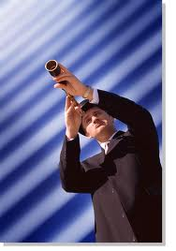
Leader (continued…)
A leader has a vision. Leaders see a problem that needs to be fixed or a goal that needs to be achieved. It may be something that no one else sees or simply something that no one else wants to tackle. Whatever it is, it is the focus of the leader's attention and they attack it with a single-minded determination.
The Drive To See It Through:
It is not enough to just have a vision. Lots of people see things that should be done, things that should be fixed, great step forward that could be taken. What makes leaders different is that they act. They take the steps to achieve their vision.

Slide 6
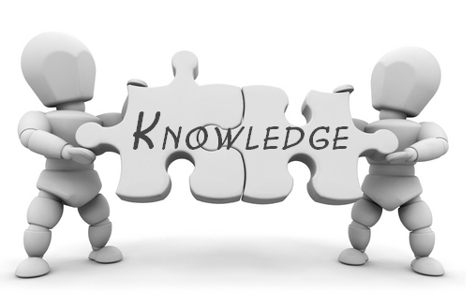
Leadership begins with Self-knowledge
Self-knowledge is the basis for character...
Character is the root of integrity...
Integrity provides the foundation for leadership”.
(Lombardi, 2001)

Slide 7
Leadership is about:
Motivating
Inspiring
Taking people to greater heights
Working with participants on the how and helping them figure out what and why
Encouraging them to push themselves to achieve the highest possible performance
Action
Enabling, not telling
Talking the talk and walking the walk...walking alongside

Slide 8
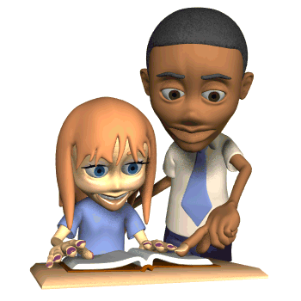
The Leadership Role
A good leader is a person who:
Is a good teacher
Doesn’t put down those they are working with
Gets the most from those they are working with
Works within the framework of the rules

Slide 9
The Leadership Role (continued…)
Leadership style is the manner and approach of providing direction, implementing plans, and motivating people.
Positive Leaders use rewards (independence, education) to motivate employees.
Negative Leaders use penalties with employees. These leaders act domineering and superior w/people. Negative penalties include: days off without pay, reprimanding in front of others, assigning unpleasant job tasks.

Slide 10
What are the three primary tasks of a leader?
Set direction: mission, goals, vision
Build commitment: motivate & inspire
Confront challenges: innovation, deal with change, turbulence, take risks

Slide 11

Watch video on leadership
Video 1

Slide 12
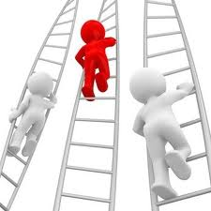
How people become leaders (Bass' Theory of Leadership)
Bass' theory of leadership notes there are three basic ways to explain how people become leaders:
A crisis or important event may cause a person to rise to the occasion, which brings out extraordinary leadership qualities in an ordinary person.
Some personality traits may lead people naturally into leadership roles.
People can choose to become leaders. People can learn leadership skills. This is the Transformational or Process Leadership Theory. It is the most widely accepted theory today and the premise on which this guide is based.

Slide 13
Leadership styles
Leadership style is the manner and approach of providing direction, implementing plans, and motivating people. Kurt Lewin (1939) led a group of researchers to identify different styles of leadership. This early study has been very influential and established three major leadership styles. The three major styles of leadership are:
Authoritarian or autocratic
Participative or democratic
Delegative or Free Reign

Slide 14
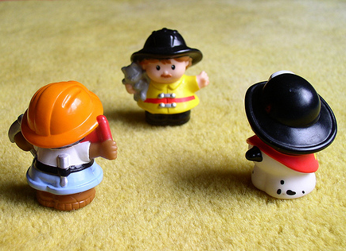
1. Authoritarian (autocratic)
This style is used when leaders tell their employees what they want done and how they want it accomplished, without getting the advice of their followers. Some of the appropriate conditions to use it is when you have all the information to solve the problem, you are short on time, and your employees are well motivated.
Some people tend to think of this style as a vehicle for yelling, using demeaning language, and leading by threats and abusing their power. This is not the authoritarian style, rather it is an abusive, unprofessional style called “bossing people around.”
The authoritarian style should normally only be used on rare occasions.

Slide 15
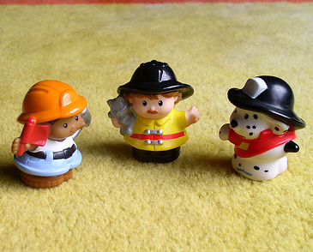
2. Participative (democratic)
This style involves the leader including one or more employees in the decision making process (determining what to do and how to do it). However, the leader maintains the final decision making authority.
Using this style is not a sign of weakness, rather it is a sign of strength that your employees will respect.
This is normally used when leader has one part of the information, and employees have other parts.
Leader is not expected to know everything — this is why knowledgeable and skillful employees are employed. Using this style is of mutual benefit — it allows them to become part of the team and allows you to make better decisions.

Slide 16
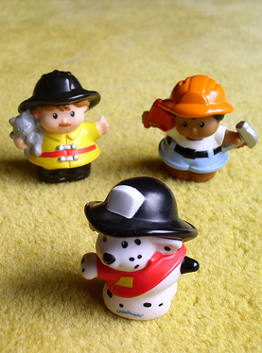
3. Delegative (free reign)
In this style, the leader allows the employees to make the decisions. However, the leader is still responsible for the decisions that are made. This is used when employees are able to analyze the situation and determine what needs to be done and how to do it. You cannot do everything! You must set priorities and delegate certain tasks.
This is not a style to use so that you can blame others when things go wrong, rather this is a style to be used when you fully trust and confidence in the people below you.

Slide 17
Leadership styles
Liking for leader
Group atmosphere
Productivity
Authoritarian (autocratic)
Liked less
Aggressive,
dependent,
self-oriented
High (leader present)
Low (leader absent)
Friendly,
Group-centered,
task-oriented
Relatively high
(unaffected by
presence and absence
of leader)
Participative (democratic)
Liked More
Delegative (free reign)
Friendly,
Group-centered,
play-oriented
Low (Increased in
absence of leader)
Liked less

Slide 18
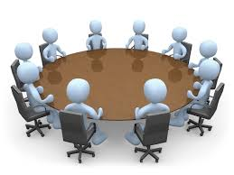
Emotion-laden process
Leadership can be perceived as a particularly emotion-laden process, with emotions entwined with the social influence process. In an organization, the leader's mood has some effects on his/her group. These effects can be described in three levels:
The mood of individual group members: Group members with leaders in a positive mood experience more positive mood than do group members with leaders in a negative mood. The leaders transmit their moods to other group members through the mechanism of emotional contagion. Mood impurity may be one of the psychological mechanisms by which charismatic leaders influence followers.

Slide 19
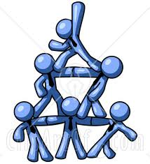
Emotion-laden process (continued…)
The affective tone of the group: Group affective tone represents the consistent or homogeneous affective reactions within a group. Group affective tone is an aggregate of the moods of the individual members of the group and refers to mood at the group level of analysis. Groups with leaders in a positive mood have a more positive affective tone than do groups with leaders in a negative mood.
Group processes like coordination, effort expenditure, and task strategy: Public expressions of mood impact how group members think and act. When people experience and express mood, they send signals to others. Leaders signal their goals, intentions, and attitudes through their expressions of moods.
For example, expressions of positive moods by leaders signal that leaders deem progress toward goals to be good. The group members respond to those signals cognitively and behaviorally in ways that are reflected in the group processes.

Slide 20
Leadership theories
Early leadership theories focused on what qualities distinguished between leaders and followers, while subsequent theories looked at other variables such as situational factors and skill levels.
While many different leadership theories have emerged, most can be classified as one of eight major types.

Slide 21
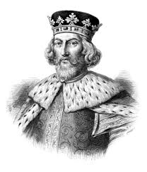
1. Great Man Theory
Great man theory assumes that the capacity for leadership is inherent – that great leaders are born, not made.
It portrays that great leaders as heroic, mythic and destined to rise to leadership when needed.
The term "Great Man" was used because, at the time, leadership was thought of primarily as a male quality, especially in terms of military leadership.

Slide 22
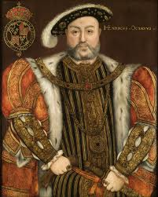
2. Trait Theory:
Similar in some ways to "Great Man" theory, trait theory assumes that people inherit certain qualities and traits that make them better suited to leadership.
Trait theory often identifies particular personality or behavioral characteristics shared by leaders.
If particular traits are key features of leadership, then how do we explain people who possess those qualities but are not leaders? This question is one of the difficulties in using trait theory to explain leadership.

Slide 23
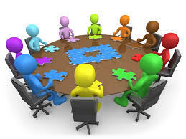
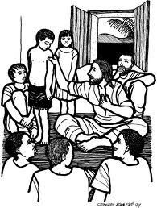
3. Contingency Theory
Contingency theory of leadership focuses on particular variables related to the environment that might determine which particular style of leadership is best suited for the situation.
According to this theory, no leadership style is best in all situations.
Success depends upon a number of variables, including the leadership style, qualities of the followers and aspects of the situation.

Slide 24
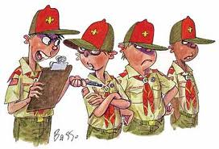

4. Situational Theory
Situational theory proposes that leaders choose the best course of action based upon situational variables.
Different styles of leadership may be more appropriate for certain types of decision-making. For example, in a situation where the leader is the most knowledgeable and experienced member of a group, an authoritarian style might be most appropriate.
In other instances where group members are skilled experts, a democratic style would be more effective.

Slide 25
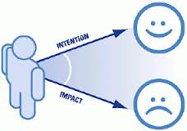
5. Behavioral Theory
Behavioral theories of leadership are based upon the belief that great leaders are made, not born.
Rooted in behaviorism, this leadership theory focuses on the actions of leaders not on mental qualities or internal states.
According to this theory, people can learn to become leaders through teaching and observation.

Slide 26

6. Participative Theory
Participative leadership theory suggests that the ideal leadership style is one that takes the input of others into account.
These leaders encourage participation and contributions from group members and help group members feel more relevant and committed to the decision-making process.
In it, however, the leader retains the right to allow the input of others.

Slide 27

7. Management Theory
Management theory, also known as transactional theory, focuses on the role of supervision, organization and group performance.
This theory bases leadership on a system of rewards and punishments.
It is often used in business; when employees are successful, they are rewarded; when they fail, they are reprimanded or punished.

Slide 28

8. Relationship Theory
Relationship theories, also known as transformational theories, focus upon the connections formed between leaders and followers.
Transformational leaders motivate and inspire people by helping group members see the importance and higher good of the task.
These leaders are focused on the performance of group members, but also want each person to fulfill his or her potential.
Leaders with this style often have high ethical and moral standards.

Slide 29
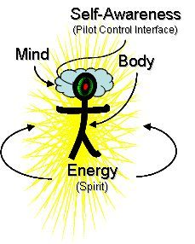
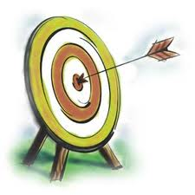
Leadership qualities
Leadership qualities associated with exceptional leadership include such attributes as:
Self Awareness: Self Awareness is having a clear perception of your personality, including strengths, weaknesses, thoughts, beliefs, motivation, and emotions. Self Awareness allows you to understand other people, how they perceive you, your attitude and your responses to them in the moment.
Mission: Leaders know what their mission is. They know why the organization exists. A superior leader has a well thought out (often written) mission describing the purpose of the organization. That purpose need not be esoteric or abstract, but rather descriptive, clear and understandable.

Slide 30

Leadership qualities (continued…)
Vision: Where do you want your group/team/organization to go? A vision needs to be abstract enough to encourage people to imagine it but concrete enough for followers to see it, understand it and be willing to climb onboard to fulfill it.
Goal: How is the organization/team/group is going to achieve its mission and vision and how will you measure your progress? Like a vision, goals need to be operational; that is specific and measurable. If your output and results can't be readily measured, then it will be difficult to know if you have achieved your purpose. The leader may have wasted important resources (time, money, people, and equipment) pursuing a strategy or plan without knowing if it truly succeeded.

Slide 31
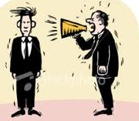
Leadership qualities (continued…)
Communication skills: For leaders it is not enough to just know what to say—but how to say it in a way that persuades people to act.
  Leadership communication skills help leaders covey their principles and intelligence within all of their business communications.
  Developed leadership skills inspire other people and help develop a sense of purpose surrounding business goals.
  Leadership communication skills often focus on the recipient of your message.
  Learning how to motivate and inspire action in team members is an acquired skill.
  Like any skill worth having, it requires an investment of practice and coaching and the dividends are valuable.
  Mastering leadership communication skills can improve effectiveness and showcase a high level of business acumen.

Slide 32

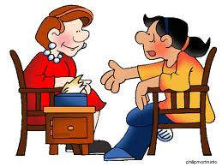
Leadership qualities (continued…)
Facilitating skills: Liaise with team-members and arrive at the best possible solution. There could be diverse ideas and perspectives for any single agenda, but an effective leader will work towards reaching a consensus.
    It ensures that discussions take place in a structured manner without losing sight of the outcome.
    Acts as an icebreaker by engaging followers and keeping up the momentum.
Mentoring skills: It involves providing constructive guidance wisely as and when required. This helps followers in recovering from any glitch or stumbling block.
    It gives the chance to know the other person well.
    It gives a fair idea where to draw the line.

Slide 33


Leadership qualities (continued…)
Influence and Motivation skills: It is a conglomeration of both communication skills and leadership skills. While, through good communication one can influence and persuade others, through leadership skills one can demonstrate his/her motivational skills which boost the spirits of the followers. Motivational skills instill confidence in the mind of the follower. It helps inspire the followers, instead of commanding them.
Decision making skills: A leader has to make countless decisions. A wrong decision may prove costly while a right decision at a crucial time may bring favorable results. Tackle issues as and when required without conflict. Steer the dynamics of the team “to the next level”.

Slide 34
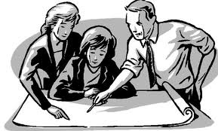
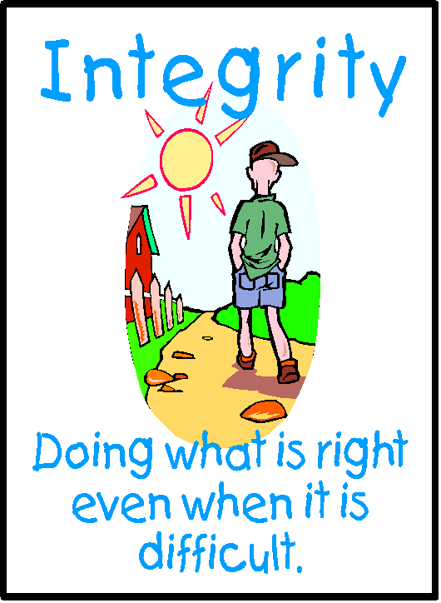
Leadership qualities (continued…)
Planning: Planning involves taking certain strategic decision about the future. Planning includes the list of activities and the contingency plan that needs to be carried forward.
    Proper planning is like choosing the right track to get onto.
    With the correct direction in mind, you can move towards the fulfillment of the goal.
    It also makes a leader organize his/her agenda by arranging “first things first”.
Integrity: A leader builds trust and this fosters collaboration and facilitates sharing of information. In this way, he creates a solid team who supports each other’s views.
    Integrity means honesty, fairness and creating good relationships.
    It is about personal values that cannot be compromised.
    Integrity speaks volumes on emotional intelligence.

Slide 35
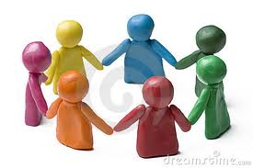
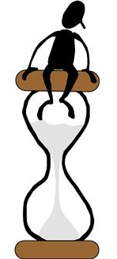
Leadership qualities (continued…)
Team work: It involves co-operating with fellow members while nurturing their aspirations. Through team work, a leader develops a sense of collaboration while working with his peers and subordinates.
    It teaches the art of delegating work among fellow members.
    Derive the support of others by emphasizing their good qualities.
Stress management: A leader manages stress effectively.
    It teaches a leader to develop the ability to bounce back from setbacks without dwelling on negative thoughts.
    It also develops the habit of being patient in any situation.

Slide 36
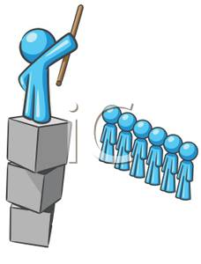
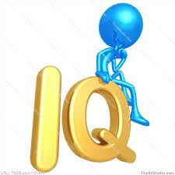
Leadership Traits
Intelligence
  More intelligent than non-leaders
  Knowledge
  Being able to get things done
  knowledge
Personality
  Verbal facility
  Honesty
  Initiative
  Aggressive
  Self-confident
  Ambitious
  Originality
  Sociability
  Adaptability

Slide 37
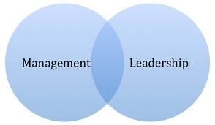
Managers vs. Leaders
Managers
Focus on things
Do things right
Plan
Organize
Direct
Control
Follows the rules
Leaders
Focus on people
Do the right things
Inspire
Influence
Motivate
Build
Shape entities

Slide 38

Watch video on skills of a leader
Video 2

Slide 39
THANKYOU

