Slide 1
Review of Previous Lecture- National Power
Definition and Concept of power
The capacity to impose one’s will on others by reliance on effective sanctions in case of non-compliance.
Concept of National power:
The ability to control the behaviour of other nations in accordance with one’s own will.
The state uses power to get more power
Characteristic of National power: relative & dynamic
Elements of National Power
Population, Technology, Geography, National Character and Morale, Economic Development, Leadership, Diplomacy, Ideology, Military Preparedness, Natural Resources

Slide 2
Element of National Power cont.
3. Geography
Include size, location and topography
Size/Area: Greater area, greater power
Also provides more resources to defend itself
Can bear large population and their needs
Greater production and export
China, USA, Russia are powerful due to large size
England, France, Germany, Portugal were powerful when they possessed colonies
Large states are difficult to conquer: territory swallows the conqueror e.g. Napoleon and Hitler failed in Russia and Japan in China in 1937

Slide 3
8. Ideology
Pedelford and Lincoln: ‘A body of ideas concerning economic, social and political values and goals which pose action program for attaining these goals’
Ideologies tend to arise in the times of crises and social stress
Act as motivating force for a nation, integrates them to strive collectively for the common cause (economic, political or social)
Common ideology provides support to the government both nationally and internationally e.g. communist states, capitalist states, Islamic countries, democratic states etc.

Slide 4
Ideology cont.
Germany, Japan and Italy made alliance in WWII due to common ideology of having strong dictatorial governments
Israel attack on Masjid Al Aqsa led the foundation of OIC for protection of Islam
However, states may cooperate despite conflicting ideologies
E.g. Russia cooperation with USA and Britain during WWII, China and US relationship politically and economically,

Slide 5
9. Military Preparedness
The most evident and observable element in national power
The stronger the military power- the greater the national power
includes the quality of military training and skills
The quality of weapons and arms
The military leadership

Slide 6
Quality of military training and skills:
Includes physical as well as professional training, updated military warfare techniques, training in use of knowledge as well as weapons, intelligence system etc.
The quality and quantity of weapons and arms:
Includes the advancement of technology in making the weapons, possession of chemical, biological, nuclear weapons, aircrafts, ships, submarines, missiles etc.
The military leadership:
The genius and intellect of military leaders, their spirit, wisdom, war skills and techniques etc.

Slide 7
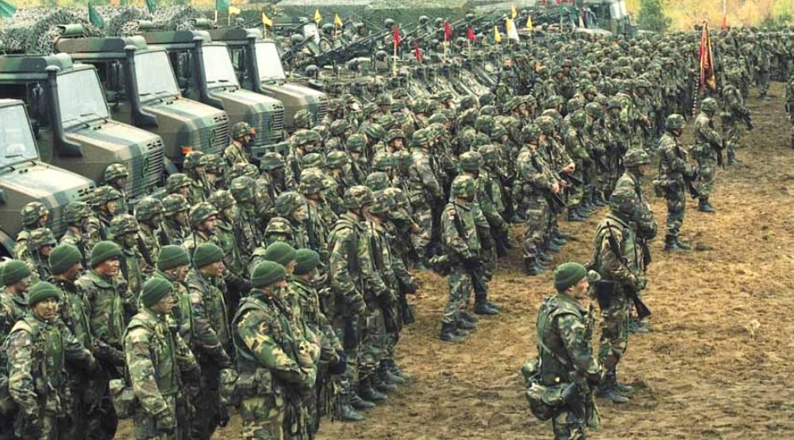
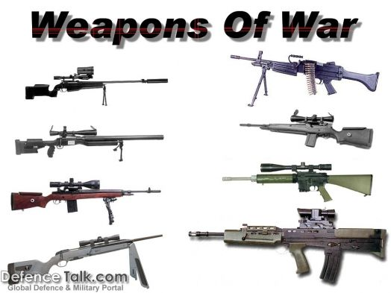
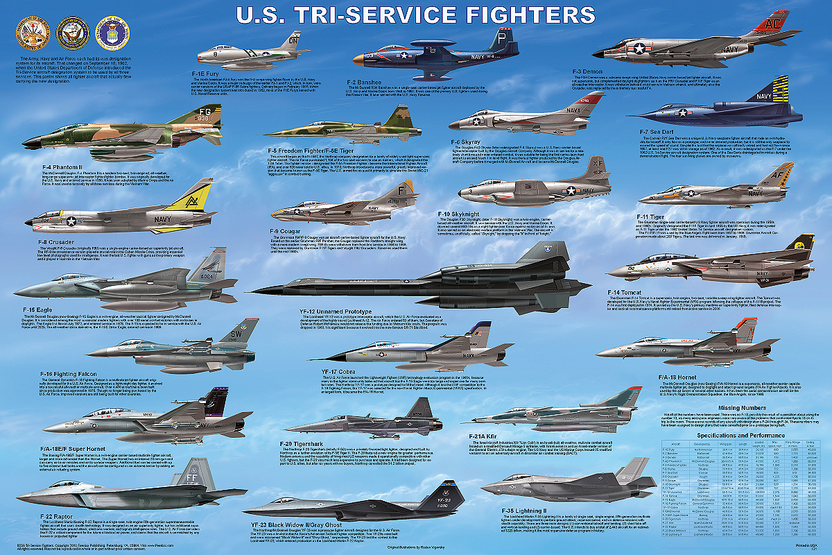

Slide 8
10. Natural Resources
Natural resources provides national power if they are exploited and utilized
Mere possession of resources do not contribute to power
Natural resources includes minerals, water resources, fertility of soil, flora and fauna etc.
Raw materials are useful if they are transformed into finished goods internally
Some resources have become very important due to advancement in science and technology e.g.
Oil, natural gas, coal, uranium (for production of energy)

Slide 9
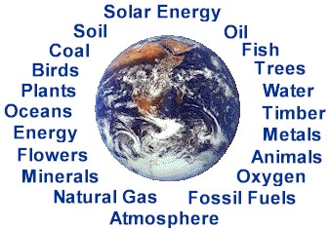
Natural Resources cont.
Some are always important e.g.
Gold, silver, iron, copper, gem stones
etc. and food
Countries with self sufficiency in food and grains were powerful during wars e.g. USA and SU during world wars, Germany struggle hard for food during WWI.
Future conflicts will be on water resources
Some other factors of national power are: Efficiency of Bureaucracy, Education, Intelligence network, Foreign Support

Slide 10
Limitations on National Power
A state can increase its national power through the components described.
However, certain factors limit the national power.
They are:
Balance of Power
International Morality
World Public Opinion
Disarmament
International Organization

Slide 11
1. Balance of Power
A phenomena where by the power of a nation or a group of nation is balanced by another state or group of sate through different mechanism
Checking power with power to achieve balance
Thus national power of a state can be limited by the phenomena of balance of power (through alliances and counter alliances, divide and rule, armaments, buffer state etc.)

Slide 12
2. International Morality
A state can not keep on increasing its national power by all means like Machiavellian policies
The states have to abide by some accepted international norms and principles of morality
These limits the national power as the rulers and diplomats have to consider them in dealing in international affairs
Some of these are: keeping promises, fair dealing, abiding by pacts and treaties, respect for international law, protection of minorities, safeguard of human rights, peaceful means for settling disputes, respecting international boundaries, principle of non interference in internal affairs of other state, etc.

Slide 13
3. World Public Opinion
The world public opinion safeguard the interest of humanity
Protects against violation of fundamental rights, threat to world peace, genocide, misuse of power, denial of justice etc.
It unifies the people all around the world to strive for the just cause and to put pressure on their governments to struggle for the same
E.g. disarmaments, nuclear free zone, struggle against drug trafficking, war against terrorism,
World public opinion on Israel atrocities in Gaza and use of social media
India and Pakistan announced a moratorium on nuclear testing after nuclear explosions in 1998

Slide 14
3. World Public Opinion cont.
A state tries to follow world public opinion to avoid embarrassment and condemnation at international level
Sometimes, states will not care for it and will keep its policy to pursue national interests
E.g. Israel pay no heed to world public opinion and kept on attacking and killing innocent people in Gaza in 2014
India continues its hard policy against Kashmiri people in IHK

Slide 15
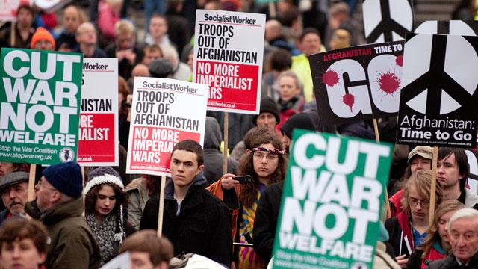


Slide 16
4. Disarmament
The effort to reduce the acquisition of weapons and arms
Disarmament reduces national power of a state
Nuclear proliferation Treaty, Comprehensive Test Ban Treaty, Strategic Arms Limitation Talk, Strategic Arms Reduction Talk etc.
Efforts of UN and agencies like International Atomic Energy Commission for disarmament of Iraq in middle east to decrease its capacity to attack others

Slide 17
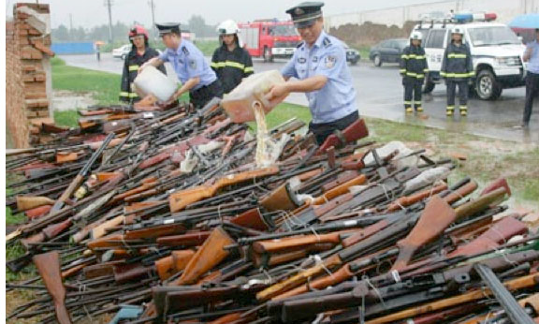
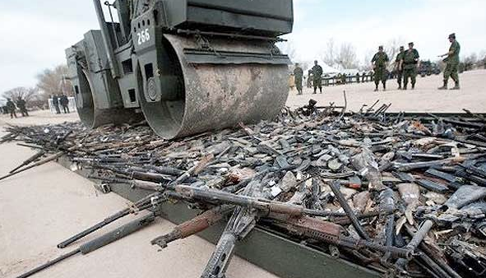

Slide 18
5. International Organization
League of Nations and United Nations objective
To maintain peace and collective security and to take measures for prevention and removal of threats to peace
Thus, UN can intervene if it deem necessary that a particular state has become a threat to world peace
E.g Iraq after gulf war, resolution against Israel aggression in Palestine,

Slide 19
Summary
Meaning and concept of Power
Definition of National Power
Components of National Power
Population
Technology
Geography
National Character and Morale
Economic Development
Leadership
Diplomacy
Ideology
Military Preparedness
Natural Resources

Slide 20
Summary
Limitations on National Power
Balance of Power
International Morality
World Public Opinion
Disarmament
International Organization

Slide 21
Review Questions
Define power and national power.
How a state can increase its national power?
What are the limitations on national power?

