Slide 1
Review of Previous Lecture- NSS
Concept and definition of NSS
Origin and Development NSS
industrial revolution, growth of international law, rise of democracy, development of diplomacy, growth of commercial and business activity between states
Deep impact:
Rise of nationalism,
Military movements and warfare
Rise of ideology
Extension of NSS to non-European states
Elements of NSS
Sovereignty
Territorial Integrity
Legal Equality
Nationalism

Slide 2
National Power
Dr. Fayyaz Ahmad Faize
Assistant Professor, Department of Humanities,
COMSATS Institute of Information Technology, Islamabad-Pakistan.

Slide 3
National Power
Definition and Concept of power
Concept of National power
Characteristic of National power
Elements of National Power
Limitations

Slide 4

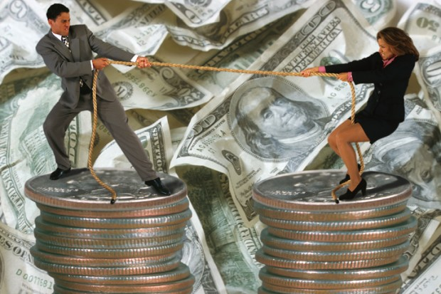

Power
Do you like power?
Man (individual) struggle for power in some form or other
Physical, social, moral, economic, spiritual etc.

Slide 5
Power
State (collective) also struggle for power
Economic
Military
technological
Manpower etc.

Slide 6
But What is Power?
Power can be understood through the following words.
Something impressive, influential, leading, dominating, controlling, directing, imposing, inspiring, stimulating
Something expressive, revealing, prominent, self-evident, illuminating

Slide 7
Power?
Morgenthau- ability to influence the minds and actions of men
Organski: The ability to influence the behavior of others in accordance with one’s own ends.
Schwarzenberger: The capacity to impose one’s will on others by reliance on effective sanctions in case of non-compliance.
Reference: Chander, P (1995). International Relations (10th Edn)

Slide 8
National Power?
Power of a nation / Power of a state
A state always strives to increase its power
Now the Question is ……
Is Power the mean or is it the end?
Power is the mean- Power is also the end
The state uses power to get more power
(Machiavelli & Morgenthau are the main supporters of this theory)
However, Power corrupts and absolute power corrupts absolutely.

Slide 9
National Power?
Rosen and Jones: - ability of an international actor to use its tangible and intangible resources and assets in such a way as to influence the outcomes of events in the international system in the direction of improving its own satisfaction with the system.
The ability or potential of a state to influence the decision and behaviour of other states in international affairs according to its interests.
Steven J Rosen & Walter S Jones, The Logic of International Relations (Massachusetts: Winthrop Publishers 1977), 182

Slide 10
National Power cont.
Hartman, “National Power denotes the ability of a nation to fulfill national goals. It tells us as to how much powerful or weak a particular nation is in securing its national goals.”
Padelford and Lincon, “National power is that combination of power and capacity of a state which the state uses for fulfilling its national interests and goals.”
Through National Power, a nation is able to control the behaviour of other nations in accordance with one’s own will.

Slide 11
Characteristic of National Power
Power is relative and not absolute. A State may be powerful than one state but may not be in comparison to other state
E.g. India may be stronger than Nepal, but is not strong than US or China
Power is dynamic and not static in IR.
The power of states keep on changing
Some events may quickly change the power status e.g. a revolution, war (e.g. Europe after WWII, economic recession (loss of business activities, stock exchange crash, unemployment, currency devaluation etc.), acquisition of weapons and successful arms and missile tests etc.
National Power is both Means as well as an End
National Interests are determined by National power

Slide 12
Components of National Power
National power is mostly linked with military capacity and superiority because of wars
However, National Power does not depend on a single component-Complex
Many Components
Derived strengths from these components.
The stronger and many the components, the greater the national power and vice versa

Slide 13
Components of National Power
Population
Technology
Geography
National Character and Morale
Economic Development
Leadership
Diplomacy
Ideology
Military Preparedness
Natural Resources

Slide 14
1. Population
How be the population? Small or large?
Is it strength or weakness?
Can be both?
If the population is small, it can be effectively utilized, the facilities can be effectively provided
However, large population can be source of strength if quality of population is good-
Educated and trained- politically conscious,
provide large man power, more production, provide large army, (USA, China)
But, if uneducated, or large number of old and children, or non-working, then burden on economy (under developed state)

Slide 15
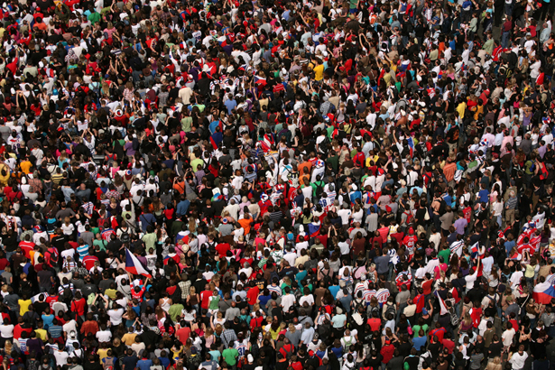
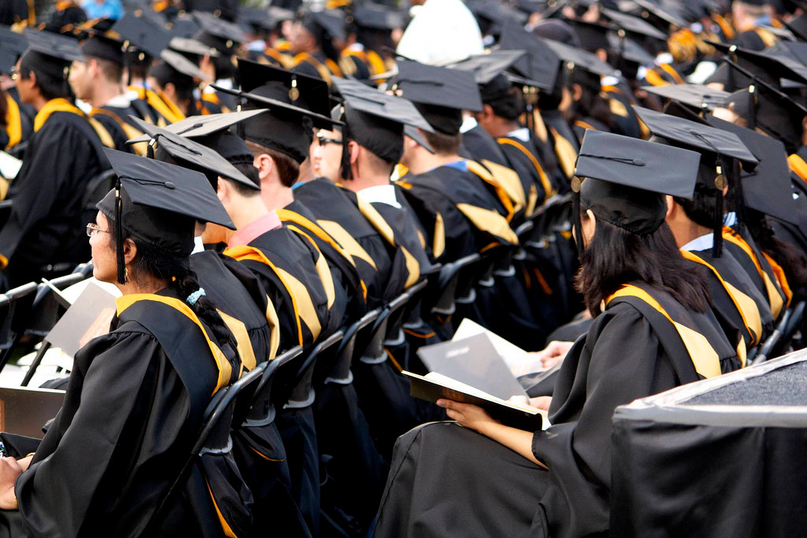

Slide 16
2. Technology
What is technology?
Technology is the use and application of science and modern methods of production
Industrial revolution equipped West with tremendous power to establish colonies,
US and SU become superpowers due to superiority in technology
Technology use has increased in present world
Technology in 3 areas
Industrial, military and communication

Slide 17

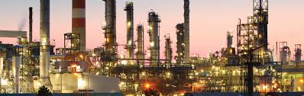

Slide 18
Industrial:
Better tools and machinery, less cost, less use of effort and energy, convenient method, increased production, better quality and more income
USA, European countries, Japan – superiority in industrial T.
Military:
Better and sophisticated weapons, more destruction, greater national security, export of weapons
USA, Russia, China, Britain, France became powerful due to superiority in military technology
Communication:
Improvement in method of transportation of goods, people and ideas
Network of roads, highways, motorways, telephonic system, improved air travel, safe sea-routes, railway tracks, optical fibre network, internet etc.

Slide 19
3. Geography
Include size, location and topography
Size/Area: Greater area, greater power
Also provides more resources to defend itself
Can bear large population and their needs
Greater production and export
China, USA, Russia are powerful due to large size
England, France, Germany, Portugal were powerful when they possessed colonies
Large states are difficult to conquer: territory swallows the conqueror e.g. Napoleon and Hitler failed in Russia and Japan in China in 1937

Slide 20
Geography
Location:
Ensures security if more isolated e.g. England, Japan being island
USA in WW I and WW II was safe than Europe and Asia
States with extremely frigid zone does not contribute to power than states in temperate zone
Even great civilizations flourished in these regions
Regions with natural resources like oil, gas, gold, minerals, gem stones contributes to national power but are also areas of rivalry and conflict e.g. mid-east, central-asia, India, Africa

Slide 21
Geography cont.
Topography:
If state is inaccessible to reach, provides more security to hide and attack
This include high mountains, rivers, sea etc.
Himalayas blocked attack b/w China and India, Afghanistan topography, tribal belt during British rule and now
However, topography lost its importance due to advancement in science and technology
Improved communication, air travel, spy satellites, nuclear arms, guided ballistic missiles etc.

Slide 22
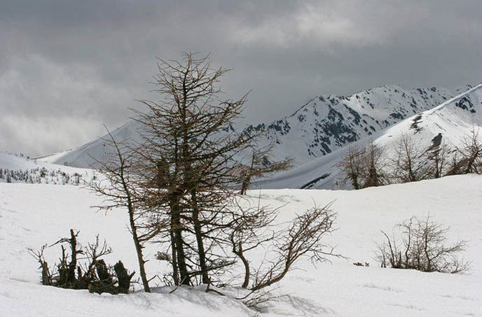


Slide 23
4. National Character and Morale
The quality of population contributes to national power
Morgenthau: ‘the degree of determination with which a nation supports the home and foreign policies of its government in times of peace and war’
The people keep national interest and welfare above personal interest
The nation exhibits high spirit of loyalty, courage, patience, discipline, sacrifice and unity
This provides strength to the government to pursue its policies nationally and internationally
The European countries though small establish colonies in Asia and Africa (English, German, French, Russian)

Slide 24
5. Economic Development
Economic development provides state with sufficient funds, materials and physical infrastructure to defend itself
Exploitation and utilization of resources is must
Requires chain of industries, expert scientists, skilled and trained man power, better organization working environment, efficient managerial skills etc.
Raw materials are transformed in finished products
Earn high prices and more profit
European and developed countries import raw materials for their industry and export finished goods
Increased productivity and export of surplus production will increase economic development

Slide 25
6. Leadership
What is a leader?
The one who leads the followers
Without a leader, the people is a mob
Very important because makes decision which can result in victory or defeat
He may be weak physically but very strong mentally
Possesses - strength of character, high energy, greater wisdom, prolific knowledge, extraordinary courage, will power
Both Political and military Leadership are important for success

Slide 26
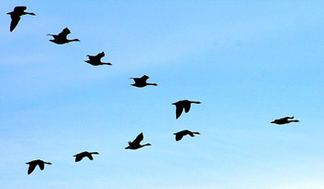

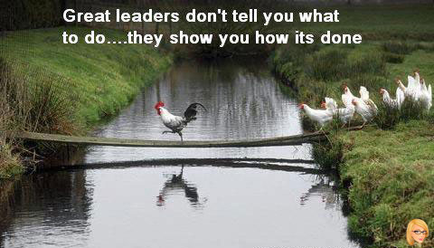

Slide 27
Leadership cont.
A good leader infuses spirit, provides direction, set examples for followers, unite their strength and achieve targets
Boost national character and morale during crises, while followers would blindly follow
E.g. President Wilson during WWI, Roosevelt during WWII, Churchill, Stalin, Hitler, Mussolini, Jinnah

Slide 28
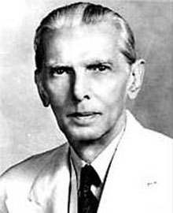
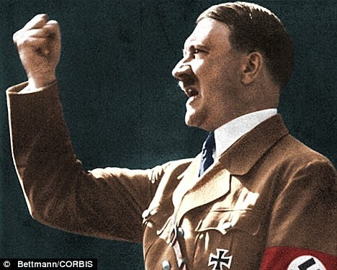
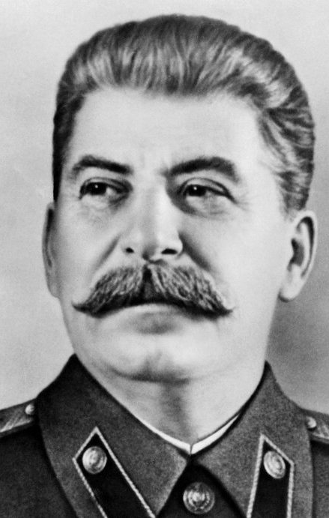
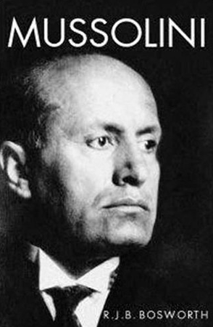
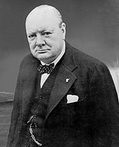

Slide 29
7. Diplomacy
Morgenthau: Diplomacy is the brain of national power
Determines how skillfully and convincing the national interests are pursued by government officials
A good diplomacy can win international support for government policies,
win friends and favorable alliances
pursued national goals with least resistance
Diplomats lost importance and power at present?
Improved and fast means of communication
Popular opinion and popular interest in international affairs
Rise of open diplomacy and media coverage

Slide 30
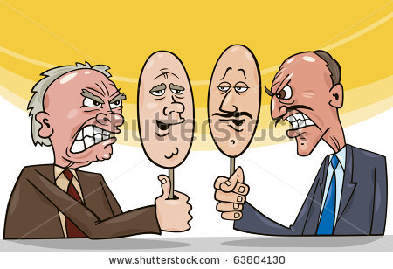
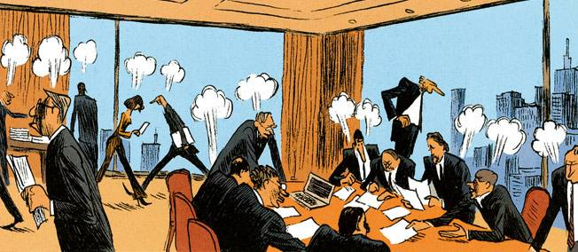
Diplomacy cont.
Termed as ‘dignified clerk’ now
Keep close contact with their government and can not act independently (more freedom in the past)
World opinion can be molded through good diplomacy to catch international attention and solve national problems

Slide 31
8. Ideology
Pedelford and Lincoln: ‘A body of ideas concerning economic, social and political values and goals which pose action program for attaining these goals’
Ideologies tend to arise in the times of crises and social stress
Act as motivating force for a nation, integrates them to strive collectively for the common cause (economic, political or social)
Common ideology provides support to the government both nationally and internationally e.g. communist states, capitalist states, Islamic countries, democratic states etc.

Slide 32
Ideology cont.
Germany, Japan and Italy made alliance in WWII due to common ideology of having strong dictatorial governments
Israel attack on Masjid Al Aqsa led the foundation of OIC for protection of Islam
However, states may cooperate despite conflicting ideologies
E.g. Russia cooperation with USA and Britain during WWII, China and US relationship politically and economically,

Slide 33
9. Military Preparedness
The most evident and observable element in national power
The stronger the military power- the greater the national power
includes the quality of military training and skills
The quality of weapons and arms
The military leadership

Slide 34
Quality of military training and skills:
Includes physical as well as professional training, updated military warfare techniques, training in use of knowledge as well as weapons, intelligence system etc.
The quality and quantity of weapons and arms:
Includes the advancement of technology in making the weapons, possession of chemical, biological, nuclear weapons, aircrafts, ships, submarines, missiles etc.
The military leadership:
The genius and intellect of military leaders, their spirit, wisdom, war skills and techniques etc.

Slide 35
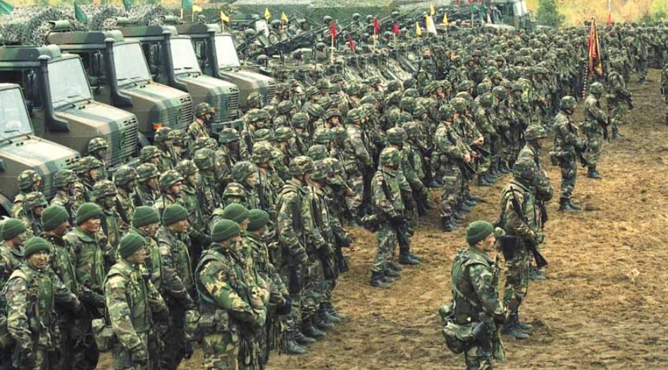
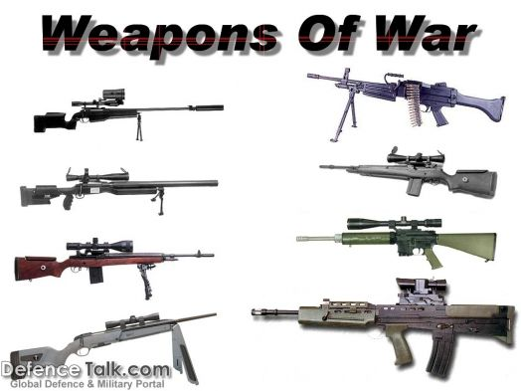
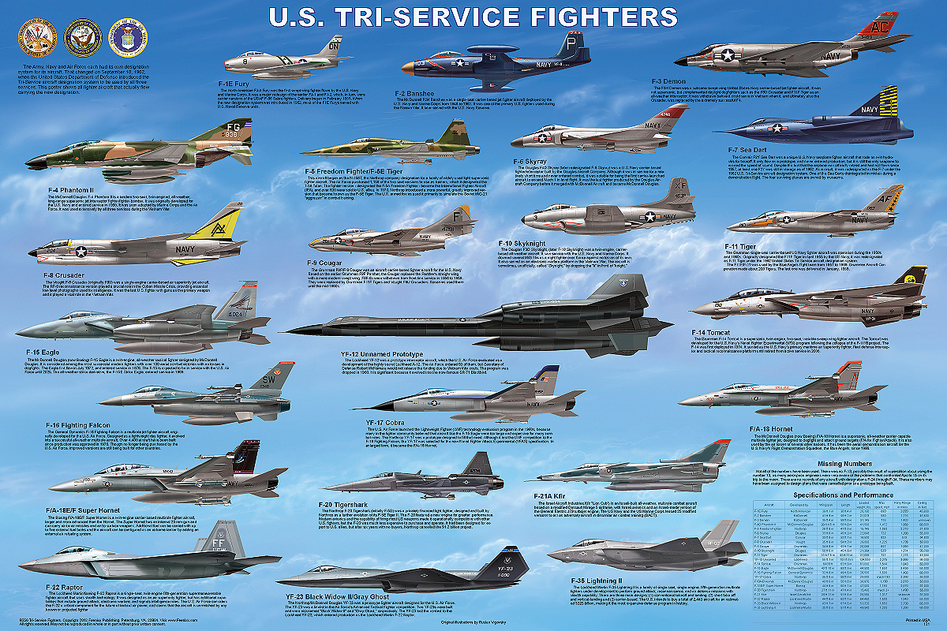

Slide 36
10. Natural Resources
Natural resources provides national power if they are exploited and utilized
Mere possession of resources do not contribute to power
Natural resources includes minerals, water resources, fertility of soil, flora and fauna etc.
Raw materials are useful if they are transformed into finished goods internally
Some resources have become very important due to advancement in science and technology e.g.
Oil, natural gas, coal, uranium (for production of energy)

Slide 37
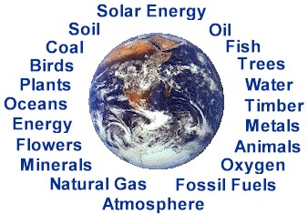
Natural Resources cont.
Some are always important e.g.
Gold, silver, iron, copper, gem stones
etc. and food
Countries with self sufficiency in food and grains were powerful during wars e.g. USA and SU during world wars, Germany struggle hard for food during WWI.
Future conflicts will be on water resources
Some other factors of national power are: Efficiency of Bureaucracy, Education, Intelligence network, Foreign Support

Slide 38
Limitations on National Power
A state can increase its national power through the components described.
However, certain factors limit the national power.
They are:
Balance of Power
International Morality
World Public Opinion
Disarmament
International Organization

Slide 39
1. Balance of Power
A phenomena where by the power of a nation or a group of nation is balanced by another state or group of sate through different mechanism
Checking power with power to achieve balance
Thus national power of a state can be limited by the phenomena of balance of power (through alliances and counter alliances, divide and rule, armaments, buffer state etc.)

Slide 40
2. International Morality
A state can not keep on increasing its national power by all means like Machiavellian policies
The states have to abide by some accepted international norms and principles of morality
These limits the national power as the rulers and diplomats have to consider them in dealing in international affairs
Some of these are: keeping promises, fair dealing, abiding by pacts and treaties, respect for international law, protection of minorities, safeguard of human rights, peaceful means for settling disputes, respecting international boundaries, principle of non interference in internal affairs of other state, etc.

Slide 41
3. World Public Opinion
The world public opinion safeguard the interest of humanity
Protects against violation of fundamental rights, threat to world peace, genocide, misuse of power, denial of justice etc.
It unifies the people all around the world to strive for the just cause and to put pressure on their governments to struggle for the same
E.g. disarmaments, nuclear free zone, struggle against drug trafficking, war against terrorism,
World public opinion on Israel atrocities in Gaza and use of social media
India and Pakistan announced a moratorium on nuclear testing after nuclear explosions in 1998

Slide 42
3. World Public Opinion cont.
A state tries to follow world public opinion to avoid embarrassment and condemnation at international level
Sometimes, states will not care for it and will keep its policy to pursue national interests
E.g. Israel pay no heed to world public opinion and kept on attacking and killing innocent people in Gaza in 2014
India continues its hard policy against Kashmiri people in IHK

Slide 43
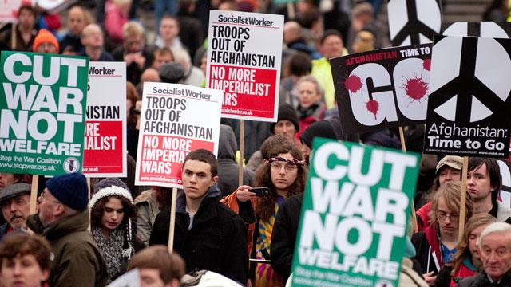


Slide 44
4. Disarmament
The effort to reduce the acquisition of weapons and arms
Disarmament reduces national power of a state
Nuclear proliferation Treaty, Comprehensive Test Ban Treaty, Strategic Arms Limitation Talk, Strategic Arms Reduction Talk etc.
Efforts of UN and agencies like International Atomic Energy Commission for disarmament of Iraq in middle east to decrease its capacity to attack others

Slide 45
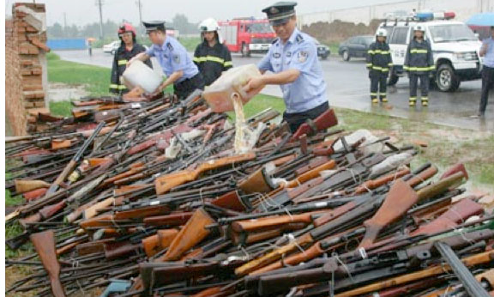
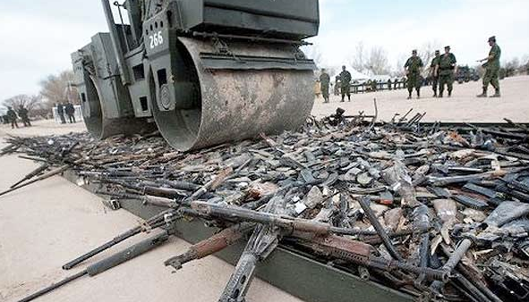

Slide 46
5. International Organization
League of Nations and United Nations objective
To maintain peace and collective security and to take measures for prevention and removal of threats to peace
Thus, UN can intervene if it deem necessary that a particular state has become a threat to world peace
E.g Iraq after gulf war, resolution against Israel aggression in Palestine,

Slide 47
Summary
Meaning and concept of Power
Definition of National Power
Components of National Power
Population
Technology
Geography
National Character and Morale
Economic Development
Leadership
Diplomacy
Ideology
Military Preparedness
Natural Resources

Slide 48
Summary
Limitations on National Power
Balance of Power
International Morality
World Public Opinion
Disarmament
International Organization

Slide 49
Review Questions
Define power and national power.
How a state can increase its national power?
What are the limitations on national power?

