Slide 1
Review of Previous Lecture
Development of NSS – Deep impact by following factors
Rise of nationalism
Military movements and warfare
Rise of ideology
Extension of NSS to non-European states
Elements of NSS
Sovereignty
Territorial Integrity
Legal Equality
Nationalism

Slide 2
Today’s Lecture
Elements of NSS
Nationalism
Territorial Integrity
Legal Equality
Nationalism

Slide 3
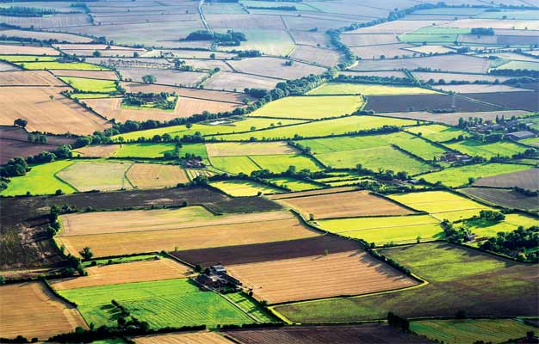
2. Territorial Integrity
Where will a nation live?
A nation needs a state to live- It needs Territory-
NSS will exist if the integrity of territory continue
No Land--No Nation

Slide 4
Territorial Integrity
A nation thus protects its own territory and safeguards its integrity
It does not like interference in its internal affairs
Similarly, non-interference in internal affairs of other
Protection against external threats
Abstain from use of force to solve inter-state problems
Respect for international boundaries
Use of peaceful means to solve problems
Q. What are the peaceful means?
diplomacy, negotiations, observance of international law, role of international organizations

Slide 5
Nationalism قوم پرستی
What is nationalism?
Concept of common identity based on ethnic, cultural and linguistic foundations
Snyder- ‘a condition of mind, feeling or sentiment of a group of people living in a geographical area, speaking a common language, possessing a literature in which the aspirations of nation have been expressed, attached to common traditions and common customs’
Spirit of nationalism unites the people to strive collectively for common aims and interests
Many freedom movements are led by nationalistic forces
Q. Can you give some examples?
Russian, Pakistan, China, etc.
Responsible for freedom and democracy

Slide 6
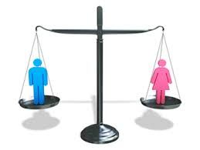
3. Legal Equality
Q. What is legal equality?
NSS assumes all states to be equal
irrespective of population, area,
economic condition, military power etc.
Equality implies respect for all
Inequality would result in humiliations, conflicts, tension and war
Does the UN charter also recognize it?
Yes, it is accepted by UN charter as well

Slide 7
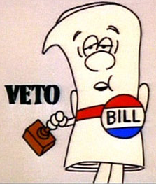
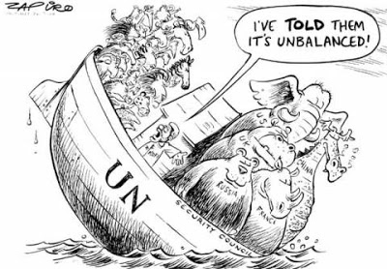
Veto power in UN is against legal equality
International affairs and policies are shaped and driven by big powers
Can veto any resolution even if General Assembly has approved it majority
Smaller states though given equality certificate have little say in international affairs

Slide 8
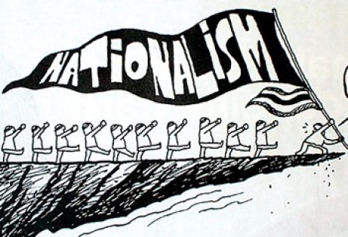
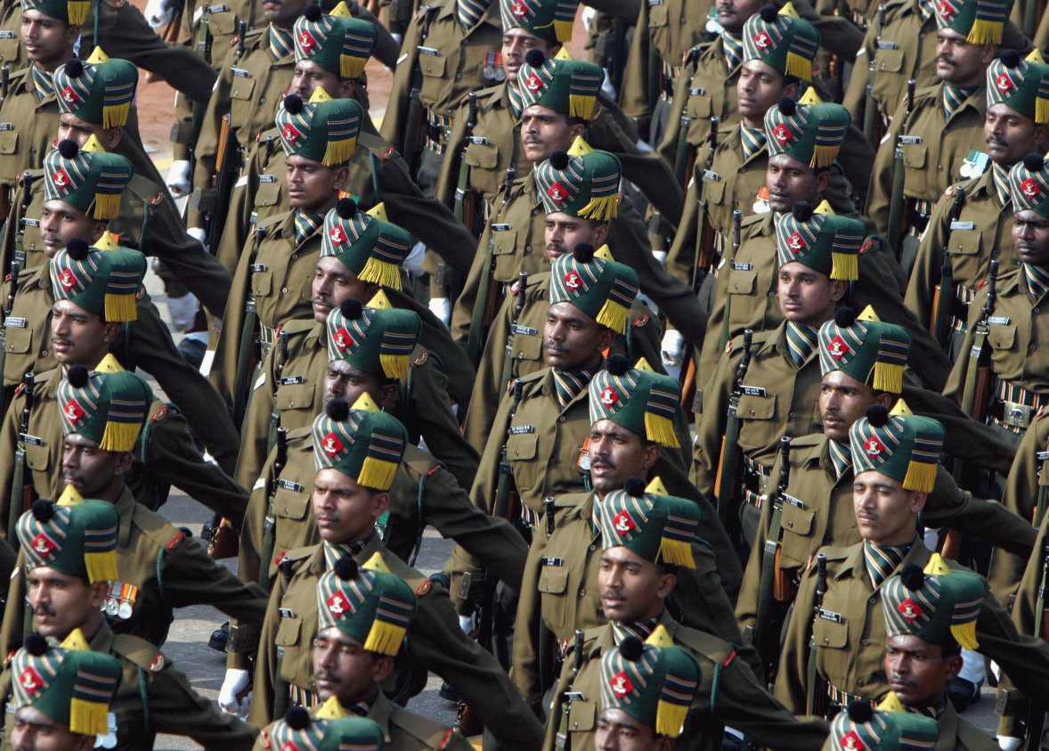
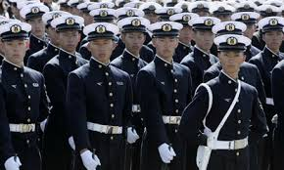
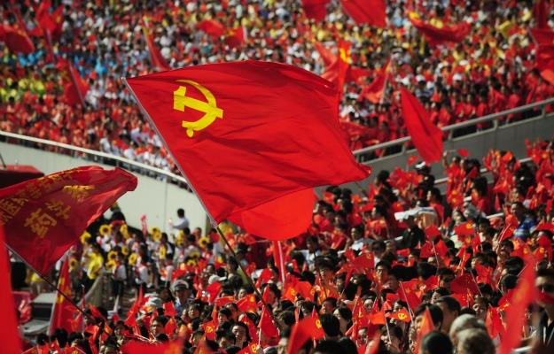

Slide 9
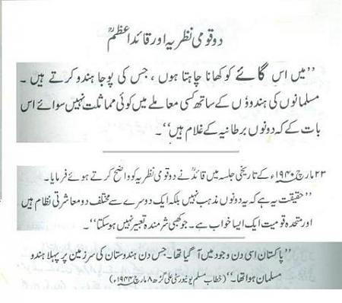

Slide 10
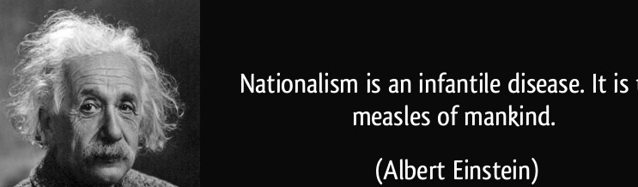
Danger of Nationalism
Is there any danger of nationalism?
Responsible for intolerance
Creates hatred towards other nations and ethnocentrism
Responsible for war and destroying world peace (WWI and WWII)
Hayes: Nationalism is ‘a curse and nothing but a curse’

Slide 11
Conclusion
Nationalism has both merits as well as demerits.
Brogan referred to nationalism as ‘this greatest destructive constructive force’.
Nationalism is neither moral nor immoral doctrine
If misused, then lead to tyranny and war
If used constructively, then source of unity, strength, community service
The state shall pursue it with care
Sense of respect and tolerance for others.

Slide 12
Summary of the Unit- NSS
What is a state?
What is a nation?
The goal of nation- state
A nation needs a state. One nation, one state
In Islam- Muslim Ummah- Muslim Community based on religion of Islam and not on ethnic, language or cultural similarity.

Slide 13
Summary cont.
NSS: A system in which a state deriving its strength from linguistic, ethnic or cultural similarity and possessing a territory governed by a sovereign
1648- Treaty/Peace of Westphalia
30 years war ended and peace established in Europe
dynastic rivalries in France and Germany
Catholics and Protestants for reformation
Development of NSS – Deep impact by following factors
Rise of nationalism
Military movements and warfare
Rise of ideology
Extension of NSS to non-European states

Slide 14
Summary cont.
Elements of NSS
Sovereignty
Territorial Integrity
Legal Equality
Nationalism

Slide 15
Review Questions
How NSS originated from 30 years war?
Trace the developments that cast a deep impact on the NSS after peace of Westphalia, 1648.
Describe the concept of sovereignty and is absolute sovereignty possible in today’s world?
Discuss the main elements of NSS?
What is legal equality of states and does it really exist?

