Slide 1
Review of Previous Lecture- Nation State System
What is a state?
What is a nation?
World population – diverse groups- groups based on different grounds
Dominant group forms nation state
Morgenthau: A nation needs a state. One nation, one state
In Islam- Muslim Ummah- Muslim Community based on religion of Islam and not on ethnic, language or cultural similarity.

Slide 2
Summary cont.
NSS: A system in which states deriving its strength from linguistic, ethnic or cultural similarity and possessing a territory governed by a sovereign
1648- Treaty/Peace of Westphalia
30 years war ended and peace established in Europe
dynastic rivalries in France and Germany
Catholics and Protestants for reformation
Development of NSS
Rise of nationalism
Military movements and warfare
Rise of ideology
Extension of NSS to non-European states

Slide 3
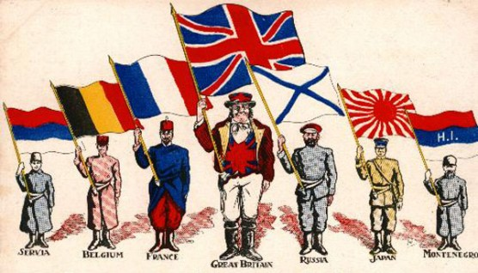
1. Rise of nationalism
is a feeling that unites people with some similarity
Strongest impact on NSS, Why?
Forms a stronger group of people and then unites that group towards the state
Nationalistic forces provide strong support to their ruler towards their national interests E.g. Germany, Japan, France

Slide 4
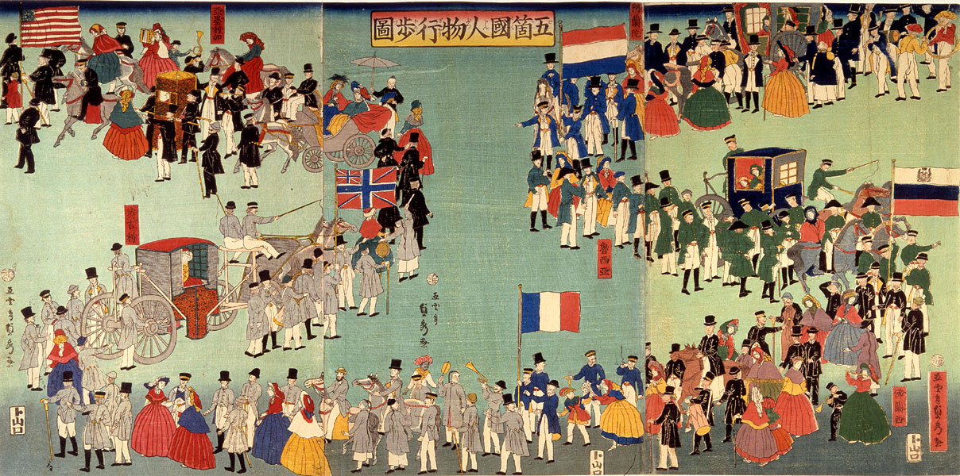
What would have happened in states with diverse nationalities?
suffered freedom movements
Austria-Hungary, Balkan states, Ottoman empire, sub-continent
Thus many new states emerged due to rise in nationalism
Notes:
Albania Bosnia and Herzegovina Bulgaria Greece^{[clarification needed]} Kosovo Macedonia Montenegro

Slide 5
Nationalism cont.
Nationalism is a very distinctive species of patriotism (Gellner 1983: 183).
In sub-continent, Muslim nationalism grew stronger- Why?
Because they suffered
due to ill-treatment of Hindus (Cow slaughter, Hindi-Urdu controversy, protest against Bengal partition, betrayal in Khilafat movement, Nehru report, Congress rule etc.)

Slide 6
2. Military movements and warfare
Military movements grew stronger in 19th and 20th century
e.g. Germany, Spain, Italy,
Sophisticated weapons and techniques in warfare (bombs, tanks, fighter planes, submarines, landmines)
This produced mass mobilization and patriotism towards the state
The people strongly supported their military to protect them from enemy and their political and social institutions
And to destroy the enemy
And to impose ones ideology and social institutions on the defeated nation

Slide 7
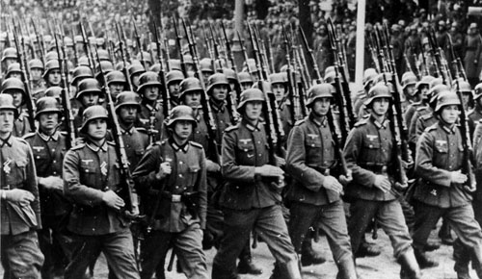
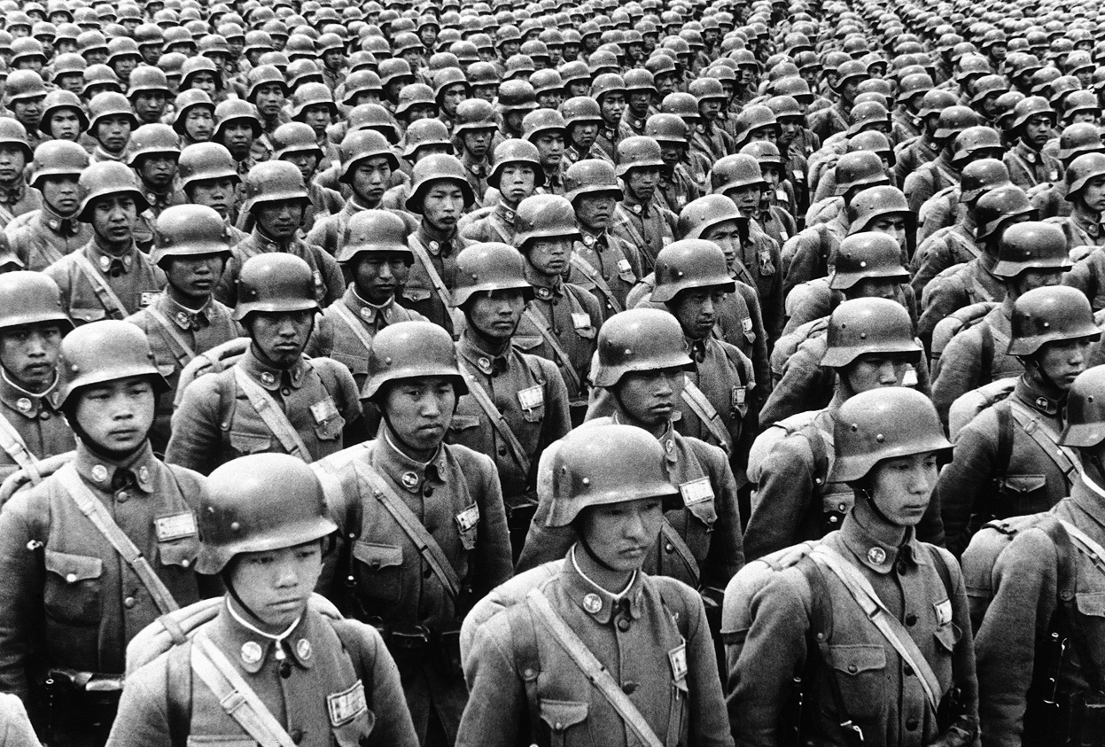

Slide 8
3. Rise of ideology
What is ideology?
Set of beliefs, values, ideals, goals and a body of knowledge which a people considers true and solution to problem.
Pedelford and Lincoln: ‘A body of ideas concerning economic, social and political values and goals which pose action program for attaining these goals’
When ideology emerges?
Ideologies tend to arise in the times of crises and social stress
An ideology emerges when people feel strongly that they are being mistreated, oppressed, denied their due rights or when their status is threatened by fundamental changes occurring in society

Slide 9
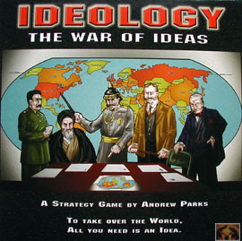

Does ideology unite people?
Yes, it integrates them and also give them direction
Offers solution to problem by providing a line of action/strategy.
Gives CHANGE

Slide 10
Ideology cont.
Brings revolutions and form new cultures and civilizations
Can you name some revolution?
Russian revolution, Pakistan in sub-continent, China revolution, Iran revolution
1917, 1947, 1949, 1979
Imperialism, Nazism, Fascism, socialism, capitalism, democracy, Islamic ideology
A nation tries to protect and promote its ideology e.g. Western Europe for capitalism, former Russia for socialism, Pakistan for Islamic ideology
Provides strength to NSS

Slide 11
4. Extension of NSS to non-European states
NSS extended outside Europe (Asia, Africa, Latin America)
When it happened?
Can you name some countries?
E.g. Pakistan, India, Burma, Indonesia, Malaysia, China, Taiwan, N. Korea, S. Korea, Philippine,
From where these countries got independence?
Thus NSS extends to the whole world
When did Russia disintegrated?
Can you name some countries that got independence?
Tajikistan, Kazakhstan, Kirghizstan, Uzbekistan, Turkmenistan etc. (named on the dominant group)

Slide 12
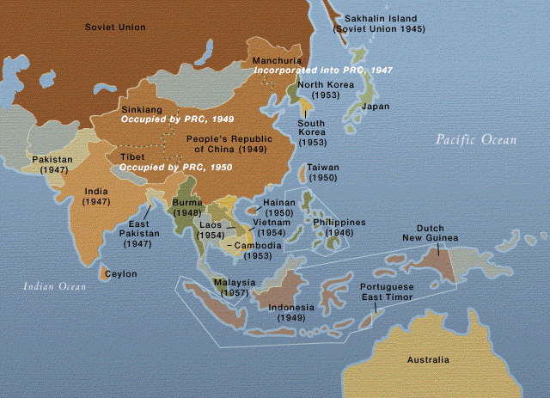

Slide 13
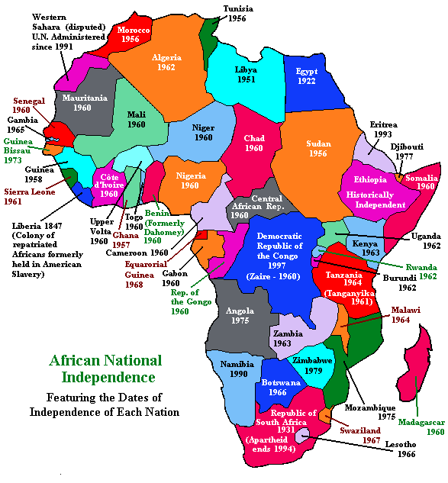

Slide 14
Elements of NSS
4 important elements of NSS
Sovereignty
Territorial Integrity
Legal Equality
Nationalism

Slide 15
Sovereignty
Q. What is Sovereignty?
The supreme power over citizens and subjects unrestrained by law (Bodin- the father of modern concept of sovereignty)
The supreme will of the state (Willoughby)
The absolute, unrestrained, supreme authority to make laws and enforce it.
A state which is not sovereign can not make treaty, or become member of international organization

Slide 16
Sovereignty cont.
Can there be two or more sovereign in a state?
Only 1 sovereign exists in a state
Sovereignty is indivisible and inalienable i.e.
Its power can not be limited, divided or transferred
Morgenthau: concept of divisible sovereignty is illogic and politically unfeasible

Slide 17
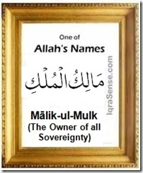
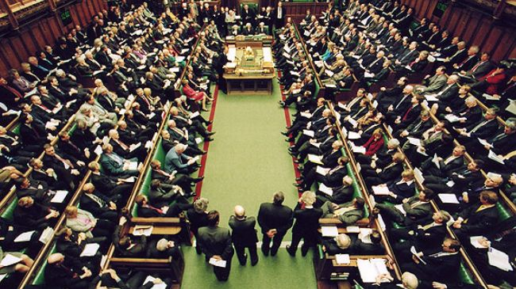
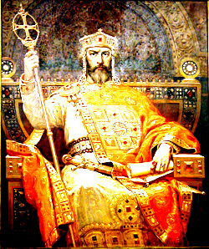
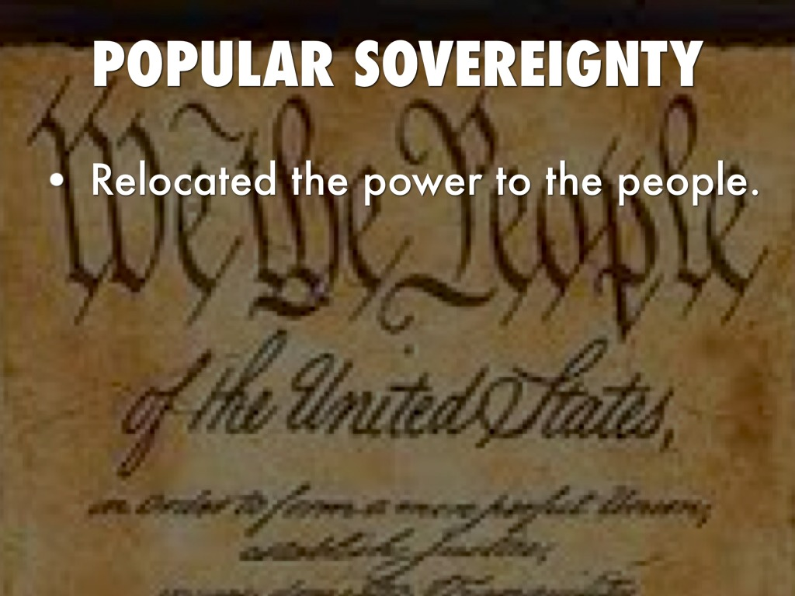

Slide 18
Sovereignty cont.
Q. Is Absolute sovereignty possible?
No, not at present, Why?
A sovereign has to make adjustment, compromises in the internal and external matters- thus restricting his power
Q. What limits the power of sovereign in today’s world?
Treaty/pacts, Int. organizations, international law, public opinion, pressure group etc. restricts sovereignty
However, for NSS to exist- concept of sovereignty will also continue to exist

Slide 19
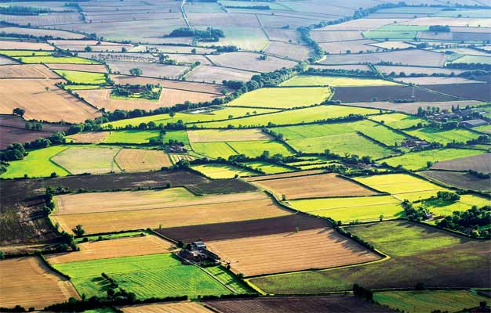
2. Territorial Integrity
Where will a nation live?
A nation needs a state to live- It needs Territory-
NSS will exist if the integrity of territory continue
No Land--No Nation

Slide 20
Territorial Integrity
A nation thus protects its own territory and safeguards its integrity
It does not like interference in its internal affairs
Similarly, non-interference in internal affairs of other
Protection against external threats
Abstain from use of force to solve inter-state problems
Respect for international boundaries
Use of peaceful means to solve problems
Q. What are the peaceful means?
diplomacy, negotiations, observance of international law, role of international organizations

Slide 21
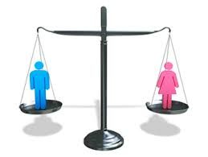
3. Legal Equality
Q. What is legal equality?
NSS assumes all states to be equal
irrespective of population, area,
economic condition, military power etc.
Equality implies respect for all
Inequality would result in humiliations, conflicts, tension and war
Does the UN charter also recognize it?
Yes, it is accepted by UN charter as well

Slide 22
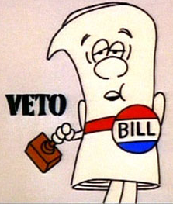
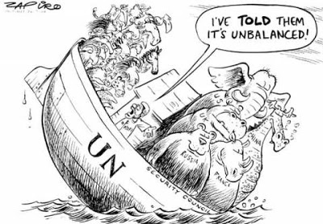
Veto power in UN is against legal equality
International affairs and policies are shaped and driven by big powers
Can veto any resolution even if General Assembly has approved it majority
Smaller states though given equality certificate have little say in international affairs

Slide 23
Nationalism قوم پرستی
What is nationalism?
Concept of common identity based on ethnic, cultural and linguistic foundations
Snyder- ‘a condition of mind, feeling or sentiment of a group of people living in a geographical area, speaking a common language, possessing a literature in which the aspirations of nation have been expressed, attached to common traditions and common customs’
Spirit of nationalism unites the people to strive collectively for common aims and interests
Many freedom movements are led by nationalistic forces
Q. Can you give some examples?
Russian, Pakistan, China, Iran etc
Responsible for freedom and democracy

Slide 24
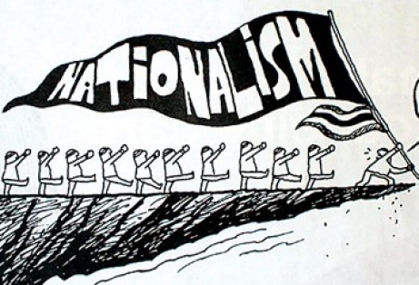
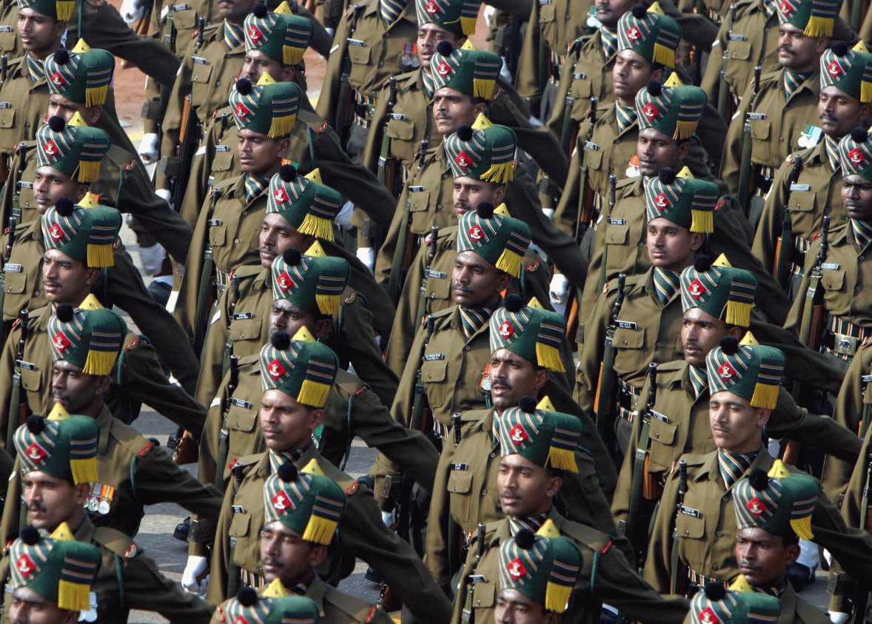
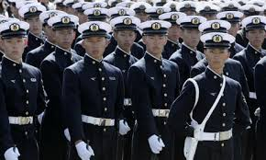
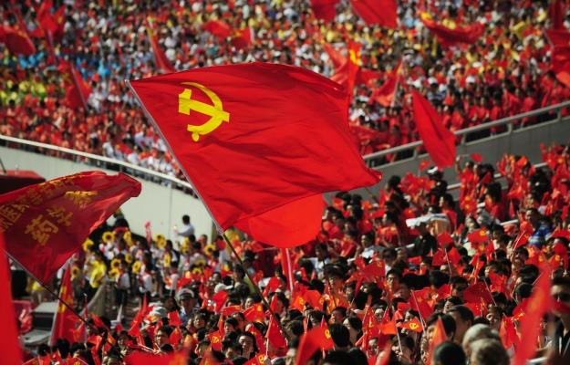

Slide 25
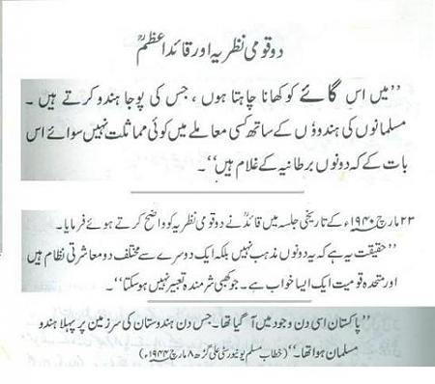

Slide 26
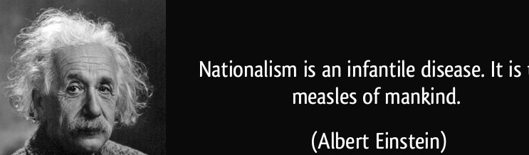
Danger of Nationalism
Is there any danger of nationalism?
Responsible for intolerance
Creates hatred towards other nations and ethnocentrism
Responsible for war and destroying world peace (WWI and WWII)
Hayes: Nationalism is ‘a curse and nothing but a curse’

Slide 27
Conclusion
Nationalism has both merits as well as demerits.
Brogan referred to nationalism as ‘this greatest destructive constructive force’.
Nationalism is neither moral nor immoral doctrine
If misused, then lead to tyranny and war
If used constructively, then source of unity, strength, community service
The state shall pursue it with care
Sense of respect and tolerance for others.

Slide 28
Summary of the Unit- NSS
What is a state?
What is a nation?
The goal of nation- state
A nation needs a state. One nation, one state
In Islam- Muslim Ummah- Muslim Community based on religion of Islam and not on ethnic, language or cultural similarity.

Slide 29
Summary cont.
NSS: A system in which a state deriving its strength from linguistic, ethnic or cultural similarity and possessing a territory governed by a sovereign
1648- Treaty/Peace of Westphalia
30 years war ended and peace established in Europe
dynastic rivalries in France and Germany
Catholics and Protestants for reformation
Development of NSS – Deep impact by following factors
Rise of nationalism
Military movements and warfare
Rise of ideology
Extension of NSS to non-European states

Slide 30
Summary
Elements of NSS
Sovereignty
Territorial Integrity
Legal Equality
Nationalism

Slide 31
Review Questions
How NSS originated from 30 years war?
Trace the developments that cast a deep impact on the NSS after peace of Westphalia, 1648.
Describe the concept of sovereignty and is absolute sovereignty possible in today’s world?
Discuss the main elements of NSS?
What is legal equality of states and does it really exist?

