Slide 1
Review of Previous Lecture (IR, defn, scope..)
Who used the word International for first time?
In which year the word appear?
What is other significance of this year:
When was IR started as a field of study?
In which university it was started?
What is narrow view of IR?
What is broad view of IR?
What is IP?
Difference between IR and IP?
Name of the book written by Morgenthau?
Areas/events/changes contributing to Increasing scope of IR?
Scope of IR: Diplomatic, international law, International Organizations, Post World War II- Decline of Europe, independence of colonies, armament, bi-polar world, nuclear proliferation, rise of representative government, concept of welfare state
Importance of IR: understanding the present world and the policies, understanding the problems, international cooperation, encouraging peaceful relations, proper economic relations, human culture.

Slide 2
Nation State System
Dr. Fayyaz Ahmad Faize
Assistant Professor, Department of Humanities,
COMSATS Institute of Information Technology, Islamabad-Pakistan.

Slide 3
Nation State System (NSS)
Definition and Concept
Origin and Development
Elements

Slide 4
Review
Q1. What is a state?
Ans1. Body of people occupying a definite territory and politically organized under one government.
Q2. What is a nation?
Ans 2. Group of people with a sense of social homogeneity and mutual interest
Q3. What kind of social homogeneity?
Ans 3. Homogeneity of blood, language, culture……

Slide 5
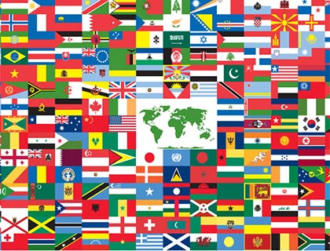
What is Nation State?
Definition and Concept
Slow pronunciation
Nation---State--- ?
Meaning a nation
possessing a particular
state
Or a state with a particular
nation
Notes:
Pic of bentham, country

Slide 6
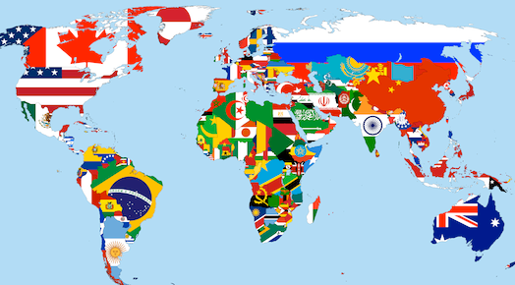
Concept
World has a large population- is the population same?
Population divided into groups- kind of groups?
Economic, religious, ethnic, linguistic etc. dominant group?
The ethnic and linguistic group more dominant
Thus helped in forming a stronger group- nation
The nations aspire to get a state- their first goal
NSS- Western concept

Slide 7
Islamic concept
No economic, linguistic, racial or ethnic, geographical preference
Group formed on ideology- Islamic ideology
Termed as Muslim Ummah- Muslim Community
All Muslims are one- Ummah
All Muslims are brothers.
Manf-e-at ek hai is qaum ki nuqsaan bhi ek
ek hi sab ka nabi deen bhi iman bhi ek
harame paak bhi Allah bhi Quran bhi ek
kuchh bari baat thi hote jo Musalman bhi ek (Iqbal)
In IR- we study from western point of view
Morgenthau: A nation needs a state. One nation, one state
Notes:
Prof dunn pic

Slide 8
Freedom Struggle
Jinnah’s argument for 2 nation theory against 1 nation theory
“we are a nation with our own distinctive culture and civilization, language and literature, art and architecture, names and nomenclature, sense of values and proportions, legal laws and moral codes, customs and calendar, history and tradition, and aptitude and ambitions. In short, we have our own outlook on life and of life.”

Slide 9
Definition of NSS
A system in which states deriving its strength from linguistic or ethnic affinity and possessing a territory governed by a sovereign
A nation-state is a political entity (sovereign state) that governs a cultural entity (nation) by successfully serving all its citizens
Palmer and Perkins: NSS ‘is the pattern of political life in which people are separately organized into sovereign states that interact with one another in varying degrees and in varying ways’
Merriam-Webster dictionary: a form of political organization in which a group of people who share the same history, traditions, or language live in a particular area under one government

Slide 10
Origin
Traced back to 1648- Treaty/Peace of Westphalia (Germany)
30 years war ended and peace established in Europe
dynastic rivalries between France, Spain and Germany
Struggle b/w Catholics and Protestants for reformation in Roman empire and church
Catholic Church- control on religious duties and beliefs
Church was oppressive, controlled freedom and knowledge
Notes:
Pic wright

Slide 11
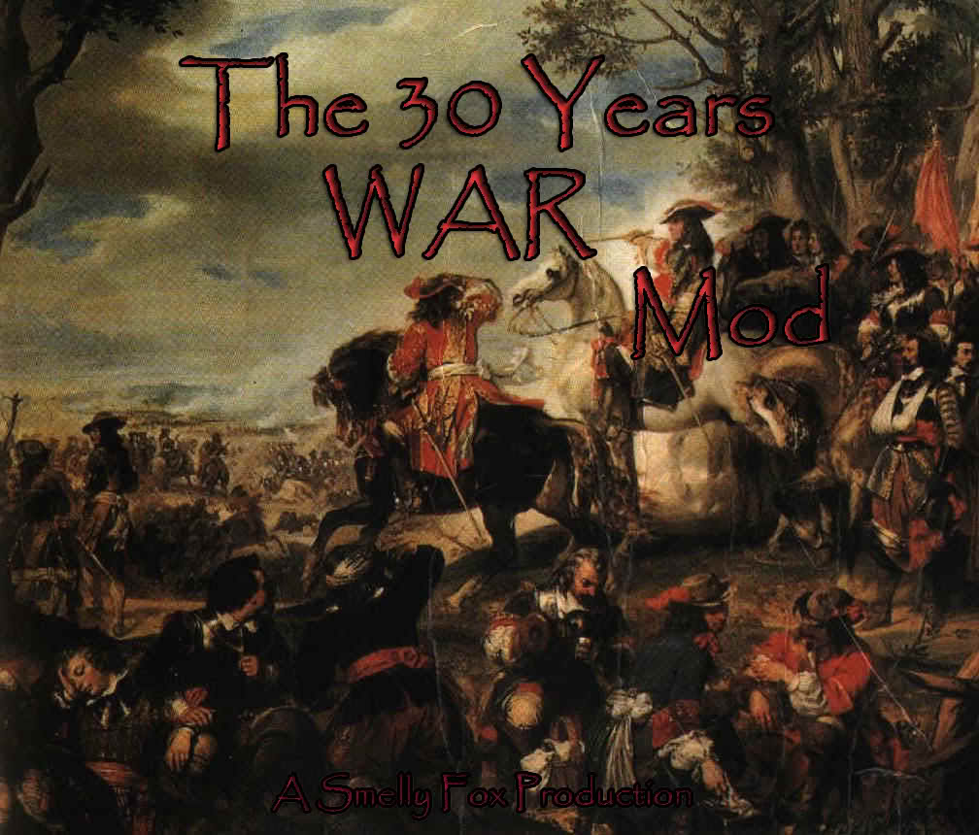
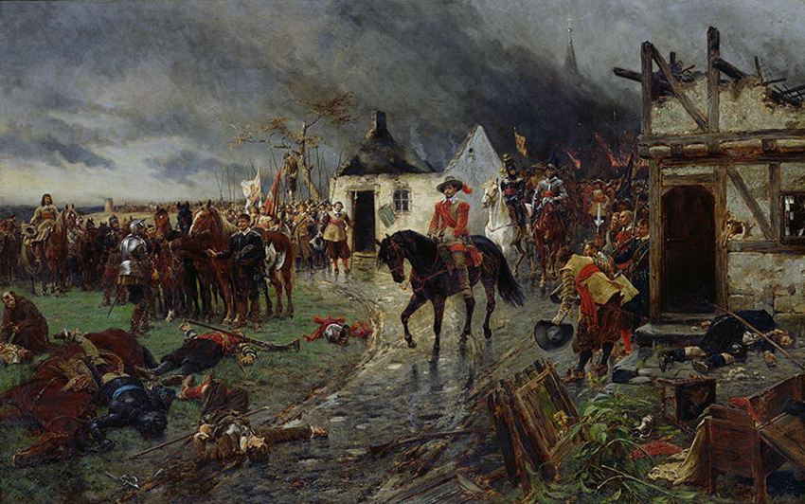
30 years War

Slide 12
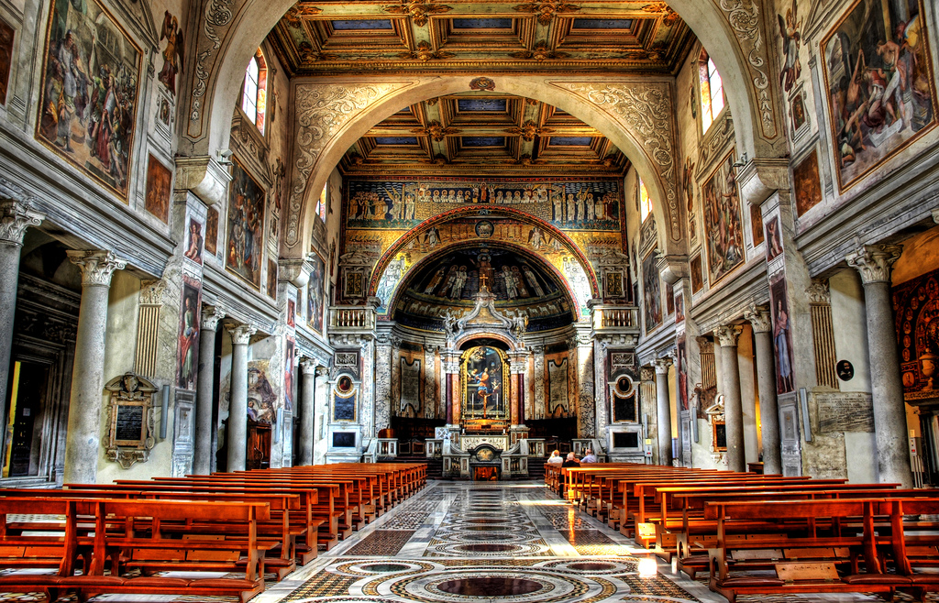
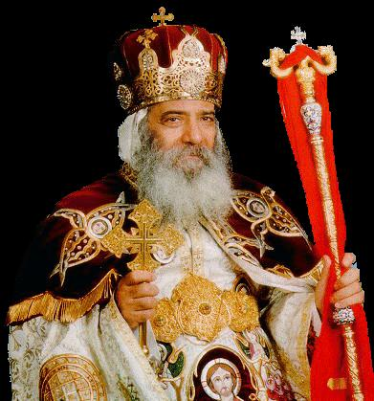
States existed before 1648- but not sovereign
States not independent in religious and secular matters
Religion- authority was restricted by Roman church
Secular- authority restricted by Roman emperor
Thus states were not sovereign
signed in Germany between France, Holy Roman Empire, Spain, and Dutch. England did not join the war.

Slide 13
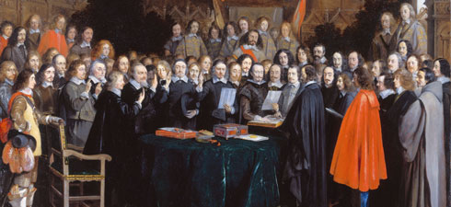
Peace of Westphalia

Slide 14
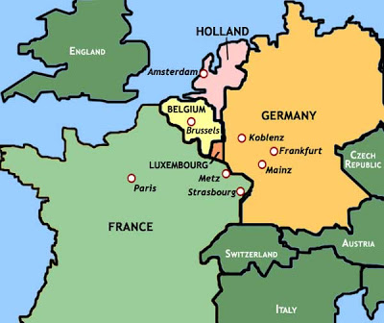
30 years war ended the authority of Pope and Roman emperor over the states in Europe
Independent and sovereign states emerged after 1648
England, France, Germany, Spain, Switzerland, Holland……
Now these states were independent and enjoyed full sovereignty over the land
and people
Notes:
Kurd iraq turkey,

Slide 15
Achievements of Westphalia Peace
recognition of sovereignty of each state
no state must interfere in the affairs of another state
the king has the right to rule over his territory without any interference and can determine his own religion
every state should be considered independent from other state and must be seen as equal to all other states
end of pope’s power
Fall of feudalism and power shifted to king
Urbanization started after 1648 for Jobs since there are no more feudal, landlords to work for.

Slide 16
Development of NSS
NSS developed with the passage of time
Various events and development strengthened it
E.g. industrial revolution, growth of international law, rise of democracy, development of diplomacy, growth of commercial and business activity between states
Deep impact:
Rise of nationalism
Military movements and warfare
Rise of ideology
Extension of NSS to non-European states

Slide 17
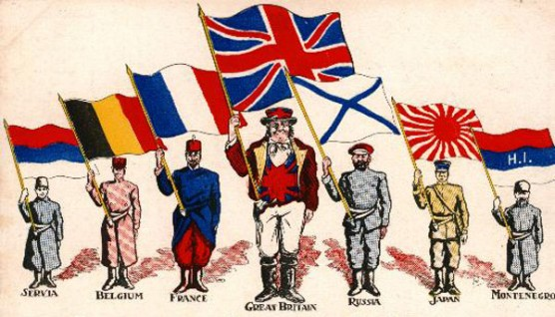
Rise of nationalism
Strongest impact on NSS
Act as a bonding force- cementing element
Strongly unites the people towards the state based on ethnic or linguistic affinity
Nationalistic forces will provide strong support to the ruler for national interests E.g. Germany, Japan, France

Slide 18
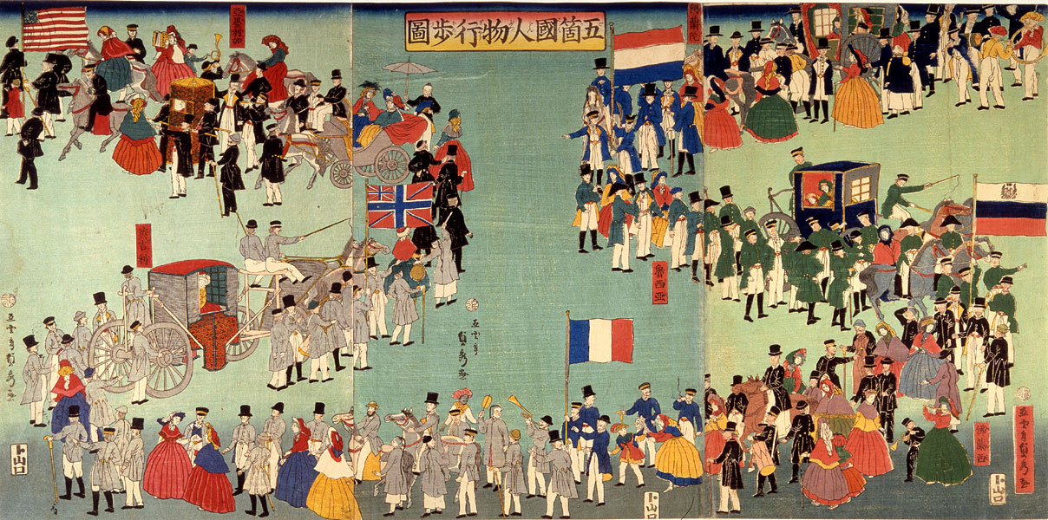
Countries with multi ethnic and linguistic groups suffered freedom movements
Russia, Austria-Hungary, Balkan states, Ottoman empire
Many new states emerged as a result in Europe
Notes:
Albania Bosnia and Herzegovina Bulgaria Greece^{[clarification needed]} Kosovo Macedonia Montenegro

Slide 19
Nationalism cont.
In sub-continent, Muslim nationalism grew stronger due to ill-treatment of Hindus (Cow slaughter, Hindi-Urdu controversy, protest against Bengal partition, betrayal in Khilafat movement, Nehru report, Congress rule etc.)

Slide 20
Military movements and warfare
Military movements grew stronger in 19th and 20th century e.g. Germany, Spain, Italy, France
Sophisticated weapons and techniques in warfare (bombs, tanks, fighter planes, submarines, landmines)
This produced mass mobilization and patriotism towards the state to protect one’s political and social institutions
And to destroy the enemy
And to impose ones ideology and social institutions on the defeated nation

Slide 21
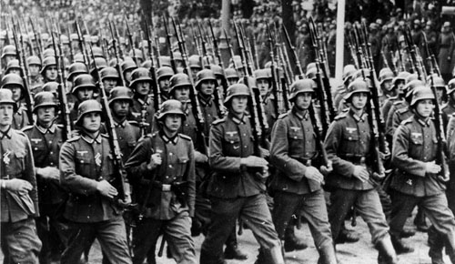
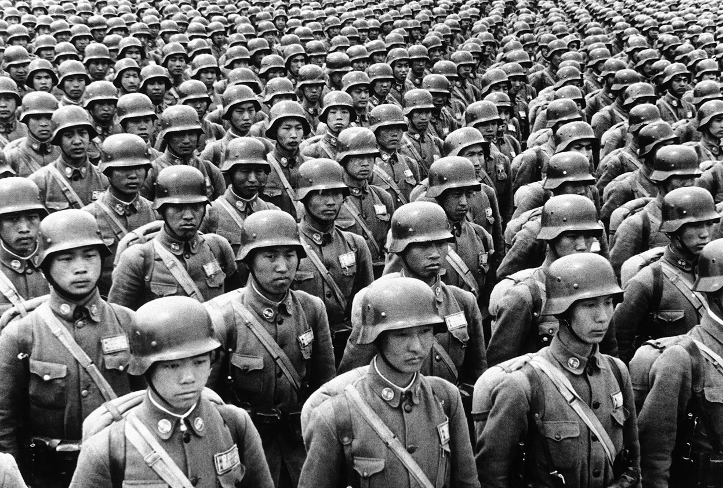

Slide 22
Rise of ideology
ideology system of beliefs, values, ideals, goals and a body of knowledge which a people considers true, binding and practicable.
Pedelford and Lincoln: ‘A body of ideas concerning economic, social and political values and goals which pose action program for attaining these goals’
Ideologies tend to arise in the times of crises and social stress
An ideology emerges when people feel strongly that they are being mistreated, oppressed, denied their due rights or when their status is threatened by fundamental changes occurring in society

Slide 23
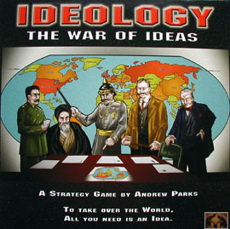

unifying element and provides direction
People have strong attachment to ones ideology

Slide 24
Ideology cont.
Ideology is a motivating force for a nation,
Cement element- integrates people into one unit, brings them closer
Solution to problem by providing a line of action/strategy.
give shape to the revolutions and new cultures and civilizations.
Imperialism, colonialism, Nazism, Fascism, socialism, capitalism, democracy, Islamic ideology
A nation tries to protect and promote its ideology e.g. Western Europe for capitalism, former Russia for socialism, Pakistan for Islamic ideology
Provides strength to NSS

Slide 25
Summary of today’s lecture
What is a state?
What is a nation?
World population – diverse groups- groups based on different grounds
Dominant group forms nation state
A nation needs a state. One nation, one state
In Islam- Muslim Ummah- Muslim Community

Slide 26
Summary cont.
NSS: A system in which a state deriving its strength from linguistic or ethnic affinity and possessing a territory governed by a sovereign
1648- Treaty/Peace of Westphalia
30 years war ended and peace established in Europe
dynastic rivalries in France and Germany
Catholics and Protestants for reformation
Development of NSS
Rise of nationalism
Military movements and warfare
Rise of ideology
Extension of NSS to non-European states

Slide 27
Extension of NSS to non-European states
NSS extended outside Europe (Asia, Africa, Latin America)
E.g. Pakistan, India, Burma, Indonesia, Malaysia, China, Taiwan, N. Korea, S. Korea, Philippine,
Either through acceptance of European NSS by non-European states or through independence from European power
Thus NSS extends to the whole world
Disintegration of Russia after cold war
Tajikistan, Kazakhstan, Kirghizstan, Uzbekistan, Turkmenistan etc.
More than 180 NSS at present

Slide 28
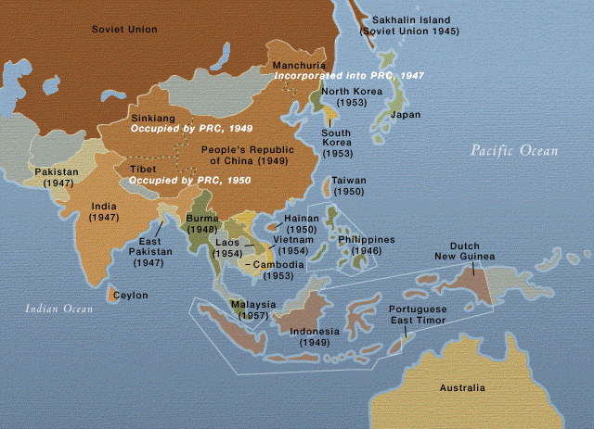

Slide 29
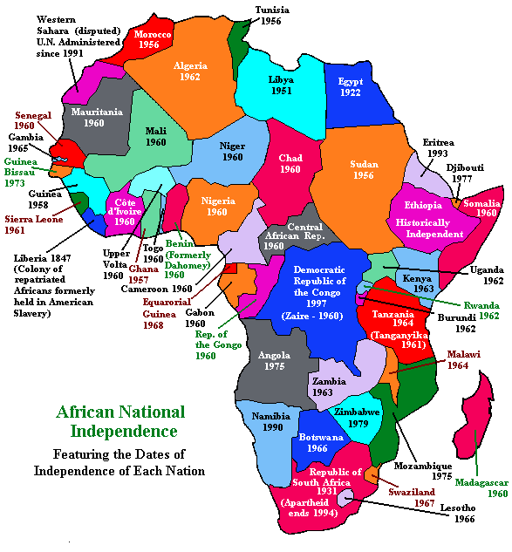

Slide 30
Elements of NSS
Sovereignty
Territorial Integrity
Legal Equality
Nationalism

Slide 31
Sovereignty
The supreme power over citizens and subjects unrestrained by law (Bodin- the father of modern concept of sovereignty)
The supreme will of the state (Willoughby)
The absolute, unrestrained, supreme authority to make laws and enforce it.
A state which is not sovereign can not make treaty, or become member of international organization

Slide 32
Sovereignty cont.
Only 1 sovereign exists in a state
Sovereignty is indivisible and inalienable i.e.
Its power can not be limited, divided or transferred
Morgenthau: concept of divisible sovereignty is illogic and politically unfeasible

Slide 33
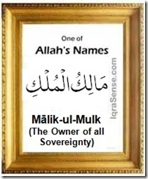
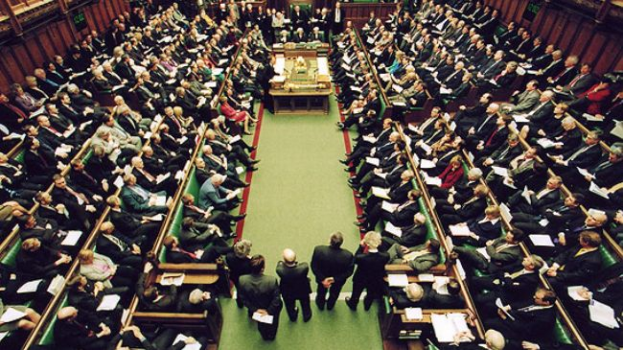
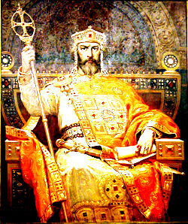
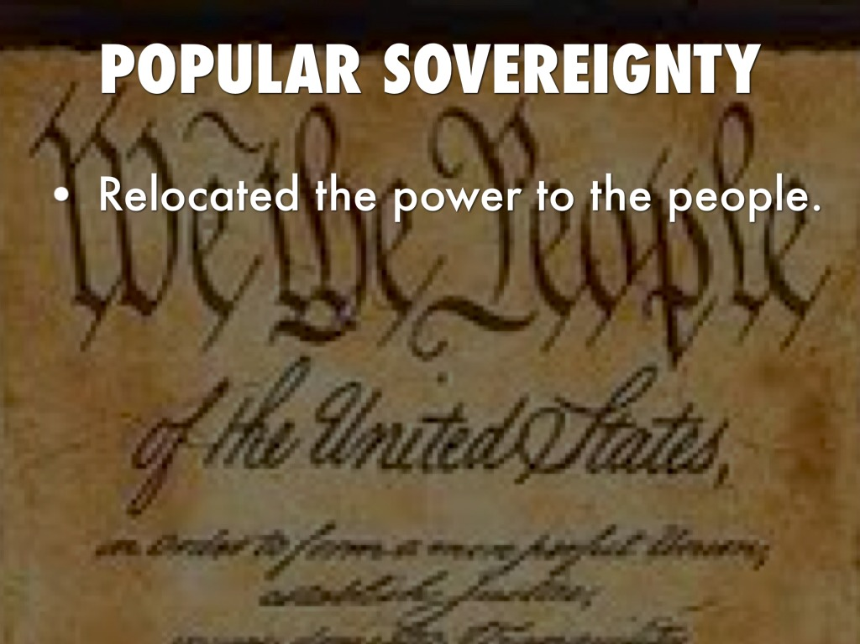

Slide 34
Sovereignty cont.
Is Absolute sovereignty possible?
A sovereign has to make adjustment, compromises in the internal as well as external matters- thus restricting the power
Treaty/pacts, Int. organizations, international law, public opinion, pressure group also restricts sovereignty
However, for NSS to exist- concept of sovereignty will also continue to exist

Slide 35
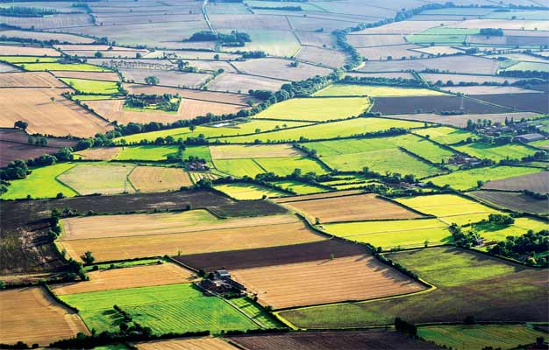
Territorial Integrity
A nation needs a state to live
Territory- an important element of NSS
NSS will exist if the integrity of territory continue
No Land--No Nation

Slide 36
Territorial Integrity
The nation thus protects its own territory and safeguards its integrity
Principle of non-interference in internal affairs of other
Abstain from use of force to solve inter-state problems
Respect for international boundaries
Use of peaceful means to solve problems-diplomacy

Slide 37
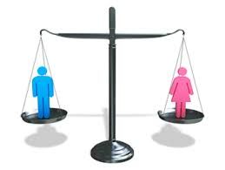
Legal Equality
NSS assumes all states to be equal
irrespective of population, area,
economic condition, military power etc.
Accepted by UN charter as well
Equality implies respect for all
Inequality would result in humiliations, conflicts, tension and war

Slide 38
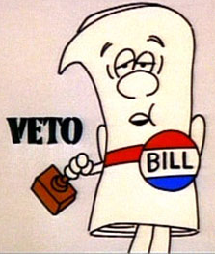
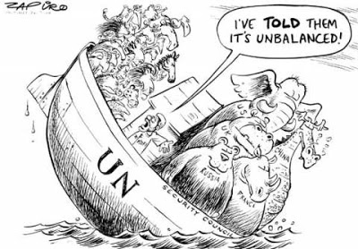
Veto power in UN is against legal equality
International affairs and policies are shaped and drive by big powers
Can veto any resolution even if General Assembly has approved it majority
Smaller states though given equality certificate have little say in international affairs

Slide 39
Nationalism
Refers to concept of common identity based on ethnic, racial and linguistic affinity
Snyder- ‘a condition of mind, feeling or sentiment of a group of people living in a geographical area, speaking a common language, possessing a literature in which the aspirations on nation have been expressed attached to common traditions and common customs’
Spirit of nationalism unites the people to strive collectively for common aims and interests
Many freedom movements are led by nationalistic forces
Responsible for freedom and democracy
Two Nation Theory in sub-continent- freedom struggle

Slide 40
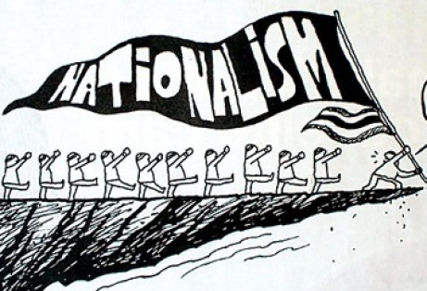
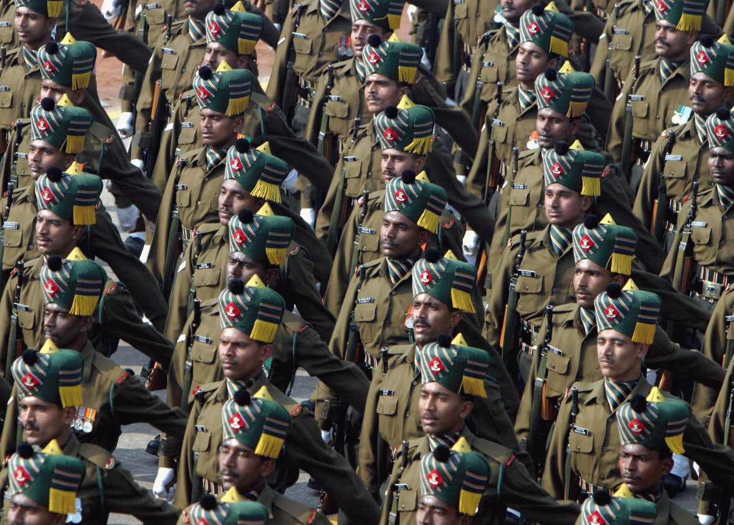
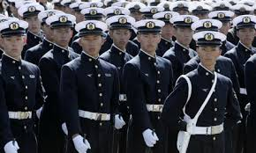
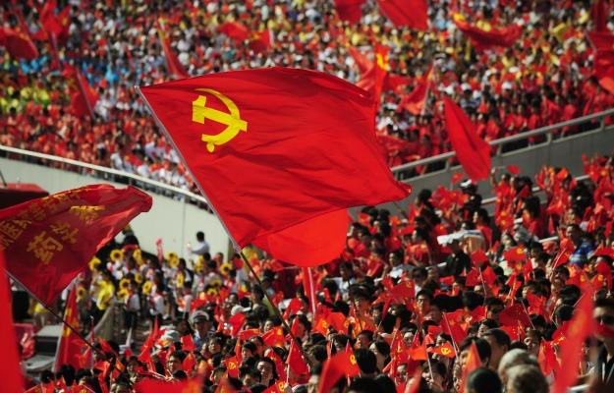

Slide 41
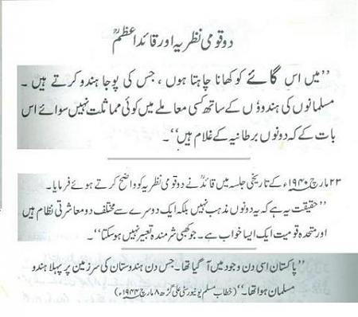

Slide 42
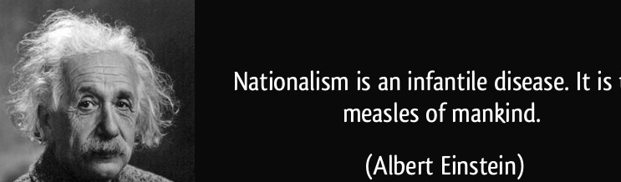
Danger of Nationalism
Responsible for intolerance
Creates hatred towards other nations and ethnocentrism
Responsible for war and destroying world peace (WWI and WWII)
Hayes: Nationalism is ‘a curse and nothing but a curse’

Slide 43
Conclusion
Brogan referred to nationalism as ‘this greatest destructive constructive force’.
Nationalism is neither moral nor immoral doctrine
If misused, then lead to tyranny and war
If used constructively, then source of unity, strength, community service
The state shall pursue it with care
Sense of respect and tolerance for others

Slide 44
Summary
Concept and definition of NSS
Origin and Development NSS
industrial revolution, growth of international law, rise of democracy, development of diplomacy, growth of commercial and business activity between states
Deep impact:
Rise of nationalism,
Military movements and warfare
Rise of ideology
Extension of NSS to non-European states
Elements of NSS
Sovereignty
Territorial Integrity
Legal Equality
Nationalism

Slide 45
Review Questions
How NSS originated from 30 years war?
Trace the developments that cast a deep impact on the NSS after peace of Westphalia, 1648.
Describe the concept of sovereignty and is absolute sovereignty possible in today’s world?
Discuss the main elements of NSS?
What is legal equality of states and does it really exist?

