Slide 1
Review of Deterrence and Limited War
Deterrence concept and definition
Enforcing Deterrence: Threat and Reward
Types of deterrence: Direct deterrence, Extended deterrence, Immediate deterrence General deterrence
Dangers Behind Defending Protégé
Limited War
Examples of limited war: Kargil war, Israel attacks in Gaza, Drone attacks,
Why limited war?

Slide 2
Foreign Policy of Pakistan and Its Role
Dr. Fayyaz Ahmad Faize

Slide 3
Foreign Policy of Pakistan and Its Challenges
Foreign Policy
Guiding Principles of Pakistan Foreign Policy
Objectives of Pakistan Foreign Policy
Challenges to Pakistan Foreign Policy
Conclusion

Slide 4
Foreign Policy Definition and Concept
Deals with relations between sovereign states
Hartmann: ‘a systematic statement of deliberately selected national interests’
Gibson: ‘a well rounded comprehensive plan based on knowledge and experience for conducting the business of government with the rest of the world. It is aimed at promoting and protecting the interests of the nations’
Crabb: ‘ Foreign policy consists of two elements, national objectives to be achieved and means for achieving them’
indicates the principles and preferences on which a country wants to establish relations with another country for promoting national interests

Slide 5
Foreign Policy cont.
Foreign policy is the systematic plan, intention, aspiration, and ideals of any country on how to deal with its neighbours and the world entirely.
It tells us about a country, it political objectives, its economic preferences and its goals in the international affairs
So foreign policy is concerned with behaviour of a state with other states and is aimed at promoting and protecting national interests.

Slide 6
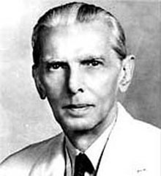
Jinnah on Pakistan Foreign Policy
Quaid-i-Azam on Foreign Policy (1948).
‘Our Foreign Policy is one of friendliness and good-will towards all the nations of the world. We do not cherish aggressive designs against any country or nation. We believe in the policy of honesty and fair play in national and international dealings and are prepared to make our utmost contribution to the promotion of peace and prosperity among the nations of the world. Pakistan will never be found lacking in extending its material and moral support to the oppressed and suppressed peoples of the world and in upholding the principles of the United Nations Charter’.

Slide 7

Guiding Principles of Pakistan's Foreign Policy
Protection of Freedom and Sovereignty
Sacrifices of million of Muslims for freedom
Now the need for preservation of its independence and territorial integrity
Every effort will be made to preserve freedom
independence in internal affairs and self-rule and no dictation
Support democracy and the welfare of all people

Slide 8
Guiding Principles of Pakistan's Foreign Policy cont.
2. Cordial Relations with Muslim Countries
Ideological state on the name of Islam
So friendly relations with Muslim countries esp. Arabs
Showed concern against Israel, India and U.S.S.R aggression against Palestine, Kashmir and Afghanistan respectively.
Struggle for safeguarding the rights of the Muslims and finding solution to their problem
also an active member of the OIC and cooperate with muslim countries

Slide 9
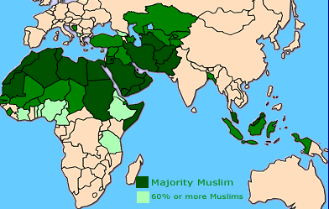
Pakistan and Muslim World

Slide 10
Guiding Principles of Pakistan's Foreign Policy cont.
3. Non-Interference in Internal Affairs of Other Countries
Does not want interference in its internal matters
Also does not interfere in the internal affairs of other state
Respect their sovereignty and their right to self rule
4. Implementation of U.N Charter
Active member of UN since its birth
Fully committed to UN charter and extended its full support as Jinnah’s commitment
Always followed UN resolution and helped UN in all its efforts, peace missions and social works

Slide 11
Guiding Principles of Pakistan's Foreign Policy cont.
5. Promotion of World Peace
Pakistan is a peace loving country
Has no aggressive designs against any country
Also does not like war and aggression
Stresses peaceful means for resolving conflicts than coercive measures
Is helping UN since 1960 by sending its armed forces to different warring countries for making peace, preventing human rights violation, providing health care and medical facilities, building roads and infrastructure, conducting fair and free election, providing logistics etc.
has contributed in more than 41 UN Missions spread over 23 countries e.g. Congo, Bosnia, Cambodia, East Timor, Haiti, Liberia, Ivory Coast, Sudan, Kosovo etc.

Slide 12
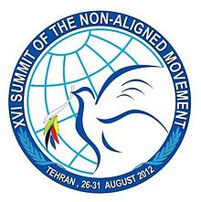
Guiding Principles of Pakistan's Foreign Policy cont.
6. Non-Alignment
Does not aligned itself with communistic or capitalistic block
Remained neutral in their conflicts
However, Pakistan joined NAM in 1979
Showed tilt towards US after independence because of security reasons and joined SEATO and CENTO
Then quit both SEATO and CENTO (1972 and 1979)

Slide 13
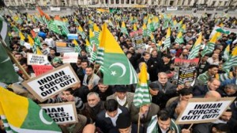
Guiding Principles of Pakistan's Foreign Policy cont.
7. Support for Self-Determination
Pakistan itself was a British colony and got freedom in 1947
Also support those who are struggling for their right of self rule and independence
Raised the issue of Kashmir and people suffering and support their right for self-determination
Also supports the rights of Palestine and their cause

Slide 14
Guiding Principles of Pakistan's Foreign Policy cont.
8. Nuclear Non-Proliferation and Disarmament
Pakistan is a peace loving country
Does not like arms race and nuclear non proliferation
Favour and support disarmament efforts
However, due to a belligerent neighbor India, it was dragged into arms race for its security
After acquiring nuclear capability, Pakistan supports a minimum amount of deterrence level for its own security
Pakistan is also against nuclear proliferation and maintains a strict command and control system so that the nuclear technology and expertise is not transferred to other non-nuclear states

Slide 15
Guiding Principles of Pakistan's Foreign Policy cont.
9. Member of International Organization
For promoting international peace, regional cooperation and economic stability, Pakistan has acquired the member of different international organizations
Also contributing to these organizations in different field
E.g. the British Commonwealth, UN, SEATO, CENTO, NAM, OIC, ECO, SAARC,

Slide 16
Summary
Foreign Policy: the systematic plan, intention, aspiration, and ideals of any country on how to deal with its neighbours
Guiding Principles of Pakistan Foreign Policy: Freedom and Sovereignty, Muslim Countries, U.N Charter, World Peace, Non-Alignment, Self-Determination, Disarmament

