Slide 1
Review of Previous Lecture-Deterrence
Deterrence concept and definition
Forms:Military,diplomatic,Economic,Cultural
Enforcing Deterrence: Threat and Reward
Types of deterrence: Direct deterrence,

Slide 2
Deterrence and Limited War Cont.
Dr. Fayyaz Ahmad Faize

Slide 3
Types of deterrence
i. Direct deterrence: The defender issues a deterrence threat that prevents the challenger from attacking her. During the Cold War, both the U.S. and the USSR engaged in direct deterrence with respect to each other and thus status quo was maintained; Pakistan Nuclear weapons against India
ii. Extended deterrence: This refers to occasions on which the defender extends his protection to a third party called protégé (زیر حفاظت و منظور منظر) and warns the challenger that not to attack that state.
E.g. Taiwan is an American protégé to prevent China from absorbing the island.
Another example is US backing South Korea against security threat from North Korea.

Slide 4
Types of deterrence
iii. Immediate deterrence: Refers to situations where the challenger can mount an attack at any moment. While the other mounts a threat to deter the attack
For example, in 1950 the Chinese attempted to deter the U.S. from pursuing a war of conquest into North Korea but their warnings were ignored, and the Chinese swarmed across the Yalu River to push back the American forces.
Another example would be the 1970 warning by Israel against potential invasion of Jordan by Syria.
Every crisis that ends in the outbreak of war is a case of failed immediate deterrence.

Slide 5
Types of deterrence
General deterrence: Refers to situations where there is no clear and present danger of attack and yet a deterrence threat is given against use of force by any other states that any state that violate will be given an exemplary punishment.
For example American treaty with Japan that secures the island against any potential aggressor even though no such threat is apparent at present just like a strong punishment to any criminal provides a general deterrence to other persons as well not to commit such crime.
General deterrence was also provided by US to Western Europe not only from the potential attack of the Red Army during the Cold War but against any threat from any state.

Slide 6
Dangers Behind Defending Protégé
The Great Powers can afford extended deterrence
Many wars have occurred when the protégé drags its protector into conflict
E.g. Before World War I, Russia guaranteed the security of Serbia and encouraged the government to resist the ultimatum delivered by the Austria-Hungary.
The Austrians were motivated by the Germans (blank cheque)
In the end, the two defenders found themselves at war with each other over a conflict between their protégé

Slide 7
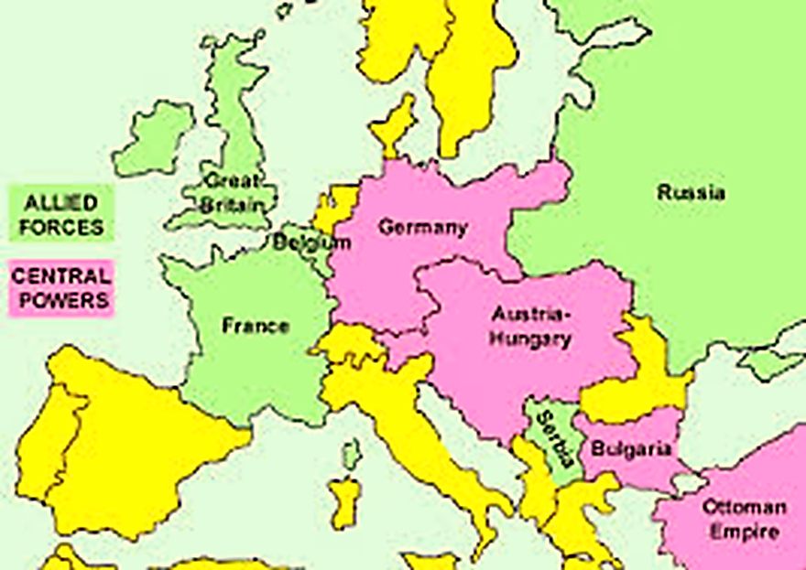
WW-I Alliances

Slide 8
Dangers Behind Defending Protégé cont.
Hence, such commitments are inherently riskier for the defenders.
So US did not give sure deterrence commitment to Taiwan
The problem is well-known: If U.S. promise unconditional defense of the island,
it may well choose to defy China and declare full independence, something that the Chinese have repeatedly insisted would cause war
Such a commitment may encourage Taiwan to pursue a reckless policy that would endanger the peace between U.S. and China

Slide 9
Limited War
What is cold war?
What is total war?
Was World Wars limited or total war?
What is limited war?

Slide 10
Limited War
Wars can not be totally eliminated
However, it can be limited
As the term suggests, is the idea of limiting or constraining the way in which war is conducted
This restraint can involve:
Confining the geographical area in which fighting takes place
Limiting the type of targets/area that can be attacked
Limiting the weapons that can be used
Limiting the degree of mobilization/troops

Slide 11
Limited War cont.
A war in which the weapons, the territory, or the objectives are restricted in some way, esp. in the use of nuclear weapons.
A war conducted with less resources and restricted in aim
A conflict in which the warring states do not expend or use all of their available resources, whether human, industrial, agricultural, military, natural, technological, or otherwise.
The reason may be to preserve the resources for other purposes.
Limited war is an opposite of total war

Slide 12
Examples of limited war
The war between Israel and Egypt from 1967 to 1970 was limited war and was consisted of artillery shelling, aerial warfare, and small scale raids.
The Kargil war between India and Pakistan in 1999.
The Vietnam war by the US to stop the spread of communism without provoking a wider confrontation with the SU
Israel bombardment on Philistine in Gaza, 2014

Slide 13
Limited War cont.
Limited war is fought with a relatively low level of violence but a high level of politics and propaganda .
These limited wars endure because one, or sometimes both, parties to the conflict cannot inflict total defeat on their enemy, but at the same time, cannot bring themselves to make peace. These wars, therefore, go on and on and on at a low level of violence, with no end in sight.
Today's Taliban and Islamist groups in Iraq are keeping their various wars going in the hope that their Western enemies will one day get tired and disappear
Taliban attacks continue against US and Pak Army
US drone attacks on Taliban leaders

Slide 14
Limited War cont.
After 1945, limited war became a necessity in order to prevent nuclear war or total war
Both USA and USSR had to impose restrictions on themselves in order to prevent the danger of a superpower confrontation involving nuclear weapons
Thus both the Korean War (1950–53) and the Vietnam War (1963–75) can be classed as ‘limited’ wars because it did not involve the USA using of all its military and economic resources

Slide 15
Why limited war?
based on humanitarian principles that focused on limiting the nature of war to protect the civilian population.
Limited War was advocated as a strategy to achieve security objectives, the humanitarian school was also arguing for the need to limit wars.
They were realistic enough to understand that wars are not totally avoidable.
The ICRC in 1956 advocated military operations to be limited only to ‘military resources, and leave the civilian population outside the sphere of armed attacks’. Thus the humanitarian school advocated that war should be limited only to a geographical area of military significance.
Saving resources financially, military and others
Military tactics and gorilla warfare encouraged limited war

Slide 16
Summary
Deterrence concept and definition
Enforcing Deterrence: Threat and Reward
Types of deterrence: Direct deterrence, Extended deterrence, Immediate deterrence General deterrence
Dangers Behind Defending Protégé
Limited War
Examples of limited war: Kargil war, Israel attacks in Gaza, Drone attacks,
Why limited war?

Slide 17
Review Questions
Define Deterrence and forms of deterrent threats.
Describe the types of deterrence and how it is enforced?
What are the dangers behind defending Protégé?
Define Limited War and give some examples.
Why limited war has replaced total war at present?

