Slide 1
Review of Previous Lecture- Disarmament
Arms Control: cooperative and multilateral approach to armament policy instead of a blind race through mutual consensus
Can be unilateral, bilateral or multilateral
Include WMD and conventional weapons but mostly WMD
contributes to balance of power
Armament is acquiring arms, increasing armed forces, military bases and spending
Armaments continues since ancient times,
Effects of Armaments: Wastage of resources, social service, industry and trade , Suspicion and fear
Need for disarmaments:

Slide 2
Conflicts & Role of Regional and International Pacts cont.
Dr. Fayyaz Ahmad Faize

Slide 3
Disarmament
Albert Einstein: “I do not know with what weapons World War III will be fought, but World War IV will be fought with sticks and stones.”
"Every gun that is made, every warship launched, every rocket fired signifies, in the final sense, a theft from those who hunger and are not fed, those who are cold and are not clothed.
The cost of one modern heavy bomber is this: a modern brick school in more than 30 cities.“ [Former U.S. President Dwight D. Eisenhower (1952-1960)]

Slide 4

Disarmament
A systematic plan for reduction or abolition of armed forces, number of weapons, military bases and expenditures.
Disarmament is the act of reducing, limiting, or abolishing weapons and defence spending

Slide 5

Difference b/a Arms Control and Disarmament
Arms control may allow for increase in arms, disarmament seeks reduction in arms
Arms control tries to stabilize the status quo, disarmament seeks to disturb the status quo
Arms control is conservative enterprise while Disarmament is a radical one

Slide 6
Needs for Disarmament
If armaments leads to fear and war, then disarmaments would lead to peace and easing of tension
Leads to better understanding of a state’s intentions and confidence building
Saving of resouces and socio-economic development
However, mutual agreement is needed for disarmament

Slide 7
Some Disarmament Efforts
1. Can be traced back to Peace of Westphalia, 1648
Agreed that all existing fortification be abolished and no new fortification will be made
2. First systematic proposal given by Czar of Russia in 1816 but was not accepted by other European powers
3. Proposal of France for reducing arms but in vain
4. Tsar of Russia on 1898 for reducing arms but not much success
5. President Wilson stressed on disarmament after WW-I that it be reduced to ‘lowest point consistent with domestic safety’

Slide 8
Some Disarmament Efforts cont.
6. League of Nations also emphasized on general disarmaments- membership only if willing to accept arms regulation by League
7. However, League failed to pursue effectively disarmament efforts due to rivalry between major powers and armament continued.
8. UN charter also laid emphasis on regulation of arms. UNO has a separate office for disarmament. It is called The United Nations Office for Disarmament Affairs (UNODA) which implements the decisions of the General Assembly on disarmament matters
9. Atomic energy Commission (1946): for preventing the acquiring of nuclear weapons for destruction and ensuring its peaceful use and to identify safeguards by way of inspections of nuclear sites.

Slide 9
Some Disarmament Efforts cont.
However, it did not achieve anything concrete as other permanent members of security council did not test their nuclear bomb.
10. Atom for Peace Plan (1953): President Eisenhower of US proposed to use atomic energy for peaceful purpose through establishing an international pool of fissionable material which could be provided to other states only for peaceful purposes. However, SU opposed the plan arguing that first an agreement on prohibiting nuclear weapons is more important.
11. Nuclear Test Ban (1958-61): US, UK and SU involved in series of talk to arrive at agreement to suspend all types of nuclear test in earth atmosphere, outer space, in ocean and underground.
However, the 100 Megaton Bomb explosion by SU in 1961 spoiled all the efforts and US announced to do similar test as well.

Slide 10
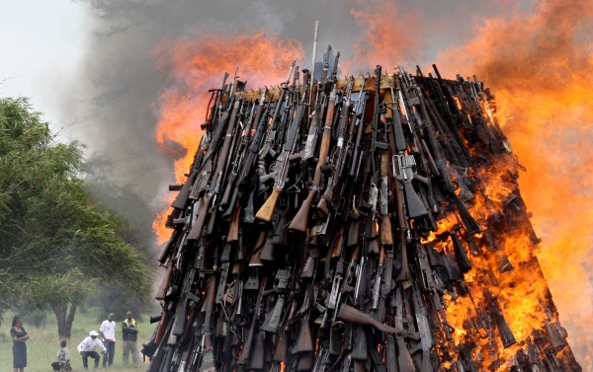

Slide 11
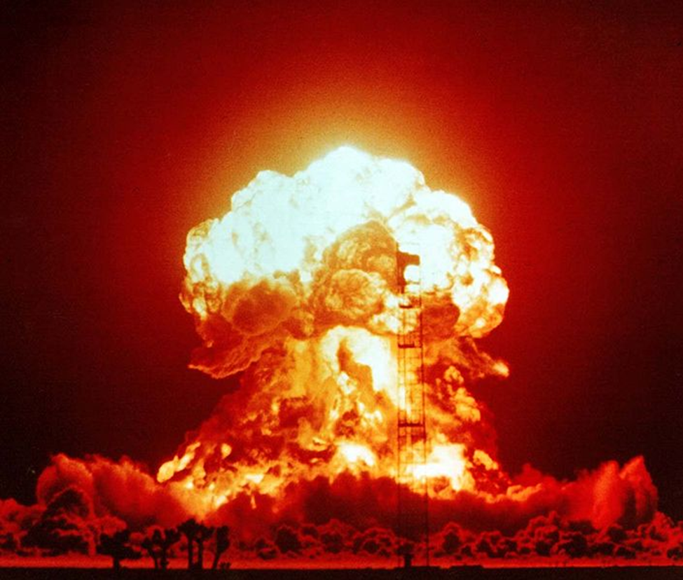
Nuclear Explosion 1953 at the Nevada Test

Slide 12
Some Disarmament Efforts cont.
12. Antarctic Treaty (1959): Antarctica was declared as a military free zone. No military base, test or deployment of forces, disposal of nuclear waste in Antarctica.
13. Limited Test Ban Treaty (1963): concluded in Moscow
prohibited nuclear test and explosion in atmosphere, outer space, under water. Underground test was not prohibited.
It was signed by US, UK and SU, but France and China refused as they did not test their nuclear weapon. 1964, China test her first bomb. Efforts failed.
14. Non-Proliferation Treaty (1968): prohibited the transfer of nuclear weapons to other states, nuclear states shall not help other state acquire nuclear weapons, the non-nuclear states signing the treaty will not acquire these weapons, allowed the use of nuclear energy for research and peaceful purpose- enforced 1970

Slide 13
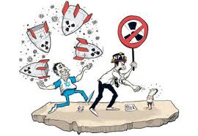
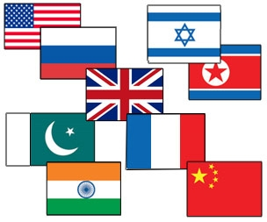
Nuclear states

Slide 14
Some Disarmament Efforts cont.
15. Strategic Arms Limitation Treaty (1972): Both super powers agreed to reduce their arms and sophisticated weapons comprising of ICBM and submarine-launched ballistic missiles (SLBMs). The number of ICBM for SU was fixed at 1618 and for US 1054.
16. SALT II (1979): After expiry of SALT I in 1977, SALT II signed to further decrease strategic offensive weapons and ICBMs. Before US senate could ratify it, SU intervention in Afghanistan disturbed the atmosphere. However, US continued with following the limits proposed by the treaty.
The Missile Technology Control Regime, 1987 – An informal agreement between 34 states to prevent the proliferation of missile technology. It was supplemented in 2002 by the International Code of Conduct against Missile Proliferation (ICOC) and its membership of 119 states.

Slide 15
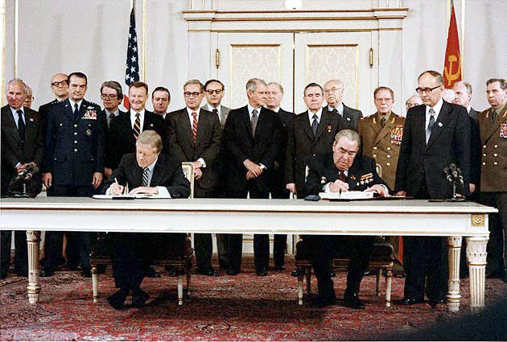
Jimmy Carter and Leonid Brezhnev signing SALT II treaty, June 18, 1979, in Vienna.

Slide 16
Some Disarmament Efforts cont.
INF (Intermediate Range Nuclear forces Treaty): ban long and Shorter Range Missiles. Signed in 1987 between US & USSR eliminating ground launched Ballistic and Cruise Missiles with the range between 500 and 5,500 km. More than 2,500 missiles with the nuclear warheads were destroyed in 3 years time.
17. Strategic Arms Reduction Treaty (1991): proposed reduction in nuclear weapons to 6000 and ICBMs to 1600. It resulted in 80% reduction of strategic nuclear weapons
18. START-II (1993): kept the condition of 3,000 to 3,500 nuclear warheads for US and RUSSIA by year 2003
19. Comprehensive Nuclear Test Ban Treaty (CTBT): adopted in 1996. Bans all types of nuclear explosion for all purpose. India and Pakistan did not sign so not enforced yet.

Slide 17
20. The SORT Treaty (Strategic Offensive Reductions Treaty, also known as the Moscow Treaty): adopted in 2002, to limit the US and Russia to 1700–2200 deployed strategic nuclear weapons each by 2012. However, it still allows unlimited numbers of nuclear weapons to be held as non-deployed.
21. New START Treaty—signed 2010, into force in 2011: replaces SORT treaty, reduces deployed nuclear warheads by about half, will remain into force until at least 2021
South Africa is the only country that developed nuclear weapons during the 1980s, and dismantled all of them 1990s.

Slide 18
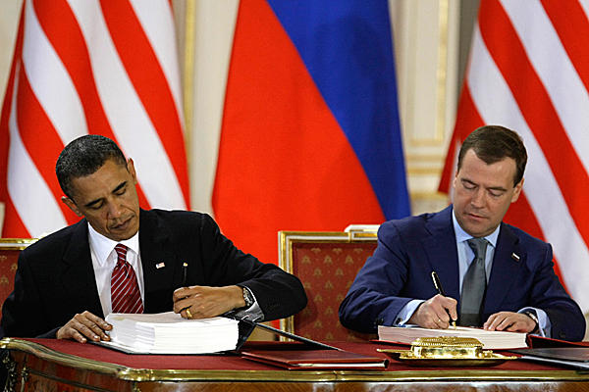
President Barack Obama and Russian President Dmitry Medvedev signed the New START treaty on nuclear weapons today.

Slide 19
Conclusion
Security cannot be achieved through the continued reliance on weapons, but only through international cooperation in developing and maintaining effective, binding, and verifiable multilateral agreements such as embodied in the peaceful regimes of Disarmament and Arms Control.
Disarmament and Arms Control must be given highest priority across the globe.
Disarmament resulted in confidence building measures between the two hostile blocks and lead to reduction in the number of strategic nuclear weapons.
Prevented the wastage of resources and diversion of these resources for humanitarian purposes and national development
Promoted peace and reduced tension and fear atmosphere and brought stability in the region

Slide 20
Summary
Disarmament: systematic plan for reduction or abolition of armed forces, number of weapons, military bases and expenditures.
Difference between arms control and disarmament:
Need for Disarmament: bring peace, security, confidence building measure, saving of resources and socio-economic development,
Disarmament Efforts:
Conclusion

Slide 21
Review Questions
Q1. What are the effects of armaments?
Q2. Distinguish between arms Control and disarmament.
Q3. Why Disarmament is needed?
Q4. Trace some disarmament efforts that contributed to lessening of tension.

