Slide 1
Review of Previous Lecture: Regional Organizations
The Warsaw Treaty Organization,
Problems in WARSAW Pact and End
SEATO
CENTO

Slide 2
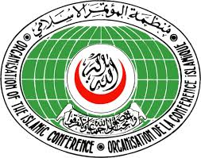
OIC
OIC stands for Organization of Islamic Conference.
The official languages of the OIC are Arabic, English and French.
It changed its name and logo on 28 June 2011 from the Organization of the Islamic Conference to Organization of Islamic Countries
It was founded in Rabat, Morocco in 1969 in reaction to Israel attack on Al-Aqsa Mosque.
membership of 57 states spread over
four continents.
.

Slide 3
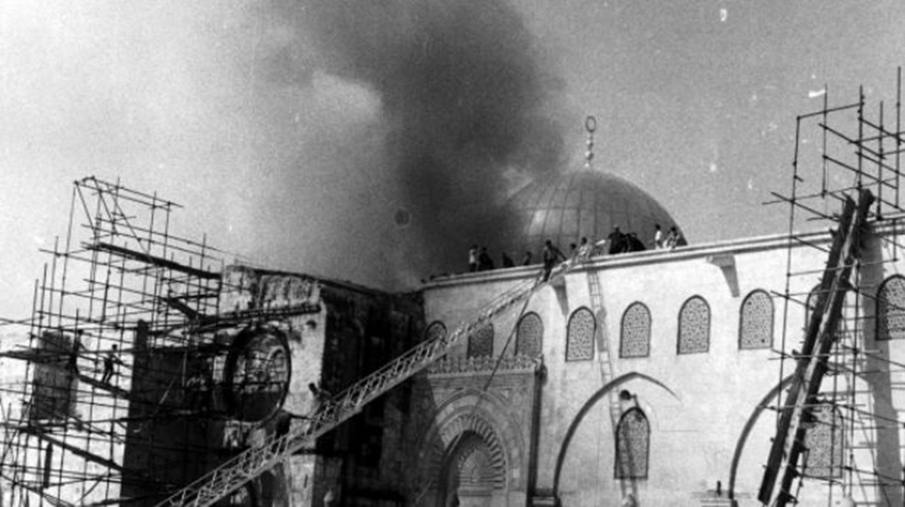
Al Aqsa on fire, 1969

Slide 4
Purpose of OIC
Enhance and consolidate the bonds of fraternity and solidarity among the Member States;
Safeguard and protect the common interests of the Member States
Respect the right of self-determination and non-interference in the domestic affairs and to respect sovereignty, independence and territorial integrity of each Member State
Strengthen intra-Islamic economic and trade cooperation; in order to achieve economic integration leading to the establishment of an Islamic Common Market
Exert efforts to achieve sustainable and comprehensive human development and economic well-being in Member States;
Protect and defend the true image of Islam, to combat defamation of Islam and encourage dialogue among civilizations and religions;
Enhance and develop science and technology and encourage research and cooperation among Member States in these fields

Slide 5
Main Bodies of OIC
The Islamic Summit: composed of Kings and Heads of State and Government of Member States, is the supreme authority of the Organization.
It convenes once every three years to deliberate, take policy decisions and provide guidance on all issues faced by Ummah.
The Council of Foreign Ministers: meets once a year,
Adopting decisions and resolutions on matters of common interest in the implementation of the objectives
Reviewing progress of the implementation of the decisions and resolutions adopted at the various level
The General Secretariat: the executive organ of the Organization, entrusted with the implementation of the decisions of the two preceding bodies.

Slide 6
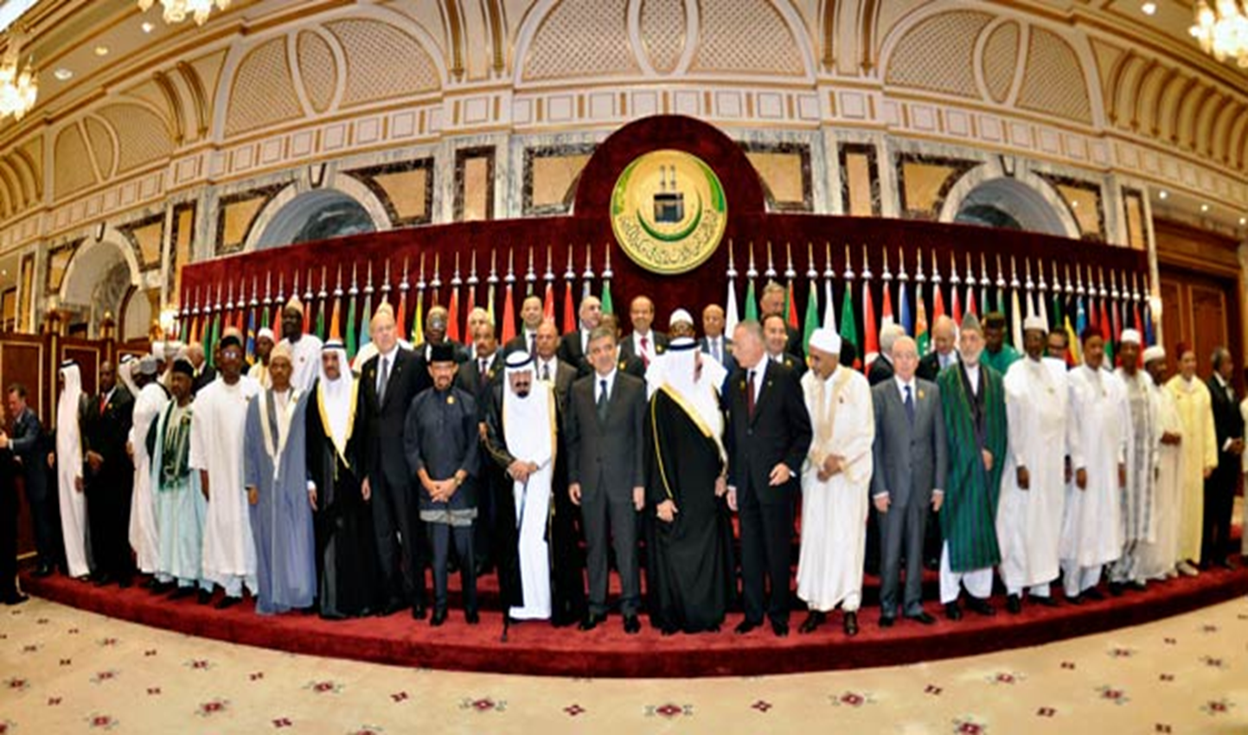
OIC summit in Mecca

Slide 7
Achievements of OIC
Conflict resolution through preventive diplomacy and mediation in Muslim countries such as Iraq, Somalia, Afghanistan, Palestine etc.
Iraq: holding successfully the meeting of Iraqi Sunni and Shiite religious leaders and the signing of the Makkah Document on Iraq to stop shedding blood and paved the way for national reconciliation.
Terrorism: stresses on promoting moderation and modernization for creating environment of peace and tolerance. It condemns terrorism in all its forms.
Solved conflict between Jordan and Palestine Liberation Organization.
extended its activities from merely holding conferences to covering international trade, business, economy, culture, civilization, education, commerce and humanitarian activities in member and non member countries

Slide 8
OIC failure
OIC failed to solve Palestine problem and innocent killing by Israeli force in Gaza
Kashmir problem is unresolved and killing of thousands of Kashmiri people and human rights violation is un-noticed
Similarly Afghan war, Gulf war and it being silent spectator
OIC has achieved nothing to tackle or stop the increasing sectarian violence across the Muslim world
The trade and economic cooperation among Muslim counties is very less. Most of them have trade with West and their accounts in the Western banks
Furthermore, there are disputes between OIC member states, including border demarcation and political systems
Still needs a long way to go for becoming an effective Muslim countries representative body

Slide 9
DISARMAMENT AND ARMS CONTROL
Dr. Fayyaz Ahmad Faize

Slide 10
DISARMAMENT AND ARMS CONTROL
Arms Control definition and concept
Armaments and its effects
Difference between arms control and disarmament
Need for Disarmament
Disarmament Efforts
Conclusion

Slide 11
Arms Control Concept
We don’t rule atoms- rather these atoms rule us
Arms control does not mean reducing arms and weapons or forces
simply an agreement made between adversaries to limit the weapons that might be used in warfare between them.
It is a cooperative and multilateral approach to armament policy instead of a blind race through mutual consensus

Slide 12
Arms Control
Jaffrey Larsen: “any agreement among states to regulate some aspect of their military capability or potential. The agreement may apply to the location, amount, readiness, and types of military forces, weapons and facilities”
Hedley Bull: ‘Arms control is restraint internationally exercised upon armaments policy, whether in respect of the level of armaments, their character, deployment or use’
Arms Control can be formal which will involve treaties and other binding arrangements between states
Or it can be informal in which a state may control arms herself according to her set priorities
These processes or steps can be unilateral, bilateral or multilateral; the most essential element is a willingness to cooperate with other states to achieve security interests.

Slide 13
Arms Control cont.
Arms control can be applied to both weapons of mass destruction (WMDs) and to conventional weapons, although it has been applied most heavily to WMDs.
These are nuclear, radiological, chemical and biological weapons, and are categorized as WMDs because of their enormous potential for causing mass casualties
Conventional weapons are not much covered because of the implied right of sovereign states to possess them for national security and defence
Arms control contributes to a more stable and calculable balance of power

Slide 14
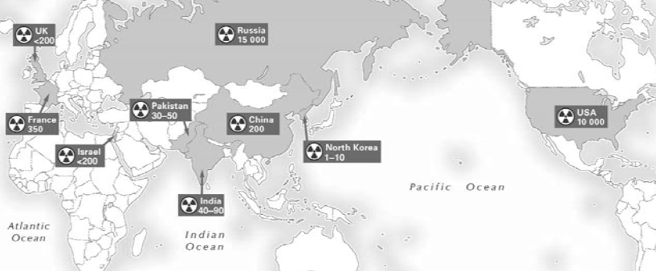
Suspected Nuclear Weapons in the World

Slide 15
Armaments vs Disarmament
Armament is acquiring arms, increasing armed forces, their military bases and spending
Prevalent since ancient times, states acquire arms and weapons
Armaments was done mostly during crises and tension
Mostly struggled for quantity of arms at that time
With development of science and technology, quality becomes more important
European states fell in a made race for arms due to rivalry between France, England, Germany. Russia etc.
Military spending was increased and weapons become more sophisticated and perfected-
military alliances and counter alliances were formed

Slide 16
Armaments cont.
This created suspicion and fear and thus resulted in wars
However, armaments continue after WWII due to cold war between US and SU
New military alliances and blocks were formed- NATO vs WARSAW
Strategic and more sophisticated weapons invented e.g. spy satellites, ballistic missiles, nuclear bomb, hydrogen bomb, inter-continental ballistic missiles, fighter planes with precise targets,

Slide 17
Effects of Armaments
Wastage of resources on arms. Lots of money was spend on arms manufacturing and imports. Besides, money was stopped from being spent on industry and trade and thus resulted in inflation and economic crises.
Less funds for humanitarian purpose and developmental activities
Hindrance to national development and threat to democratic process
Suspicion, fear and distrust and threat of war (armaments produces fear and fear produces more armaments – Baker). Affects positive relations and cooperation between states
And possibility and danger of a more terrible world war
So there was a need for disarmaments

Slide 18
Why Disarmament?
Armament instill fear and distrust in neighboring states for their security thinking that the other state is undertaking military preparedness and possibly attack.
US report (1951): ‘Our arms create fear in Russia; Russia arms create fear in us. By seeking to deter Russians by military might, we are inevitably forced to plunge the world into an arms race and arms race is not conducive to security’
If Armaments leads to war, then it means disarmaments would lead to peace (Palmer and Perkins)
However, through mutual agreement to limit arms or disarmament can open up communication between states,
lead to greater transparency
better understanding of a state’s intentions.

Slide 19
Summary
OIC
Arms Control definition and concept
Armaments and its effects

