Slide 1
Review of Previous Lecture- Cold War & NATO
Effects of Cold War: US direct involvement, armaments and nuclear proliferation, social sectors and political institutions, alliances and counter alliances, Non-Aligned Movement, UN ineffective, disintegration of SU, independence of newly independent countries, Unipolar world
NATO Origination and Purpose (POLITICAL & MILITARY)
NATO and the Cold War:
NATO Operations After Cold War: Turkey, Bosnia, terrorism, Libya

Slide 2
Conflicts & Role of Regional and International Pacts cont.
Dr. Fayyaz Ahmad Faize

Slide 3
The Warsaw Treaty Organization, 1955
The Warsaw Treaty Organization (also known as the Warsaw Pact) was a political and military alliance established on May 14, 1955 between the Soviet Union and several Eastern European countries.
The Soviet Union formed this alliance as a counterbalance to the NATO
Following World War II, the Soviet Union concluded bilateral treaties with each of the East European states except for East Germany, which was still part of the Soviet occupied-territory of Germany.

Slide 4

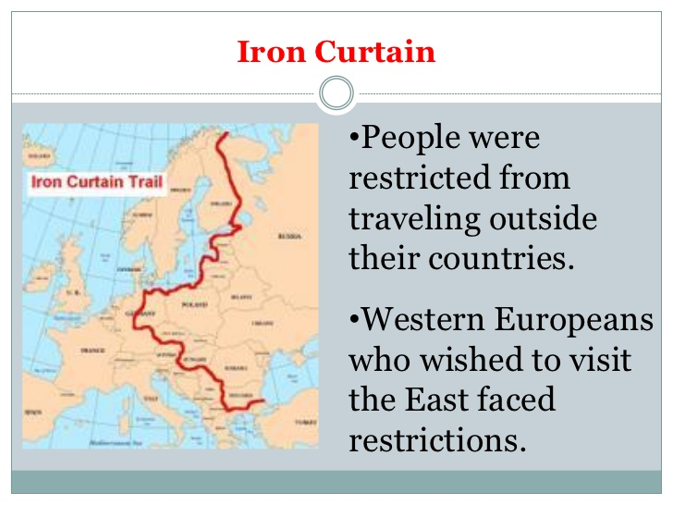

Slide 5
The WARSAW PACT
When the Federal Republic of Germany entered NATO in early May 1955 and was allowed to remilitarized, the Soviets feared the consequences of a strengthened NATO and a rearmed West Germany
SU hoped that the Warsaw Pact would contain West Germany and negotiate with NATO as an equal partner.
Also civil unrest was on the rise in Eastern European countries and SU determined that a unified, multilateral political and military alliance would tie Eastern European capitals more closely to Moscow to control them
headquarters in Warsaw, Poland.
Furthermore, the Supreme Commander of the Unified Armed Forces of the Warsaw Treaty Organization was under USSR control

Slide 6
WARSAW Members
The original signatories to the Warsaw Treaty Organization were:
the Soviet Union, Albania, Poland, Czechoslovakia, Hungary, Bulgaria, Romania, and the German Democratic Republic.
members of the Warsaw Pact pledged to defend each other if one or more of them came under attack,
And emphasized non-interference in the internal affairs of its members, and supposedly organized itself around collective decision-making, the Soviet Union ultimately controlled most of the Pact’s decisions.

Slide 7
Problems in WARSAW Pact
By the 1980s, the Warsaw Treaty Organization was beset by problems related to the economic slowdown in all Eastern European countries.
By the late 1980s political changes in most of the member states made the Pact virtually ineffectual.
In late 1989, civil and political discontent forced the Communist governments from power
Eventually, the populaces of Hungary, Czechoslovakia, Albania, East Germany, Poland, Romania, and Bulgaria deposed their Communist governments in the period from 1989–91 and SU growing economic backwardness due to defence liabilities
In September 1990, East Germany left the Pact and reunified with West Germany.
By October, Czechoslovakia, Hungary, and Poland also withdrew
The Warsaw Pact officially disbanded in March and July of 1991 following the dissolution of the Soviet Union.

Slide 8
The South East Asia Treaty Organization (SEATO)
an international organization for collective defense in Southeast Asia created by the Manila Pact and signed in September 1954 in Philippines.
The formal institution of SEATO was established in 1955 in Bangkok, Thailand. The organization's headquarter was also in Bangkok.
Eight members joined the organization.
They were: Australia, France, New Zealand, Pakistan (including East Pakistan, now Bangladesh), the Philippines, Thailand, the United Kingdom, and the United States.
Most are not south east Asian countries
Primarily created to block further communist gains in Southeast Asia.

Slide 9
SEATO cont.
SEATO is generally considered a failure because internal conflict and dispute hindered general use of the military force
However, SEATO-funded cultural, educational programs and labor activities left long-standing effects in Southeast Asia and were successful.
In 1959, SEATO's first Secretary General, Pote Sarasin, created the SEATO Graduate School of Engineering (currently the Asian Institute of Technology) in Thailand to train engineers.
SEATO was intended to be a Southeast Asian version of the North Atlantic Treaty Organization (NATO), in which the military forces of each member would be coordinated to provide for the collective defense of the members' country
But was not as effective as NATO

Slide 10
SEATO cont.
By joining SEATO, Pakistan agreed to US demands to fight communism as part of the Cold War.
In fact, Pakistan was obligated to fight communism, while it received no guarantee of collective action against attack by foreign aggression, and no promises of security from India’s hostile attitude.
Pakistan came in for bitter criticism from India when she joined these purely defensive alliances. India charged that by so doing “Pakistan had brought the cold war to the subcontinent”.

Slide 11
SEATO cont.
After its creation, SEATO quickly became insignificant militarily, as most of its member nations contributed very little to the alliance and was dominated by western states.
While SEATO military forces held joint military training, they were never employed because of internal disagreements.
Pakistan did not receive any aid from SEATO in 1965 and 1971 war with India (as SEATO members declared assistance only against communism)
Pakistan withdrew in 1972 after Bangladesh was founded as a protest.
France withdrew financial support for SEATO in 1975
SEATO was dissolved on 30 June 1977 after many members lost interest and withdrew

Slide 12
The Central Treaty Organization (CENTO) or the Baghdad Pact
formed in 1955 by Iran, Iraq, Pakistan, Turkey, and the United Kingdom.
In 1958, the United States joined the military committee of the alliance.
One of the least successful of the Cold War alliances.
CENTO committed the nations to mutual cooperation and protection, as well as non-intervention in each other's affairs.
Its goal was to protect against SU communist threat.
Unlike NATO, CENTO did not have a unified military command structure, nor were many U.S. or UK military bases established in member countries.
The Middle East and South Asia became extremely volatile areas during the 1960s with the ongoing Arab-Israeli Conflict and the Indo-Pakistani Wars.

Slide 13
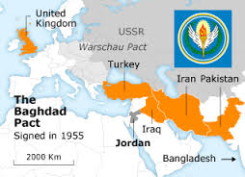

Slide 14
CENTO
CENTO was unwilling to get deeply involved in either dispute. In 1965 and 1971, Pakistan tried unsuccessfully to get assistance in its wars with India through CENTO, but this was rejected under the idea that CENTO was aimed at containing the USSR, not India.
After Iraq revolution in 1958, it left the treaty
The Baghdad Pact original name was Middle East Treaty Organization (METO) replaced by the name of Central Treaty Organization (CENTO) after the withdrawal of Iraq.
CENTO moved its headquarter to Turkey (Ankara) in 1958.

Slide 15
CENTO cont.
The Soviet Union charged that by joining the Baghdad Pact, Pakistan had become a member of "an aggressive Western alliance," and it responded by radically altering its stand on Kashmir, as it now agreed with India that Kashmir belonged to them.
Near the end, it had become clear to CENTO members that the organization was better for economic and technical cooperation than it was a military alliance.
Pakistan withdrew in 1979 after determining the organization no longer had a role to play in ensuring its security esp. against India
With the fall of the Iranian monarchy and Pakistan withdrawal in 1979, CENTO was finally dissolved in l979.

Slide 16
Summary
The Warsaw Treaty Organization,
Problems in WARSAW Pact and End
SEATO
CENTO

