Slide 1
Review of Previous Lecture- UN
United Nations Organization (UNO)
Why UNO
Structure and Functions: The General Assembly, The Security Council, The Economic and Social Council, The Trusteeship Council, The International Court of Justice, The Secretariat

Slide 2
Conflict and Change in the Post-War World cont.
Dr. Fayyaz Ahmad Faize

Slide 3
The Secretariat
The principal administrative department of the UN
It is headed by the Secretary-General appointed by the General Assembly on the recommendation of the Security Council for a term of five years. He can be re-­elected.
The staff of the Secretariat is appointed by him chosen from among the 192 member countries.
He organizes conferences, oversees peace­keeping operations, drafts reports on economic and social trends, prepares studies on human rights, mediates in international disputes and prepares budget estimates.
All member countries must abide by the policies and programmes of the United Nations, if the latter is to succeed

Slide 4
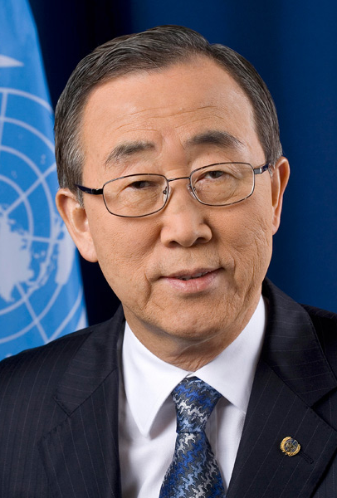
UN Secretaries-General since 1945
Trygve Lie (1945–1953), Norway
Dag Hammarskjo¨ ld (1953–1961), Sweden
U Thant (1961–1971), Myanmar/Burma
Kurt Waldheim (1972–1981), Austria
Javier P´ erez de Cu´ ellar (1982–1991), Peru
Boutros Boutros-Ghali (1992–1996), Egypt
Kofi Annan (1997–2006), Ghana
Ban Ki-Moon (from January 2007), ROK.

Slide 5
Achievements of the United Nations
Peace keeping
The First and foremost it has prevented the occurrence of any further world wars since its creation and tried to maintain peace.
Through it Peace keeping operations, it has resolved many international disputes and stopped wars.
Since 1945, the UN has been credited with negotiating 172 peaceful settlements that have ended regional conflicts.
Currently, the UN has 16 active peacekeeping missions in hotspot like Syria, Kosovo, North Korea

Slide 6
Achievements of the United Nations
2. Strengthening NSS:
It helped in ending colonialism and imperialism and apartheid in South Africa. The colonies were developed to get independence and this strengthened the nation state system
3. Disarmament
A Significant role in disarming the world and stopping the growth of nuclear weapons.
'Partial Test Ban Treaty' and 'Nuclear non-proliferation treaty' and Comprehensive Test Ban Treaty have been signed under UN by many member countries.

Slide 7
Achievements of the United Nations
4. Human Rights
UN Acted as vanguard for the protection of human rights of the people of the world. Passed Universal Declaration of Human Rights, 1948.
Pass various conventions and declarations on child labour and protection, women rights, wild life, climate, etc,
“UNICEF” protects the rights of children and to enhance the living standards of children
headquarters is based in New York.
the number of deaths for children under the age of 5 has declined from nearly 12 million in 1990 to 6.9 million in 2011.

Slide 8
Achievements of the United Nations
5. Food Aid
The World Food Program is known as one of the most successful programs UN has ever ratified because of its enormous impacts on global community. Every year, the UN feeds 104 million people in 80 poor countries with famine and draught situation.
UN through its agencies, provide food to people in war zones, to refugees, to people hit by natural disasters such as flood, earth quake, IDPs etc.

Slide 9
Achievements of the United Nations
6. Aid to refugees
UN High Commissioner on Refugees (UNHCR) is another success of the United Nations.
has helped 17 million asylum-seekers and refugees such as Afghan refugees, IDPs in Pakistan
Two Nobel Peace Prizes in 1954 and 1981 are given to UNHCR.
UNHCR is facing a problematic financial issue, trying to protect and assist 700,000 people who migrated due to conflict in Syria, Mali, Sudan and the Democratic Republic of Congo (DRC).
It is truly the hope of millions of refugees all over the world.

Slide 10
Achievements of the United Nations
7. Health
Provides vaccination to member countries for various children and infectious diseases
Fights against deadly diseases such as cancer, AIDS, hepatitis etc.
According to the most recent report, the number of people who died from AIDS has decreased from 2.3 million in 2005 to 1.6 million in 2012.

Slide 11
Achievements of the United Nations
8. Monitoring Elections
The UN has fought continuously for the voting right of people in areas where the ideology of dictatorship or monarchy is still dominating.
conducted free election in Iraq and formed a government there
Also monitor election and voting process through its observers to ensure that free and fair elections are held in a country

Slide 12
Failures of the United Nations
UN still could not solve the Kashmir problem which was brought in its notice since 1948 and still the Kashmiri are struggling for their freedom.
Israel has been taking aggressive action in middle east since many decades and is involved in extreme kind of human rights violation and killings in Gaza but UN failed to stop it due to US veto power
No emphatic role in worst crisis like the Cuban Missile Crisis, Vietnam crisis in which US was involved and may have resulted in a large scale war.
The UN became a silent spectator during the cold war. The violation of human rights by communist in Russia and silencing the opponents by force could not be stopped by UN
UN was nowhere in the picture when the NATO rained bombs over former Yugoslavia after USSR disintegration.

Slide 13
Failures of the United Nations
Uni-polarity and unilateralism has shaken the relevance of the world body. The US now being the only super power is dominating world politics and influence its working. E.g. Unilateral action in Iraq
Failed to generate a universal consensus to protect the deteriorating world climate
Number of nuclear powers in the world increased after WWII. UN Could not control the horizontal expansion and proliferation of weapons and arms. Nuclear weapons states include US, UK, France, Russia, China, Pakistan, India, North Korea, Israel

Slide 14
Failures of the United Nations
Financial dependence on the industrialized nations has at times deviated UN from neutrality and impartiality.
Human rights violation and insecure law and order situation in Iraq and many regions of Afghanistan, despite on active UN. These regions are now marked by suicide bombing, armed conflicts, civilian killing, kidnapping etc.
The UN failed to prevent the genocide of Bosnian Muslim by the Serbs in 1990’s. The Serbs freely killed thousands of Muslims while the UN could not take any effective action. Many Bosnian became refugees and took shelter in different countries.

Slide 15
Conclusion
UN has failures and achievements
However, the achievements are more - Peace, solving inter-state disputes, lessening of tension, reforms and improvement for education, health, child abuse, human rights, women rights, labour laws, refugees care, protection of wildlife, efforts for environment protection, nuclear non-proliferation, economic assistance and trade agreements, ethic education, etc.
Still some more to be done
Finding new ways of financing its activities and not to rely on some few
Exploring new methods of seeking real cooperation from member countries
Deliberations in doing away with veto power and arriving at some better options

Slide 16
Summary
United Nations Organization (UNO)
Why UNO
Structure and Functions: The General Assembly, The Security Council, The Economic and Social Council, The Trusteeship Council, The International Court of Justice, The Secretariat.
Achievements: Peace keeping, Strengthening NSS, Disarmament, Human Rights, Food Aid, Aid to refugees, Health, Monitoring Elections
Failure: Kashmir problem, Israel aggression, Cuban Missile Crisis, dominated and influenced by US, lack of neutrality and impartiality, deteriorating world climate, proliferation of nuclear weapons, Genocides

Slide 17
Review Questions
Q1. What was the purpose of establishing League of Nations?
Q2. Discuss the structure and functions of the important organs of League of Nations?
Q3. Highlight some of the achievements and failures of League of Nations.
Q4. What was the purpose of establishing United Nations?
Q5. Discuss the structure and functions of the important organs of United Nations?
Q6. Highlight some of the achievements and failures of United Nations.

