Slide 1
Review of Previous Lecture- LON
League of Nation (LON)
Why LON
Structure and Functions: The General Assembly, The Secretariat, The Council, The Permanent Court of International Justice
Achievements: combatting opium trade, preventing sexual slavery, Nansen passport for refugees, border disputes Sweden and Finland over the Aaland, Mosul for Iraq, struggle against leprosy and malaria, Most of its bodies adopted by UN
Failure: outbreak of World War II, lacked an armed force, Economic sanctions not productive, appeasement policy, United States never joined, Japan left (1933), Italy (1937), Germany (1933), Soviet Union (1939), powerless when powerful nations were involved, failed for 48 hours labor work, disarmament

Slide 2
Conflict and Change in the Post-War World cont.
Dr. Fayyaz Ahmad Faize

Slide 3
Origin of UNO
August 1941, the U.S. President, Franklin Roosevelt, and the British Prime Minister, Winston Churchill, met on a battleship, ‘the Cruiser’, in the mid-Altantic and drew up the Atlantic Charter which was released on 14 August, 1941
The Atlantic Charter stated no territorial aggrandizement; no territorial changes made against the wishes of the people; restoration of self-government, global cooperation to secure better economic and social conditions for all; freedom from fear and want; freedom of the seas as well as disarmament
The name “United Nations” was devised by United States President Franklin D. Roosevelt
The United Nations Charter was drawn up by the representatives of 50 countries at the United Nations Conference on International Organization, which met in San Francisco from 25 April to 26 June 1945.

Slide 4
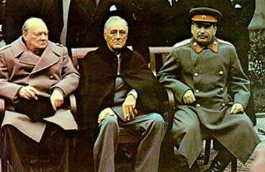
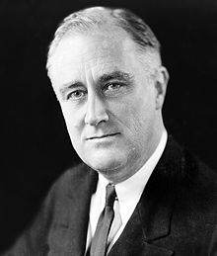
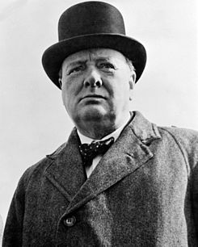
Churchill, Roosevelt and Stalin
Yalta Conference, 1945

Slide 5
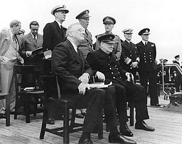
Roosevelt and Churchill aboard ship

Slide 6
Origin of UNO
The Charter was signed on 26 June 1945 by the representatives of the 50 countries.
The United Nations officially came into existence on 24 October 1945, when the Charter had been ratified by
China, France, the Soviet Union, the United Kingdom, the United States, and a majority of other signatories.
United Nations Day is celebrated on 24 October each year

Slide 7
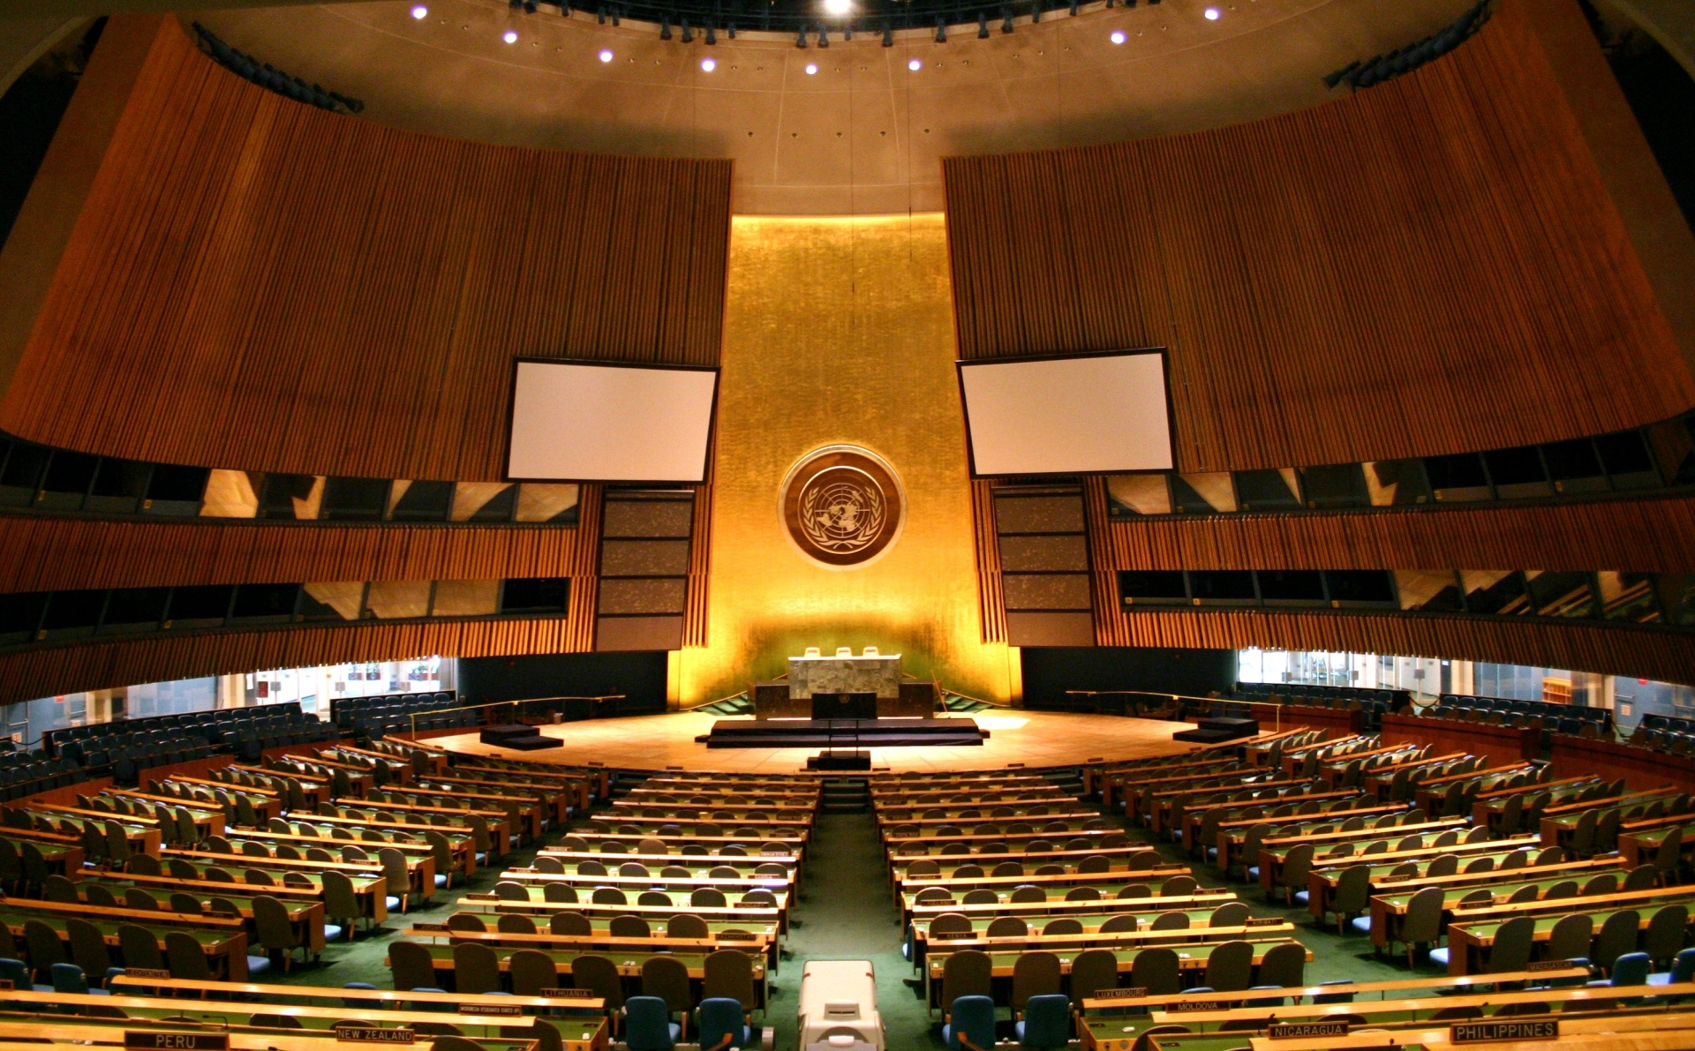
UNO

Slide 8
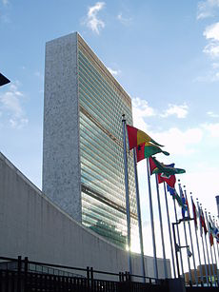
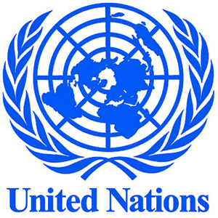
UNO Building And Logo

Slide 9
Purpose of the United Nations:
To save succeeding generations from the scourge of war.
To maintain international peace and security.
To develop friendly relations among nations on the basis of equality
To foster international cooperation in solving economic, social, cultural and humanitarian problems.
To promote human rights and fundamental freedom for the people of the world.
To serve as a centre where various nations can coordinate their activities towards the attainment of the objectives of the United Nations.

Slide 10
The organs of the United Nations:
The UN has six principal organs to carry out its functions:
1. The General Assembly,
2. The Security Council,
3. The Economic and Social Council,
4. The Trusteeship Council,
5. The International Court of Justice
6. The Secretariat.

Slide 11
The General Assembly:
the largest organ of the UN.
All members of the UN are members of the General Assembly
Each state can send up to five representatives but is entitled to one vote
all the member states have equal status.
The General Assembly meets once a year for three months.
But special sessions may be held during times of crisis.
At the beginning of every session, the Assembly elects a new President.

Slide 12
Functions of the General Assembly
1. can discuss any matter affecting international peace and security.
2. makes recommendations for peaceful settlements of disputes.
3. passes the budget of the UN.
4. elects the non-permanent members of the Security Council.
5. also elects the members of the Economic and Social Council and the Trusteeship Council.
6. admits new members to the UN on the recommendation of the Security Council.
7. The Security Council and the General Assembly elect the members of the International Court of Justice.

Slide 13
Functions of the General Assembly
8. the General Assembly increased its power through a recent resolution called Uniting for Peace Resolution. Now it can make recommendations for “collective measures, including the use of armed forces”, in case the Security Council is unable to take a decision during a crisis.
9. Decisions are taken by a simple majority vote. In some important cases a two-thirds majority vote is required for taking a decision if it decides that the matter is of importance.

Slide 14
The Security Council:
the most important and effective organ of the UN.
It is the executive wing of the UN.
The Security Council consists of 15 members.
Five of them are permanent members, namely Britain, China, France, Russia and the USA.
The ten non-permanent members are elected by the General Assembly for a term of two years.
Each member has one vote. Decisions are taken by a majority vote of at least nine members including the five permanent members.

Slide 15
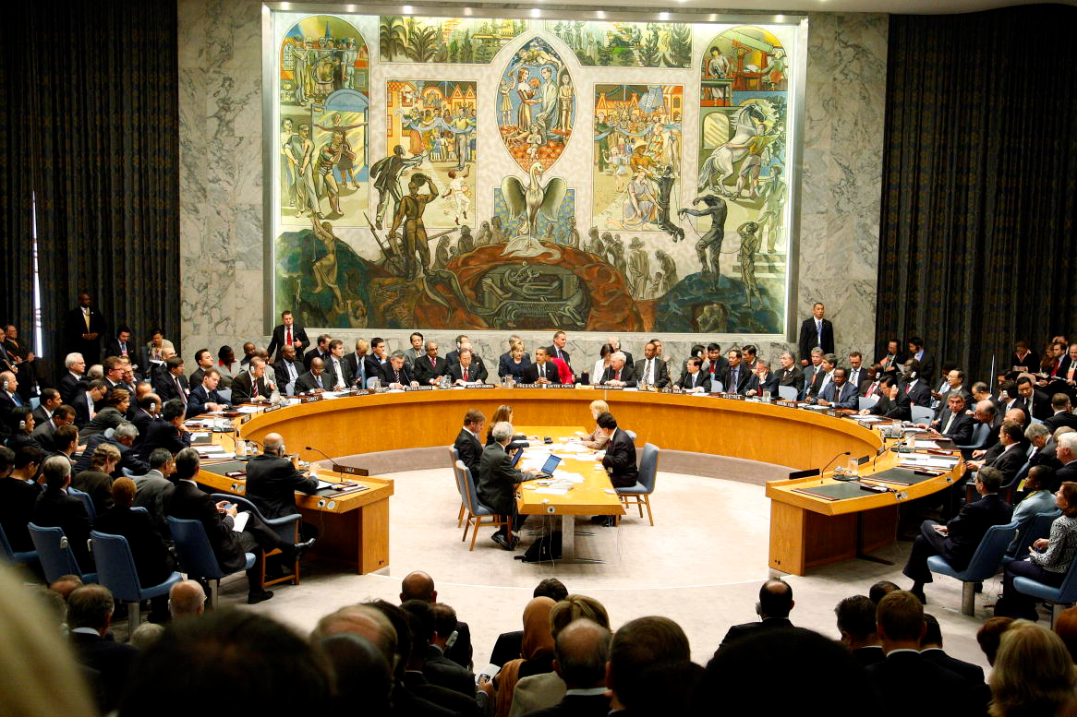
Security Council

Slide 16
The Security Council:
Each permanent member has the power to reject or veto a decision. This means a negative vote by any one of the permanent members would lead to a cancellation of the resolution.
The Council is powerless to act if there is such a veto by any permanent member although it may be supported by all other permanent members.
The Security Council has the basic responsibility of maintaining peace and security in the world. The Security Council meets once a month but in the event of an emergency, a meeting may be held whenever required.

Slide 17
Functions of the Security Council
1. To maintain international peace and security in the world.
2. To investigate international disputes and recommend appropriate methods of settling them.
3. To call on member states to apply economic sanctions against the aggressor and thus to put pressure on the guilty state to stop aggression.
4. The Security Council may take military action against the aggressor, if required.

Slide 18
The International Court of Justice
The International Court of Justice, located in The Hague, Netherlands, is the principal judicial organ of the United Nations.
The Court consists of 15 Judges from different countries elected by the General Assembly and the Security Council. They are elected for a nine-year term.
For purposes of ensuring continuity, five judges are elected every three years
No two judges can be citizens of the same country.
The Security Council’s are not allowed to use their veto during the election of judges.
Functions of the International Court of Justice
(1) To settle disputes brought to it by member nations.
(2) To provide legal advice to any organ of the UN on request.

Slide 19
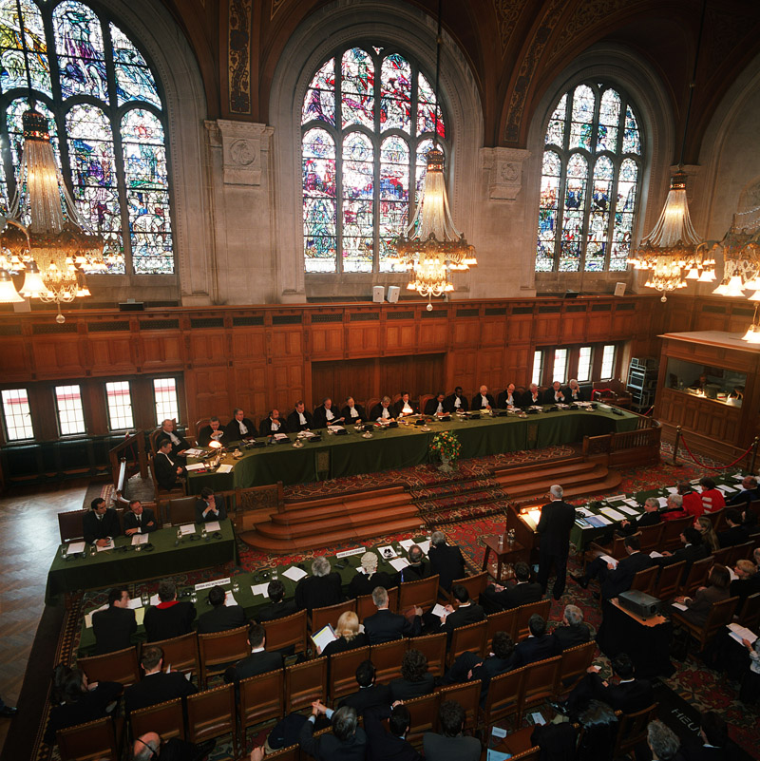
ICJ

Slide 20
The Trusteeship Council:
The Trusteeship Council was set up immediately after the Second World War.
It was set up to ensure the proper administration and development of those areas of the world that were under foreign rule.
The Council was also to take steps to help them attain self- government or independence
Trusteeship territories: Nauru, New Guinea, Ruanda, Urundi, Togoland and Cameroon (French administered), Togoland and Cameroon (British administered), the Pacific Islands, Western Samoa, South West Africa, Tanganyika, and Palestine.
The Trusteeship Council suspended operation on 1 November 1994, with the independence of Palau, the last remaining United Nations trust territory

Slide 21
The Economic and Social Council
The Economic and Social Council consists of 54 members elected by the General Assembly for a three-year term.
The ECOSOC discusses major economic and social issues. It is mainly concerned with the management of the UN’s social, economic, cultural and humanitarian activities.
Its main functions are as follows:
1. To promote economic and social progress.
2. To solve problems relating to health, illiteracy, unemployment etc
3. To coordinate the functions of the agencies of the UN like the International Monetary Fund (IMF), the International Labour Organization (ILO), the Food and Agricultural Organization (FAO), the World Health Organization (WHO), the United Nations Educational Scientific and Cultural Organization (UNESCO), the United Nations International Children’s Fund (UNICEF), etc.

Slide 22
Summary
United Nations Organization (UNO)
Why UNO
Structure and Functions: The General Assembly, The Security Council, The Economic and Social Council, The Trusteeship Council, The International Court of Justice,

