Slide 1
Review of Previous Lecture: International Law
Definition and Concept
Need of International Law: peaceful relations, preventing use of force, solution to problems, protects rights, natural resources, trade or business, regulates the conduct of states, diplomacy
Sources of International Law
Treaty , Custom, Judicial Decisions, Writings of scholars/ jurists/ commentators, Resolutions of international Organizations/ Institutions

Slide 2
INTRODUCTION TO INTERNATIONAL LAW cont.
Dr. Fayyaz Ahmad Faize

Slide 3
International Court of Justice
A branch of the UN- meets in The Hague (Netherlands)
15 judges with No two may be nationals of the same country.
  serving nine-year terms
  five judges elected every three years, in order to ensure continuity within the court.
  selected by UN
Hears cases brought by states against other states Example: border disputes (Honduras vs. El Salvador), Canal Water Dispute b/w Pakistan and India

Slide 4
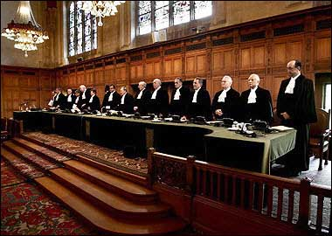
Judges of ICJ

Slide 5
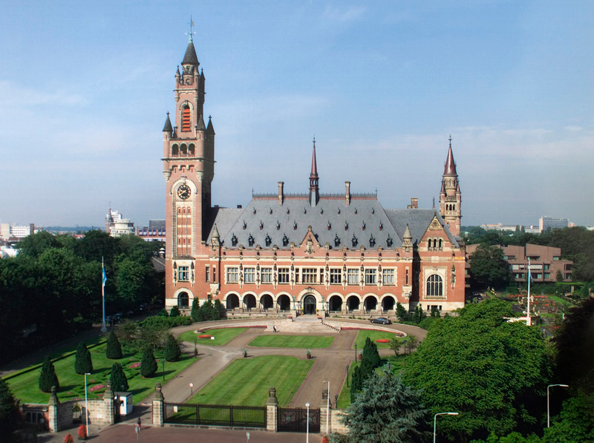

Slide 6
Is International Law a Law?
What is a law?
Austin: A rule of conduct imposed and enforced by sovereign in the form a command which obliges the subject to a course of conduct
There are two diverse views:
(i) Positive school.
(ii) Historical school.
I. Positive school:
Supported by John Austin and Holland:
Austin: International law is not a law but rules of morality governing international relation between states.

Slide 7
Is International Law a Law? Cont.
International is not made by any formal legislature
It is poorly developed and the process of its making is highly decentralized i.e. some time made through treaties, international organizations, customs etc. and thus may not be appealing to other states with diverse socio-cultural and economic institutions
It lacks a formal agency to execute it. There is no police force.
There is no sovereign that executes the law through his authority. The reason here is that the parties are sovereign states.
The rules are vague and uncertain in international law and with limited scope. Most of them are coming from treaties with less appeal for others.

Slide 8
Is International Law a Law? Cont.
It has limited jurisdiction. The international disputes are referred to national courts and International Court of Justice (ICJ). However, ICJ has an advisory jurisdiction. Moreover, ICJ can take a case only if both the parties agree for the case to be put before ICJ for resolving.
It has only moral obligation and its violation does not invite any punishment.
In the light of discussion, one can say that international law is not a law.

Slide 9
Is International Law a Law? Cont.
Historical school:
led by Oppenheim, Starke, Lawrence, Hall
law in true sense because observance and not enforcement is essential element of law.
It’s a law though it is violated some time but even national laws is violated by criminals. Violation does not mean that it is not a law.
The question is that if an enforcing agency is not present, will the law can not be called a law? Students playing football in a ground before teacher observe rules. What if the teacher is not present?
The states observe it because it serves their purpose and is necessary for proper conduct in the international affairs

Slide 10
Is International Law a Law? Cont.
It is accepted by states as existing and binding for proper conduct in international affairs. Many states have embodied it either in their constitution as binding e.g. India, US or through their government commitment as signatory on various treaties and resolutions,
  It is also accepted by ICJ and UN as well. UN Charter of 1945 authorized the UN Security Council to use force in order to maintain peace and security and compliance with rules of international law-
  Enforced by ICJ, UN can also ask for blockades, diplomatic sanctions, Court of Public Opinion through condemnation/shame and media talks etc.
  And it works most of the time

Slide 11
Conclusion
It is a law which is still under the process of development
It is becoming more exact with the passage of time and as it is more codified
There are sanctions behind international law though they are different such as international media, world public opinion, the aggrieved state may go for diplomatic protest, economic sanctions, boycott and according to Kleffens, more important is the feeling in our heart and conscience to follow it.
The decision of ICJ is binding upon the states.
However, it is a weaker law because it is between states and not above states (Oppenheim)

Slide 12
Role of International Law
Helpful in regulating peaceful relations among nation states. The states know what is expected behaviour from them and try to follow those rules and regulations. Thus, unpleasant and confrontational situation is avoided in the presence of international law.
Helps in resolving problems confronted on the international level between states. In the absence, the states might have come across war like situation. In case a problem arises, both the states tries to solve problem keeping in mind the international accepted norms and principles. The two parties can also consult the international court of justice to decide the case between them. In case a state loses, no embarrassing arise as it can take it as a court decision to follow and not its weakness to give up its stand.

Slide 13
Role of International Law cont.
3. It helps the member states resolve their issues by themselves. The states know about international law and the conventions and resolution passed by various international bodies. The inter-state disputes can be amicably resolved such as inter-state boundary disputes, natural flow of water between states, movement across borders, air flights, navigation in high seas etc.
4. International law has greatly helped in specifying rules for diplomacy which is a very important instrument for keeping international relations between states. It underlined the guiding principles and rules for diplomatic mission, working of diplomatic offices, conduct of diplomatic staff, privileges and immunities etc.

Slide 14
Role of International Law cont.
5. International isolation is not possible today. The states are inter-dependent on one another for meeting various needs and human requirement. International law has a vital role in regulating the inter-state trade and business activities. This include the bilateral and multilateral trade agreements, principles of providing financial assistance to a state, international market policies etc.
6. International law has a key role in protection and promotion of social and political institutions. It has protected the rights of individuals against other states and organizations. It has codified and set rules and standards for advancing human rights, women rights, labor rights, child protection, child labor, animals rights etc. Most of these rights are given legal status by the member countries through their legislature acts and bills.

Slide 15
Summary
Definition and Concept
Need of International Law: peaceful relations, preventing use of force, solution to problems, protects rights, natural resources, trade or business, regulates the conduct of states, diplomacy
Sources of International Law
Treaty , Custom, Judicial Decisions, Writings of scholars/ jurists/ commentators, Resolutions of international Organizations/ Institutions
Is International Law really a Law? (not made by formal legislature, lacks an executing agency, no sovereign, limited jurisdiction, no punishment on violation)
Role of International Law: peaceful relations, preventing use of force, solution to problems, protects rights, natural resources, trade or business, regulates the conduct of states, diplomacy

Slide 16
Review Questions
Q. Define International law:
Q. Why International law is needed when national law exists?
Q, Discuss important sources of International Law.
Q. Discuss whether International law is really a law or not?
Q. Describe the role of international law in the present world.

