Slide 1
Review of Previous Lecture- Diplomacy
Usage of the term
Concept and Definition
Functions of Diplomats: Representation, Negotiation, Reporting, Protection of national interests and citizens
Types of Diplomacy
Features of Traditional Diplomacy: Europe centered, ignore weak states, more power, secret
Features of New Diplomacy: Greater Openness, Multilateral Diplomacy, Personal or Summit Diplomacy

Slide 2
Diplomacy cont.
Dr. Fayyaz Ahmad Faize

Slide 3
Summit Diplomacy cont.
Advantage of Summit Diplomacy
Dramatic breakthroughs or major decisions can be taken by the leaders (more freedom to make decision)
It may saves time than normal channel of diplomacy
Mutual confidences/friendships may develop among leaders and lessening of tension e.g. PM of India and Pakistan and exchange of gifts for families

Slide 4
Drawback of Summit Diplomacy
If the talks between diplomats fail, people would not care much. However, situation is more embarrassing if summit diplomacy fails- creates frustration among people.
The real function of heads is to formulate policies and not to negotiate which is the domain of diplomats.
Also, the heads are not technical and professional and thus may not successfully negotiate as compared to diplomats who are specialist and professional trained for the purpose.

Slide 5
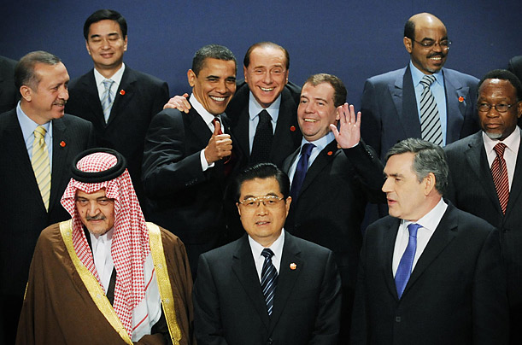
Summit Diplomacy cont.
Summit diplomacy shall be conducted after the diplomacy at lower level reaches a settlement. The heads could then meet to guarantee their commitment for the settlement. And to give good news to public.

Slide 6
Conclusion
Both traditional and new diplomacy have merits and demerits
We can avoid the weakness of each of them and combining their positive aspects
Summit diplomacy shall not be conducted at the initial level
The task of negotiations be given to diplomatic officials who are trained for this purpose and will use all types of techniques such as bargaining, give and take, rewards and punishment etc.
These diplomatic talks shall be kept secret as it may include harsh and unpleasant moments and discussions
Once agreement is reached, then summit diplomacy shall be involved
The final agreement or settlement shall be made open and public and necessary approval is granted through summit diplomacy for its observance and compliance

Slide 7
Comparison of Old and New diplomacy
Old Diplomacy | New Diplomacy
Limited to European countries and politics | Extends to all countries of the world
Included only few major European powers | Include all countries small or big
The major powers were responsible for world peace | All states are responsible for world peace
Diplomats belong to aristocratic class having similar status and education. | Diplomats belong to all section of society (civil servants appointed through tests)
Diplomacy was secret | Diplomacy is open
Diplomats enjoyed more freedom in negotiation | Diplomats are dignified clerks and work under continuous instruction and guidance from foreign office

Slide 8
The Rules of Effective Diplomacy
Be realistic in negotiation and making commitment (don’t demand unrealistic and don’t commit unrealistic)
Understand the importance of language and words and their implications (use clear language and words, avoid double sense words)
Seek common ground and identical interests (conflicting demands be discussed at the end)
Be flexible (compromise and adjustments)
Listen carefully and understand the other side
Be patient in listening and acting
Leave avenues of retreat open and don’t push yourself to closed end
Write whatever is decided or committed

Slide 9
Options for Conducting Diplomacy
Below are the options available for conducting diplomacy.
Direct versus indirect negotiation (through some third party or through press statements, letters or spokes person, envoy etc. Taliban when not recognized)
High-level versus low-level (depend upon issue)
Using threat versus rewards to gain agreement (awarding general amnesty vs. threat of war and punishment to Taliban, carrot and stick policy with Pak, N. Korea, Communists)
Being precise versus being intentionally vague (like politicians)
Communicating by word versus by deed (e.g. US insistence on Pakistan to show and do more on terrorism than words, voting against in UN)
Maximizing or minimizing a dispute (whether talks, propaganda, adopting rigid or flexible attitude eg talks with Taliban, Kashmir)

Slide 10
Diplomatic Immunities
Diplomats are given certain privileges and immunities. They are:
The premises of diplomatic missions, offices, house, vehicle is immune from police search
The diplomat can not be arrested or detained for any civil or criminal violation by the receiving state e.g. When Raymond Davis was arrested in Lahore for killing two civilians, he claimed to be a diplomat
The diplomat can not be sue by receiving state in any court of law. Only his home country can sue him/her.
Immunity from taxation under municipal law, income tax, custom duty on goods imported for office and personal use.

Slide 11
Diplomatic Immunities
Can use his country flag on his office, car and residence
Can move freely in the receiving country subject to security threats and traffic rules.
The immunities available to diplomats can be waived by sending state through an expressed statements if involved in an act
The receiving state can also request the sending state to waive the immunities because of some serious violation of law.

Slide 12
Termination of diplomatic missions
Diplomatic missions are terminated because of:
Expiry of the duration of the diplomatic mission
Recall notice by the sending state
Declaring persona non-grata ناپسندیدہ شخص by the receiving state
Change or death of the head of sending state
Declaration of war between the two states
Merger or extinction of either sending or receiving state
Change in the rank of diplomatic officer

Slide 13
Summary
Usage of the term
Concept and Definition
Functions of Diplomats: Representation, Negotiation, Reporting, Protection of national interests and citizens
Types of Diplomacy
Comparison of Old and New diplomacy: Europe centered, ignore weak states, , secret, diplomats from aristocrat, more freedom, summit diplomacy
Diplomatic Immunities: immunity from police search, arrested, sue, taxation, use his country flag, move freely
Termination of diplomatic missions: Expiry of the duration, Recall notice, persona non-grata, death/change of the government, Declaration of war, merger or extinction of either state

Slide 14
Review Questions
Q. What is meant by diplomacy?
Q. Discuss the functions of diplomacy.
Q. Explain the two types of diplomacy.
Q. Discuss the main features of traditional diplomacy.
Q. Discuss the main features of new diplomacy.
Q. What are the Rules of Effective Diplomacy?
Q. What options are available for Conducting Diplomacy?
Q. Mention some of the diplomatic immunities at present.
Q. In what ways are diplomatic missions terminated?

