Slide 1
Review of Previous Lecture- Diplomacy
Usage of the term
Concept and Definition
Functions of Diplomats: Representation, Negotiation, Reporting, Protection of national interests and citizens
Types of Diplomacy
Features of Traditional Diplomacy: Europe centered, ignore weak states,

Slide 2
Diplomacy cont.
Dr. Fayyaz Ahmad Faize

Slide 3
Traditional Diplomacy cont.
3. Diplomatic service was taken as a profession and specific training and standards were developed for diplomatic officials. The diplomats were regarded important for world peace.
4. Traditional diplomacy was secret and not open to public
Q. Why it was kept secret?
A. Monarchical forces were strong, public were not interested in foreign affairs, means of communication were not well developed, prince would care more about royal interests

Slide 4
Traditional Diplomacy cont.
5. Diplomats have more freedom to negotiate and greater discretion
The public would not know about negotiations. settlement and moment of threats. The diplomats would conduct negotiations secretly with greater freedom and then convey the decision to their governments because the means of communication were not well developed and travelling was time consuming

Slide 5
The New Diplomacy
Q. When did new diplomacy started?
Started in the beginning of 20th century
Q. Why new diplomacy become popular?
Development of social and political institutions and rise of democracy (people get interested in country’s international relations and foreign policy)
Development in communication technology such as telephone, television, fax machine, air travel, and now mobile, emails, video conferencing etc.
Traditional diplomacy was conducted when the states were ruled by monarchs/princes. The power was with the ruler and people had no say in international affairs. The ruler would pursue diplomatic relations for royal benefit and interests.

Slide 6
The New Diplomacy cont.
The new diplomacy shifted the focus from royal interest to people’s interest.
The new diplomacy became more open and people were taken into confidence on various matters to get popular support
Q. Why new diplomacy become open?
Because of rise of representative government and people’s growing interests to know about foreign relations
New Diplomacy reduced the role of diplomatic freedom and made them more dependent on their foreign office for guidance
Q. Why diplomats become dependent on their foreign office?
A. The advancement in communication technologies (aero planes, telephone, telegraphs) reduced the role of diplomatic freedom and made them dependent on their foreign office for guidance

Slide 7
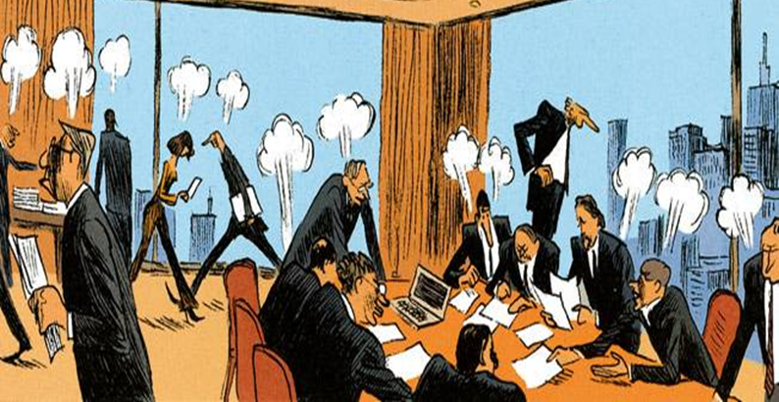
The New Diplomacy cont.
Diplomats become ‘Dignified Clerks’

Slide 8
Some More Features of New Diplomacy
Greater Openness
Multilateral Diplomacy
Personal or Summit Diplomacy

Slide 9
Features of New Diplomacy
Greater Openness
Q. What do we mean by greater openness?
A. That people are now made aware of whatever is decided.
Meaning:
No more secret treaties, pacts, negotiations and agreements
Every thing must be made clear and be known
This feature was not available in traditional diplomacy where there were secret pacts and treaties which produced suspicion and distrust and what happened as a result?
Open diplomacy was supported and advocated by President Wilson of US
The League of Nations and UN Charter also supported this

Slide 10
Features of New Diplomacy cont.
Every treaty and international agreement must be registered with UN secretariat and will be published
Now every country makes its Foreign policy objectives and goals known to all states as well as its own people.
The date for the talks and negotiations with a state is announced in advance
Not only the people of both states are informed rather other countries are also informed about decision and the result
The outcome whether successful or failure is intimated to all
Now there are hundreds of news channels and newspapers covering from minute to large issues and problems as well as adding experts commentaries and analysis on it for public understanding
.

Slide 11
Features of New Diplomacy cont.
2. Multilateral Diplomacy
Q. What is multilateral and bilateral?
A. Multilateral involves more than two parties, bilateral involves two
Earlier states would conduct bilateral agreements and talks
Now States are involved in multi-lateral diplomacy
Q. Can you give any example from history when multilateral diplomacy was conducted
Peace of Westphalia (1648) was multilateral as it involves several European states
Other examples are treaty of Versailles, League of Nations, etc.

Slide 12
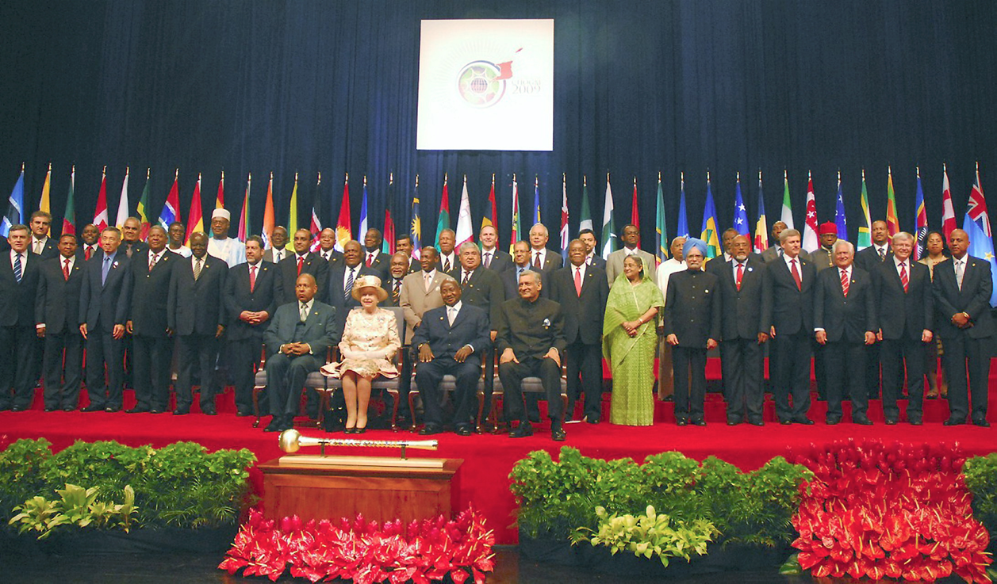
2. Multilateral Diplomacy

Slide 13
Features of New Diplomacy cont.
Q. Why states go far multilateral diplomacy at present?
Many reasons
Due to advancement of technology and growing international interaction
problems have assumed international character and involve many states for successful solution
Mutual interest and benefits of all states involved in the process
More funds, resources and energies can be utilized
Major areas of interest for multilateral diplomacy are regional peace, trade, environment, science and technology collaboration, defence etc.
The UN also help in arranging multilateral negotiations through conferences and seminars through its different bodies and agencies like UNESO, UNHCR, UNICEF etc.

Slide 14
Features of New Diplomacy cont.
3. Personal or Summit Diplomacy
Coined by Churchill, British PM after WWII
Diplomacy conducted by the top person
Q. Who are involved in summit diplomacy?
The foreign ministers, the heads of states or heads of governments directly take part in negotiations
During WWII, Churchill, Roosevelt and Stalin and others leaders would meet on various occasions
In traditional diplomacy, the relations were conducted mainly through diplomats but now its very common and frequent
Why summit diplomacy has become more common and frequent?

Slide 15
Features of New Diplomacy cont.
One reason may be the improved and fast means of communication.
the heads can easily travel and be back the same day in their country without spending much time on travelling which was not preferable in old diplomacy
Travelling outside has become more safe as well involves less people
Even, the heads can now communicate on fax, phone and internet (hot line established b/w US and SU during cold war)
OIC meetings, ECO meetings, SAARC, ASEAN, EU, Arab League, Pak-India PM meetings etc.
The heads may meet or may directly talk on phone

Slide 16
Summary
Usage of the term
Concept and Definition
Functions of Diplomats: Representation, Negotiation, Reporting, Protection of national interests and citizens
Types of Diplomacy
Features of Traditional Diplomacy: Europe centered, ignore weak states, more power, secret
Features of New Diplomacy: Greater Openness, Multilateral Diplomacy, Personal or Summit Diplomacy

