Slide 1
Balance of Power
Part II
Dr. Fayyaz Ahmad Faize

Slide 2
Review of Previous Lecture- BOP
Concept and definition
Types- Simple and Complex
Characteristics: dynamic, not achieved automatically, aims at bringing peace, power game of big states, balancer,
Techniques
Alliances and Counter Alliances,
Compensation,
Partition,

Slide 3
Techniques for BOP cont.
3. Partition:
The territory of a state is divided between the major actors in such a way as to maintain the power equation in the region
In 1772, Poland was divided between Russia, Prussia and Austria-Hungary to maintain BOP among them
Germany was divided in to East and West Germany after WWII,
4. Armament and Disarmament
Armament is acquiring arms and weapons
BOP can be achieve through armaments by which a weaker state may become powerful e.g. Germany after WWI armed itself heavily and thus prepared herself for WWII.
The colonies that got independence acquired arms for national security and neighboring threats e.g. Pakistan, India, North Korea, China, etc.

Slide 4
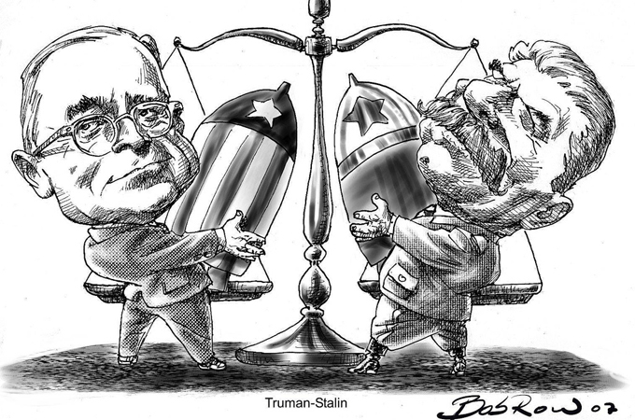

Slide 5
Techniques for BOP cont.
Arms race at present may lead to destruction due to deadly effect
Race for Armament also leads to wastage of resources and economic backwardness
So Disarmament is introduced
The states disarm themselves and reduce the quantity of weapons though mutual agreement to maintain BOP
1st started in treaty of Versailles, then League of Nations
After WWII, many efforts for nuclear disarmament e.g. SALT, START, NPT, CTBT
US Intervention in gulf war on the reason to disarm Iraq from some strategic weapons

Slide 6
Techniques for BOP cont.
5. Intervention and War
The states intervene in the internal affairs of another state for gaining some benefits and to protect its national interests
Intervention may result in war
Examples: Italy and Germany intervened in Spanish Civil war,
US intervened in gulf war in 1991 against Iraq to free Kuwait
SU intervened in N. Korea, Hungary and Eastern Europe to combat capitalistic ideology
SU intervene in Afghanistan and US start supporting Afghanistan

Slide 7
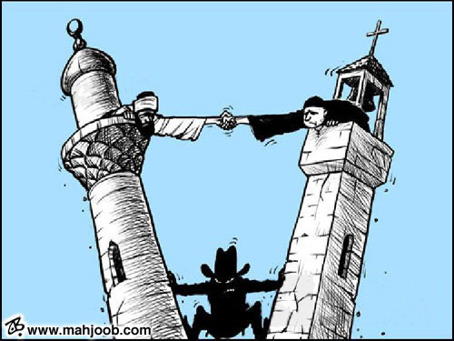
Techniques for BOP cont.
6. Divide and Rule:
The policy is used to weaken the power of competitor by dividing their territory or producing rift among people
This helps in maintaining rule over them
Britain used the policy in her colonies
SU adopted this policy in Eastern Europe
France used it in Germany from 17th century to beginning of 20th century

Slide 8
Techniques for BOP cont.
7. Buffer State:
Buffer state is a state that lies between two hostile states
the conflicting states may agree over policy of non-interference towards the buffer state
The non-interference may be due to mutual interest in buffer state or to maintain BOP
Afghanistan acted as buffer state between Britain and Russia during 19th and beginning of 20th century
Rhineland as buffer state between France and Germany
Canada as buffer state between US and SU during cold war

Slide 9
Benefit of BOP
Helped in maintaining and brining peace. It provided peace in the absence of any other effective mechanisms of collective security. Peace in Europe existed in 19th century due to BOP. Peace between Pakistan and India exists for the same reason.
Helped in preservation of independence of smaller states post WWII. The smaller states joined with one of the block to ensure its security during cold war. While, some states formed Non Aligned Movement to become neutral during cold war and ensure their security.
Due to BOP between the two super powers, the smaller states were able to maintain their independence while the super power also did not interfere in their affairs. Thus, the modern nation state system was strengthened by BOP.

Slide 10
Benefit of BOP cont.
3. The BOP acted as an agent in observing respect and obedience for international law in the absence of any other agency.
If BOP exist, then the states would observe international law to avoid any unpleasant situation and international criticism for its own benefit and interest.
If a state is very powerful, then it will not care about any international law or principle and would follow ‘might is right’ principle e.g. US drone attacks is against international law but it does not care due to no check on her power, similarly Israel attacks in Gaza
4. BOP also contributed to disarmament and arms control. US and SU agreed to decrease their nuclear and other sophisticated weapons and still maintain BOP resulting in lessening of tension and distrust and building confidence between them.

Slide 11
Criticism of BOP
BOP did not bring peace rather it encouraged war e.g. WWI and WWII. Peace exists because of preponderance of power
BOP theory assumes that states actions are always aimed at seeking power. However, power is not the sole aim and actions are not always motivated to increase power. E.g. promotion of ideology, culture, trade, games tournament etc.
Power is not increased through alliances, armaments, divide and rule and other factors discussed. It can also be increased through industrialization, national character and morale, improving education, charismatic leadership etc.
Theory assumes that BOP has been prevalent through out ages which is wrong. Preponderance of power had been the rule throughout. E.g. Roman empire, Great Britain and now USA

Slide 12
Criticism of BOP
Peace was disturbed by weaker states and their desire to increase their power. While preponderance of power is not a threat rather peace was established by big powers. Peace in Europe from 1815 to 1914 existed because of preponderance of Great Britain and France power.
Its very difficult to measure power position and then ascertain that balance of power exist. It can be measured accurately through the result after the war which is not a proper and justified method.
The BOP theory assumes that state can take side as they wish to bring BOP which is not true. The states will not much care about balancing but will be driven by its national interest and goals to choose allies.

Slide 13
Criticism of BOP
8. The theory assumes the presence of a ‘balancer’ that will side with the weak to bring balance. This is done because the stronger party is a threat while, with the weaker sides, a state can maintain its freedom.
However, this may not happen. The balancer would not take side to maintain BOP rather would be driven by her own interests and goals. E.g. Britain as a balancer used to safeguard her interests
Meanwhile, there exists no balancer at present in the uni-polar world.

Slide 14
Conclusion
BOP is responsible for power struggle and power politics
Power is dynamic and thus the states are forcefully driven into power game for their security
Creates hatred, suspicion and arms race
However, it also contributed to promoting international peace and collective security and leads to disarmament.
Thus, the concept of BOP has utility as well and can not be abandoned
Palmer and Perkins: ‘as long as the nation state system is the prevailing pattern of international society, balance of power policies will be followed in practice’

Slide 15
Summary
Concept and definition
Types- Simple and Complex
Characteristics: dynamic, not achieved automatically, aims at bringing peace, power game of big states, balancer
Techniques: Alliances and Counter Alliances, Compensation, Partition, Armament and Disarmament, Intervention and War, Divide and Rule, Buffer state, Neutralization
Benefits of BOP: maintaining and brining peace, preservation of independence of smaller states, observing respect and obedience for international law
Limitations/Criticism: encouraged war, states actions always aimed at seeking power, Power is not increased through the techniques, BOP has not been prevalent through out ages, Peace was disturbed by weaker states, difficult to measure power, state can take side as they wish, presence of a ‘balancer
Conclusion

Slide 16
Review Questions
Q. Define the concept of balance of power and its types?
Q. Mention some of the characteristics of balance of power?
Q. What are the techniques for achieving balance of power?
Q. Balance of power has utility as well as criticism. Discuss.

