Slide 1
Balance of Power
Dr. Fayyaz Ahmad Faize

Slide 2
Review of Previous Lecture- National Interests
Interest
National Interest
Development of National Interest
Interest of church, interest of the ruling class, interest of the people.
Kinds of National Interest
Primary
Secondary
Permanent
Variable
General
Specific

Slide 3
Summary cont.
How to Promote NI?
Coercive method
Alliances
Diplomacy
National Interest and Foreign Policy
The foreign policy ‘seeks the defence of NI through peaceful means
The government would never pursue a foreign policy which would harm NI
The national interests of other states are also kept into consideration
NI may result in conflict and tension in the international world due to conflicting interests
This kind of situation may lead to conflict or war
modification in foreign policy

Slide 4
Balance of Power
Dr. Fayyaz Ahmad Faize

Slide 5
Balance of Power (BOP)
Concept and definition
Types
Characteristics
Techniques
Benefits of BOP
Limitations/Criticism
Conclusion

Slide 6
Balance of Power (BOP)
Concept
Is power a threat to Peace?
May be.
Can power bring peace?
May be
Can power maintain peace?
May be
Will you prefer to fight a strong wrestler more powerful than you?
May be not
What about the strong Wrestler? Will he prefer to fight with you?
Definitely

Slide 7
Balance of Power (BOP)
How can you stop him from not fighting you?
Increasing your own power
What will this do?
It will balance your power against him.
What does this mean?
BOP can stop fight, stop war and maintain peace.
The same principle applies for states as well.

Slide 8
BOP concept cont.
As long as there is balance of power, there is peace
War is the absence of BOP
So Excess power brings war
If power is not to be abuse, then it is in the nature of things that power be made a check to power (Montesquieu)
Power corrupts and absolute power corrupts absolutely. Great man are almost bad man (Lord Acton)
Power can be used for peace keeping and peace making.

Slide 9
BOP Definition
Definition: Exact definition is a bit difficult
Claude: ‘the trouble with balance of power is not that it has no meaning but that it has too many meanings’
Palmer and Perkins: ‘that through shifting alliances and countervailing pressures, no one power or combination of powers will be allowed to grow so strong as to threaten the security of the rest’
Schwarzenberger: ‘an equilibrium or a certain amount of stability in international relation’
Moregenthau: ‘It is an actual state of affairs in which power is distributed among several nations with approximate equality’

Slide 10
BOP
The question now is that do states really aim at BOP?
The reality is that States focus on increasing their power and not on balance of power
But other states also respond in the same manner and thus the growing power can be checked
Thus struggle for power continues in the international arena

Slide 11
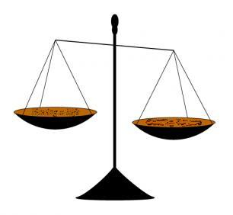
Types of BOP
Two types
Simple Balance
Multiple Balance
Simple Balance: A balance that exists between two states or any two groups of states
The number in each group may differ but the overall power is balanced between the two groups. E.g. Iran-Iraq war, India-Pakistan, the communist block against the capitalist block
Multiple Balance: Balance that exists among many nations or among different groups of nations e.g. France, Britain, Prussia, Russia, Austria-Hunagary
The world was multipolar from 1648 to 1945.

Slide 12
Characteristics of BOP
BOP is dynamic. It constantly changes from equilibrium to disequilibrium and the other way as well. (India’s nuclear explosion in 1998 disturbed BOP in South East Asia)
BOP is not achieved automatically but by active intervention of man. However, some times nature can strike a balance by decreasing the growing power of a state by natural disaster such as flood, storm, famine, epidemic diseases etc.
BOP aims at bringing peace and avoid arm conflict.
BOP may offer subjective interpretation. The powerful state will claim that a balance exist in order to favor herself and to mislead the other states to acquire power. The states like imbalance in their favor rather than balance.
BOP is a power game of big states and the weaker states are used as small weights/pawns for balancing

Slide 13
Characteristics of BOP
A balancing power is required to keep BOP in the region. England served this role in Europe in 18th and 19th century. At present, no real balancer exist.

Slide 14
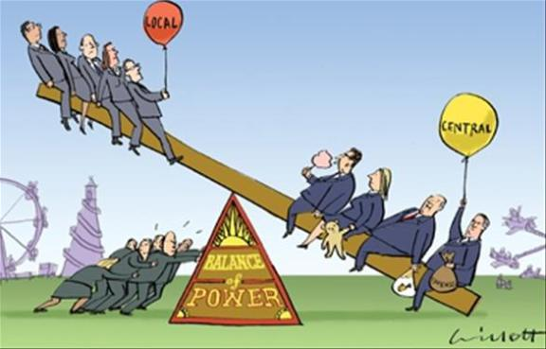
Techniques for BOP
BOP can be achieved through the following techniques:
Alliances and Counter Alliances
Compensation
Partition
Armament and Disarmament
Intervention and War
Divide and Rule
Buffer state
Neutralization

Slide 15

Techniques for BOP cont.
Alliances and Counter Alliances: معاہدہ
When the BOP is disturbed or the weaker states feel insecure, they make alliance with another weaker or powerful state
The Alliance may be defensive or offensive
A defensive alliance tries to restore BOP and maintain peace
Offensive alliance aims at disturbing BOP by adopting different coercive measures (Germany, Italy in WWII)
Alliances will be successful if mutual interest exists e.g. common enemy, common ideology, cultural similarity, common economic interests etc. e.g. Capitalistic Block during cold war
In response to alliance, counter alliance is made to bring BOP
Triple Alliance (1882)- Germany, Austria-Hungary, Italy
Triple Entente (1907)- England, France and Russia

Slide 16
Techniques for BOP cont.
NATO (1949) vs. Warsaw Pact (1955) during cold war
However, alliances and counter alliances results in suspicion, fear, tension and thus war
2. Compensation (ہرجانہ)
In order to achieve BOP, the victor nations may divide the territory of the defeated state or annex it
Mostly used in 18th and 19th century
The areas in Ottoman empire was used by victor states as compensation
After WWI, this method was used in the form of mandate system due to opposition of President Wilson of US

Slide 17
Techniques for BOP cont.
3. Partition:
The territory of a state is divided between the major actors in such a way as to maintain the power equation in the region
In 1772, Poland was divided between Russia, Prussia and Austria-Hungary to maintain BOP among them
Germany was divided in to East and West Germany after WWII,
4. Armament and Disarmament
Armament is acquiring arms and weapons
BOP can be achieve through armaments by which a weaker state may become powerful e.g. Germany after WWI armed itself heavily and thus prepared herself for WWII.
The colonies that got independence acquired arms for national security and neighboring threats e.g. Pakistan, India, North Korea, China, etc.

Slide 18
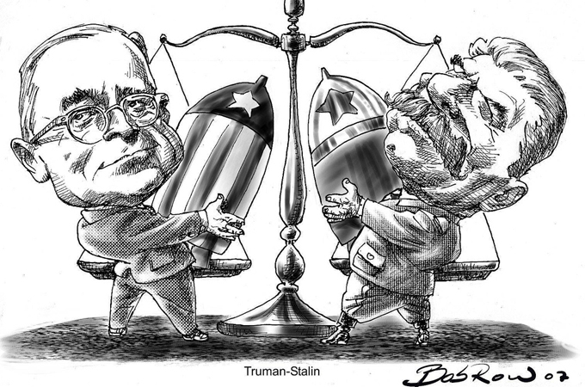

Slide 19
Techniques for BOP cont.
Arms race at present may lead to destruction due to deadly effect
Race for Armament also leads to wastage of resources and economic backwardness
So Disarmament is introduced
The states disarm herself and reduce the quantity of weapons though mutual agreement to maintain BOP
1st started in treaty of Versailles
After WWII, many efforts for nuclear disarmament e.g. SALT, START, NPT, CTBT
US Intervention in gulf war on the reason to disarm Iraq from some strategic weapons

Slide 20
Techniques for BOP cont.
5. Intervention and War
The states intervene in the internal affairs of another state for gaining some benefits and to protect its national interests
Intervention may result in war
Examples: Italy and Germany intervened in Spanish Civil war,
US intervened in gulf war in 1991 against Iraq to free Kuwait
SU intervened in N. Korea, Hungary and Eastern Europe to combat capitalistic ideology
SU intervene in Afghanistan and US start supporting Afghanistan

Slide 21
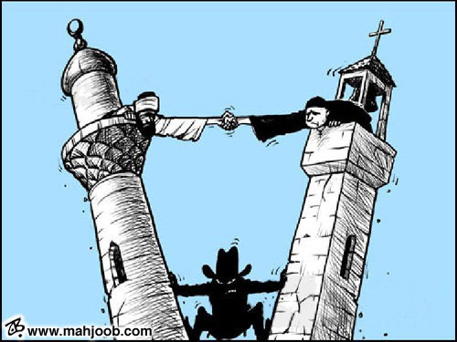
Techniques for BOP cont.
6. Divide and Rule:
The policy is used to weaken the power of competitor by dividing their territory or producing rift among people
This helps in maintaining rule over them
Britain used the policy in her colonies
SU adopted this policy in Eastern Europe
France used it in Germany from 17th century to beginning of 20th century

Slide 22
Techniques for BOP cont.
7. Buffer State:
Buffer state is a state that lies between two hostile states
the conflicting states may agree over policy of non-interference towards the buffer state
The non-interference may be due to mutual interest in buffer state or to maintain BOP
Afghanistan acted as buffer state between Britain and Russia during 19th and beginning of 20th century
Rhineland as buffer state between France and Germany
Canada as buffer state between US and SU during cold war

Slide 23
Benefit of BOP
Helped in maintaining and brining peace. Peace in Europe existed in 19th century due to BOP. Peace between Pakistan and India exists for the same reason.
Helped in preservation of independence of smaller states post WWII. The smaller states joined with one of the block to ensure its security during cold war. While, some states formed Non Aligned Movement to become neutral during cold war and ensure their security. The big powers will also not say any thing to smaller states otherwise, the BOP will be disturbed. Thus, the modern nation state system was strengthened by BOP.

Slide 24
Benefit of BOP cont.
3. The BOP acted as an agent in observing respect and obedience for international law in the absence of any other agency. The states would observe international law to avoid any unpleasant situation and international criticism and for its own benefit and interest. If a state is very powerful, then it will not care about any international law or principle and would follow ‘might is right’ principle.

Slide 25
Criticism of BOP
BOP did not bring peace rather it encouraged war e.g. WWI and WWII. Peace exists because of preponderance of power
BOP theory assumes that states actions are always aimed at seeking power. However, power is not the sole aim and actions are not always motivated to increase power. E.g. promotion of ideology, culture, trade, games tournament etc.
Power is not increased through alliances, armaments, divide and rule and other factors discussed. It can also be increased through industrialization, national character and morale, improving education, charismatic leadership etc.
Theory assumes that BOP has been prevalent through out ages which is wrong. Preponderance of power had been the rule throughout. E.g. Roman empire, Great Britain and now USA

Slide 26
Criticism of BOP
Peace was disturbed by weaker states and their desire to increase their power. While preponderance of power is not a threat rather peace was established by big powers. Peace in Europe from 1815 to 1914 existed because of preponderance of Great Britain and France power.
Its very difficult to measure power position and then ascertain that balance of power exist. It can be measured accurately through the result after the war which is not a proper and justified method.
The BOP theory assumes that state can take side as they wish to bring BOP which is not true. The states will not much care about balancing but will be driven by its national interest and goals to choose allies.

Slide 27
Criticism of BOP
8. The theory assumes the presence of a ‘balancer’ that will side with the weak to bring balance. This never has been. The balancer would not take side to maintain BOP rather would be driven by her own interests and goals. E.g. Britain as a balancer used to safeguard her interests

Slide 28
Conclusion
BOP is responsible for power struggle and power politics
Power is dynamic and thus the states are forcefully driven into power game for their security
Creates hatred, suspicion and arms race
However, it also contributed to promoting international peace and collective security
Thus, the concept of BOP has utility as well and can not be abandoned
Palmer and Perkins: ‘as long as the nation state system is the prevailing pattern of international society, balance of power policies will be followed in practice’

Slide 29
Summary
Concept and definition
Types- Simple and Complex
Characteristics
Techniques: Alliances and Counter Alliances, Compensation, Partition,

Slide 30
Review Questions
Q. Define the concept of balance of power and its types?
Q. Mention some of the characteristics of balance of power?
Q. What are the techniques for achieving balance of power?
Q. Balance of power has utility as well as criticism. Discuss.

