Slide 1
International Relations
Meaning, Scope and Importance
Dr. Fayyaz Ahmad Faize
Assistant Professor, Department of Humanities,
COMSATS Institute of Information Technology, Islamabad-Pakistan.

Slide 2
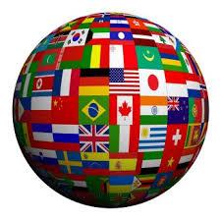
International Relations (IR)
Definition and Concept
Scope
Importance

Slide 3
Review of Knowledge
What do you mean by the word ‘international’?
What is meant by ‘International Relations’ (IR)?
What relations we may study in IR?
Is it compulsory to have relations with other states?

Slide 4
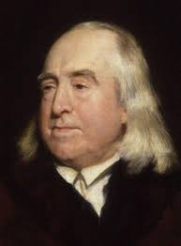
IR
Meaning and Origin
Jeremy Bentham, the English political
philosopher used the word ‘international’ for
the 1st time in 1789 (?)
Relations b/w nations
nation and state were used interchangeably,
international for relations between states
IR as a field of study-?
starts since 1919 in University of Wales
LSE and Oxford University then followed
Notes:
http://en.wikipedia.org/wiki/Jeremy_Bentham

Slide 5
Two Schools of thought
Year 1789?
French Revolution and US constitution, first President took oath
Two Schools of thought
Narrow vs Broad
Narrow View: Restrict IR to inter-state official relations
Does not include trade & business activities, educational and cultural relations, religious affairs, non-governmental organizations etc.
Main supporters: Prof Dunn and Taylor

Slide 6
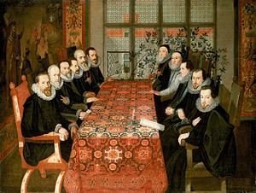
Prof Dunn: IR is concerned with ‘the actual relations that take place across national boundaries or as the body of knowledge which we have of these relations at any given time’
Trevor Taylor (1979), "a discipline, which tries to explain political activities across state boundaries".
Very simplistic and
Narrow view of IR
Notes:
Prof dunn pic

Slide 7
Broad View:
Includes many activities, relations and interactions besides official relations
Main Supporters: Quincy Wright, Hoffmann, Rosenau, Mathiesen

Slide 8
Quincy Wright: It is not only the nations which international relations seek to regulate. Varied types of groups- nations, states, government
People,
Regions, alliances,
Confederations, international organizations,
Even industrial organizations,
Cultural organizations
Religious organizations must be dealt with in the study of international relations
Notes:
Pic wright

Slide 9
Rosenau: The internal events within a state affects the relations on international level.
Even some time a boundary is difficult to draw between national and international action
Mathiesen holds the same view:
The internal affairs of a state fall with in jurisdiction of IR
Notes:
Kurd iraq turkey,

Slide 10
Example:
Saudi government decide to decrease oil supply or stop?
High level of concern through out the world, prices, inflation, jobs, etc.
Currency devaluation?
If dollar value gets low, many countries economies will be affected
Increasing defence budget by a government

Slide 11
Conclusion
IR- not limited to official relations at present
Possible only in the old states or Greek city states
need of the people has increased- welfare state
Many organizations and associations emerged
States have to consider all aspect of human life
Thus IR is concerned with all types of official, political, social, cultural, economic, ideological, military relations between and among states.

Slide 12
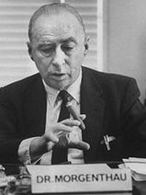
IR and International Politics (IP)
IP is not IR- different
Differ like narrow and broad view of IR
IP is limited and narrow in meaning and scope
International politics is the way in which sovereign states interact with each other on political level
(http://www.ask.com/government-politics/definition-international-politics-bdd35028e4d6303)
IP is concerned with political activities involving policies, state interests and conflicts
“It is the struggle for and use of power among nations.” (Morgenthau) www.universityofcalicut.info/SDE/IVSemInternationalPolitics.pdf
His famous book is Politics among nations

Slide 13
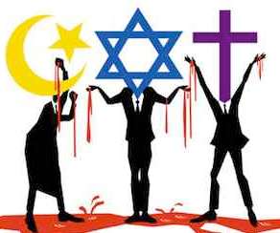
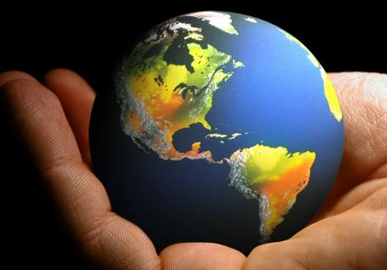
IR is broader and includes a wide variety of political, non-political, official and unofficial, formal and informal activities and relations (Palmer & Perkins)

Slide 14
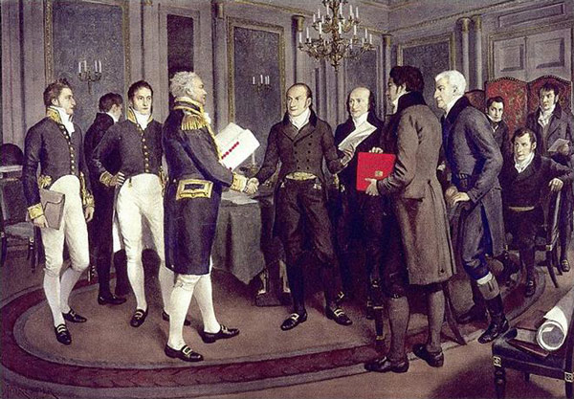
Scope:
The extent of the area or subject matter that something deals with or to which it is relevant (Oxford dictionary)
Increased with major developments and events
Started with diplomatic history and conduct of diplomatic relations between governments

Slide 15
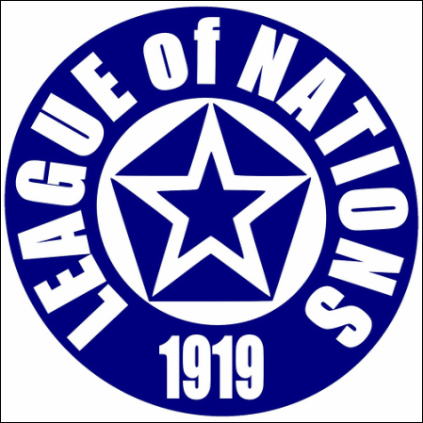

Scope cont.
Study of international law included- With more pacts and treaties, people movement
International Organizations- League of Nations (when?)
Can you name some international and regional organizations?
UNO, NATO, WARSAW Pact, SEATO, OIC, EU, SAARC etc

Slide 16
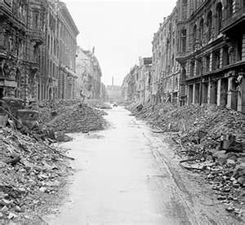
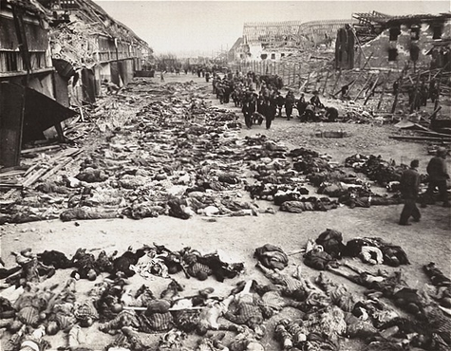
Post World War II- Great Changes in the world ?
Decline in Europe power (why ?)

Slide 17
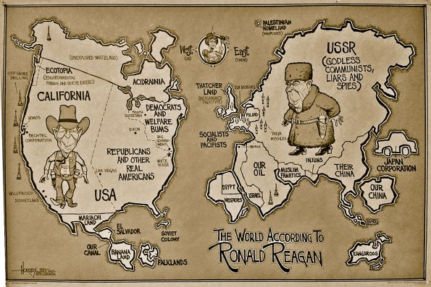
colonies getting independence, (e.g. ?)
Emergence of bi-polar world ?
Multi-polar from 1648-1945

Slide 18
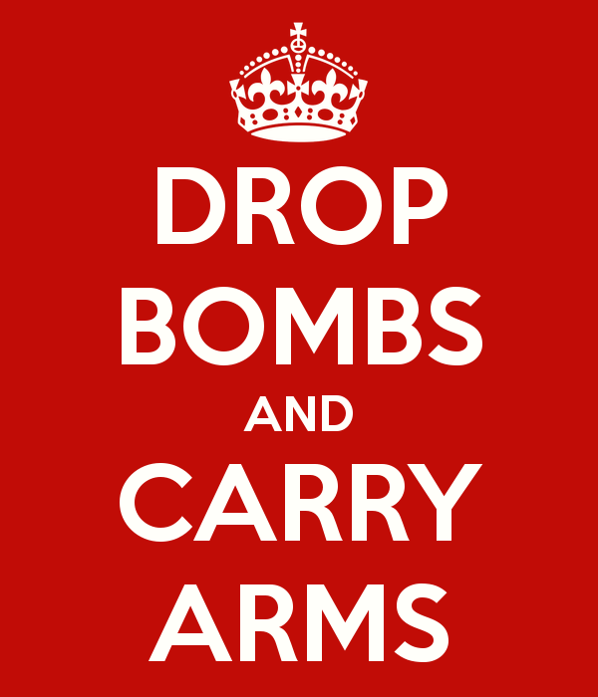
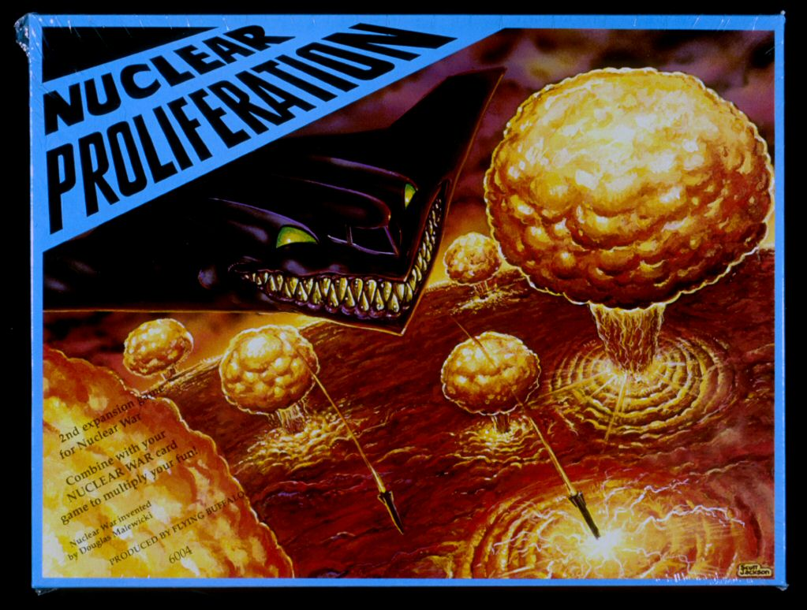
Armament ?
Nuclear Proliferations ?

Slide 19

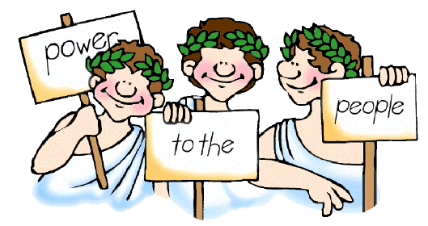
Rise of democratic governments and people expectations
Concept of welfare state and growing importance of individuals

Slide 20
Conclusion
Scope of IR- widened and broadened
Includes- diplomatic activities,
international politics,
international law,
study of international organizations,
international administrations,
area studies, foreign policies,
economic and financial matters,
geographical, ideological and military thoughts and strategic studies.

Slide 21
Cont.
Though IR is growing as a subject
Still many weakness
Lack systematic body of organized theories and principles
Lacks unity of subject matter- bundle of subjects
Dependent on other better organized disciplines for explaining various international phenomena and events (Philosophy, law, history, political science, psychology)
The international world is in transition due to rise in technology (movement of people, goods, ideas)

Slide 22
Conclusion cont.
Lacks objectivity- subjective nature and the results can not be predicted (involve man and sovereign states)
Comments and analysis of experts vary on different events
IR is a growing subject with distinctive theories if not general and a distinctive subject matter may be regarded as a discipline (Palmer & Perkins)
To provide a systematic approach for solving problems of international life

Slide 23

Importance
1. Helps in understanding the present world and the causes of advancement and backwardness of different states
Understanding government policies and the causes of success and failure, such as free market policy, privatization, nationalization, free media, education policies..
Lesson learnt can be used for progress and development
E.g. the economic policies of China is a guidance for others
the rise of Japan as a technologically advance state after WWII,

Slide 24
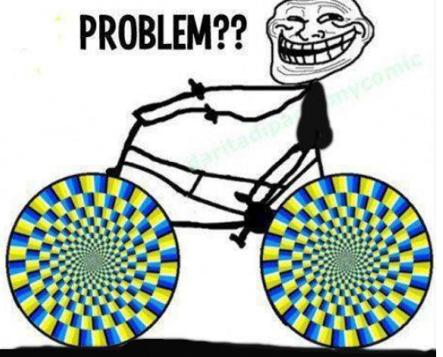
Importance cont.
2. Helps in understanding the problems facing the World and how to solve them
Understanding and finding solutions to these problems through mutual cooperation and combined strategy
E.g. Global warming, population utilization, collective security, terrorism etc.

Slide 25
Importance cont.
3. Helps in seeking international cooperation
Isolation in today’s world is not possible
State depends on one another for various needs (economic, social, educational, defence etc.)
IR helps in sharing common concern over global issues and problems
Devising combined strategies for solution to problems
Examples:

Slide 26

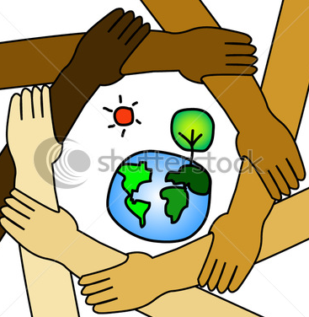
Illiteracy, nuclear proliferation, threat to global peace, Climatic changes, energy conservation etc.

Slide 27

Importance cont.
4. Helps in encouraging peaceful relations
Avoiding policy of confrontation (propaganda, secret military alliance, armaments etc.)
Teaches that national interests are supreme over personal interests but shall not contradict global interests
Struggle for global interest and world peace- universal brotherhood

Slide 28
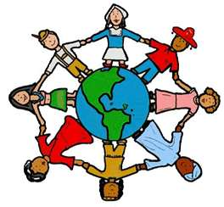
Importance cont.
5. Ensures and builds proper economic relations between international communities
Helps in promoting effective trade policies b/w states
Helps in establishing better economic associations and business forums b/w states
Regulating market policies and stock exchanges
better exchange of goods and product, currency exchanges regulations etc.

Slide 29
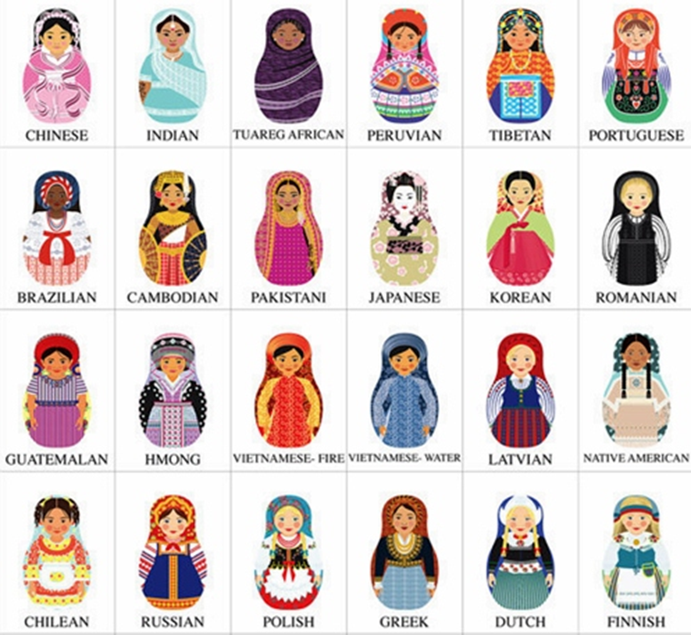
6. Understanding and promoting human culture through international exchange
Better and safe travelling across the globe
Better Visa regulations, immigrations policies and citizenship laws
Encourages scholarly visits and exchange programs
Promoting national culture through cultural exhibitions programs and cultural fair

Slide 30
References
Palmer & Perkins, ‘International Relations’.
Parkash Chander, ‘International Relations’.
http://www.en.wikipedia.org/wiki
http://www.incultureparent.com/2011/11/multicultural-matryoshka-dolls/
http://www.shutterstock.com/pic-78537562/stock-vector-international-cooperation-to-save-the-earth.html
http://www.siliconafrica.com/where-is-the-problem/
http://blogs.spectator.co.uk/coffeehouse/2013/09/times-up-for-todays-welfare-state/
http://www.museumofplay.org/online-collections/3/41/93.1084
http://www.keepcalm-o-matic.co.uk/p/drop-bombs-and-carry-arms/
http://wwiifrecker11r.wikispaces.com/After+World+War+2+ended
http://diveshistrory12.weebly.com/the-formation-of-the-league-of-nationscollective-security.html
http://www.nps.gov/adam/planyourvisit/guest-lecture-april-2012.htm
http://www.londoninternational.ac.uk/community/londonconnection/articles/features/new-ma-global-diplomacy-launches
www.universityofcalicut.info/SDE/IVSemInternationalPolitics.pdf
http://en.wikipedia.org/wiki/Timeline_of_British_diplomatic_history
http://en.wikipedia.org/wiki/Jeremy_Bentham
http://figstory.com/styled-2/index.html

Slide 31
Summary
Meaning of IR
Definition and Two views about IR
Scope of IR: Diplomatic, international law, International Organizations, Post World War II- Decline of Europe, independence of colonies, armament, bi-polar world, nuclear proliferation, rise of representative government, concept of welfare state
Importance of IR: understanding the present world, understanding the problems, international cooperation, encouraging peaceful relations, proper economic relations, human culture.

Slide 32
Review Questions
Who used the word ‘International’ for the first time and how many schools of thought exist on IR definition?
Distinguish between narrow and broad view about IR?
Trace the growth of scope of IR with passage of time?
What is the significance of studying IR?

