Slide 1
Life-styles, stress and health
Presented by:
Clinical psychologist
SADAF SAJJAD

Slide 2
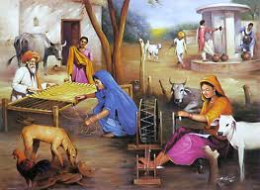
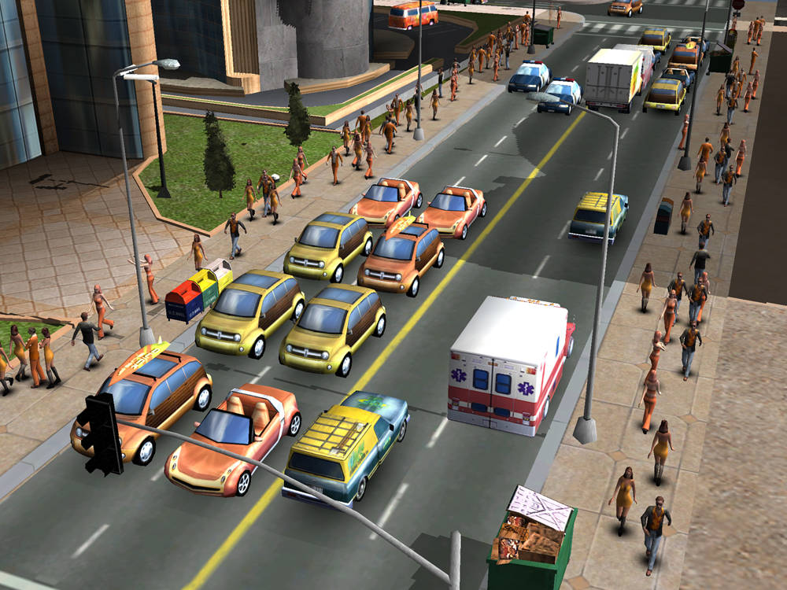
What is a life style?
A lifestyle is the way a person (or a group) lives.
This includes patterns of daily activites, health behavior, social relations, consumption, and leisure time use.
A lifestyle typically also reflects an individual's attitudes, values or worldview.

Slide 3
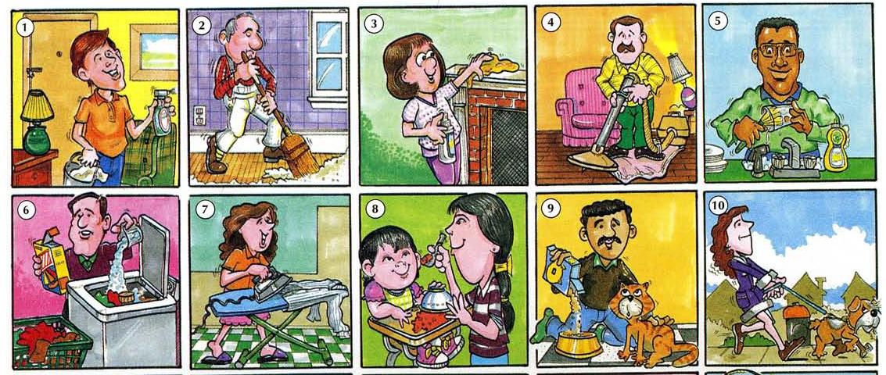
1. Daily activities:
The things we normally do in daily living including any daily activity we perform for self-care (such as feeding ourselves, bathing, dressing, grooming), work, homemaking, and leisure.
Health professionals routinely refer to the ability or inability to perform activities of daily life as a measurement of the functional status of a person.

Slide 4
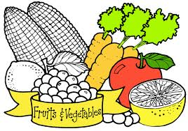
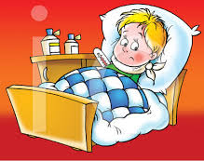
2. Health behavior
Health behavior is behavior concerned with the maintenance of health and the individuals management of their ill health. If people adopt attitudes and behaviors into their lifestyle, which improve and maintain their health such as taking exercise, watching their diet and maintaining sound hygiene then this will act as preventative medicine.

Slide 5
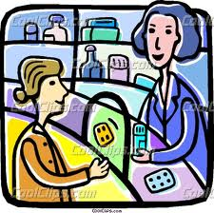
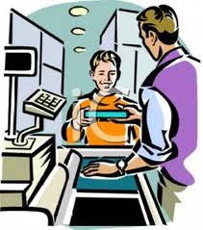
4. Consumption
Consumer behaviour is the study of how people buy, what they buy, when they buy and why they buy. It attempts to understand the buyer decision making process, both individually and in groups.

Slide 6
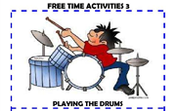
5. Leisure time use
Leisure time or free time, is a period of time spent out of work and essential domestic activity. It is also the period of discretionary time before or after compulsory daily activities such as eating and sleeping, going to work or running a business, attending school and doing homework, household chores, and day-to-day stress.

Slide 7

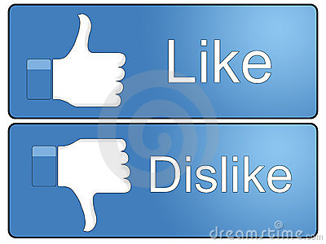
6. Individual’s attitude
Attitude is a hypothetical construct that represents an individual's like or dislike for an item. Attitudes are positive, negative or neutral views of an "attitude object": i.e. a person, behaviour or event.
People can also be "ambivalent" towards a target, meaning that they simultaneously possess a positive and a negative bias towards the attitude in question.

Slide 8
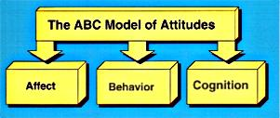
ABC model of attitude
Attitudes develop on the ABC model (affect, behavioral change and cognition).
The affective response is a physiological response that expresses an individual's preference for an entity.
The behavioral intention is a verbal indication of the intention of an individual.
The cognitive response is a cognitive evaluation of the entity to form an attitude.

Slide 9
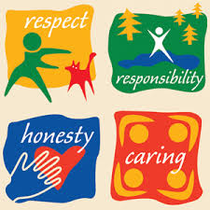
7. Values
A personal or cultural value is an absolute or relative ethical value, the assumption of which can be the basis for ethical action. Values can be defined as broad preferences concerning appropriate courses of action or outcomes. As such, values reflect a person’s sense of right and wrong or what “ought” to be.
“Equal rights for all”, "Excellence deserves admiration", and “People should be treated with respect and dignity” are representative of values. Values tend to influence attitudes and behavior.

Slide 10

8. Worldview
It means a "look onto the world".
It refers to the framework through which an individual interprets the world and interacts in it. A worldview describes a consistent (to a varying degree) and integral sense of existence and provides a framework for generating, sustaining and applying knowledge.
The 'construction of integrating worldviews' begins from fragments of worldviews offered to us by the different scientific disciplines and the various systems of knowledge. It is contributed to by different perspectives that exist in the world's different cultures

Slide 11
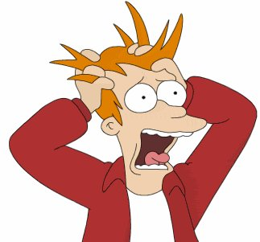
What is stress?
Stress is a feeling of strain and pressure. A state of psychological tension or strain.
Symptoms may include a sense of being overwhelmed, feelings of anxiety, overall irritability, insecurity, nervousness, social withdrawal, loss of appetite, depression, panic attacks, and exhaustion.

Slide 12

Watch explanation of stress
Video 1

Slide 13
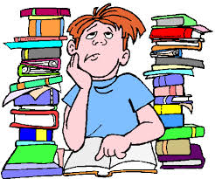
Sources of Stress
Stressor: Any environmental demand that creates a state of tension or threat and requires change or adaptation. Stressors have physical, chemical and mental responses inside of the body.
  Physical stressor produce mechanical stresses on skin, bones, ligaments, tendons, muscles and nerves that cause tissue deformation and in extreme cases tissue failure.
  Chemical stresses also produce biomechanical responses associated with metabolism and tissue repair. Physical stressors may produce pain and impair work performance. Chronic pain and impairment requiring medical attention may result from extreme physical stressor or if there is not sufficient recovery time between successive exposures.
  Stressors may also affect mental function and performance.
Change: The change in life or life activities may cause stress for some people.

Slide 14
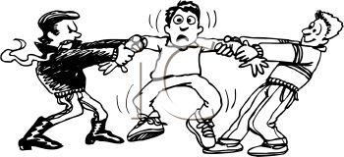
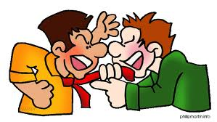
Sources of Stress (continued…)
3. Everyday hassles
During daily interaction with your environment (which means: living your life) people can run into all sorts of situations that can give stress.
Pressure: A feeling that one must speed up, intensify, or change the direction of one’s behavior or live up to a higher standard of performance.
Frustration: The feeling that occurs when a person is prevented from reaching a goal.
Conflict: Simultaneous existence of incompatible demands, opportunities, needs, or goals.

Slide 15
Some other examples of everyday hassles are:
To feel alone
Fear of rejection
worry about the meaning of life
Not enough money for basic maintenance or clothing
Worry about owing money
Side effects of medication.
Too little time for all obligations
Not having slept enough
Dissatisfaction with work
Not liking your colleagues
Traffic
Problems with your child

Slide 16

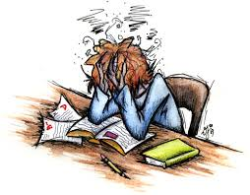
Causes of stress
From the studies conducted by Holmes and Rahe, it seems that following are the biggest causes of present day stress levels in modern societies:
Financial Problems – You and your family are not be able to do what you want to due to lack of money. Debts are piling up. Credit Card payments, pending mortgage installments, rising costs of education, mounting expenditure on health concerns. Financial matters top the list of stressors.
Workplace Stress – Stress at workplace is another of the main causes of stress. You may be worried about your next promotion. You might be facing the negative or bullying behavior of your boss. You might not be reaching your well-deserved career goals; you might be worried due to office politics.

Slide 17
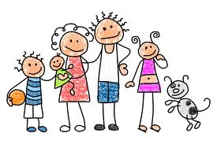
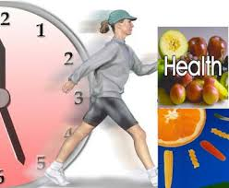
Causes of stress (continued…)
Personal Relationships – Studies of children, attitude of relatives, arguments with spouse or children, change of place due to requirements of your job, illness of a family member, moving in of parents or moving out of elder children are all main causes of stress.
Health – Heart diseases, hypertension, problems with eye sight and sugar afflict many people becoming a major cause of life stress for them. Maintaining good health, reducing weight, increasing weight, being able to lead a healthy life-style: all of these and a few more are the main causes of stress due to health concerns.

Slide 18
Causes of stress (continued…)
Irritants - Besides the ones that are mentioned earlier there are those annoyances and irritations that you encounter in your daily lives which go on to become biggest causes of stress for you.
Problems in commuting to workplace, balance of work and family life, workload, visit to doctor, not enough sleep, no time to relax, no time to discuss some nagging problems – who is not aware of these stresses and strains of our lives? You fight with them every day.

Slide 19
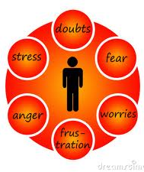
Causes of stress (continued…)
Personal problems – It includes various elements:
  Your health, if you have a chronic illness such as heart disease, diabetes, or arthritis.
  Emotional problems, such as anger you can't express, depression, grief, guilt, or low self-esteem.
  Your relationships, such as feeling a lack of friendships or support in your life.
  Major life changes, such as dealing with the death of a parent or spouse, losing your job, getting married, or moving to a new city.
  Stress in your family, such as having a child, teen, or other family member who is under stressConflicts with your beliefs and values.

Slide 20

Causes of stress (continued…)
Social and job issues that can cause stress include:
  Your surroundings. Living in an area where overcrowding, crime, pollution, or noise is a problem can create chronic stress.
  Your social situation. Being poor, feeling lonely, or facing discrimination based on your race, gender, age.
  Your job. Being unhappy with your work or finding your job too demanding can lead to chronic stress. Learn how to manage job stress.
  Unemployment. Losing your job or not being able to find work can also add to your stress level.

Slide 21
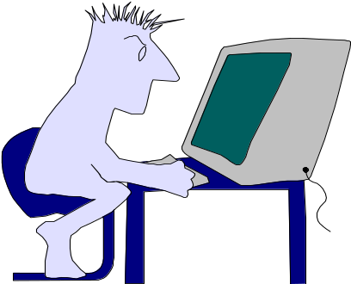
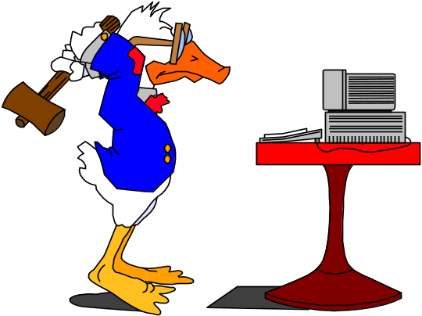
Levels of stress
Eustress or positive stress occurs when your level of stress is high enough to motivate you to move into action to get things accomplished.
Distress or negative stress occurs when your level of stress is either too high or too low and your body and/or mind begin to respond negatively to the stressors.

Slide 22
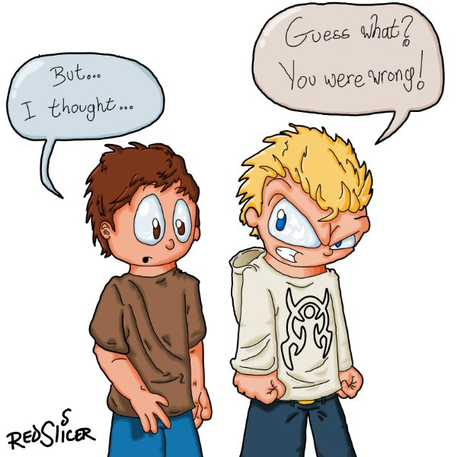
Coping with stress
Direct coping:
Confrontation: Acknowledging a stressful situation directly and attempting to find a solution to the problem or to attain the difficult goal.
Compromise: deciding on a more realistic solution or goal when an ideal solution or goal is not practical.
Withdrawal: Avoiding a situation when other forms of coping are not practical.

Slide 23
Coping with stress (continued…)
Defensive coping:
Defense mechanisms:
Denial: Refusal to acknowledge a painful or threatening reality.
Repression: Excluding uncomfortable thoughts, feelings, and desires from consciousness.
Projection: Attributing one’s repressed motives, feelings, or wishes to others.
Identification: Taking on the characteristics of someone else to avoid feeling incompetent.
Regression: Reverting to childlike behavior and defenses.

Slide 24
Coping with stress (continued…)
Defensive coping:
Intellectualization: Thinking abstractly about stressful problems as a way of detaching oneself from them.
Reaction formation: Expression of exaggerated ideas and emotions that are the opposite of one’s repressed beliefs or feelings.
Displacement: Shifting repressed motives and emotions from an original object to a substitute object.
Sublimation: Redirection repressed motives and feelings into more socially acceptable channels.

Slide 25

Watch video on stress management
Video 2

Slide 26
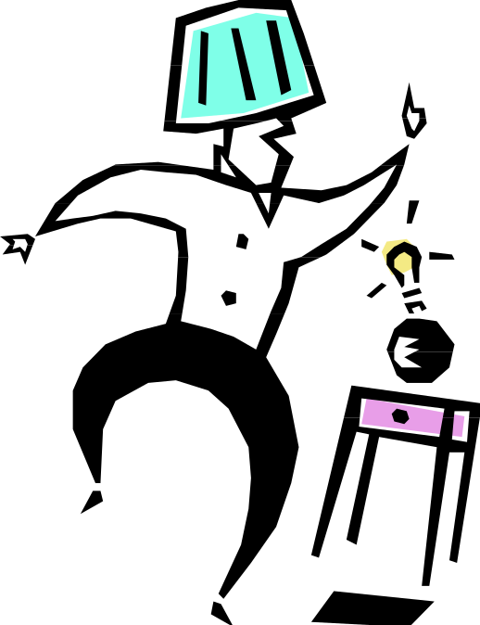
Stages of Stress
Alarm stage:
As you begin to experience a stressful event or perceive something to be stressful psychological changes occur in your body. This experience or perception disrupts your body’s normal balance and immediately your body begins to respond to the stressor(s) as effectively as possible.
  Cardiac - increased heart rate
  Respiratory - increased respiration
  Skin - decreased temperature
  Hormonal - increased stimulation of adrenal genes which produce an adrenal rush.

Slide 27
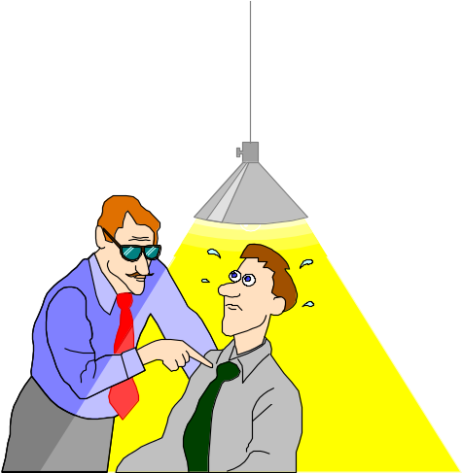
Stages of Stress (continued…)
Resistance stage:
During this stage your body tries to cope or adapt to the stressors by beginning a process of repairing any damage the stressor has caused. Your friends, family or co-workers may notice changes in you before you do so it is important to examine their feedback to make sure you do not reach overload.
  Behavior indicators include: lack of enthusiasm for family, school, work or life in general, withdrawal, change in eating habits, insomnia, hypersomnia, anger, fatigue.
  Cognitive Indicators include: poor problem solving, confusion, nightmares, hyper-vigilance.
  Emotional indicators include: tearfulness, fear, anxiety, panic, guilt, agitation, depression and overwhelmed.

Slide 28
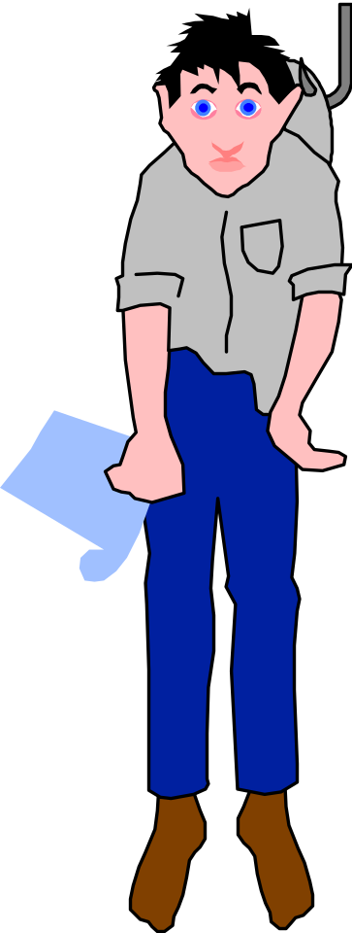
Stages of Stress (continued…)
Exhaustion stage:
During this stage the stressor is not being managed effectively and the body and mind are not able to repair the damage.
Examples: Digestive disorders, withdrawal, headaches, tension, insomnia, loss of temper.

Slide 29
Effects of stress
Memory Loss: Stress may cause more incidences of forgetfulness – misplacing items, missing appointments, and losing track of conversations.
Moodiness: When a usually even-tempered person becomes short with colleagues with little provocation, it can be a warning sign that something else is going on. Rapid swings from very good to very bad moods are also concerning, as they signal that stress is negatively impacting brain chemistry.
Sweating the Small Stuff: For some, stress takes the form of worry over every little thing, from a red light at a busy intersection to the wrong ink color on your meeting printouts. If you find yourself always moving from one insignificant worry to the next, it’s probably time to look at the bigger picture and determine what’s really bothering you.

Slide 30
Effects of stress (continued…)
Undiagnosed Illness: It certainly seems plausible that ongoing stress can result in physical ailments like stomachaches and headaches that medical tests can’t explain.
Carbohydrate Cravings: Stress is closely tied to the adrenal system, causing us to desire products made with refined sugar and salt. Ironically, though, sugar prompts the adrenal glands to release more stress hormones, keeping us trapped in a vicious cycle. And, of course, the more carbs you eat, the heavier you get and the worse you feel.

Slide 31
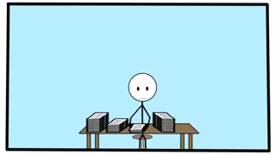
Watch video on effects of stress
Video 3

Slide 32
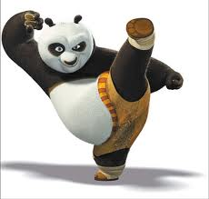
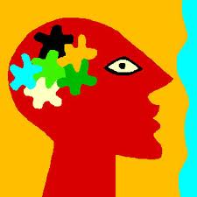
What is health?
Health is the level of functional or metabolic efficiency of a living being. In humans, it is the general condition of a person's mind and body, usually meaning to be free from illness, injury or pain.
Physical health deals with the body’s ability to function. Physical health has many components including: exercise, nutrition, sleep, drugs, and weight management.
Mental heath deals with how we think, feel and cope with daily life. Mental health encompasses learning, stress management, and mental illnesses or disorders.

Slide 33
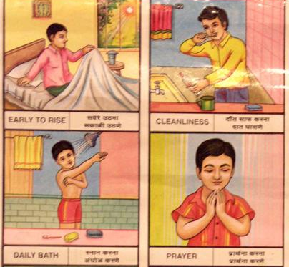

Choices that make up a life style
The lifestyle choices we make impact the quality of our lives, of the environment, and of the world we create for future generations.
Habits – Everything a person does on a habitual or regular basis helps make up their unique lifestyle. From diet and the pursuit of a good lifestyle family fitness to bad habits like smoking, they're all part of the picture.
Career – The career or employment opportunities a person pursues also help define lifestyle.

Slide 34

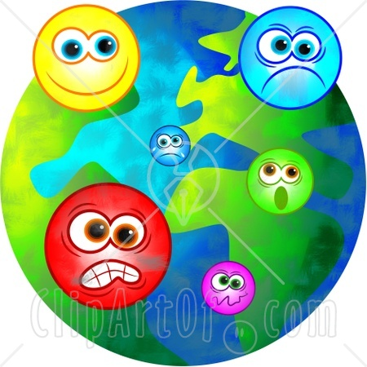
Choices that make up a life style (continued…)
Financial means – While this isn't necessarily the most important facet of a lifestyle, it does help define the manner in which an individual might live.
Emotional well being – Lifestyle is also a state of mind. When personal peace and satisfaction are a part of everyday living, wealth won't necessarily matter in the creation of a healthy, happy lifestyle.

Slide 35
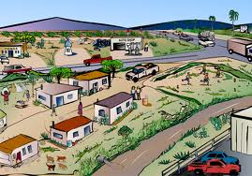

Choices that make up a life style (continued…)
Environment - There are two types of environment for a lifestyle: nature and social.
  Natural environment is the conditions in which a person, animal, or plant lives or operates.
  Social environment is totally different. Social Environment includes an individuals living and working conditions, social relations, income level, educational background, community and religious beliefs if they have any.

Slide 36
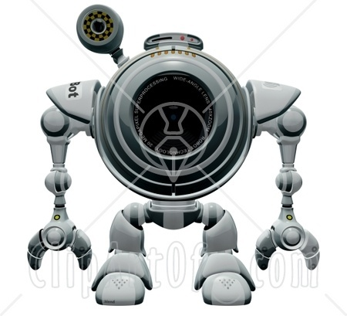
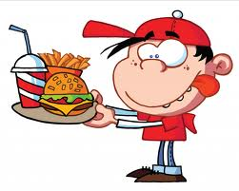
Choices that make up a life style (continued…)
Technology - Our lifestyle controls our use of technology, while technology influences our lifestyles that is present in the environment e-g television, mobiles, computer, laptop, WiFi etc. Technology has also made it easier for other factors to affect our lifestyles, such as the media.
Diet Choices – These choices are made according to the resources and finances available as well as the locality in which people live.

Slide 37
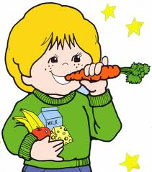
Healthy life style
It is personal health maintenance. It is any activity of an individual, family or community, with the intention of improving or restoring health, or treating or preventing disease.
Nutrition and healthy eating: Healthy eating is not about strict nutrition philosophies, staying unrealistically thin, or depriving yourself of the foods you love. Rather, it’s about feeling great, having more energy, stabilizing your mood, and keeping yourself as healthy as possible– all of which can be achieved by learning some nutrition basics and using them in a way that works for you.
Physical Fitness: Physical fitness comprises two related concepts: general fitness (a state of health and well-being), and specific fitness (a task-oriented definition based on the ability to perform specific aspects of sports or occupations). Physical fitness is generally achieved through correct nutrition, exercise, hygiene and rest.

Slide 38
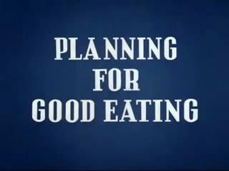
Watch video on healthy eating
Video 4

Slide 39
What are health behaviours?
Kasl and Cobb (1966) defined three types of health related behaviours. They suggested that;
A health behaviour is a behaviour aimed at preventing disease (e.g. eating a healthy diet).
An illness behaviour is a behaviour aimed at seeking a remedy (e.g. going to the doctor).
A sick role behaviour is an activity aimed at getting well (e.g. taking prescribed medication or resting).

Slide 40
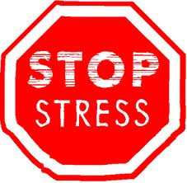

Healthy life style (continued…)
Stress management: Stress management refers to a wide spectrum of techniques and psychotherapies aimed at controlling a person's levels of stress, especially chronic stress, usually for the purpose of improving everyday functioning. Many practical stress management techniques are available, some for use by health practitioners and others for self-help, which may help an individual to reduce stress, provide positive feelings of being in control of one's life and promote general well-being.
Positive attitude: Do your best to look at life as if "the glass is half full." You must believe in yourself, have good support systems, and think positively ("I think I can, I think I can…") to succeed.

Slide 41
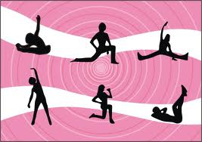
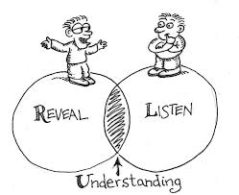
Healthy life style (continued…)
Regular exercise: A healthy life requires periodic physical activity. To prevent any type of disease exercise is important. It is performed for various reasons including strengthening muscles and the cardiovascular system, honing athletic skills, weight loss or maintenance, as well as for the purpose of enjoyment.
Understand Each Others' Family Patterns: Find out how conflicts are managed in your family. Try to have healthy conversation and social interaction with family members.

Slide 42
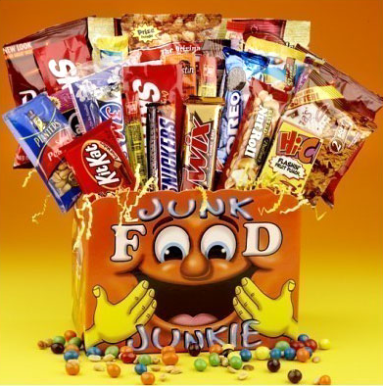
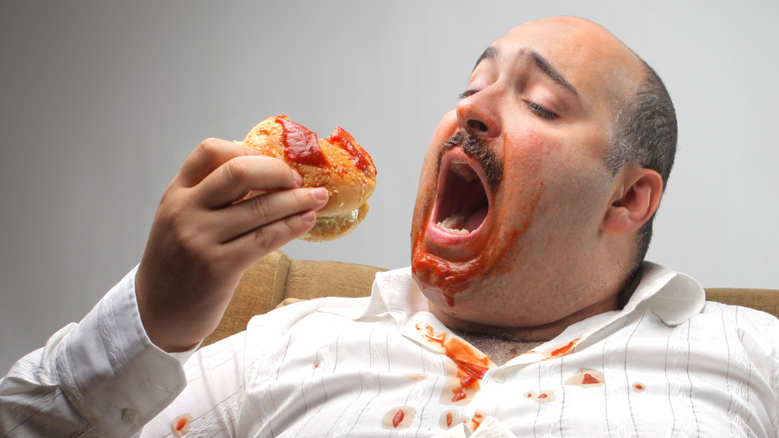
UnHealthy life style
A lifestyle being lived that is a threat to the person living it whether it be long term or short term. For example, someone who has bad lungs who smokes.
Too much junk food: Junk food is a derisive slang term for food that is of little nutritional value and often high in fat, sugar, salt, and calories. It can cause obesity, which may increase chances of an individual being a victim of high blood pressure and other heart ailments.
Bad eating habits: The surge in the consumption of high fat foods like burgers, chips, fizzy drinks and fries has already been condemned and treated as one of the main causes of bad eating habits.

Slide 43
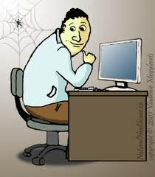
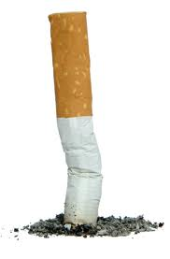
UnHealthy life style (continued…)
Physical inactivity: With teenagers spending most of their time in front of the television, playing computer games or on mobiles with their friends and lack of interest in extra-curricular activities after school or college and lack of exercise are some of the key elements of physical inactivity.
Smoking: Smoking is a practice in which a substance, most commonly tobacco, is burned and the smoke is tasted or inhaled. This is primarily practiced as a route of administration for recreational drug use, as combustion releases the active substances in drugs such as nicotine and makes them available for absorption through the lungs. It can also be done as a part of rituals, to induce trances and spiritual enlightenment.

Slide 44
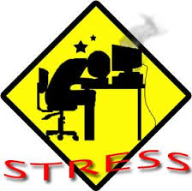
UnHealthy life style (continued…)
Too much Stress: Stress is probably the most insidious condition of all. High blood pressure, heart attacks, and other related diseases are caused by stress. It is analogous to a train going 200 miles per hour when suddenly the brakes fail and there is a major collision. That collision causes the breakdown of the body and the nervous system. Its impact reverberates for years to come.

