Slide 1
Motivation and Emotion
Presented by: Clinical Psychologist
Sadaf Sajjad

Slide 2
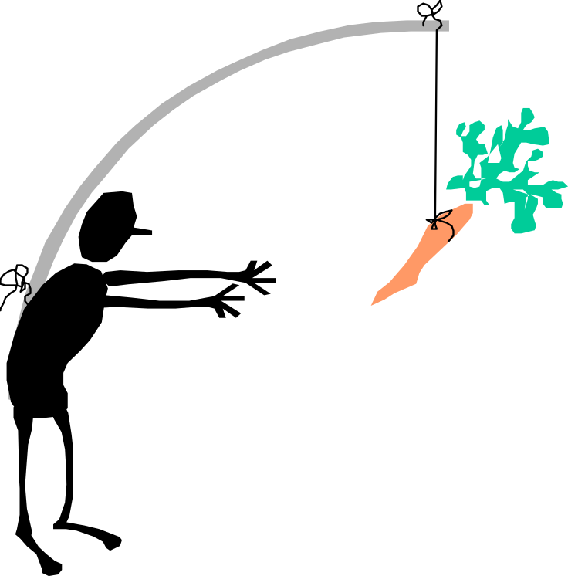
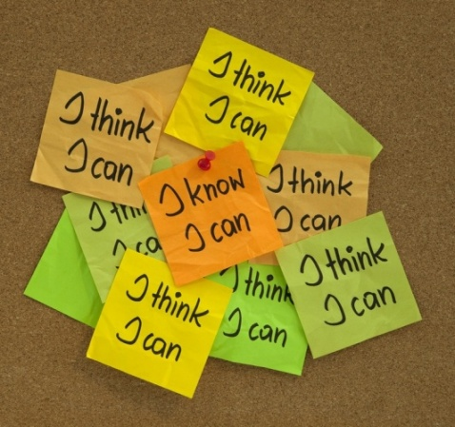
Motivation
Motivation : A psychological process that directs and maintains your behavior toward a goal.
Psychologists who study motivation seek to discover the particular desired goals—the motives
Motives are the needs, wants, interests, and desires that propel or drive people in certain directions.
The study of motivation, consists of identifying why people seek to do the things they do.

Slide 3
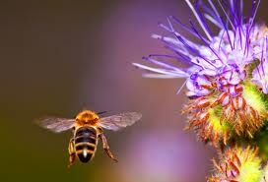
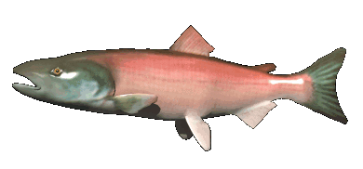
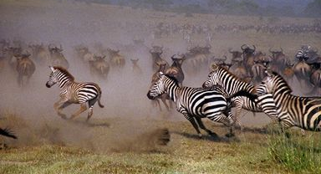
Theories On Motivation
Learned:
  Most of the time motivation is learned – we are motivated by different things.
Instinct theory:
  Inborn patterns of behavior that are biologically determined rather than learned.
According to instinct approaches to motivation, people and animals are born with preprogrammed sets of behaviors essential to their survival. These instincts provide the energy that channels behavior in appropriate directions.
Example: exploratory behavior in animals: The tendency to explore or investigate an environment.

Slide 4
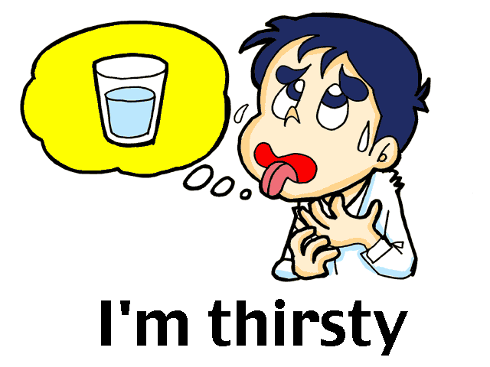
Drive Deduction Theory
Our behavior is motivated by BIOLOGICAL NEEDS.
After rejecting instinct theory, psychologists first proposed simple drive-reduction theories of motivation in its place (Hull, 1943).
Drive theories assume that people are always trying to reduce internal tension.
Therefore, drive theories believe that the source of motivation lies within the person (not from the environment)
Example:
  when people lack some basic
biological requirement such as water, a drive
to obtain that requirement (in this case,
the thirst drive) is produced.

Slide 5
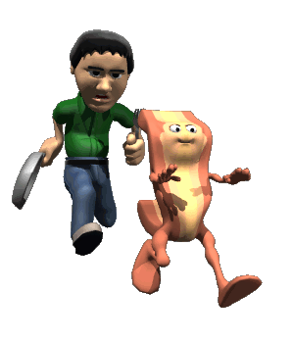
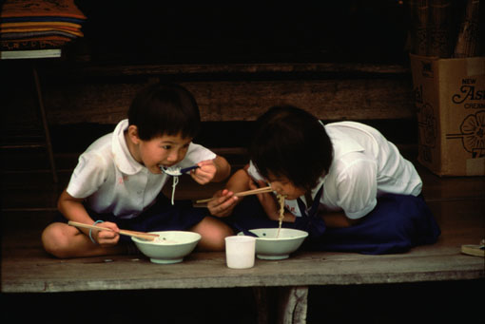
Drive Deduction Theory
Drive
  Motivational tension, or arousal, that energizes behavior in order to fulfill some need
Primary drive
  Basic drives related to biological needs of the body or the species as a whole
Secondary drives
  Needs are brought about by prior experience and learning

Slide 6
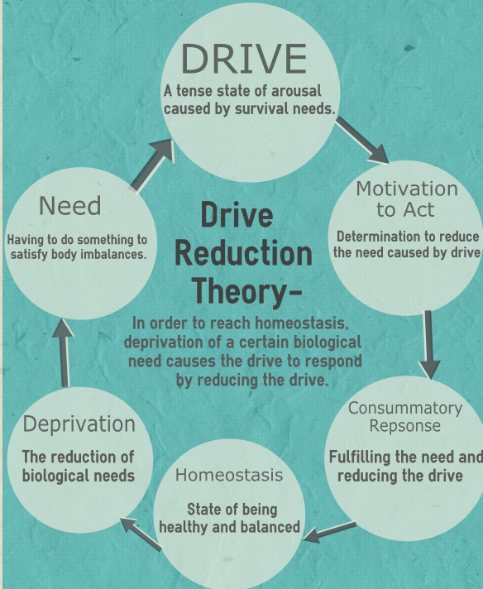
Drive Deduction Theory Approach
Wants to maintain homeostasis.
Homeostasis:
  A basic motivational phenomena that underlies primary drives and involves the body’s tendency to maintain a steady internal state
Homeostasis operates through feedback loops that bring deviations in body functioning back to a more optimal state.
similar to the way a thermostat and furnace work in a home heating system to maintain a steady temperature

Slide 7
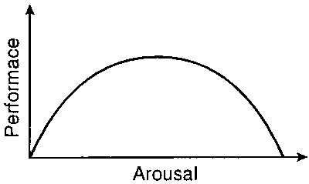

Arousal Theory
Arousal approaches seek to explain behavior in which the goal is to maintain or increase excitement (Berlyne, 1967; Brehm & Self, 1989).
According to arousal approaches to motivation, each of us tries to maintain a certain level of stimulation and activity.
As with the drive-reduction model, if our stimulation and activity levels become too high, we try to reduce them.
But in contrast to the drive-reduction model, the arousal model also suggests that if the levels of stimulation and activity are too low, we will try to increase them by seeking stimulation.

Slide 8
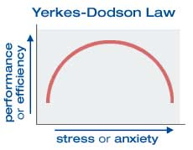
Arousal Theory Cont…
People are motivated to maintain an optimum level of arousal
  Neither too high nor too low
Arousal – level of alertness, wakefulness, and activation caused by activity in the CNS.
The optimal level of arousal varies with the person and the activity.
Yerkes-Dodson Law – We usually perform most activities best when we are moderately aroused.

Slide 9
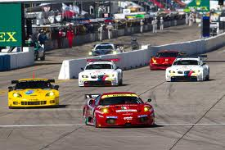
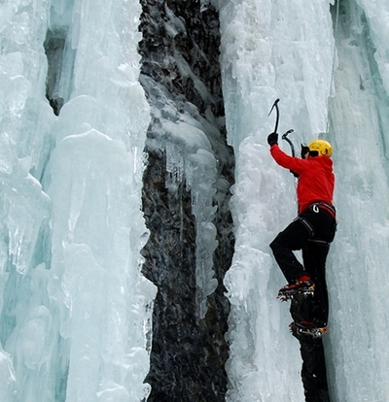
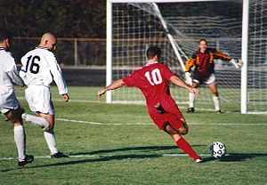
Arousal Theory Example
The law also states that we perform worse when arousal is either to low or too high.
Example: Think about sports or driving a car

Slide 10
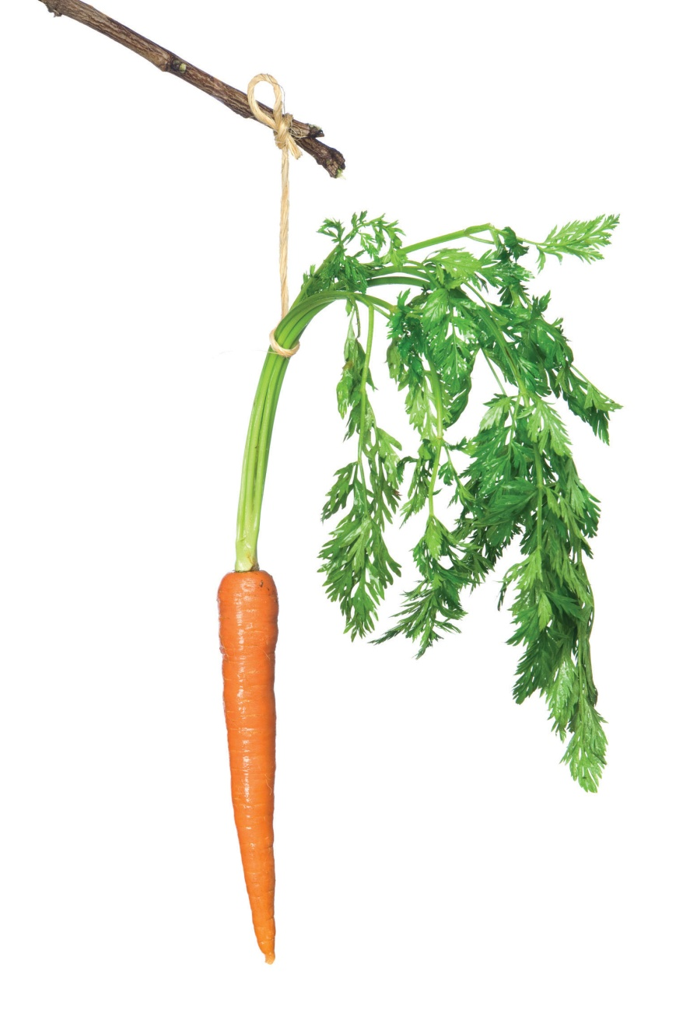
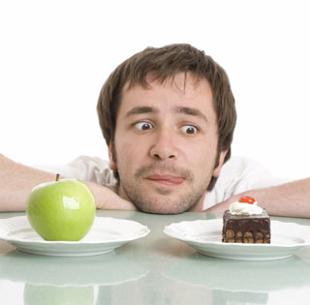
Incentive Approaches: Motivation’s Pull
An incentive has an ability to motivate behavior.
Push vs. Pull theory :
  1. Internal states of tension push people certain directions.
  2. External stimuli pull people in certain directions.
According to incentive theory, motivation comes from the environment around you.

Slide 11
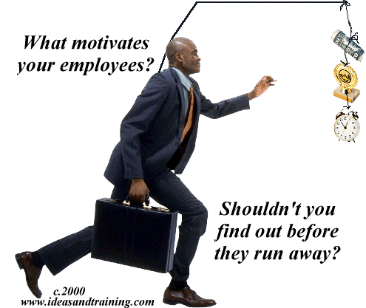
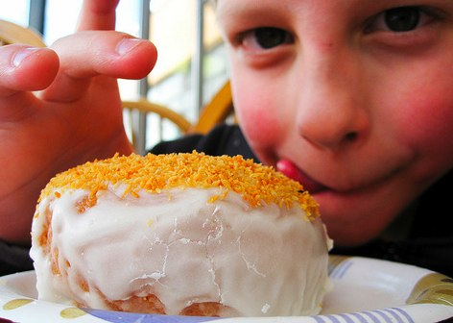
Incentive Approaches: Motivation’s Pull
Incentive approaches to motivation
  Suggests that motivation stems from the desire to obtain valued external goals, or incentives.
  Example: grades, money, affection, food etc accounts for a person’s motivation.

Slide 12
What is the difference between drive theory and incentive theory?
Drive theory – Biological internal motivation (homeostasis)
Incentive theory – Environmental motivation (not as much homeostasis, more outside factors)

Slide 13

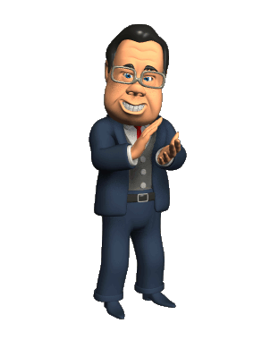

Cognitive Approaches: The Thoughts Behind Motivation
Cognitive approaches to motivation suggest that motivation is a product of people’s thoughts, expectations, and goals.
Example:
  The degree to which people are motivated to study for a test is based on their expectation of how well studying will pay off in terms of a good grade.

Slide 14

Cognitive Approaches: The Thoughts Behind Motivation
Cognitive theories of motivation draw a key distinction between intrinsic and extrinsic motivation.
  Intrinsic motivation causes us to participate in an activity for our own enjoyment, rather than for any concrete, tangible reward that it will bring us.
  Extrinsic motivation causes us to do something for money, a grade, or some other concrete, tangible reward.
  For example, when a physician works long hours because she loves medicine, intrinsic motivation is prompting her; if she works hard in order to make a lot of money, extrinsic motivation underlies her efforts.

Slide 15
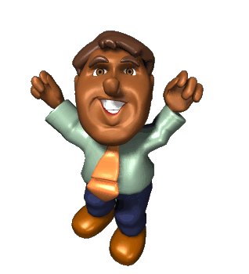
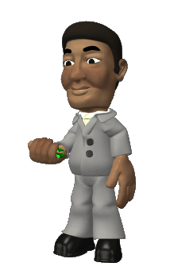

The Need for Achievement: Striving for Success
The need for achievement is a stable, learned characteristic in which satisfaction is obtained by striving for and attaining a level of excellence (McClelland et al., 1953).
People with a high need for achievement seek out situations in which they can compete against some standard, that can be grades, money, or winning at a game, and prove themselves successful.
But they are not indiscriminate when it comes to picking their challenges, they tend to avoid situations in which success will come too easily and situations in which success is unlikely.
Instead, people high in achievement motivation are apt to choose tasks that are of intermediate difficulty.

Slide 16
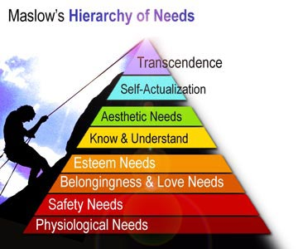
Maslow's Hierarchy Of Needs
Maslow's hierarchy of needs is a theory in psychology proposed by Abraham Maslow in his 1943 paper "A Theory of Human Motivation"
Abraham Maslow said we are motivated by needs, and all needs are not created equal.
Motives are divided into several levels of hierarchy from basic survival needs to psychological and self-fulfillment needs.
Maslow says lower needs must be met before you can
continue up the pyramid
Maslow believed few people reach this level
The model considers different motivational
needs to be ordered in a hierarchy, and it suggests that
before more sophisticated, higher-order needs can be met,
certain primary needs must be satisfied (Maslow, 1970; 1987).

Slide 17
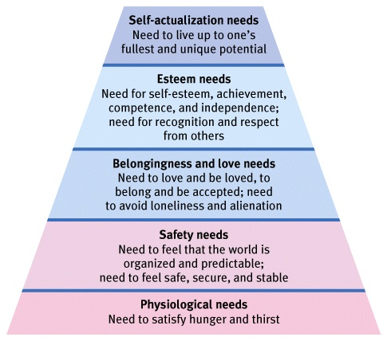
Maslow's Hierarchy Of Needs: Model

Slide 18
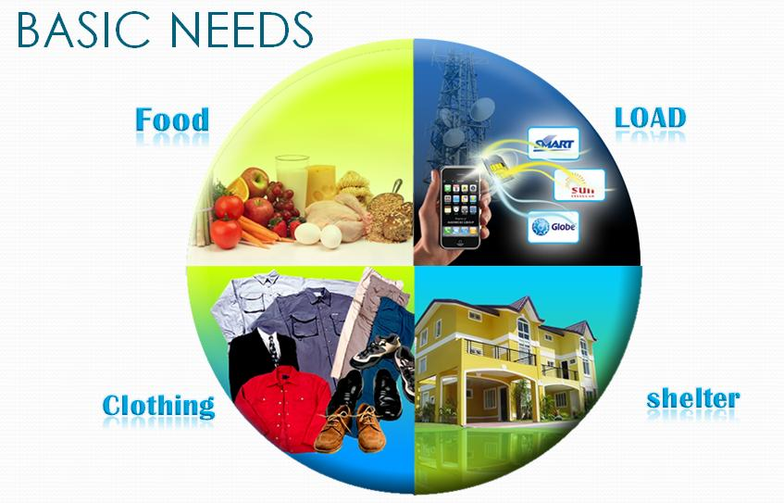

Maslow's Model Explanation
The model can be conceptualized as a pyramid in which the more basic needs are at the bottom and the higher-level needs are at the top.
The most basic needs:
  Primary drives: needs for water, food, sleep, sex, and the like. To move up the hierarchy, a person must have these basic physiological needs met.
  Safety needs: come next in the hierarchy; Maslow suggests that people need a safe, secure environment in order to function effectively. Physiological and safety needs compose the lower-order needs.

Slide 19
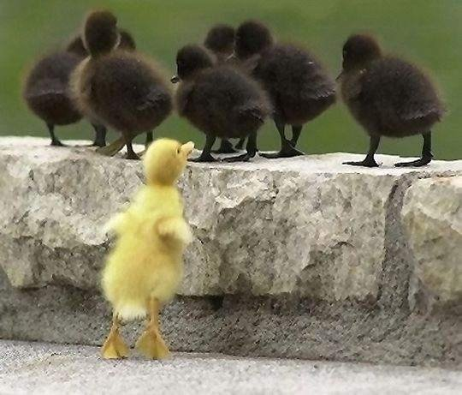

Maslow's Model Explanation: cont…
The High order needs: Only when the basic lower-order needs are met a person can consider fulfilling higher-order needs, such as the need for love and a sense of belonging, esteem, and self-actualization.
  Love and belongingness needs: include the need to obtain
  and give affection and to be a contributing member of some
  group or society.
  Esteem: After these needs are fulfilled, the person strives for
  esteem. In Maslow’s thinking, esteem relates to the need to
  develop a sense of self-worth by knowing that others are
  aware of one’s competence and value

Slide 20

Maslow's Model Explanation: cont…
The highest level of need: Once these four sets of needs are fulfilled, the person is able to strive for the highest-level need called self-actualization.
Self-actualization:
  State of self-fulfillment in which people realize their highest potential in their own unique way
Example:
    A parent with excellent nurturing skills who raises a family
    A teacher who year after year creates an environment that maximizes students’ opportunities for success.
    An artist who realizes her creative potential might all
    be self-actualized.
The important thing is that people feel at ease with them
selves and satisfied that they are using their talents to the
fullest.

Slide 21
Motivation In A Particular Instance
Motivation of Hunger

Slide 22
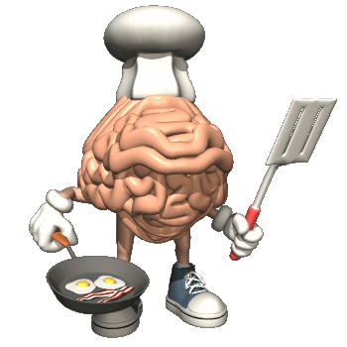
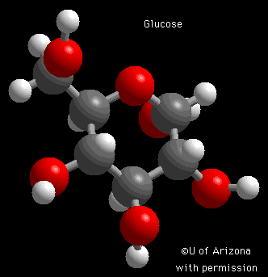
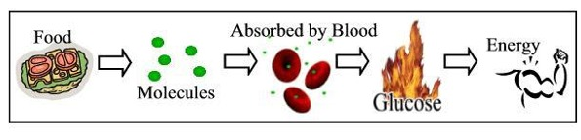
Motivation of Hunger
Hunger does NOT come from our stomach.
  It comes from our… Brain.
What part of the brain?
  The Hypothalamus
Why do I feel hungry?
Glucose
  It is the form of sugar that circulates in the blood
  It provides the major source of energy for body tissues
  Glucose Low = hunger
  Glucose High = feel full

Slide 23
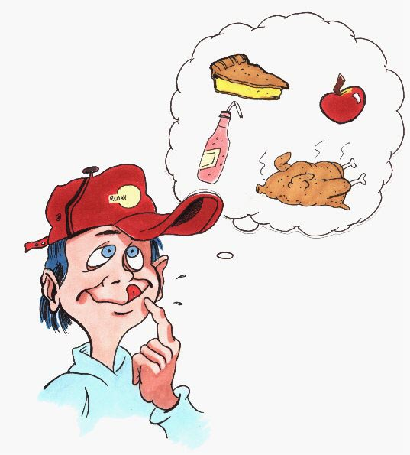
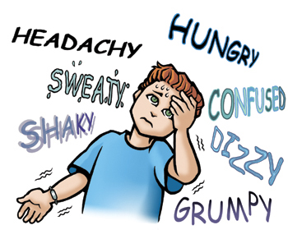
Biological Basis of Hunger:
Internal mechanisms regulate not only the quantity of food intake, but also the kind of food desire.
Example:
  rats that have been deprived of particular foods seek out alternatives that contain the specific nutrients their diet is lacking.
  animals given the choice of a wide variety of foods choose a well-balanced diet.
Changes in levels of glucose regulate feelings of hunger.
Glucose levels are monitored by the brain’s hypothalamus.

Slide 24
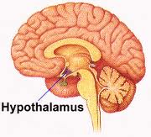
Hypothalamus
Hypothalamus is the organ primarily responsible for monitoring food intake.
There are two site of hypothalamus related to food intake. Injury to the any site has radical consequences for eating behavior.
  Ventromedial Hypothalamus:
When stimulated you feel full. When destroyed you will never feel full again.
  Lateral Hypothalamus:
When stimulated it makes you hungry. When destroyed you will never be hungry again.
Example: in Anand & Brobeck, (1951) experiment rats
whose lateral hypothalamus is damaged surgically
starved to death. They refuse food when offered, and
unless they are were force-fed, eventually died.

Slide 25
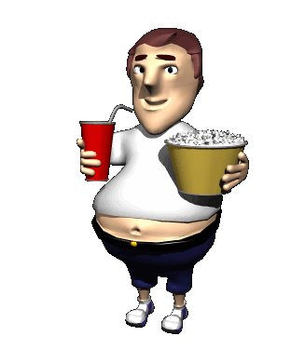
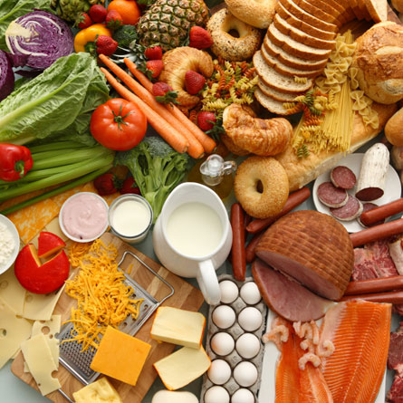
Environmental Basis of Hunger:
There are several environmental factors that affect our hunger
  Availability of food
  Learned preference and habits
  Stress
  Social factors

Slide 26
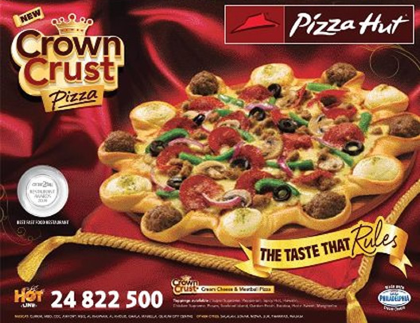
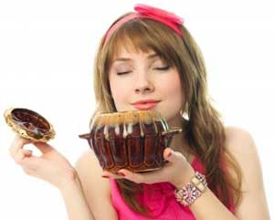
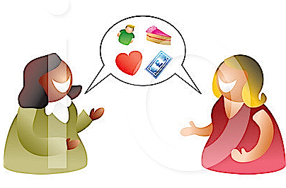
Availability Of Food
Eating for survival vs. eating for pleasure.
Tasty food is more likely to be eaten even when one is feeling full
Some environmental aspects matter for eating food:
  Commercials/attractive advertisement
  Odors
  Talking about the food item

Slide 27
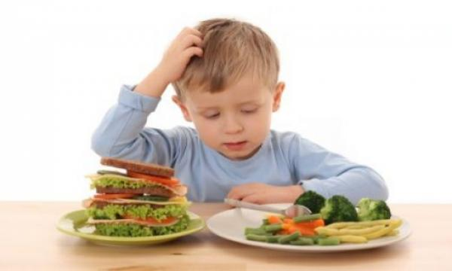
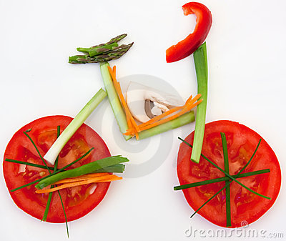
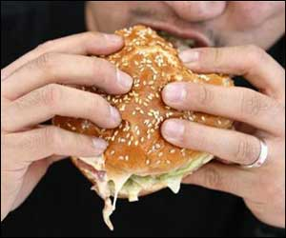
Learned Preference And Habits
People eat according to learned behaviors regarding etiquette, meal and snack patterns, acceptable foods, food combinations, and portion sizes.
Food preferences acquired through :
  Exposure
  Experience with the food
Sugary and fatty foods are important for survival (that’s why they’re popular)
Food preference becomes food habits.

Slide 28
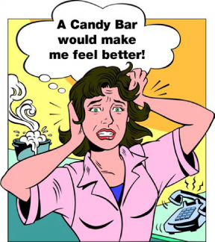
Stress
“The food drives your behavior and your behavior drives your food choice,”
Stress and nutrition have always been linked.
It is believed that eating tasty food makes you feel better.
This misconception leads to eating/digestion issues in stress.
Many people deal with stress by eating too much, too little,
the wrong things or not at all.
The emotional eater. turn to food when feeling anxious and
have a tendency to overeat at every meal.
The restrictive eater. This type of eater restricts their food intake, which increases their stress because they forbid themselves from eating specific foods.

Slide 29

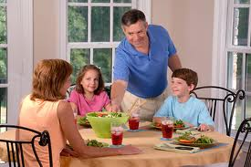
Social Factors
External social factors and what we have learned about appropriate eating behavior, play an important role.
Example:
  people usually eat breakfast, lunch, and dinner at approximately the same times every day. Because we are habituated to eating on schedule every day, we tend to feel hungry as the usual hour approaches.
Cultural influences and our own individual habits play an important role in determining when, what, and how much we eat

Slide 30
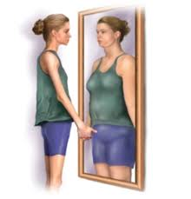

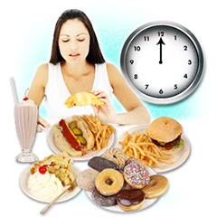
Eating Disorders
Anorexia nervosa
  A severe eating disorder in which people may refuse to eat, while
  denying that their behavior and appearance are unusual
Bulimia
  A disorder in which a person binges on large quantities of food,
  and then purges

Slide 31
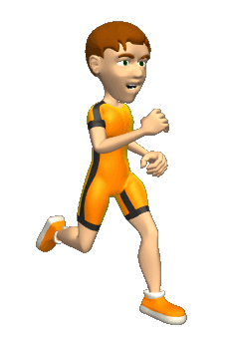
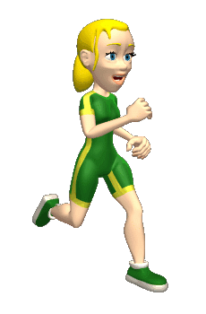
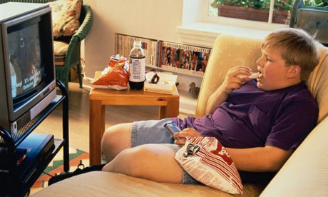
Eating Disorders Cont…
Obesity:
  It’s a condition in which one gets severely overweight to the point where it causes health issues.
Obesity is caused mostly due to bad eating habits but some people are predisposed (naturally) towards obesity.

Slide 32
Emotions

Slide 33
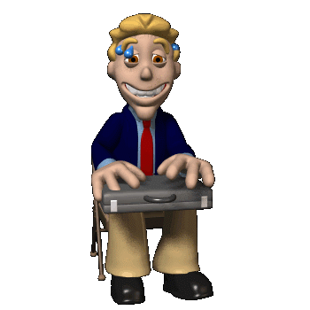

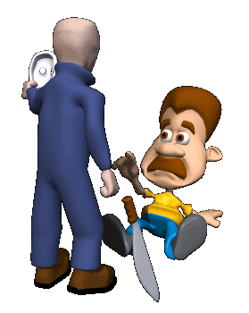
Emotions
We are emotion creatures.
Emotions
  Feelings that generally have both physiological and cognitive elements and that influence behavior
Example:
  Fear, surprise, anger, disgust, happiness, sadness.
What causes emotions:
  Autonomic Nervous System – Fight or flight
  Endocrine system – Hormones
  Amygdala – fear and anxiety
  Frontal lobes – control interpretation of emotions
  Right hemisphere – handles positive emotions
  Left hemisphere – handles negative emotions

Slide 34

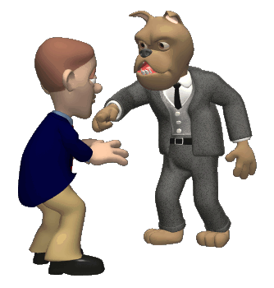
The Function of Emotions
Preparing us for action
  A link between events in our environment and our responses
Shaping our future behavior
  Act as reinforcement
Helping us to interact more effectively with others
  Act as a signal to observers, allowing them to better understand what we are experiencing and to predict our future behavior

Slide 35

Theories of Emotions
Schachter-Singer theory of emotion:
  Theory emphasizes that we identify the emotion we are experiencing by observing our environment and comparing ourselves with others.
James-Lange theory of emotion:
  James and Lange proposed that we experience emotions as a result of physiological changes that produce specific sensations. In turn, these sensations are interpreted by the brain as particular kinds of emotional experiences.

Slide 36

Lets see the video on emotions

Slide 37
Thank you

