Slide 1
Biological Basis of behavior
Presented By:
Clinical Psychologist Sadaf Sajjad

Slide 2
What we are going to learn?
  How biology effects behavior
  Neural Structure and synaptic transmission
  Structure and functions of nervous system
  Endocrine system

Slide 3

Why study biology in a psychology class?
“Everything psychological is simultaneously biological.”
  Every thought, behavior, emotion, perception, etc. is rooted in our biology, particularly our brain
  The brain is a “psychological organ” as well as a biological one.
  Biology is the science of living things ---it plays an integral role in supporting psychology.
animation:1

Slide 4

How biology effects behavior?
  Brain, nerves and hormones are responsible for your thoughts feelings and actions.
  Example:
  Biological processes are involved in every
  human action:
      You feel hungry
      You remember your favorite restaurant
      You smell the food
      Or take a bite
Video:2

Slide 5
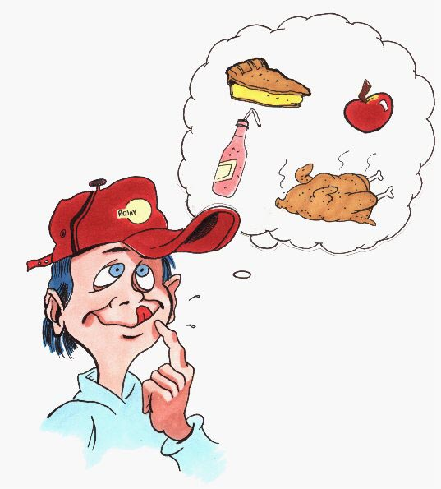
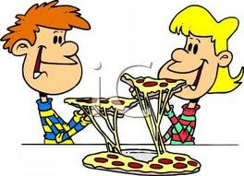
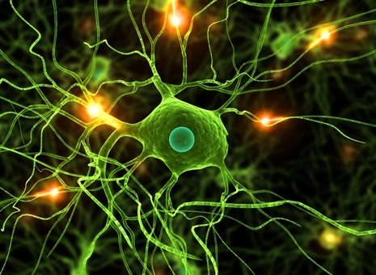
biology effects behavior:
  Psychology determines what people perceive to feel and behave - while determining the way we act, feel and behave is biology.
  Psychologists study biological psychology to
  establish a bridge between:
      Psychology and Biology
      Brain activity and mental states

Slide 6
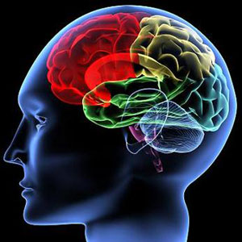
Biological psychology:
  Definition:
  The branch of psychology that studies the biological foundations of behavior, emotions, and mental processes.
  Finding biological causes of how we:
  think, feel, & act.
  Biological systems that effect behavior
Nervous system
Endocrine system

Slide 7
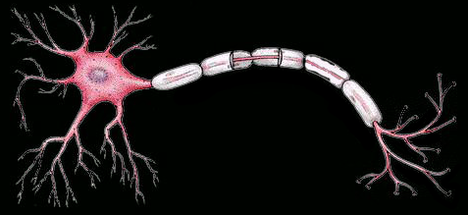
Neural structure and synaptic transmission

Slide 8
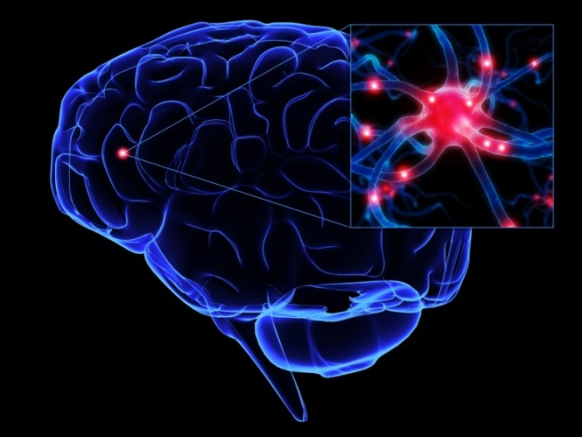
Neuron:
  Neuron is a nerve cell --- the basic unit of the nervous system.
  That are constantly sending signals to your brain muscles
  and glands.
  Signals: help different parts of body to communicate with each other
animation3

Slide 9
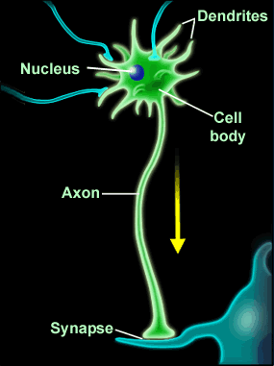
Neuron Structure:
Cell body (soma): the central part of the neuron, contains the nucleus
      Function: regulates cell functioning
Dendrites: the branching part of the neuron
      Function: receives messages from other neurons and relays them to the cell body
Axon (A nerve fiber): a single process extending from the cell body of a neuron
        Function: caries nerve impulses away from it.
Synapse: the point of connection between two neurons or between a neuron and a muscle or gland.
        Function: Electrochemical communication between neurons takes place at these junctions.

Slide 10
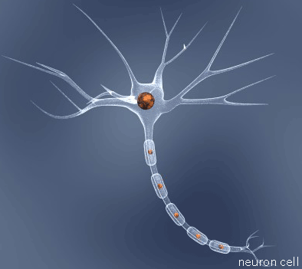
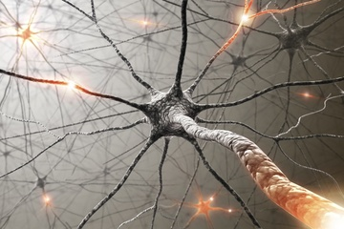
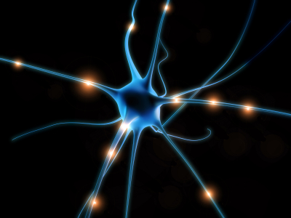
Types of Neuron:
  Types:
sensory neurons: respond to input from sensory organs (skin, eyes, etc.)
motor neurons: send signals to muscles to control movement
interneuron: connect the sensory neurons and motor neurons
Average human brain ≈ 100 billion neurons

Slide 11
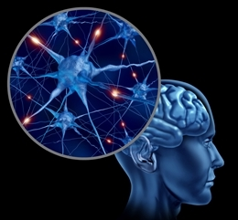
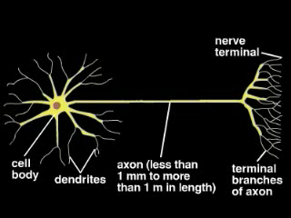
Function of Neuron:
  Function :
      It receives signals from other neurons or sensory organs.
      Processes these signals
      Sends signals to other neurons, muscles, or bodily organs.
Animation4

Slide 12

Example:
  Hitting am irritating mosquito, sitting on your arm.
Video: 5

Slide 13
Example explanation:
  You are able to feel the mosquitoes sitting on your arm and you sense that’s its dangerous so you hit it immediately.
  How???
      Sensory neuron will receive signal from skin.
      Your skin is the sensory organ that sense the presence of something on your arm.
      The signal will be processed that it is a mosquito
      Motor neuron will then send signal to the muscles (arm muscles) to move and hit the mosquito.

Slide 14
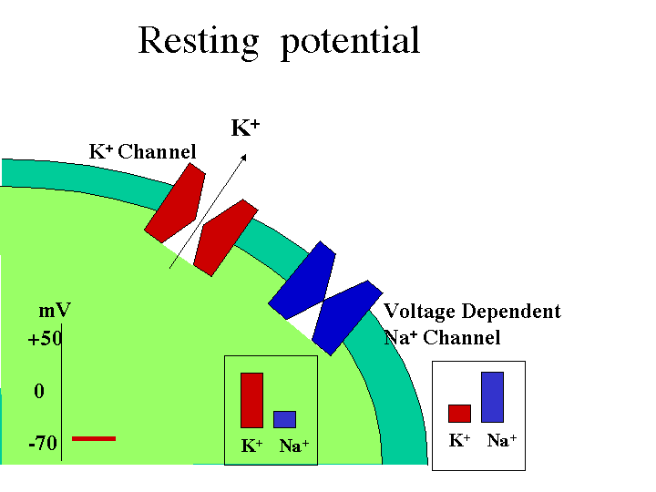
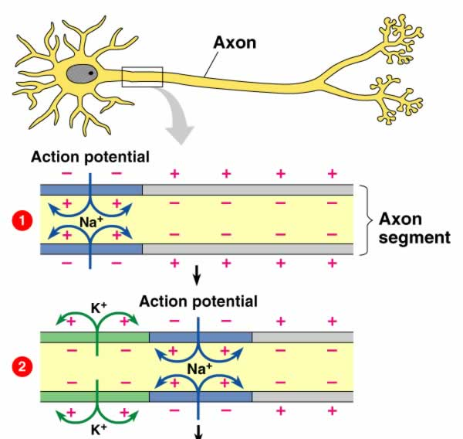
Signal propagation in neurons:
Nerves propagate signals in the form of action potentials.
Resting potential: the negative charge maintained within neurons that are at rest.
    It is due to more sodium ions outside neuron than inside, and more potassium inside neuron than outside
Action potential: a neural impulse-- the shifting change in charge that moves down the axon to terminal buttons

Slide 15
Signal propagation in neurons:
  Lets see a video for more details:
Video: 6

Slide 16
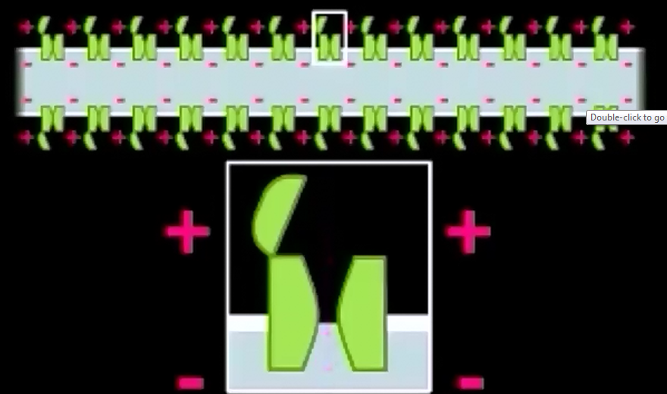
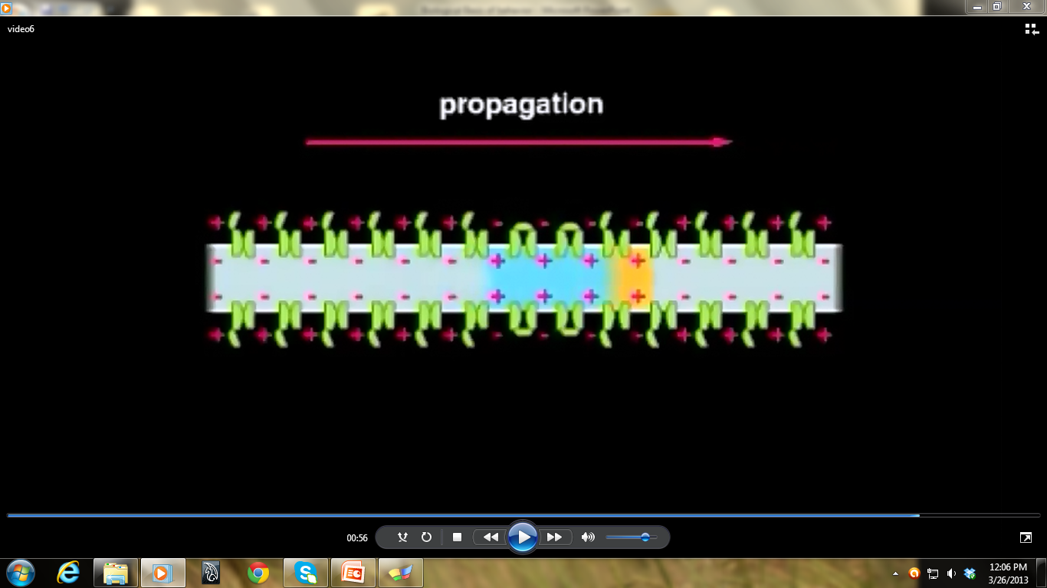
Signal propagation in neurons cont..:
  Explanation to the video
  When the action potential passes sodium channel open and response to membrane depolarization.
  Sodium ion rush into the axon, further depolarizing its membrane.
  Sodium channel then switch into a new inactivated state in which they are closed.
  Sodium channel is then ready to get open if next action potential take place.
  Action potential is propagated in only one direction in an axon.

Slide 17
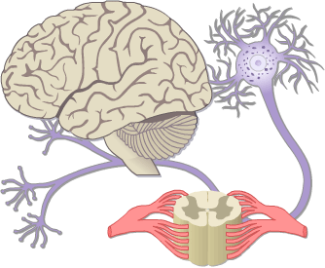
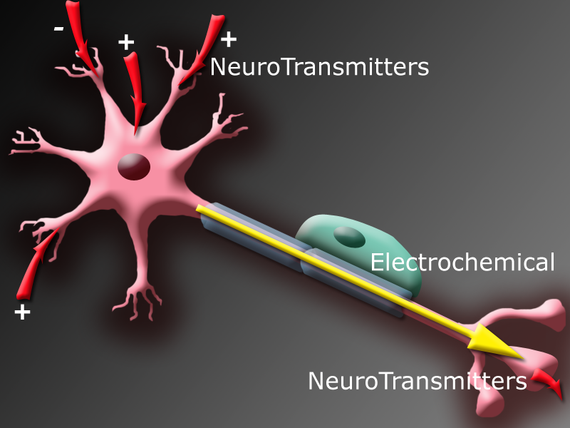
All or Non Law
  Once the neuron receives the signal it has to fire it off and generates an action potential.
  If stimulation reaches a certain threshold, or minimum level, the neuron fires and sends an impulse.
  If stimulation doesn’t reach that threshold, the neuron simply doesn’t fire.

Slide 18
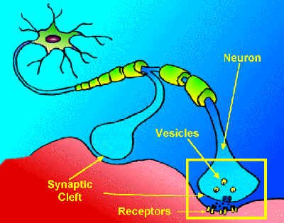
Synaptic transmission
  How a neuron communicates with another neuron?
  100 billion neurons in a human brain, connected to an average of 10,000 others; some up to 100,000 (Shepherd, 1999)
  Synapse: the place where an axon of one neuron meets with the dendrite/cell body of another neuron
  Synaptic cleft: the gap between the axon and the dendrite/cell body across which neural transmission occurs
  Neurotransmitters: a chemical that sends signals from one neuron to another over the synaptic cleft

Slide 19
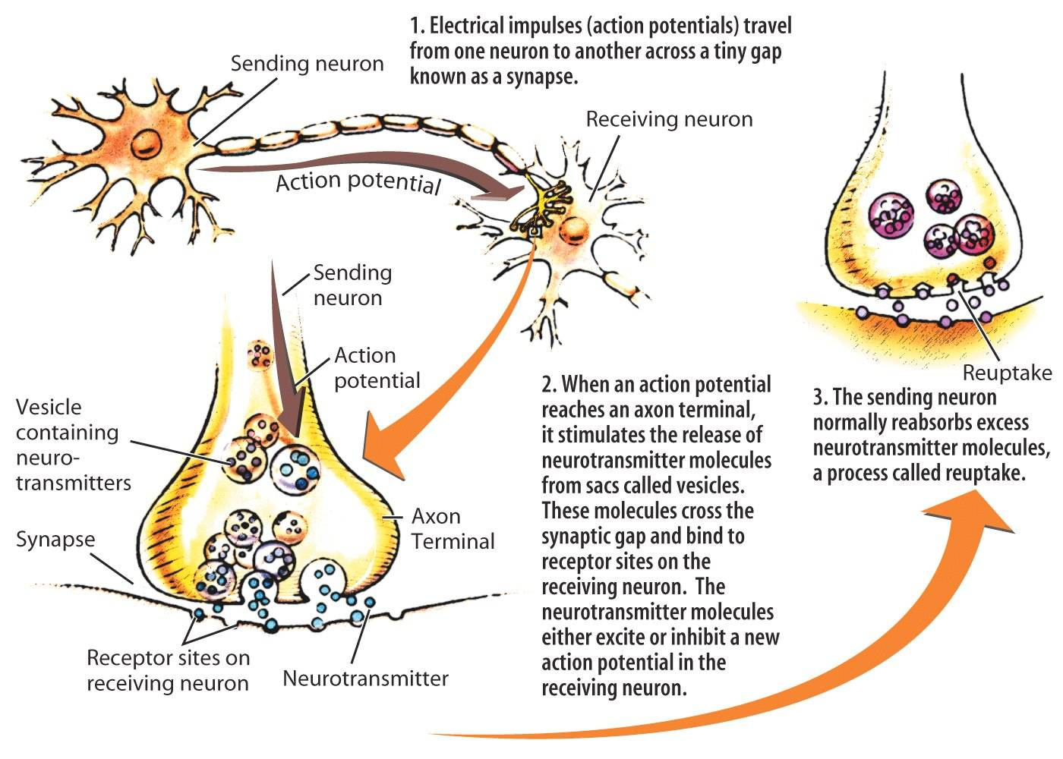
Neuron to neuron
  The signal flies over the synaptic gap to another neuron and the process repeats itself.
  The Dendrite receives the chemical signals or
  neurotransmitter.
  Excites the neuron.
  Sodium ions enter the neuron and charge it.
  An electric current travels through the axon
  and reaches the terminal.
  The terminal fire off the signal over the synaptic
  gap to the next neuron.

Slide 20

Synaptic transmission cont..
Video: 7

Slide 21
Some neurotransmitters
Neurotransmitter | Function | Examples of malfunctions
Acetylcholine (ACh) | Enables muscle action, learning & memory | Alzheimer’s disease less ACh production
Dopamine | Influences movement, learning, attention, & emotion | Excess schizophrenia Undersupply Parkinson’s disease
Serotonin | Affects mood, hunger, sleep, and arousal | Undersupply depression
Norepinephrine | Helps control alertness & arousal | Undersupply depressed mood
Glutamate | Excitatory neurotransmitter involved in memory | Excess overstimulation of brain, seizures

Slide 22
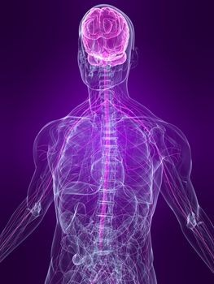
The Nervous system

Slide 23
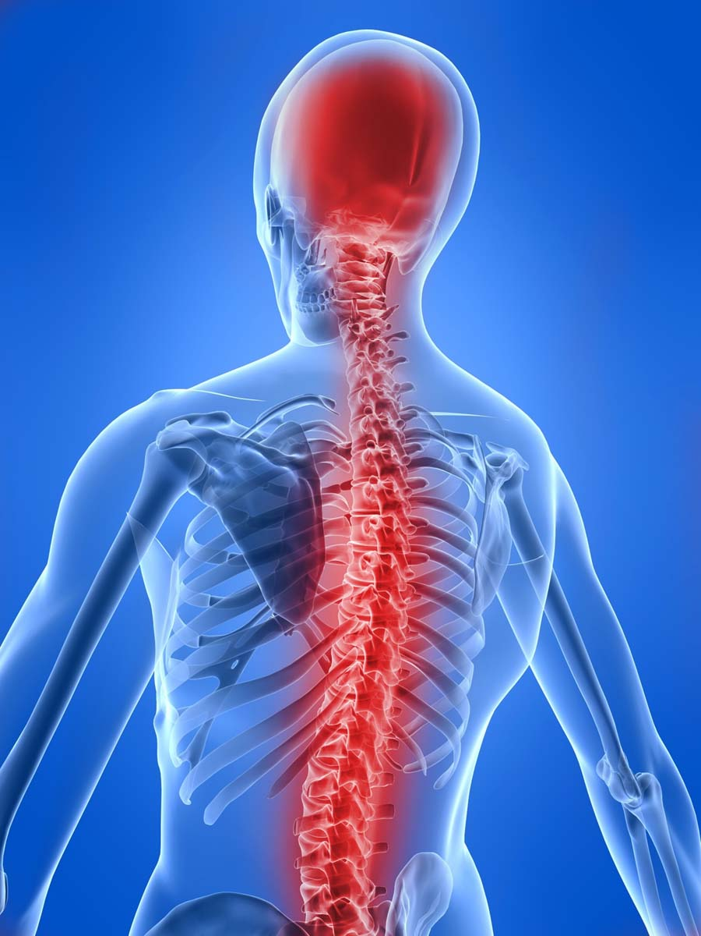
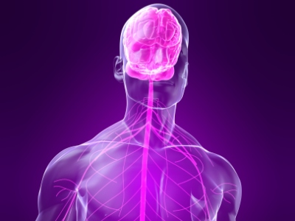
The nervous system
comprised of the central nervous system and the peripheral nervous system

Slide 24
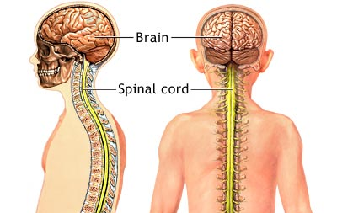
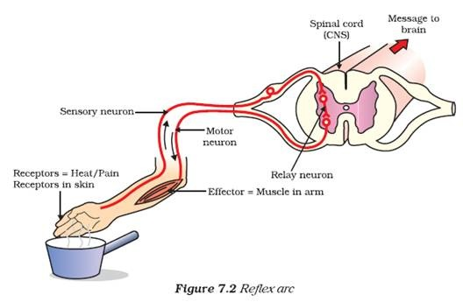
Central nervous system
central nervous system: brain and spinal cord
31 pairs of spinal nerves radiate from the spinal cord
Reflex: an automatic response to an event. The Reflex arc is the main functional unit of the nervous system that helps a person react to a stimulus.
Example: sensory neuron detects pain/hot,
send signal to spinal cord, spinal cord signal to
motor neurons

Slide 25
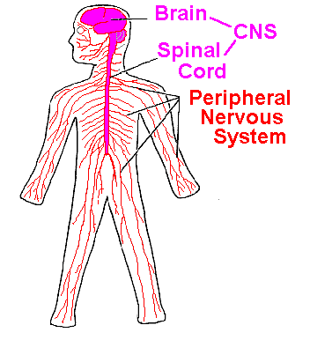
Peripheral nervous system
Peripheral Nervous System: links central nervous system to organs.
Comprised of the skeletal nervous system and the autonomic nervous system.
Skeletal nervous system: controls voluntary movements of our skeletal muscles.

Slide 26
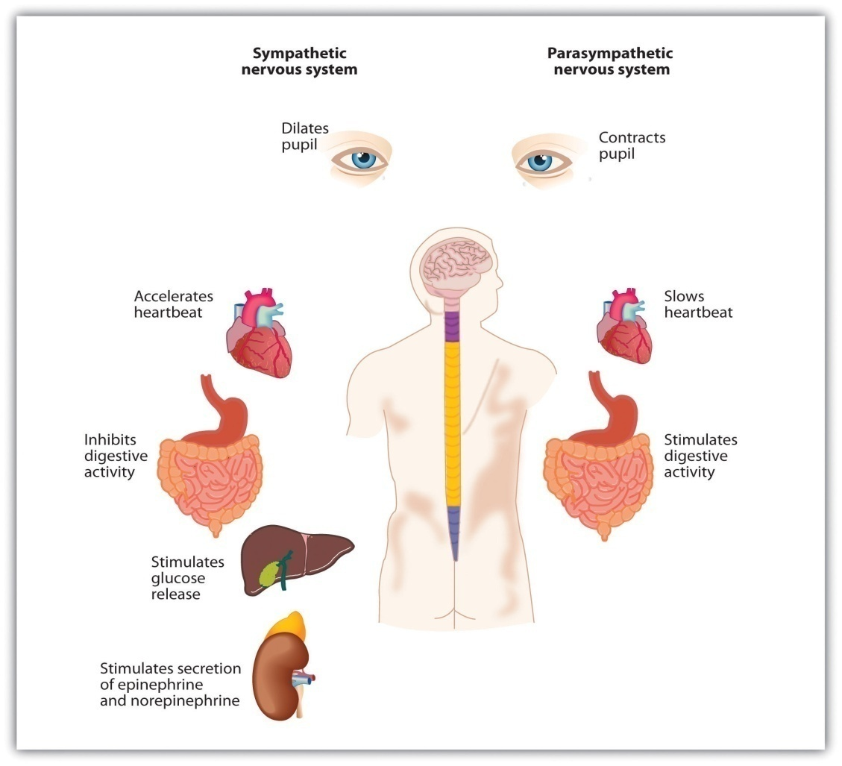
Autonomic nervous system
Autonomic nervous system: controls many of the self-regulatory functions of the body (e.g. digestion, circulation)
comprised of the sympathetic and parasympathetic
nervous systems
sympathetic: prepares us for defensive actions
against threats (e.g. faster heart rate, increased
breathing rate, inhibits digestion, dilates pupils to
allow greater light sensitivity)
Parasympathetic: counteracts effects of sympathetic
nervous system, calms us down

Slide 27
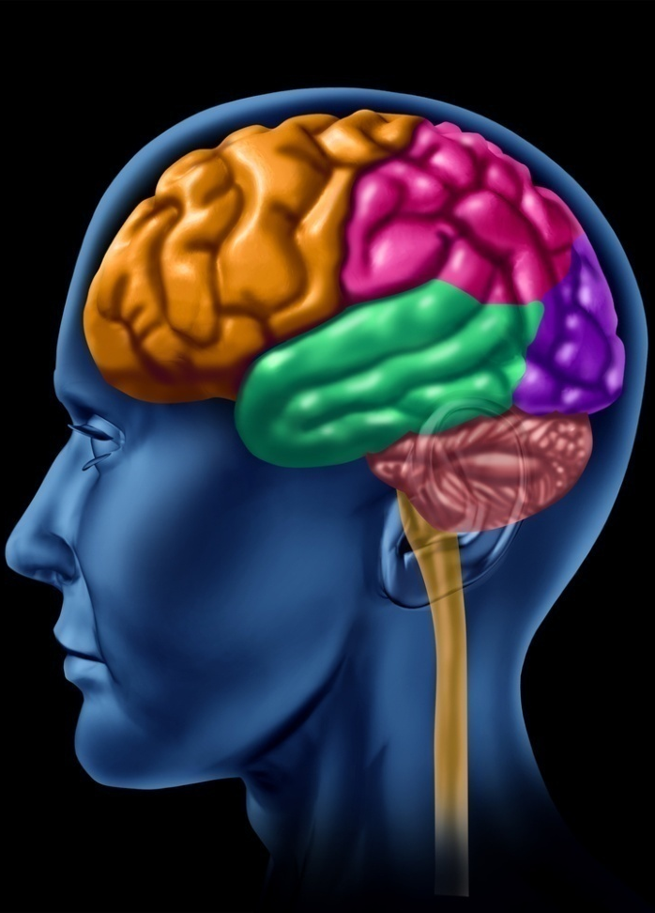
Structure of brain
Your brain is amazing and complex
Brainstem: the set of neural structures at the base of the brain, including the medulla, the reticular formation, and the Pons
Medulla: controls heartbeat, breathing, and swallowing
Reticular formation: regulates alertness and autonomic nervous system activity
Pons: bridge from brainstem to cerebellum; controls a variety of functions, including sleep and control of facial muscles
little brain: extending from rear of brainstem-- coordinates physical movement
The cerebellum: is the area of the hindbrain that controls motor movement coordination, balance, equilibrium and muscle tone.
Thalamus: the brain’s sensory switchboard; receives signals from the sensory and motor systems

Slide 28
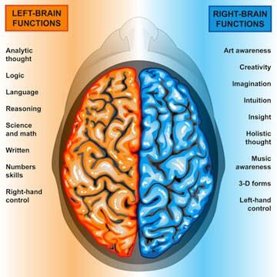
Our divided brain
Our brain is divided into two halves:
  left brain: written language, spoken language, number skills, reasoning (analytical and verbal)
  Right brain: insight, art awareness, imagination/creativity, music awareness (intuitive and perceptual)
But it’s not as simple as simply “left-brained” and “right-brained”... The two hemispheres continually work together on most tasks.

Slide 29
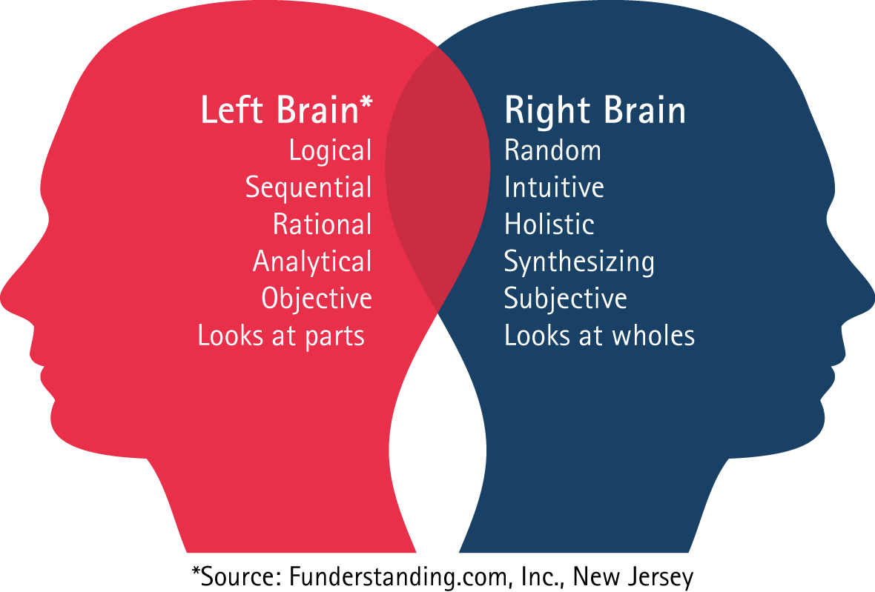
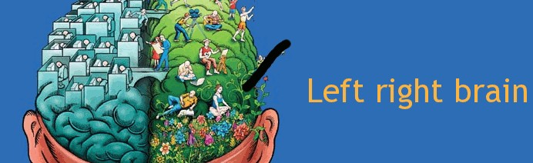
Left brain and right brain theory
Have you ever heard people say that they tend to be more of a right-brain or left-brain thinker?
According to the theory of left-brain or right-brain dominance, each side of the brain controls different types of thinking.
Example:
    a person who is "left-brained" is often said to be more logical, analytical and objective,
    while a person who is "right-brained" is said to be more intuitive, thoughtful and subjective.
In psychology, the theory is based on brain function.

Slide 30
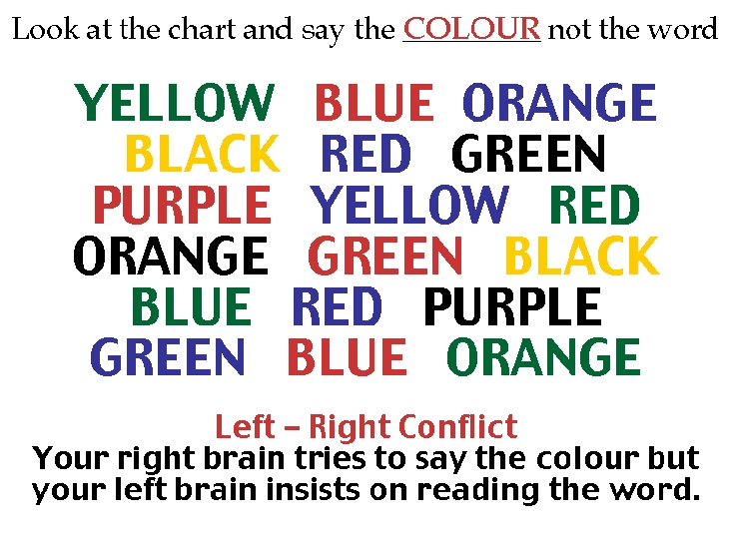
Does one side of the brain really control specific function?

Slide 31
Left brain and right brain theory cont..
The theory grew out of the work of Roger W. Sperry, who was awarded the Nobel Prize in 1981.
While studying the effects of epilepsy, Sperry discovered that cutting the corpus collosum (the structure that connects the two hemispheres of the brain) could reduce or eliminate epilepsy.
These patients also experienced other symptoms after the experiment:
    many split-brain patients found themselves unable to name objects that were processed by the right side of the brain, but were able to name objects that were processed by the left-side of the brain.
Based on this information, Sperry suggested that language was controlled by the left-side of the brain.

Slide 32
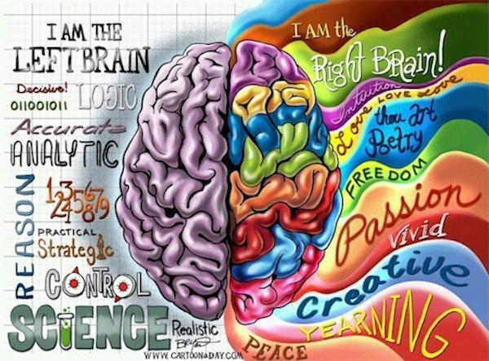
Left brain vs. right brain
  The right brain people: the right side of the brain is best at expressive and creative tasks.
      Recognizing faces
      Expressing emotions
      Music
      Reading emotions
      Color
      Images
      Intuition
      Creativity
  The left brain people: The left-side of the brain is considered to be adept at tasks that involve logic, language and analytical thinking.
    Language
    Logic
    Critical thinking
    Numbers
    Reasoning

Slide 33
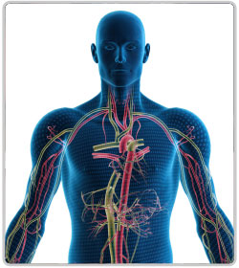
The Endocrine system

Slide 34
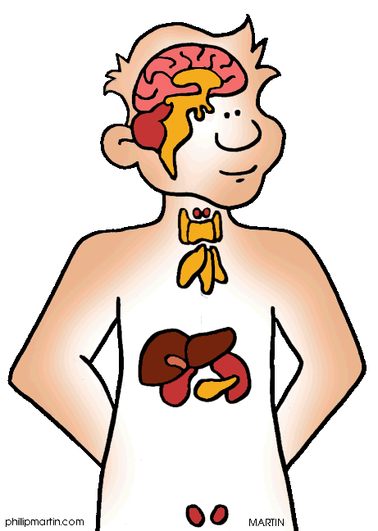
Endocrine system
Communication from the brain is sent to the rest of the body by the endocrine system as well as by the nervous system.
The endocrine system is a series of glands throughout the body that secrete chemicals (hormones) into the bloodstream.
Hormones, are transferred to the target tissues via ducts and affect body functions.
Not all hormones are proteins.
The endocrine system links the brain to the organs that
control body metabolism, growth and development,
and reproduction.

Slide 35
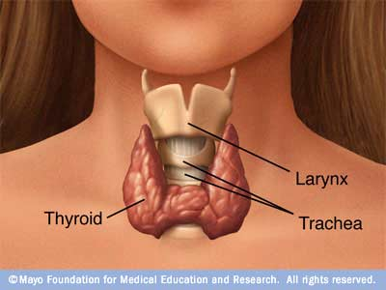
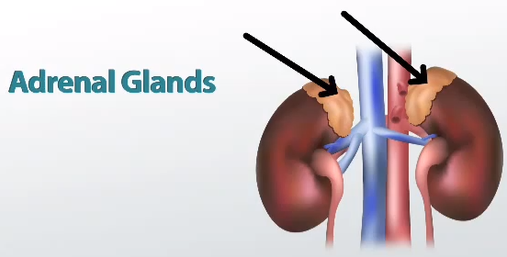
Hormones
Hormones producing glands make up your endocrine system.
Hormones are chemicals that your body produces to tell your cells how to behave.
Hypothalamus: Produces hormones that stimulate or inhibit secretion of hormones by the pituitary.
Thyroid glands: regulates your metabolism, or how
fast your body uses energy.
Pancreas: regulates how much energy your body gets.
Adrenal glands: pumps out adrenaline hormones
when your faced with stress or excited.

Slide 36
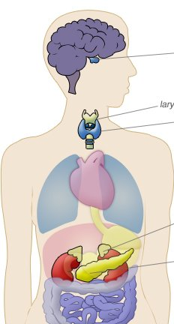
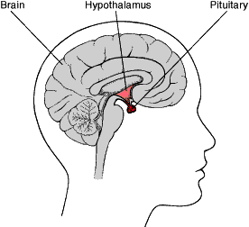
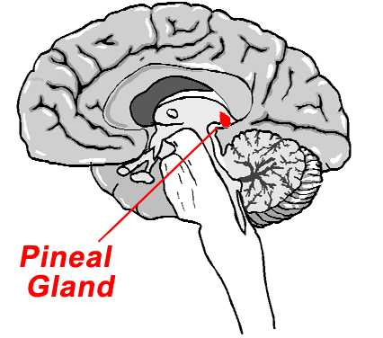
Hormones
Pituitary gland: a master gland that secretes hormones
that trigger your other gland.
Parathyroid: Produce parathyroid hormone that helps maintain calcium ion level in blood necessary for normal functioning of neurons.
Pineal gland: Produces melatonin that helps regulate circadian rhythms and is associated with seasonal affective disorder.

Slide 37
The End

